Slide 1
From your plate to the planet
The environmental impact of what we eat

Slide 2
Introduction
Food Production is responsible for approximately one third of all greenhouse gas emissions contributing to global warming.
That’s about 19 times the amount from the commercial airline industry.

Slide 3
Learning Intentions
We are learning to:
Find out different factors that contribute to the environmental impact of what we eat.
Gather and compare data about the environmental impacts of different foods.
Evaluate the source and quality of the data.
Draw a conclusion based on the data about what will make the biggest difference in reducing our impact.
Think creatively about how to do this.

Slide 4
Success Criteria
We will:
Gather data using the online calculators.
Create a visualisation
Discuss what conclusions we can draw from the data.
Design a label to show information about the carbon emissions of a food item.

Slide 5
Lesson structure
Part 1 and 2:
Data Gathering & Visualisation
Analysis & Discussion
Part 3:
Creative Activity – design a food label

Slide 6
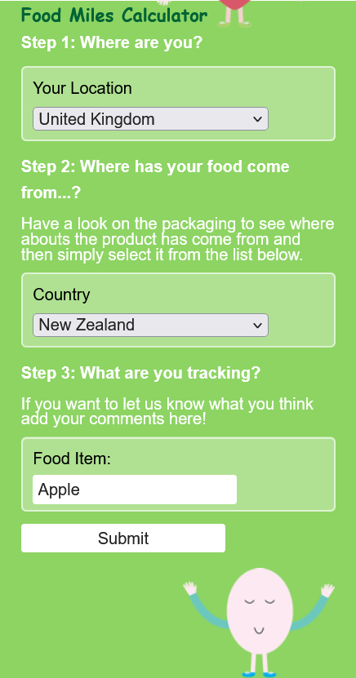
Data Gathering & Visualisation
Task 1:
Calculate the food miles of each of the food items using the food miles calculator.
If the country of origin is not specified, how could you make an educated guess?
foodmiles.com

Slide 7
Data Gathering & Visualisation
Task 2:
Visualise the data.
Three Options:
Order the food cards from most to least number of food miles
Draw a graph using paper and pencil
Use graphing software or a free online tool such as Kids’ Zone Create a Graph
foodmiles.com

Slide 8
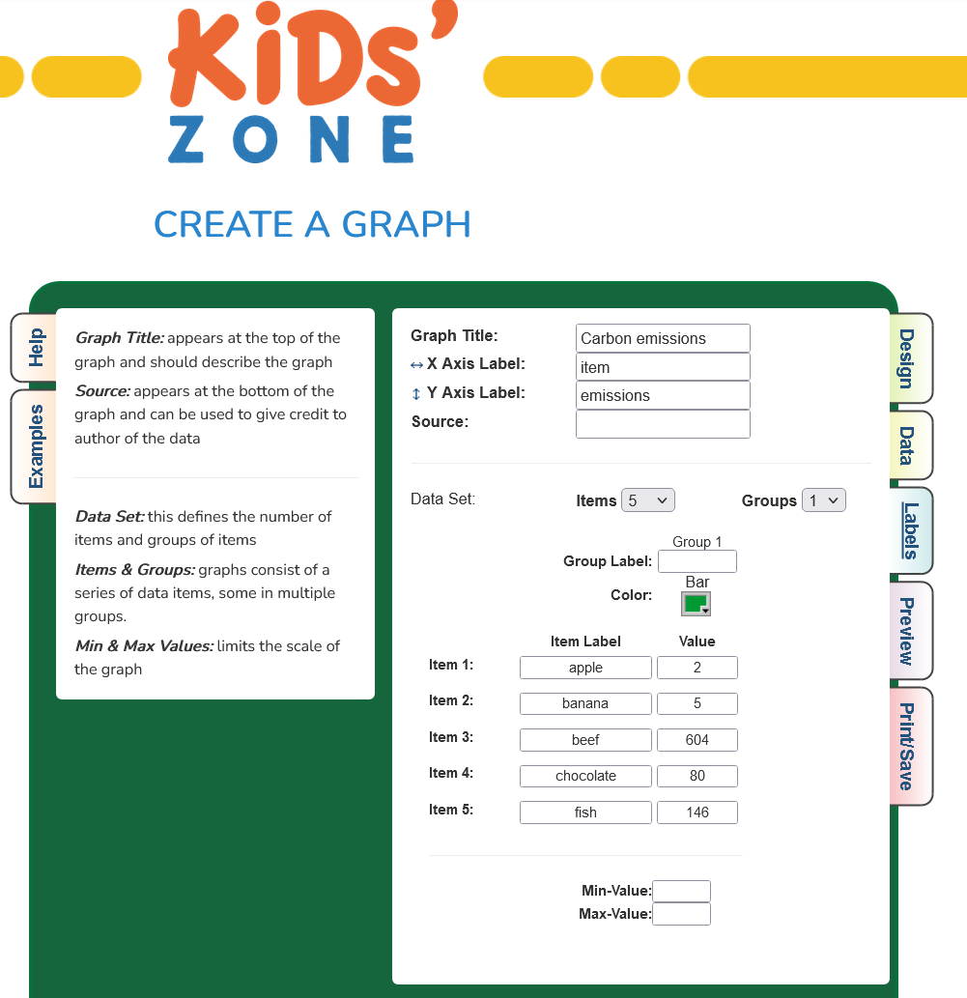
Data Gathering & Visualisation
If you want to use the ‘Create a Graph’ go to dataed.in/createagraph

Slide 9
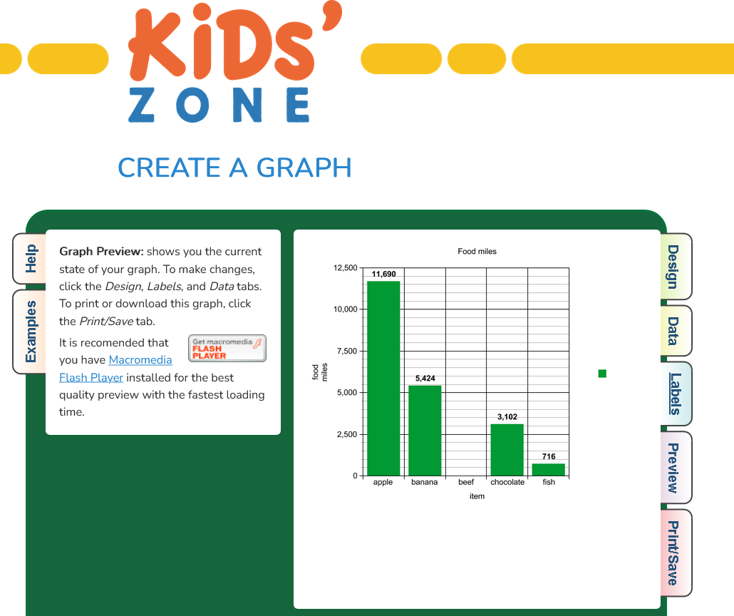
Data Gathering & Visualisation
If you want to use the ‘Create a Graph’ go to dataed.in/createagraph
Notes:
Change data carried - in to be Information can be shown by changing the

Slide 10
Data Gathering & Visualisation
Task 3:
Calculate the carbon emissions for each item.
Choose one of the three emissions calculators. Later you can compare your results with others in your class who have used a different calculator.

Slide 11
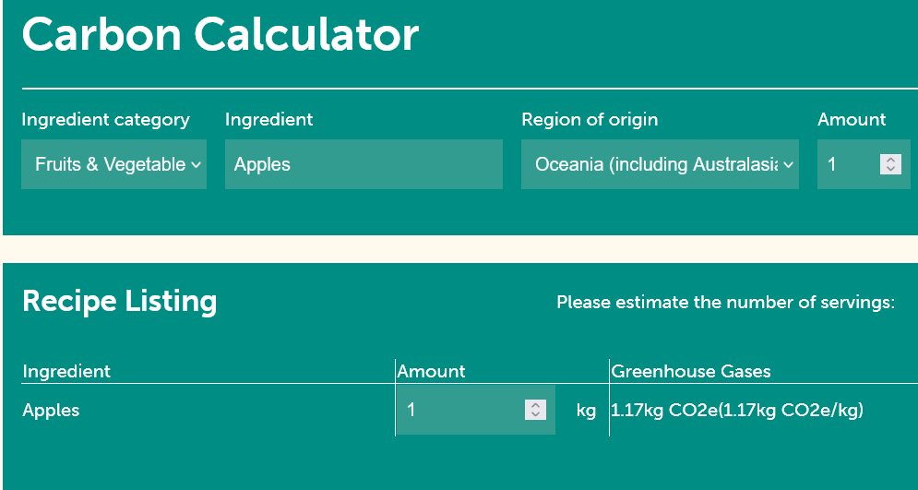
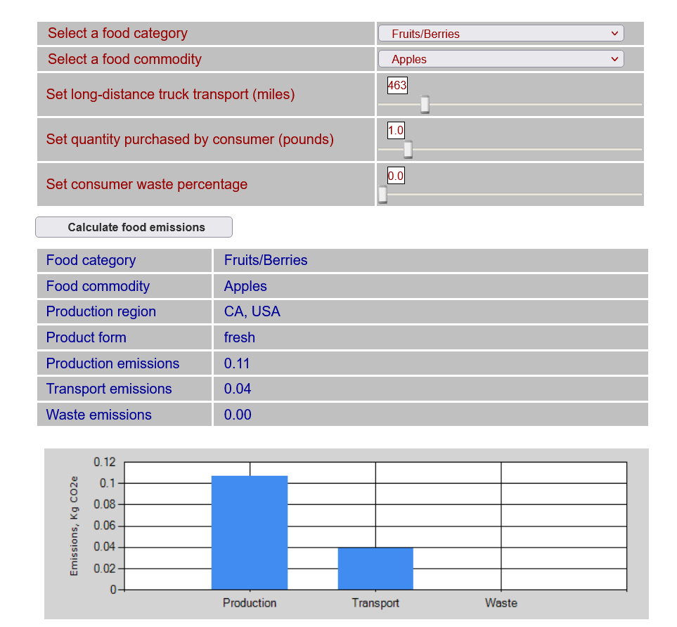
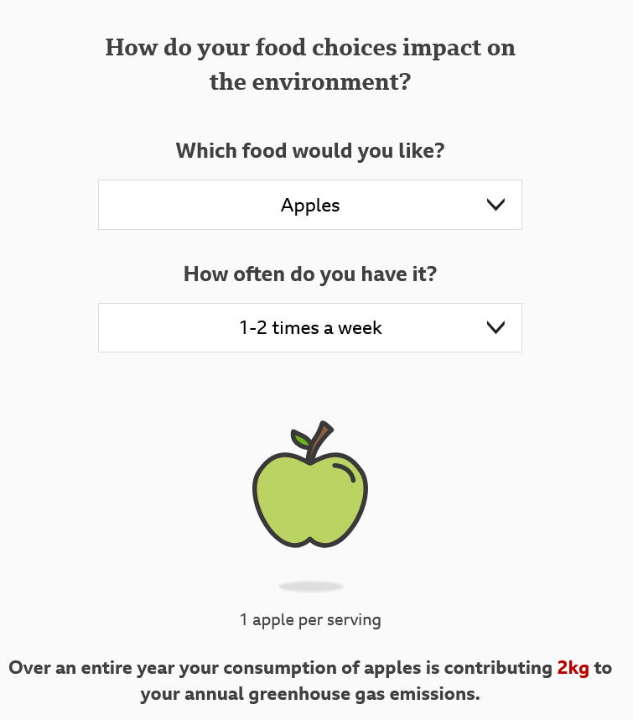
Data Gathering & Visualisation
Plate Up for the Planet dataed.in/foodcalc1
Carbon emissions calculator
dataed.in/foodcalc2
BBC food calculator
dataed.in/foodcalc3

Slide 12
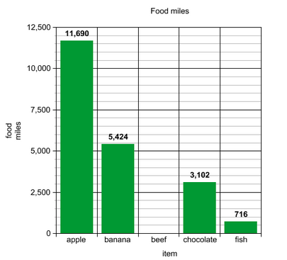
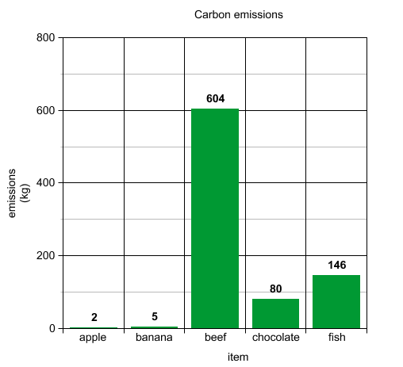
Data Gathering & Visualisation
Sample Graphs
Task 4:
Visualise your data.
Notes:
Change data carried - in to be Information can be shown by changing the

Slide 13
Data Gathering & Visualisation
Bonus Activity
Use a supermarket shopping website to find out the price per kg of each item.
Visualise the data.

Slide 14
Discussion questions
Are the items with the most food miles also the items with the most carbon emissions?
If you made graphs, how do the overall shapes compare?

Slide 15
Discussion questions
How do the different calculators measure carbon emissions?
What do they factor in? What is not factored in?

Slide 16
Discussion questions
Who made each calculator?
Do they have an agenda?
How trustworthy are they?

Slide 17
Discussion questions
If you completed the bonus task, are the most expensive foods also the ones with the most food miles or carbon emissions? Should they be?

Slide 18
Analysis & Discussion
Come up with a list of principles that would help us make more sustainable food choices.
Based on the data, how should we rank these in terms of importance?

Slide 19
Creative task: Design a food label
Many food labels tell us ingredients and the country of origin, but not the other contributing factors to carbon emissions.
Design a food label that shows the carbon emissions of the different foods we eat.

Slide 20
Well done!

