Slide 1


Slide 2
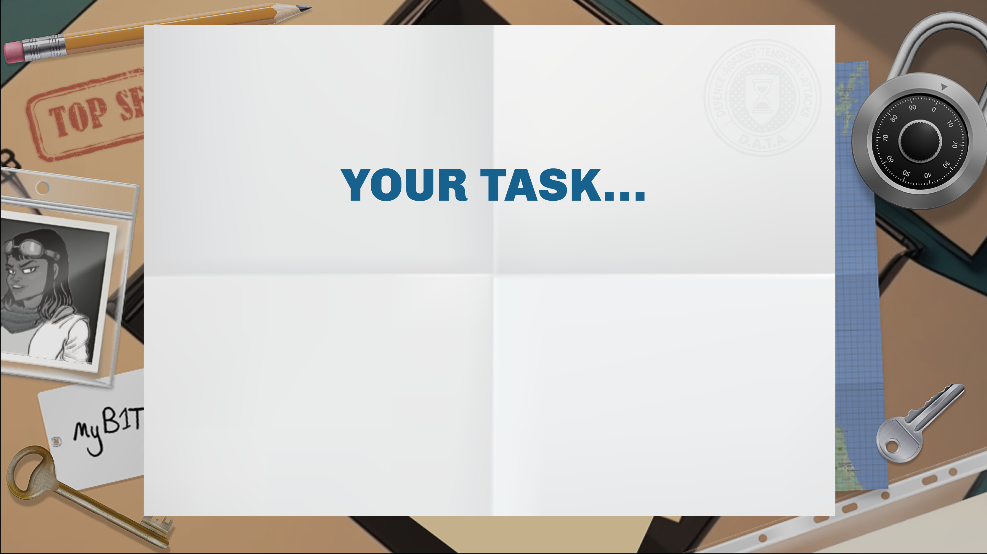
You will be creating an ‘escape room’ activity!
This will be a set of puzzles where a group of players will need to find all the clues and keys, decrypt all the codes and solve all the puzzles in order to exit the room within a time limit.

Slide 3

Bags and containers that can be locked shut (bags, backpacks, coin boxes, storage containers, etc.)
Various locks or lockable desk drawers/cupboards
Puzzles and clues (maps, books, jigsaws, photos, posters etc.)
Costumes and set dressing to give atmosphere!

Slide 4
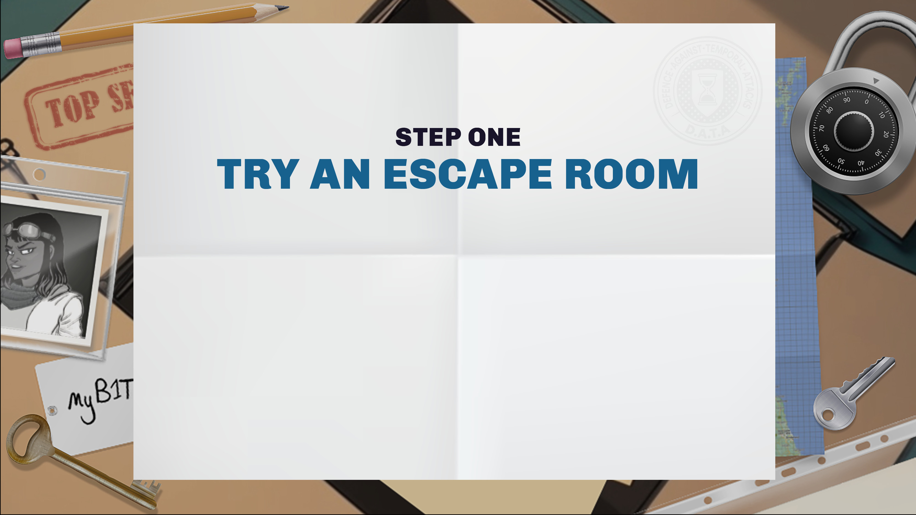
Try an escape room: maybe one nearby, an online room, an escape room board game or a print-and-play room.
Chat about what puzzles worked well and which you maybe didn’t like so well. Did you get stuck on anything? How were the challenges ordered?
Did everyone get a chance to solve puzzles?

Slide 5
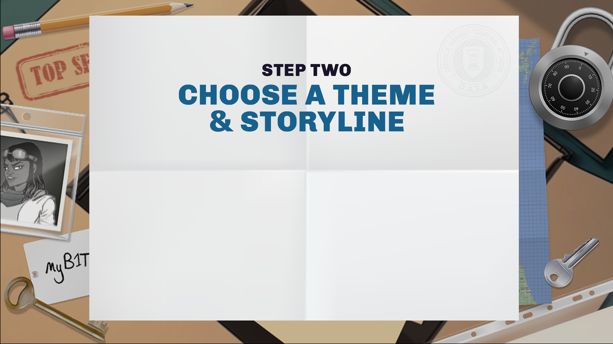
Choose a theme for your game. What locations do you have that you can use that might fit with the theme?
Think about why the players are going to be locked in and trying to escape, and why they must solve puzzles.
Then plan out your storyline. This can be used later to brief the players before they start the game.

Slide 6

Think about the theme you have chosen. Make a list of the props and costumes you will be able to find or make to decorate the escape room.
Think about objects that you can turn into clues and puzzles that fit your theme that you'll be able to find or borrow.

Slide 7
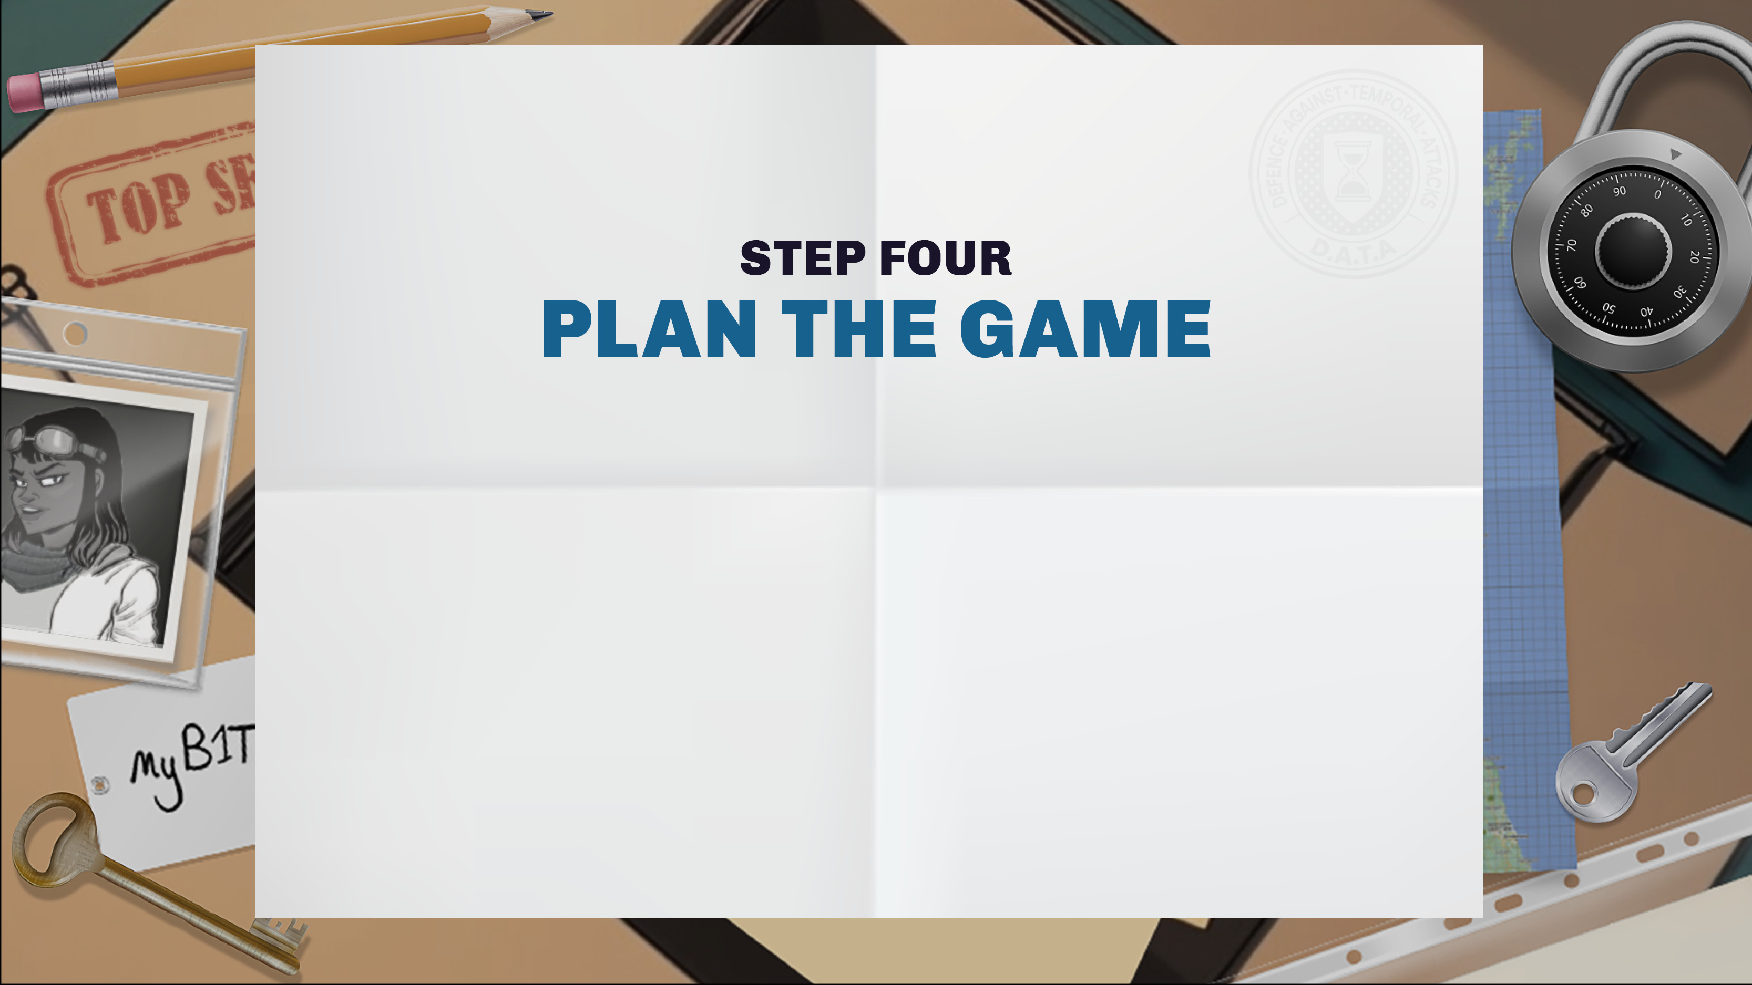
Some escape rooms are linear, where each puzzle needs to be solved to get the next puzzle.
Some rooms have non-linear puzzles, where the players get several different puzzles at the same time.
Use sticky notes to plan out the steps that the players are going to have to solve to complete the game.

Slide 8
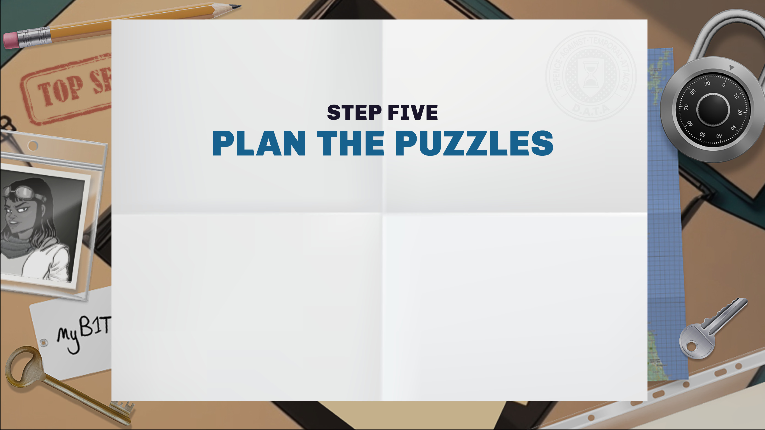
Choose puzzles and decide when each puzzle will happen. It's good to move from easy to hard puzzles.
Think about a hint or two for each puzzle to help players who are stuck.
Think about the input and the output for each puzzle.
What does the player need to know or have before starting the puzzle? What wi l they get when they finish each puzzle?

Slide 9

Explain the game to someone. Are they confused about anything?
Play-test the puzzles and game. Where did players get stuck? Do you need to tweak the instructions or the puzzles?
Think about timings of your play-test. Did the players do the puzzles too quickly or take too long? Alter or add puzzles to fit the length of game you want.

Slide 10
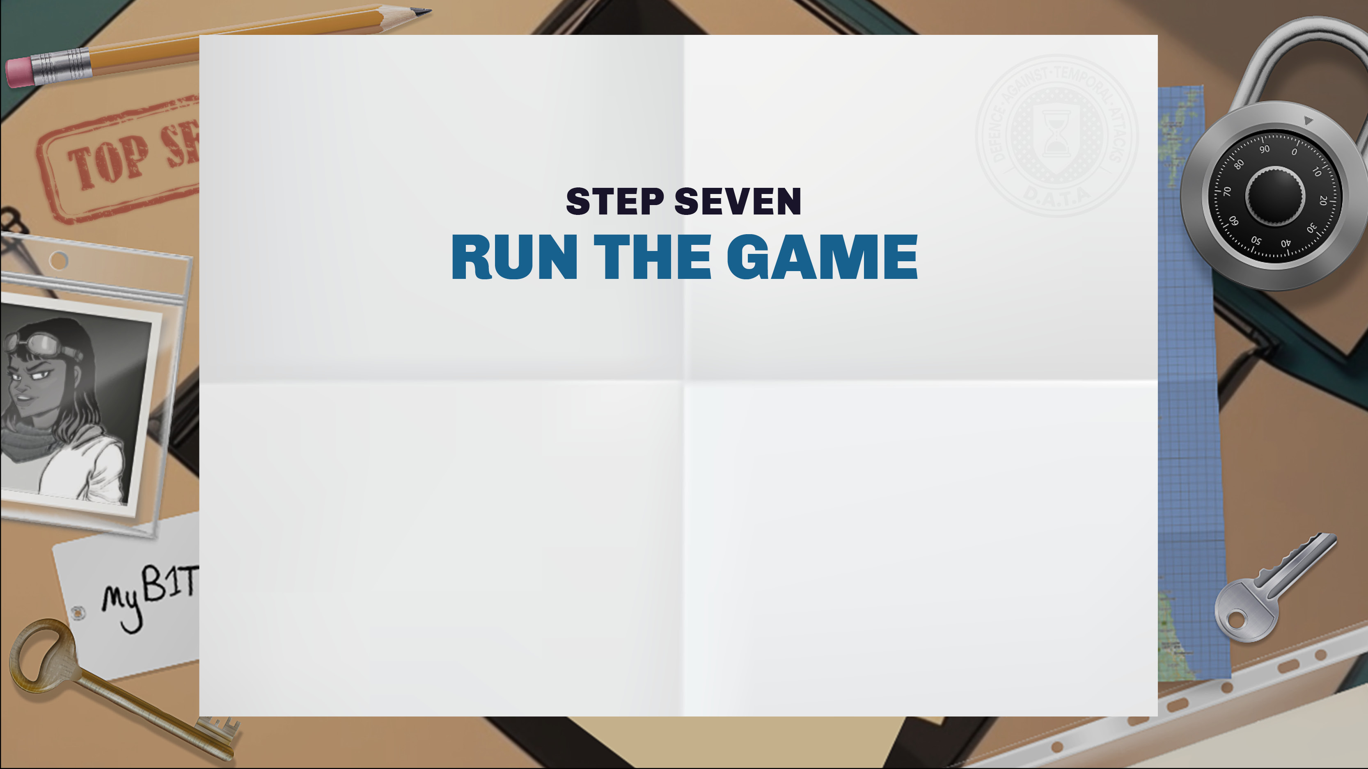
Write an introduction and rules for players.
What’s their goal? How do they get help?
Think about safety. Can anything hurt the players?
Do you want to show a countdown clock?
Congratulate players at the end!
Take a photo with their game time.

Slide 11


Slide 12
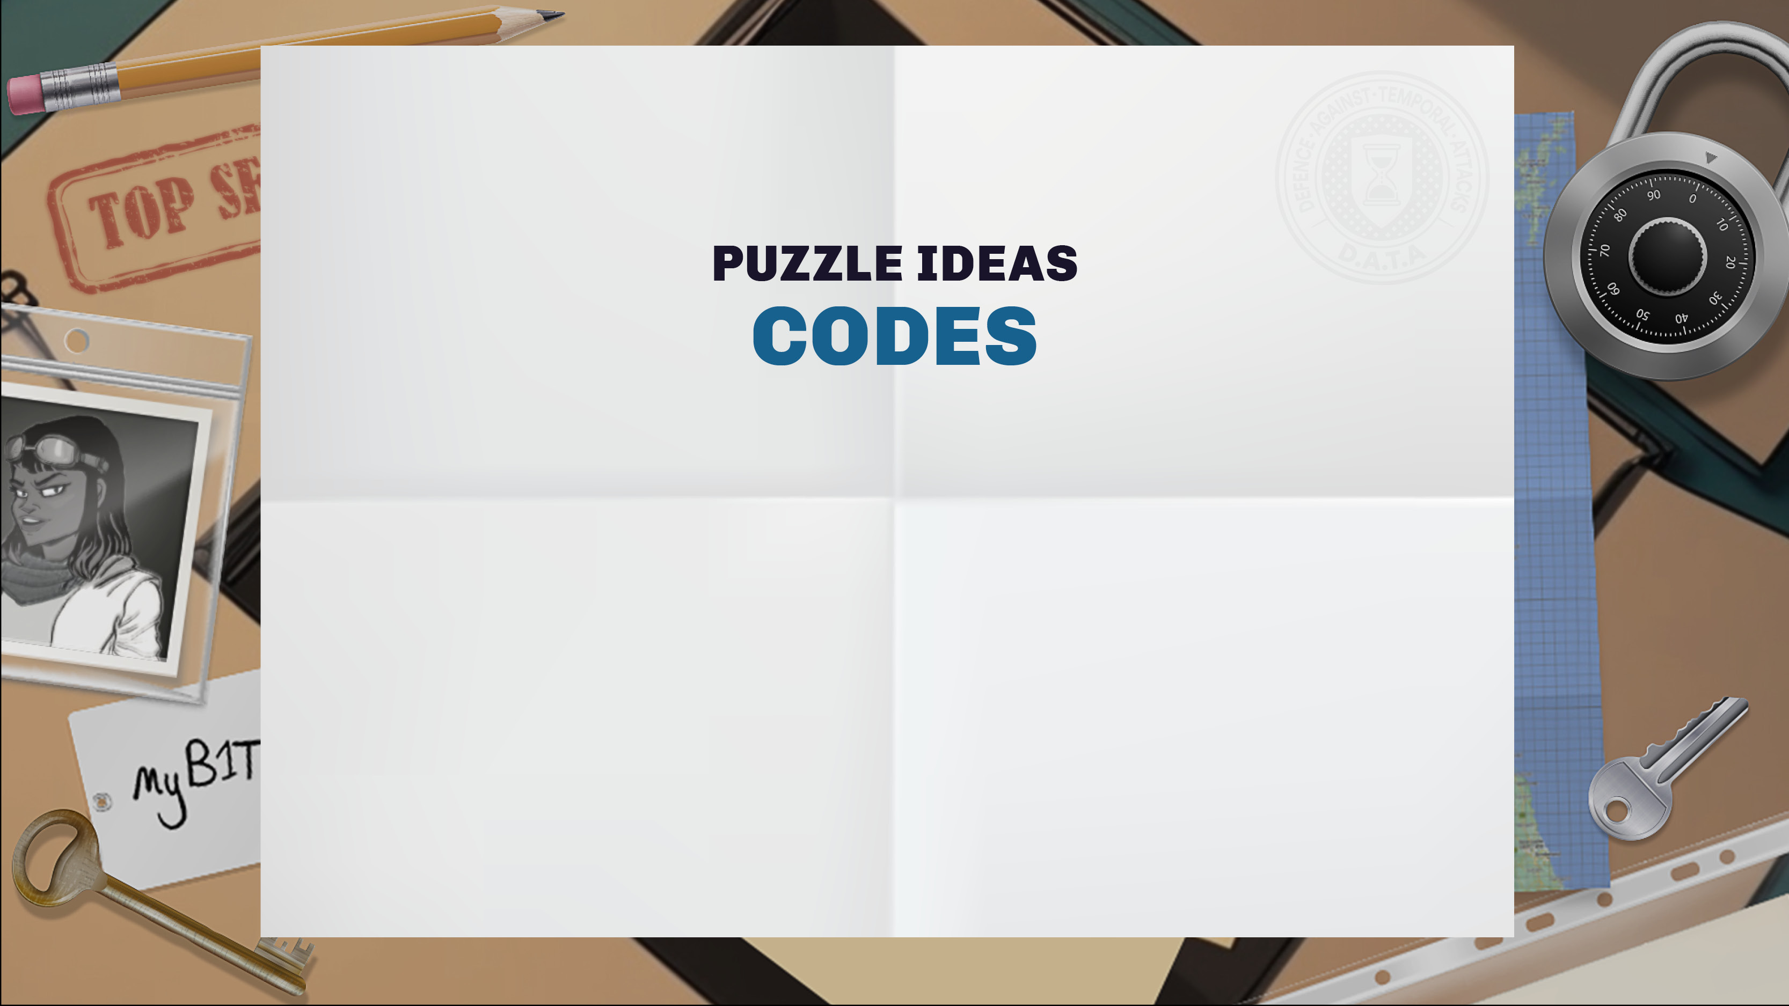
Caesar cypher, substitution cypher, pigpen cypher, Morse code, binary, Braille, Semaphore flags, British Sign Language alphabet, musical notes…
…but make sure players can work out the answer if they don’t know the code.

Slide 13

Numbers and words hidden in photos, posters and books Messages in QR codes (you can make QR codes online) Map grids, plane tickets (using an online ticket generator)
Password, pin number or shape pattern to unlock a phone or computer and find a mysterious photo, text message or document
Use a UV torch or coloured gel to find hidden writing

Slide 14
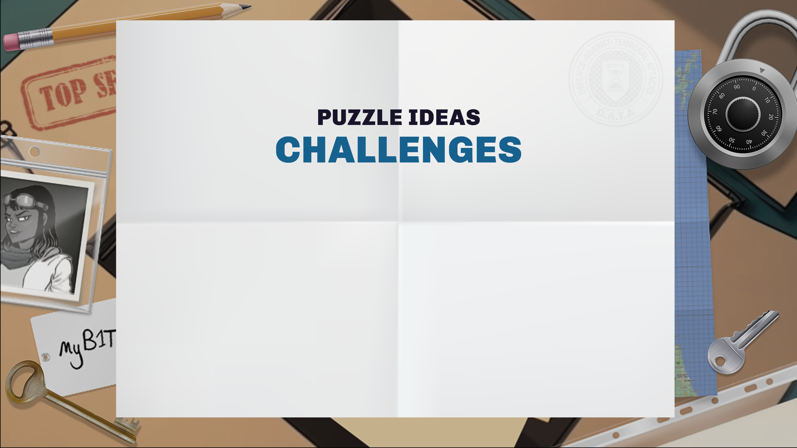
Collect jigsaw pieces or pieces of a cut-up photo to find a message
Solve a sudoku or crossword with circled numbers or letters Use tools (like a magnet) to reach objects trapped out of reach Weight objects with scales to find the right combination
of objects that are the same weight to swap with the jewel
Guide players through a blindfold string obstacle course

Slide 15

Try our print and play escape rooms:
dataschools.education/escape
Share your escape room adventures with us:
@Data_schools

