Slide 1
AGENT BRIEFING
FIND THE VIKINGS SECRET LAIR

Slide 2
AGENT BRIEFING
YOUR TASK...
The VIKINGS are trying to build a new secret mega lair. Discover the location to foil their plans!
We don’t have enough DATA agents to check out all the possible locations. Use information to narrow down the possibilities so that we can send out agents to the most likely targets.

Slide 3
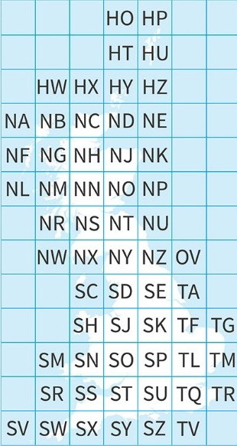
AGENT INFO
GRID REFERENCES
Great Britain is covered by grid squares measuring 100km by 100km, and each grid square is identified by two letters. This unique reference system is
known as the National Grid. The two-letter names of each large 100km x 100km square are shown in the centre of the squares on your map.

Slide 4
GRID REFERENCES
AGENT INFO
These squares are further divided into smaller squares by grid lines representing 10km x 10km spacing, each numbered from 0 to 9 from the south west corner,
in an easterly (left to right) and northerly (upwards) direction.
For example, this image shows TL63. After the letters, you count along the eastings (6) first, then up the northings (3).
If you have trouble remembering the order, say… ALONG the corridor, then UP the stairs.
9
8
7
6
5
4
3
2
1
0
NORTHINGS (up the stairs)
TL
63
South west corner
0 1 2 3 4 5 6 7 8 9
EASTINGS (along the corridor)

Slide 5
TASK ONE
GOING UNDERGROUND
We’ve intercepted a list of old underground bunkers compiled by the VIKINGS. We believe they will be expanding one of these secure underground locations somewhere around Scotland to use as their new mega-base.
Use the grid references in the table to mark these bunkers on the map. Use a RED pen to mark each bunker.

Slide 6
TASK TWO
WHERE’S THE WIND?
The VIKINGS avoid using fossil fuels, so we expect that they will power their secret lair by stealing the power from wind turbines.
For this to be possible, their secret bunker lair needs to be near a wind farm.
Add all the wind farms on the list to your map. Use a GREEN pen to mark each wind farm.

Slide 7
TASK THREE
DETECT THE DATA CENTRES
We have intelligence that the VIKINGS are planning to use their new lair as a base to target one of Scotland’s Data Centres. They might be planning to steal super secret personal data like credit card numbers, or they may want to damage the servers and take them offline in order to create havoc for social media users across the world.
Add all the data centres on the list to your map. Use a BLUE pen to mark each wind farm.

Slide 8
AGENT INFO
WHAT IS A DATA CENTRE?
A data centre is a building full of computers which are used to store data, and are connected up to the internet so that the data can be accessed from anywhere.
Ever heard of data being stored in “the cloud”? “The cloud” isn’t up in the air, it’s in a physical data centre somewhere in the world! It just means that the data can be accessed from anywhere via the internet, rather than being stored locally on someone’s personal computer.

Slide 9
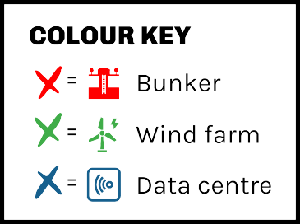
TASK FOUR
WORK OUT THE POSSIBLE LAIRS
The VIKINGS need the secret bunker lair to be within cycling distance of the data centre (they cycle instead of driving to avoid using fossil fuels). The secret lair also needs to be near a wind farm so the VIKINGS can steal electricity from wind turbines.
Use your map to narrow down the possible locations. Circle the bunkers that have a data centre AND a wind farm within one adjacent grid square.

Slide 10
TASK FIVE
HIJACKING THE INTERNET!
URGENT! URGENT! URGENT! URGENT! URGENT! URGENT! URGENT!
New information has been received from our undercover agent! We have just received intelligence that the VIKINGS have been trialling a new, super speedy, super secure system for directly communicating with their counterparts in other countries! They plan to do this by hijacking the pre-existing network of undersea fibre broadband cables.

Slide 11
AGENT INFO
WHAT ARE SUBMARINE CABLES?
The first undersea cables were used to carry telegram signals across the Atlantic Ocean. Nowadays, undersea fibre optic cables carry huge amounts of data rapidly between continents, allowing data stored in data centres to be accessible from anywhere in the world via the internet.

Slide 12
TASK FIVE
HIJACKING THE INTERNET!
Given this new information, we believe the VIKINGS will locate their secret lair near the point where a submarine cable from another country comes up onto the land.
Which of your possible bunkers is where an undersea cable reaches Scotland? Identify the three most likely locations of the VIKINGS’ new secret lair.

Slide 13
BONUS MISSIONS:
Draw the secret lair. Draw the floorplan to help pass on intelligence to other agents.
Design a new headquarters for DATA.

Slide 14
HAPPY PUZZLE SOLVING!
Try our print and play escape rooms:
dataschools.education/escape
Share your escape room adventures with us:
@Data_schools

