Slide 1
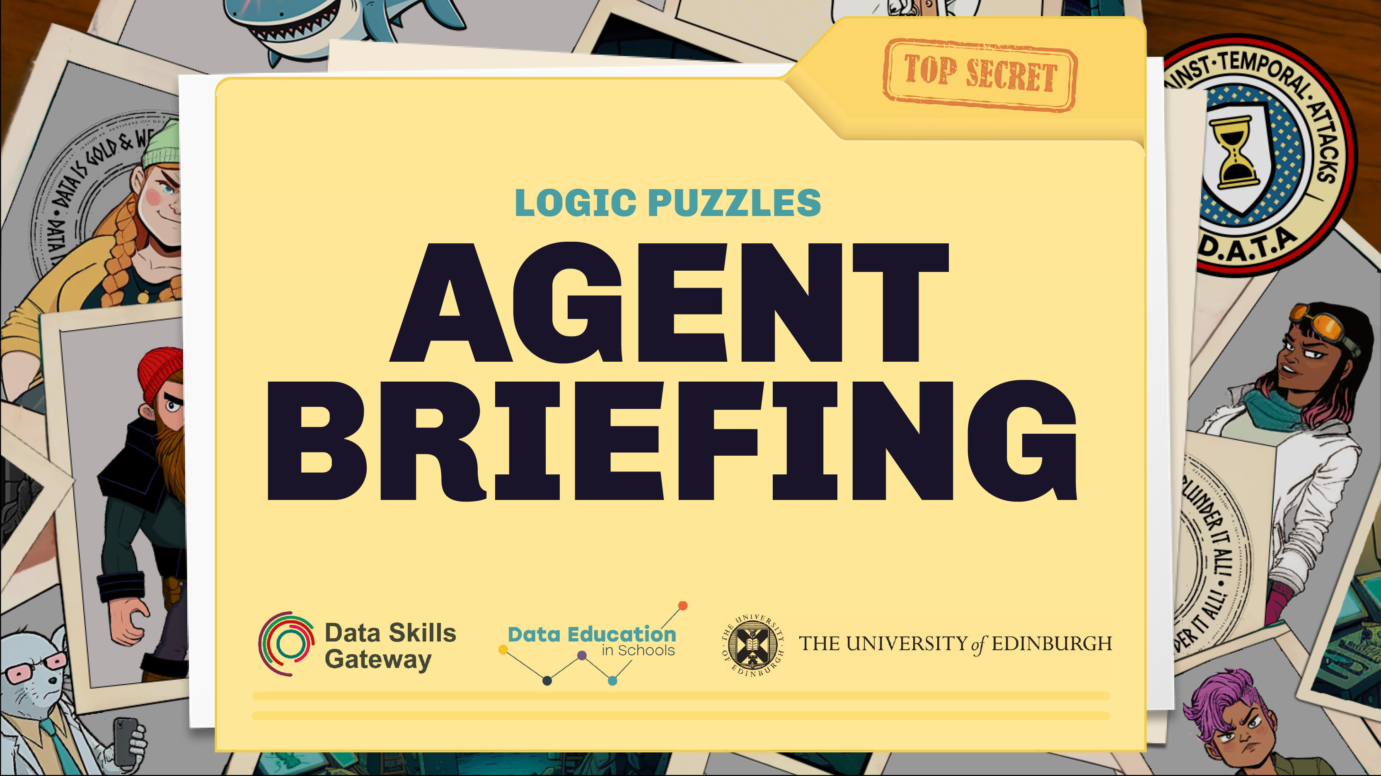

Slide 2
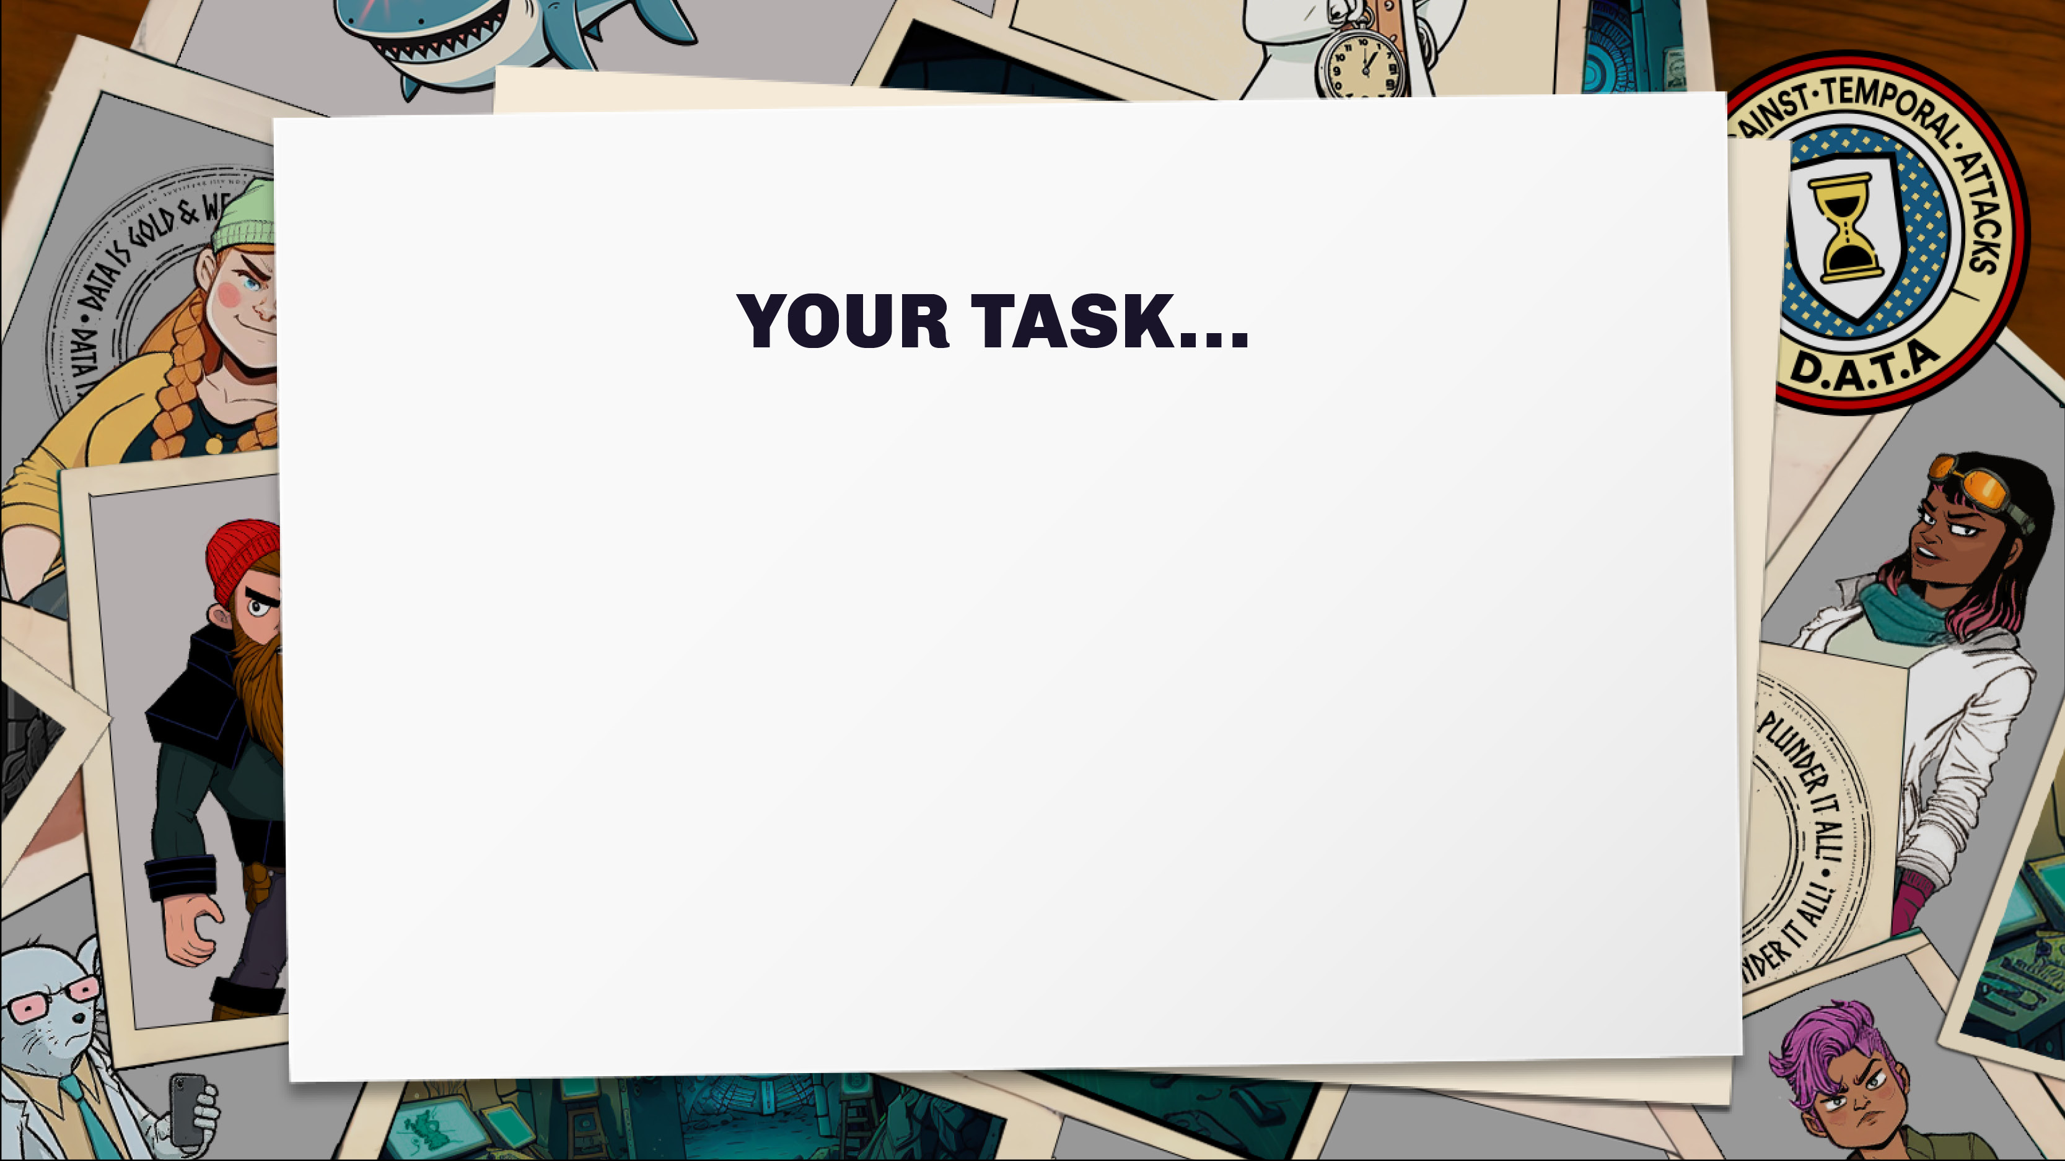
As a new agent, you need to learn more about the local VIKINGS villains.
Unfortunately, our information has been hacked and muddled. We have all the right facts but we don’t know who the facts are about.
Use logic and reasoning to work out which of the
VIKINGS is which.

Slide 3
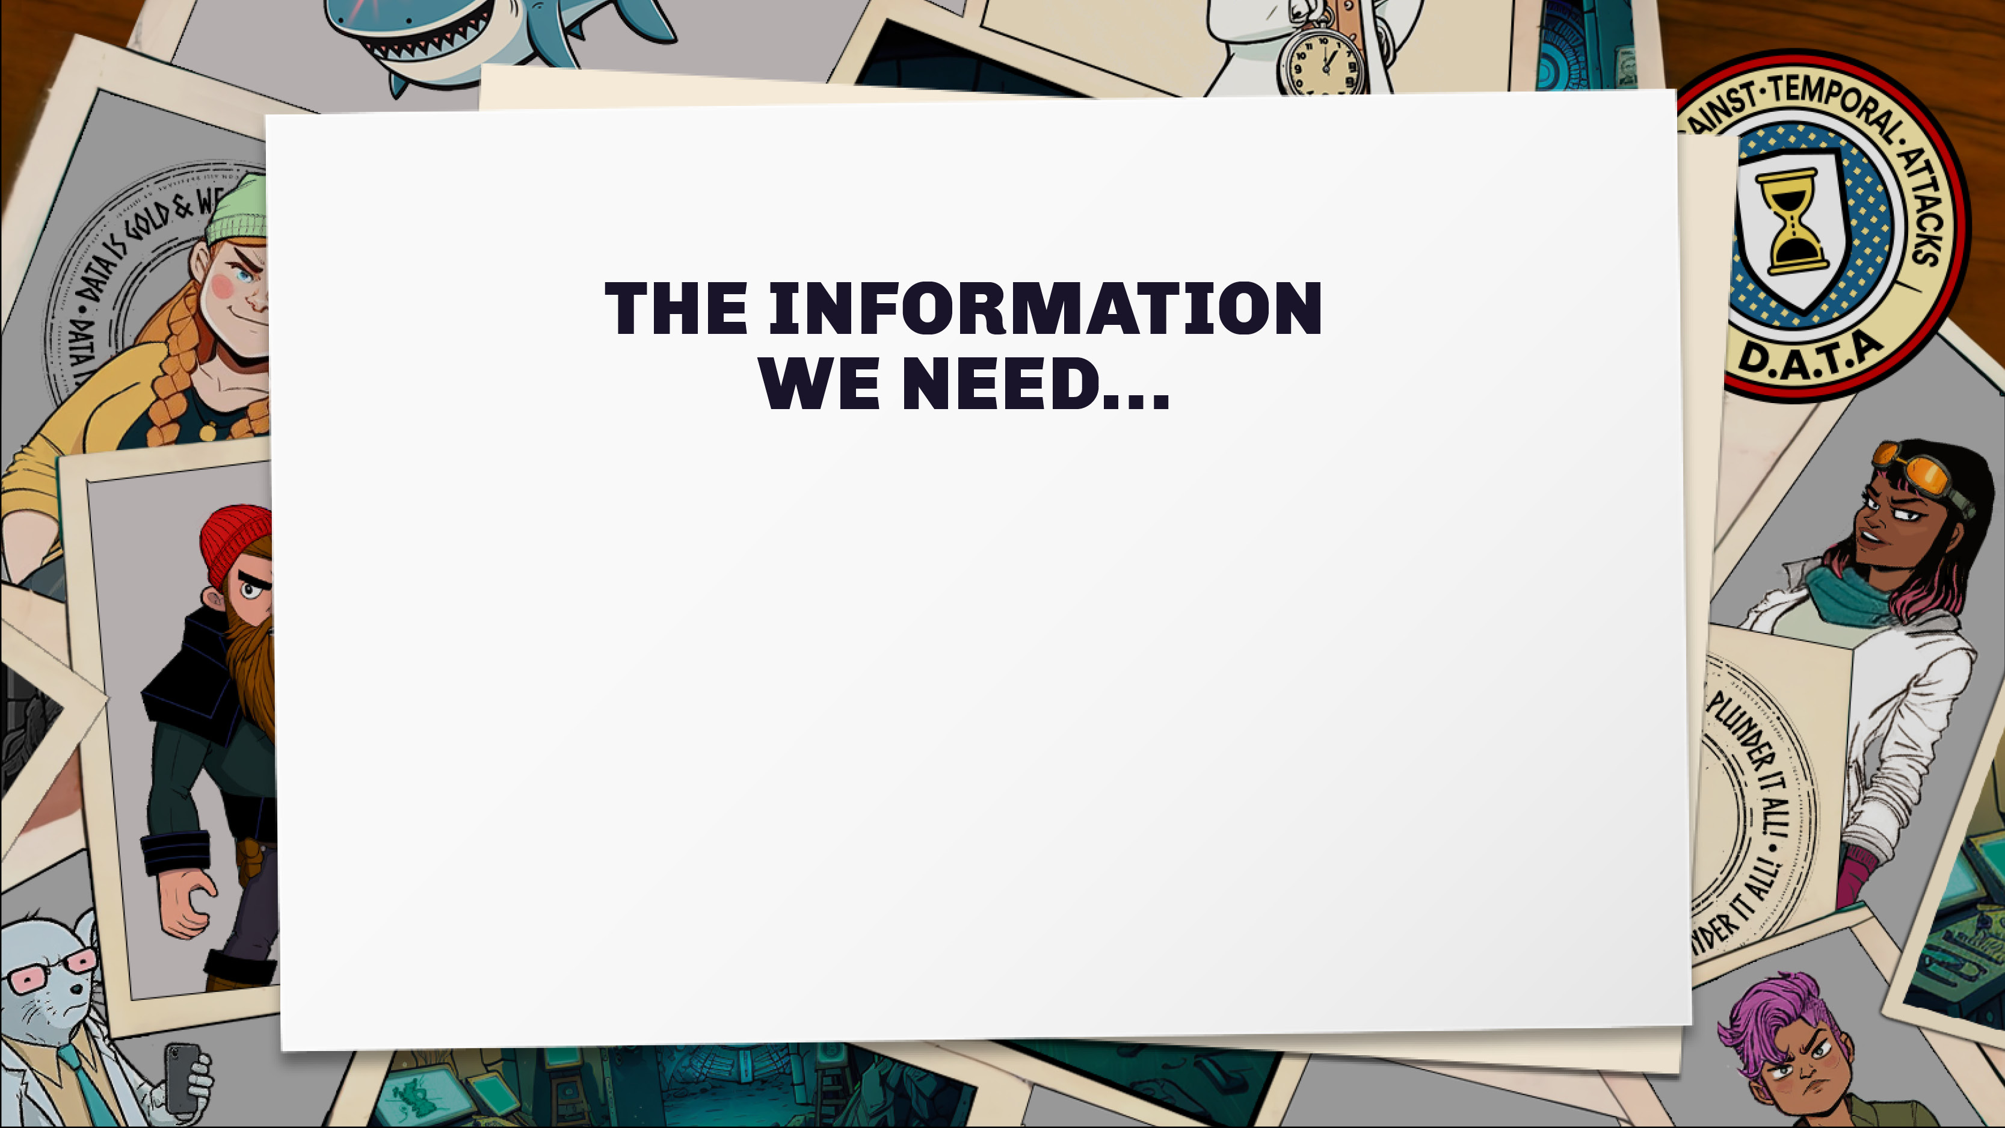
· Their name
· Their area of expertise
· The location of their base
· The name of their pet

Slide 4
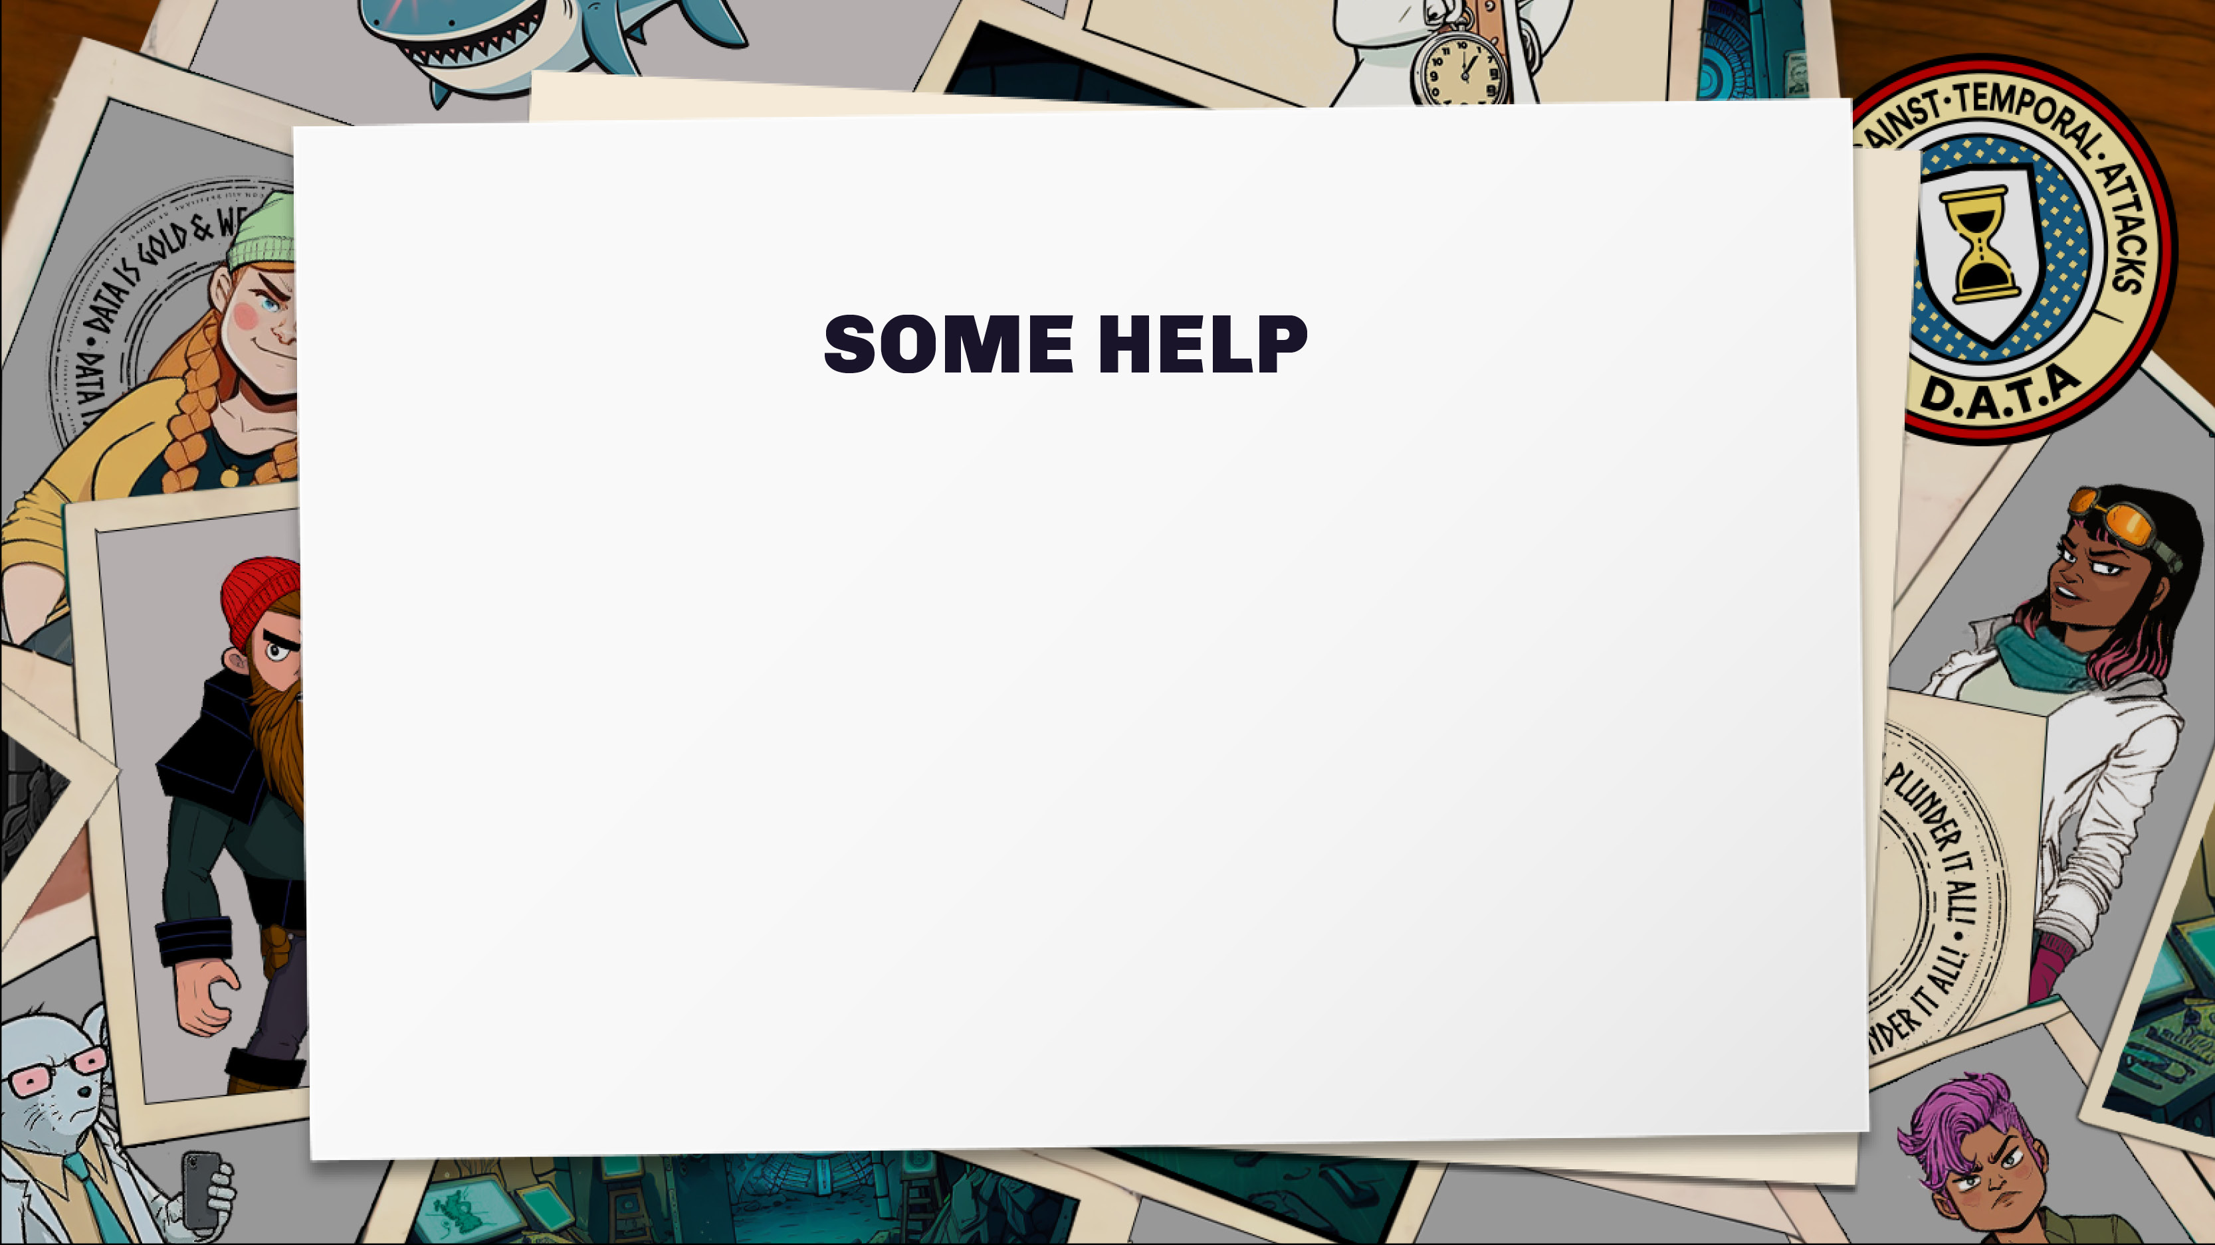
None of the VIKINGS are from the same location.
They can’t stand each other!
The VIKINGS have very individual pets, and no-one has the same animal as anyone else.
The VIKINGS all have different jobs from each other.
No-one has the same expertise as the others.

Slide 5


Slide 6
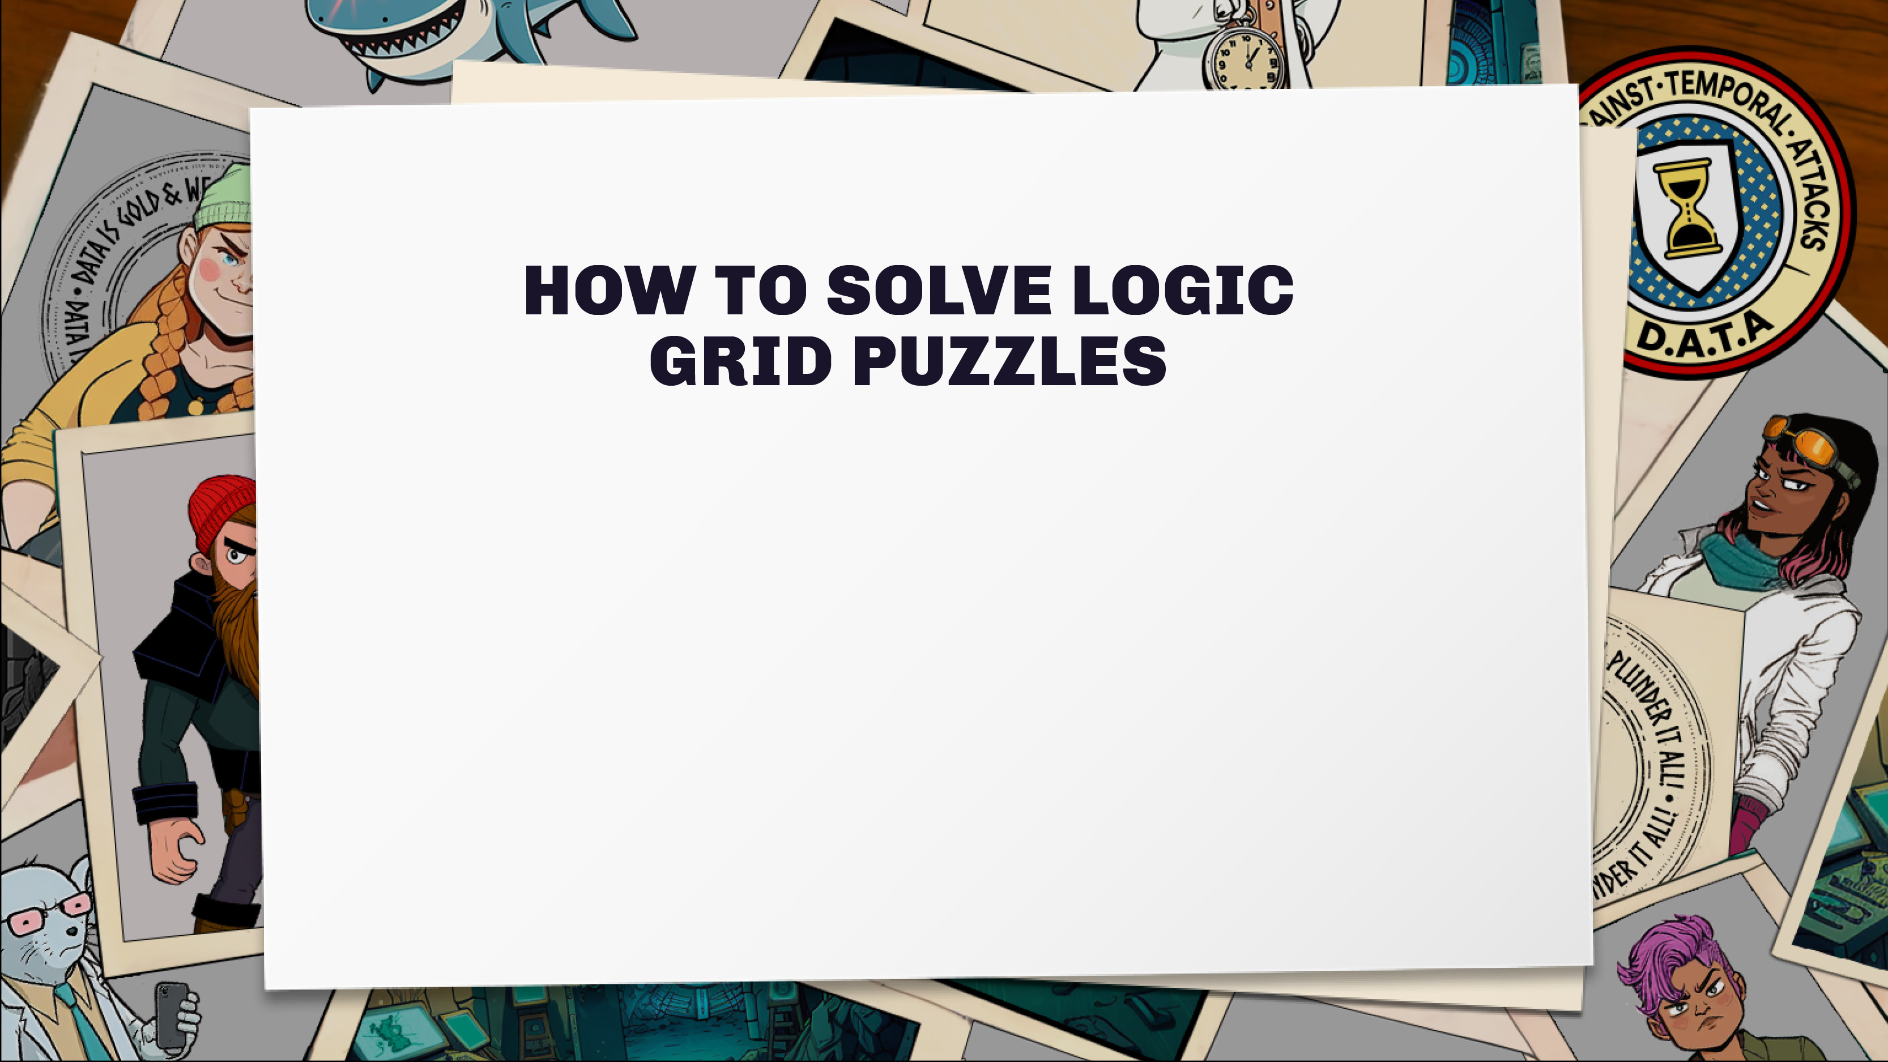
Your job is to figure out which options are linked together using a series of clues. Read the clues one at a time.
If something is true then put a circle or tick in the right place on the grid.

Slide 7
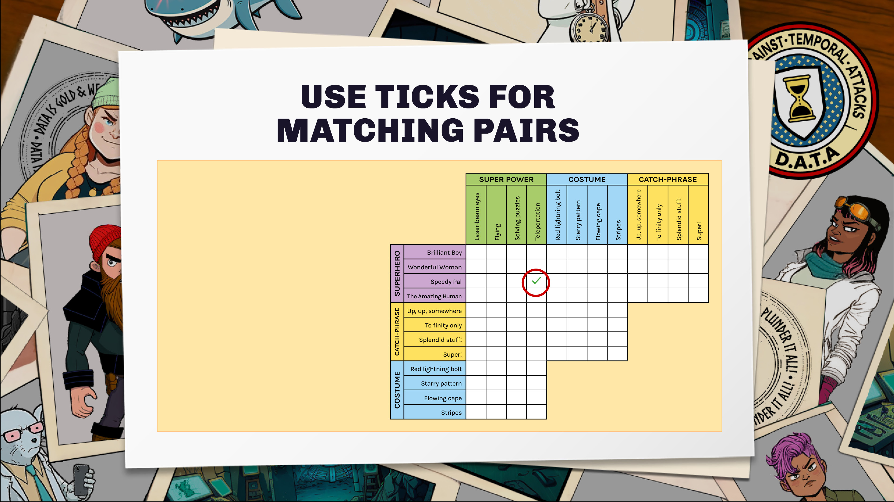
In this example puzzle, the first clue is:
“Speedy Pal got their name because they teleport to move fast”.
You can put a tick in the box that matches ‘Speedy Pal’ with ‘Teleportation’.

Slide 8
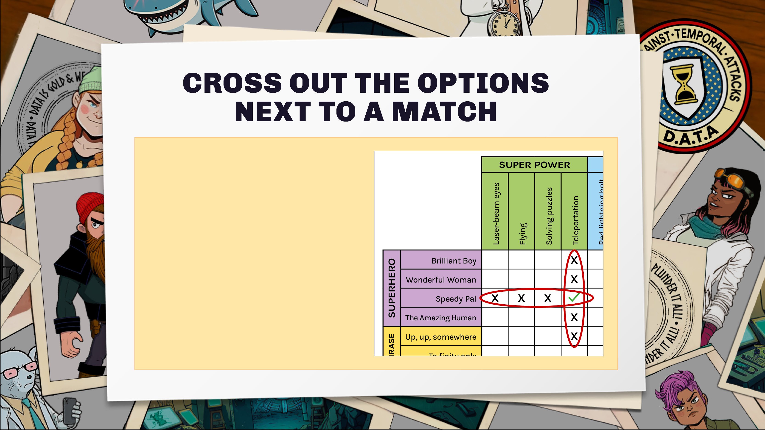
There’s only one correct pairing (no other superhero has the same power, and the superheroes only have one power).
Put crosses next to all the other powers for Speedy Pal, and cross out the other heroes for ‘teleportation’.

Slide 9
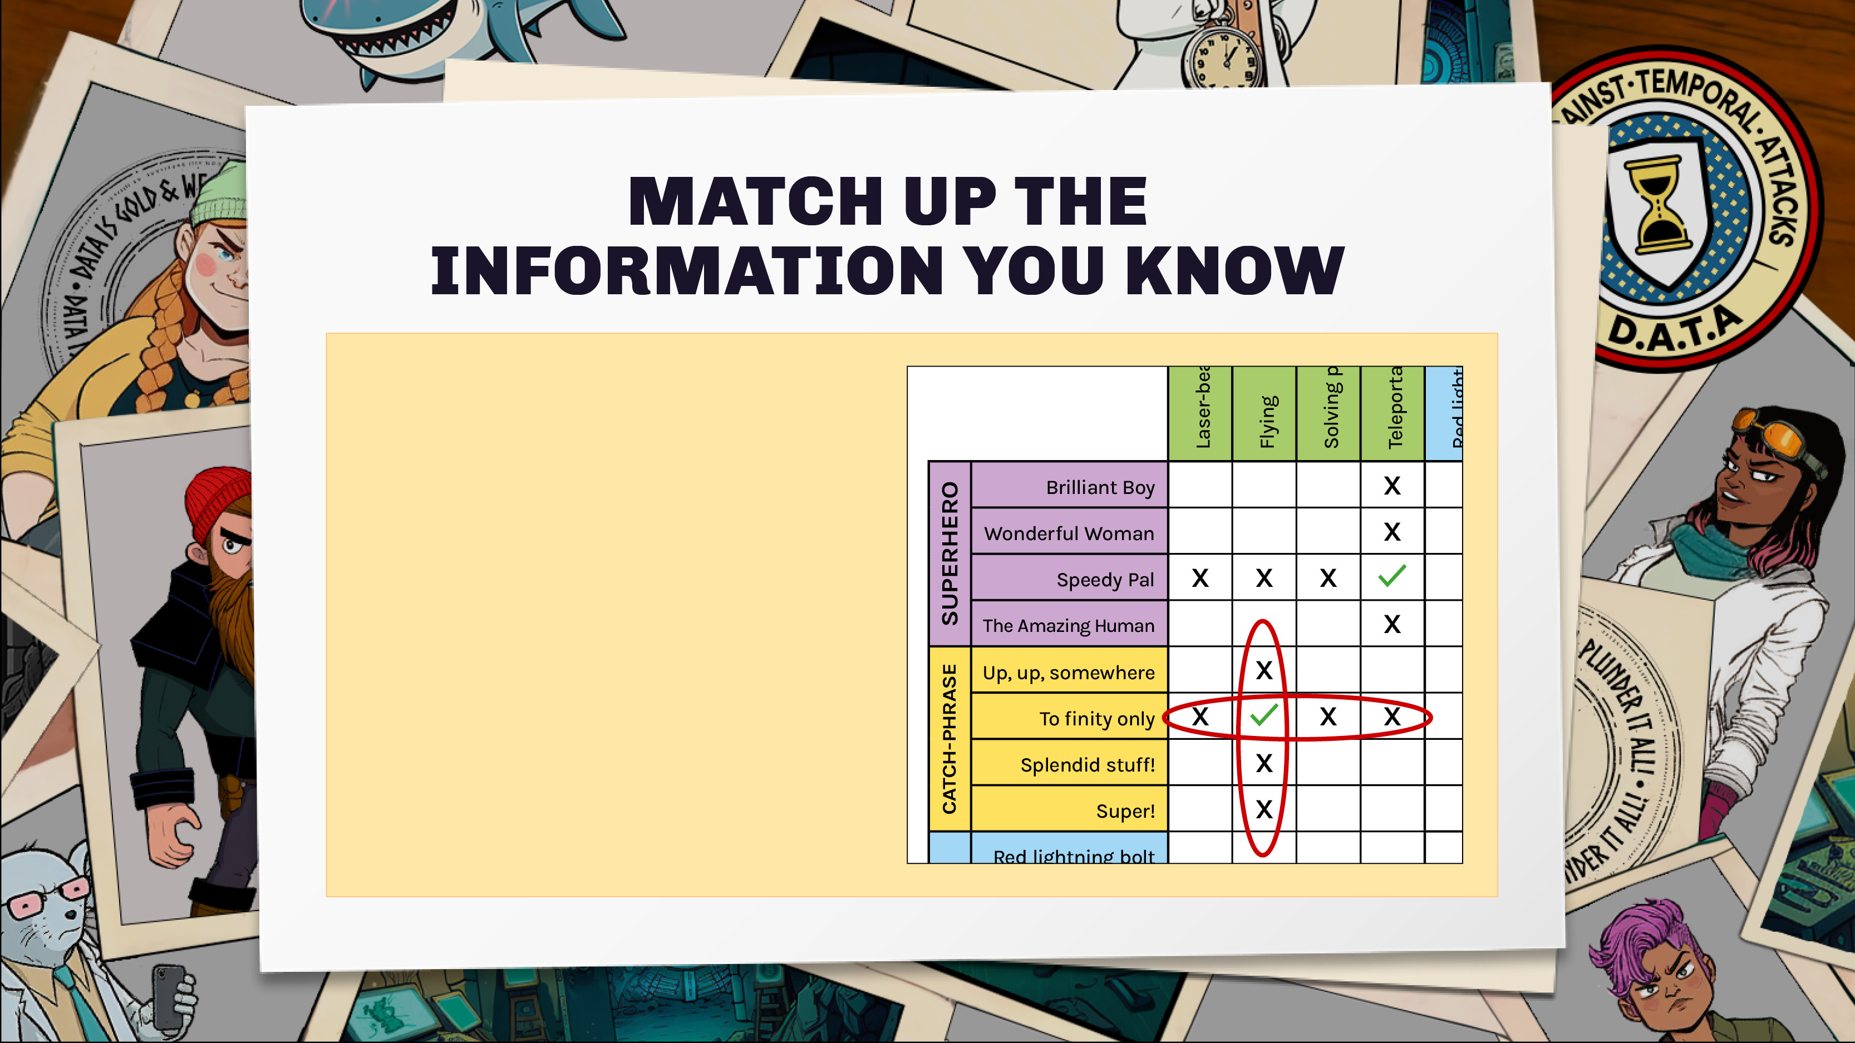
Sometimes we might match up facts but not know who they’re about yet.
We don’t know who the clue ‘The flying superhero says “To
finity only”’ is about yet,
but we can match ‘Flying’
to ‘To finity only’.

Slide 10
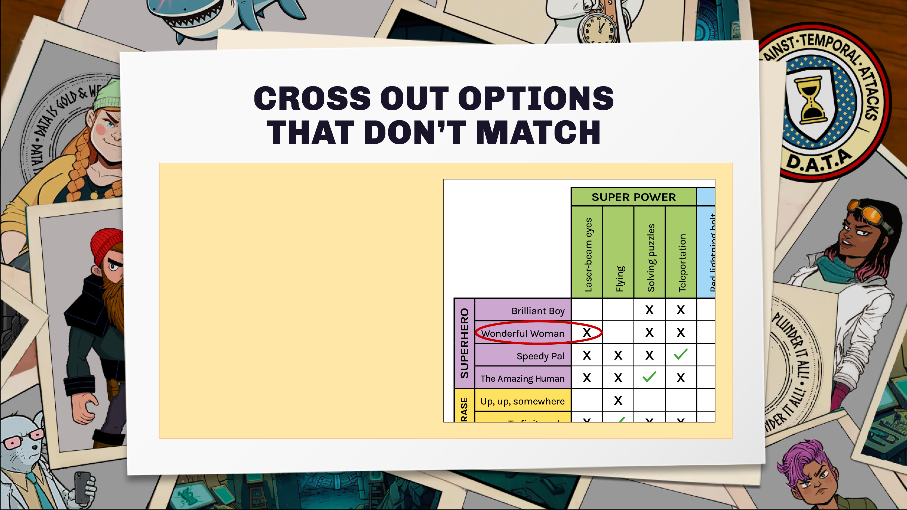
The clue “Wonderful Woman doesn’t have laser-beams” lets us add a cross between ‘Wonderful woman’ and ‘laser- beam eyes’.

Slide 11
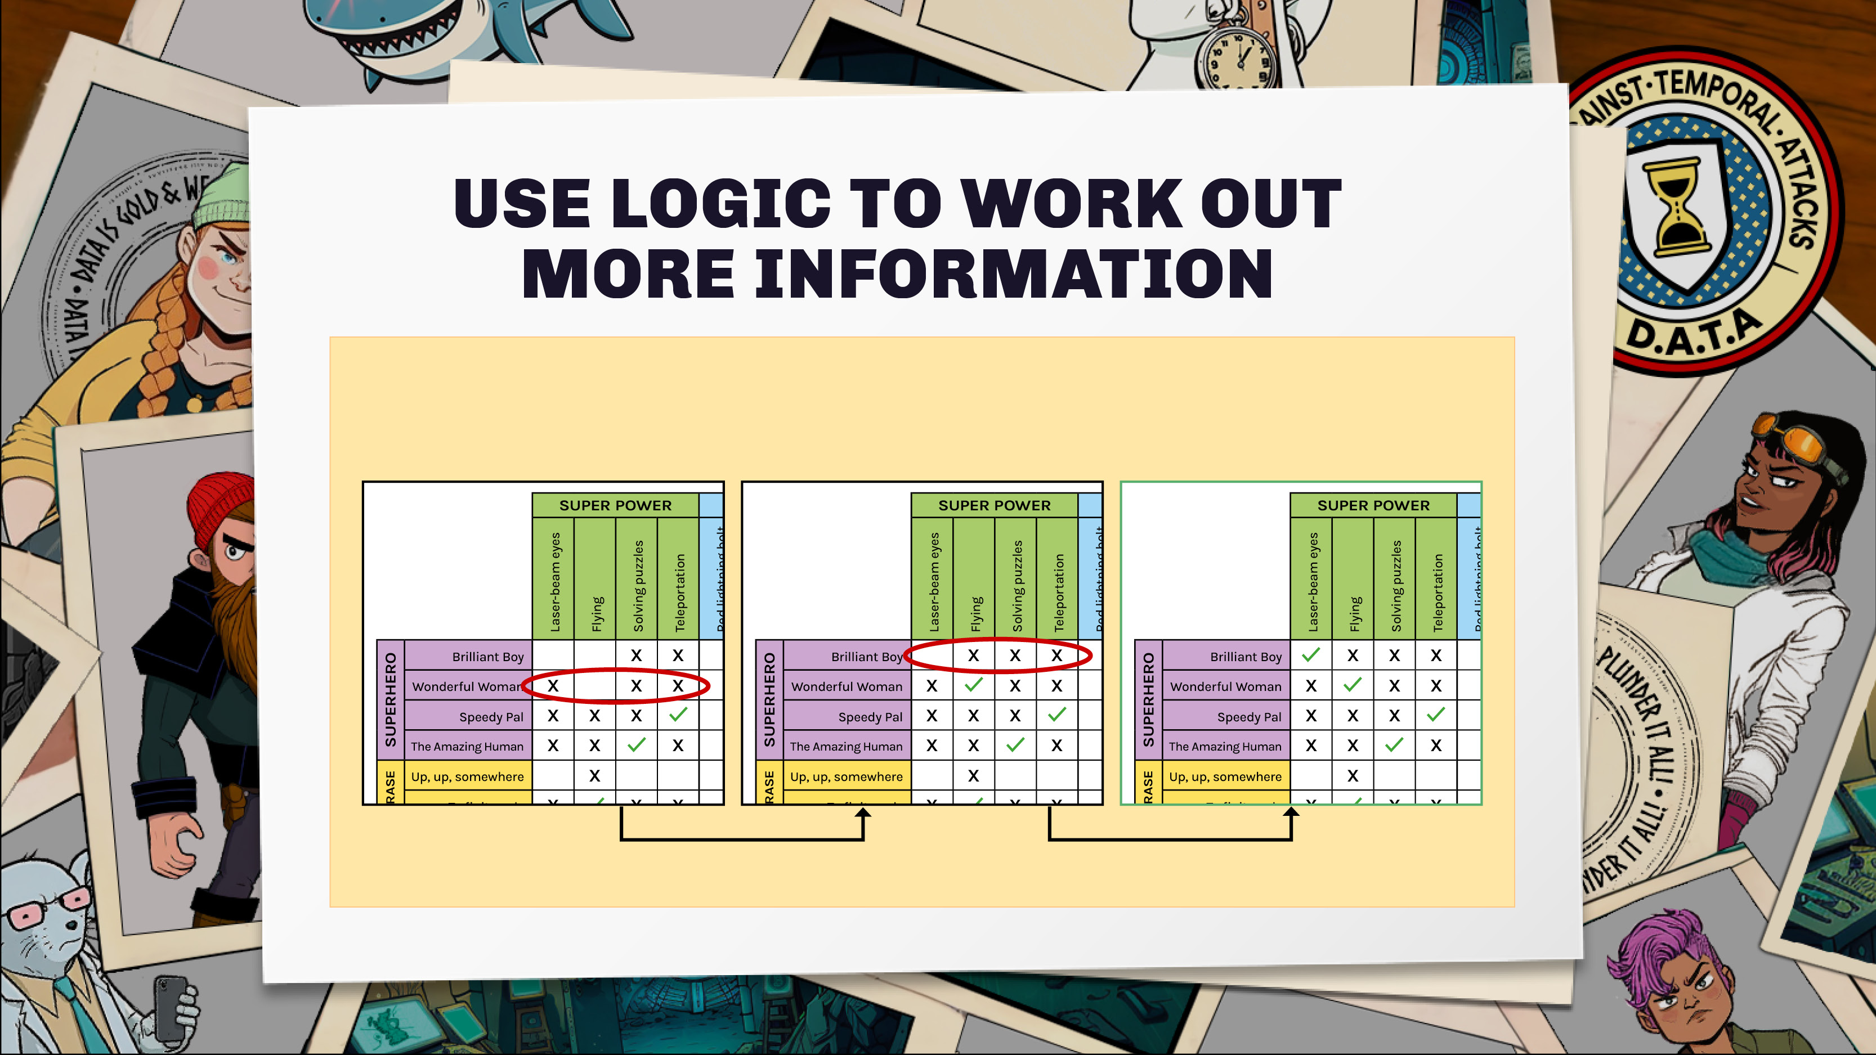
If there is only one option left, then we know it must be a match.

Slide 12
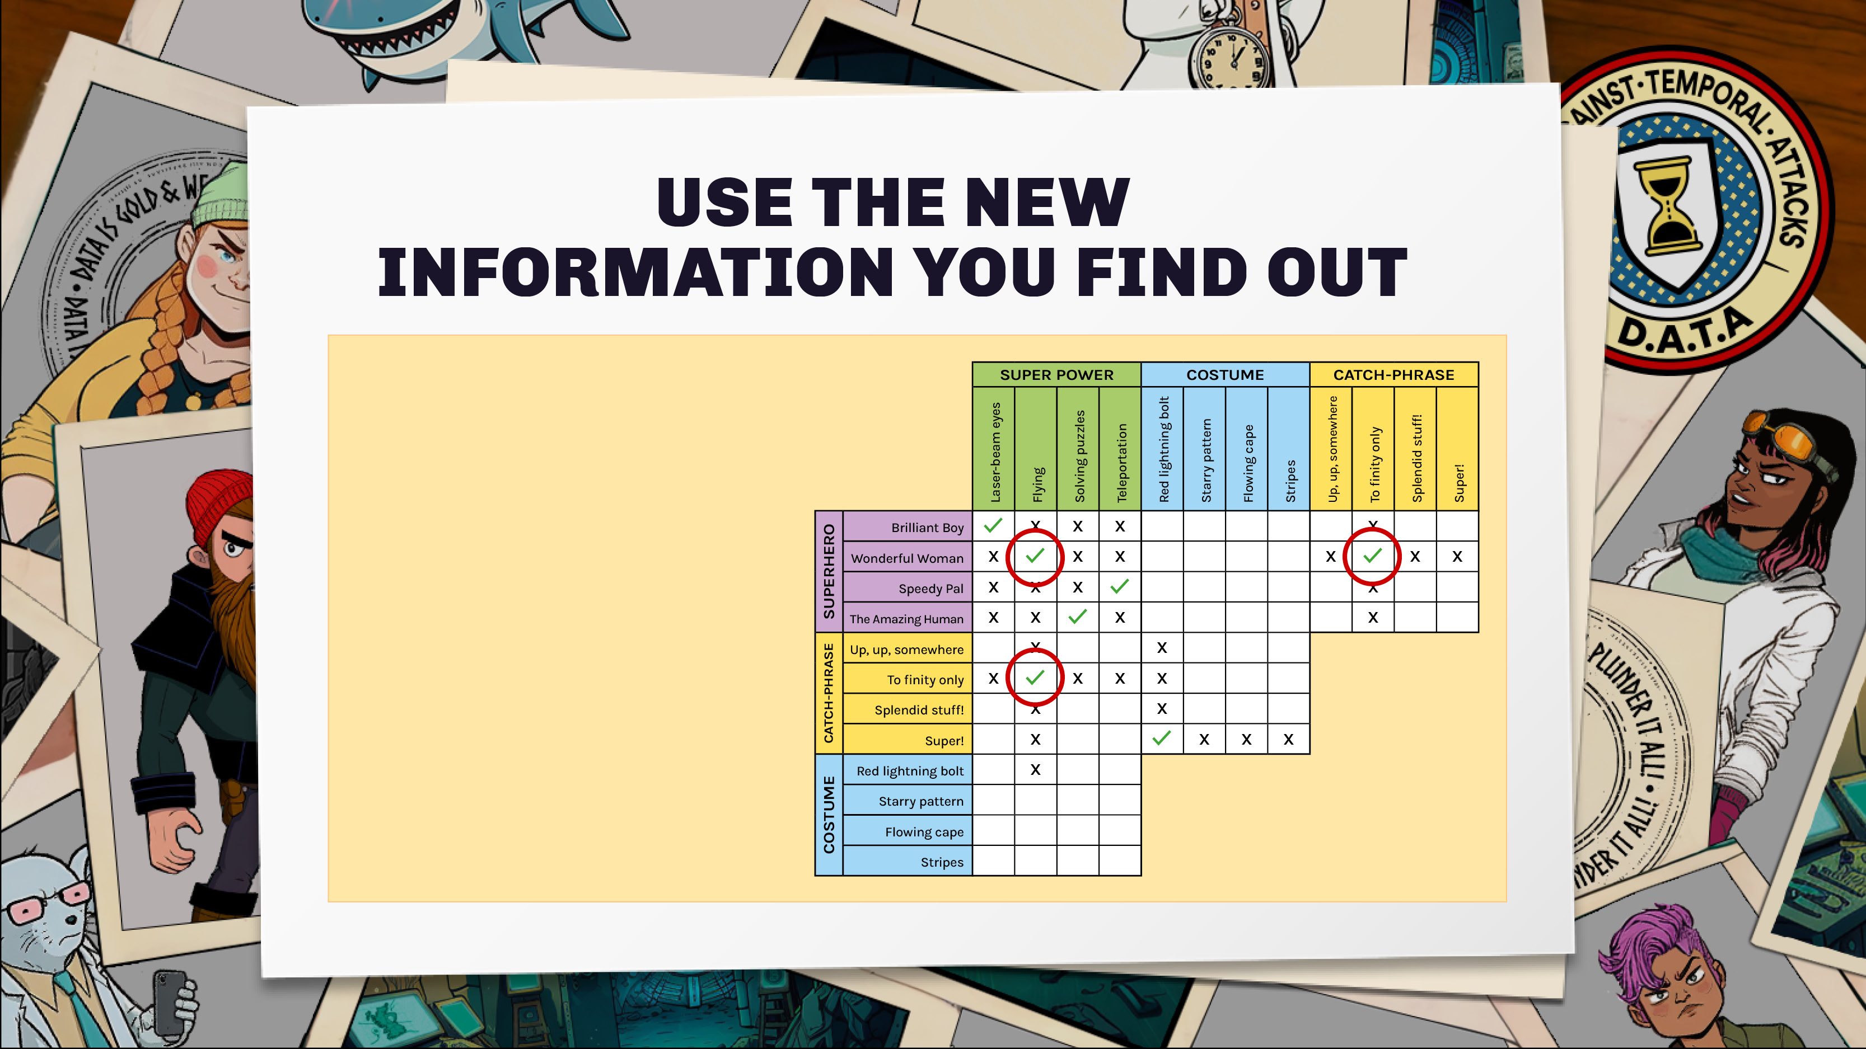
When you work out new information, see if that helps you to work out more!
If you know Wonderful Woman has the power of flying, and the person with flying says “To finity only” then you know who says that catch-phrase!

Slide 13


Slide 14
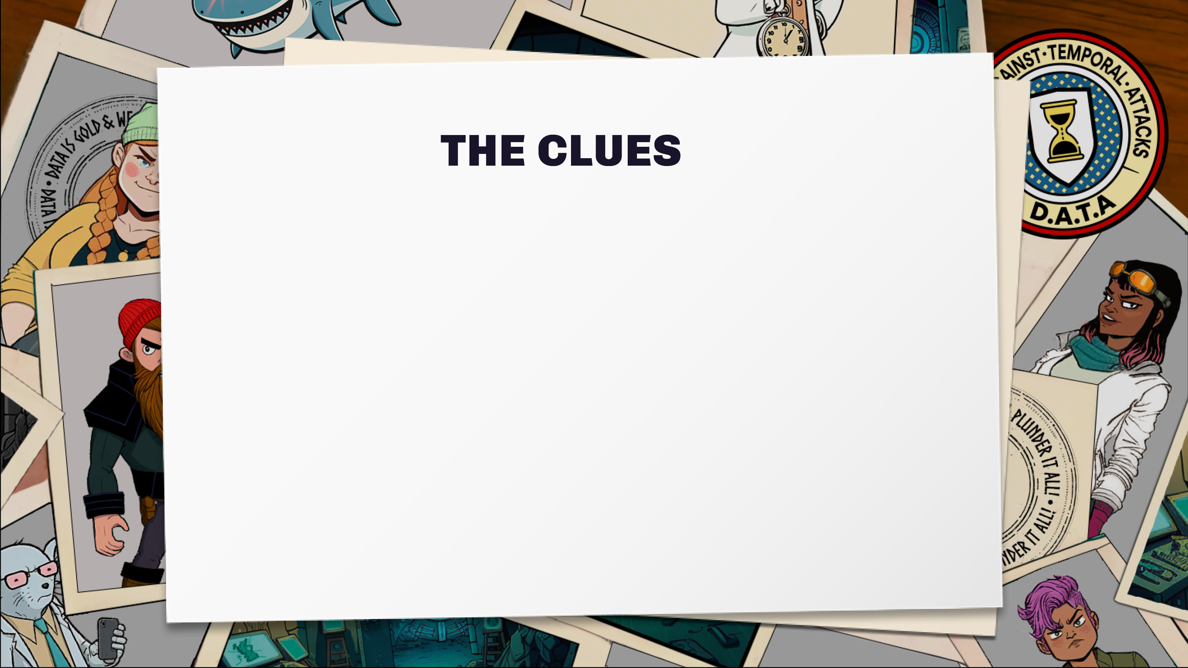
Vi doesn’t like social media
Jakub lives in Portpatrick
The person with a mouse lives in Rosyth
Peter the Tarantula lives in Portpatrick
The Cyber expert owns a shark
Prof the cat lives in Shetland or Lewis
The Malware writer owns a spider
Vi lives on the Isle of Lewis
Evelyn does not live in Rosyth
The person in Shetland is a space expert

Slide 15


Slide 16

Draw the VIKINGS villains to pass on to new
DATA trainees.
Write out one of the VIKINGS’ back story.
What turned them evil?

Slide 17

Try our print and play escape rooms:
dataschools.education/escape
Share your escape room adventures with us:
@Data_schools

