Slide 1
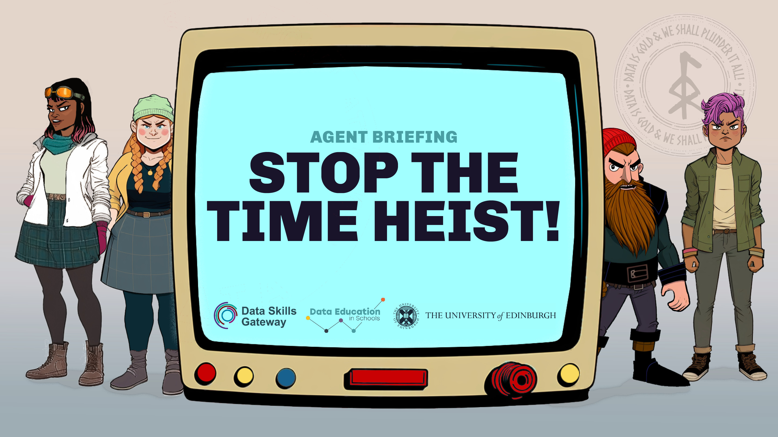

Slide 2

The VIKINGS have used their experimental time travel textual transmission technology (5T for short) to send information back in time to help them raise the money they need to build their new secret lair.
A DATA operative has snuck into each VIKINGS’ base to find clues about what they’re up to. Can you figure out what information each of the four VIKINGS villains have sent back to themselves?

Slide 3
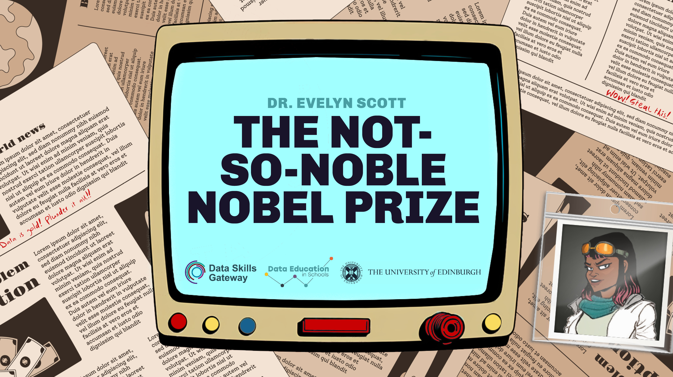

Slide 4

Our undercover agent thinks Dr. Scott really wants to win a Nobel Prize to get recognition and fame as a scientist. They found a newspaper article about the 2021 Prize winners and have worked out she’s planning on stealing their climate research and sending it back to the past so that she can win the Nobel Prize instead of them.

Slide 5
Our agent has found a graph showing how much the Prize money is each year, and an article showing the Scientists that have won each year since 1981.
Work out how many scientists won each year and how much the prize money was for each scientist. Then figure out the year with the highest prize amount.

Slide 6

Work out how many scientists won each year.
On the chart, divide the columns by the number of scientists who won.
Colour each winner in that column a different colour.

Slide 7

Work out which year gives the most money to the winning scientist.
How much money will Evelyn win if she manages to win the Nobel Prize that year?

Slide 8


Slide 9
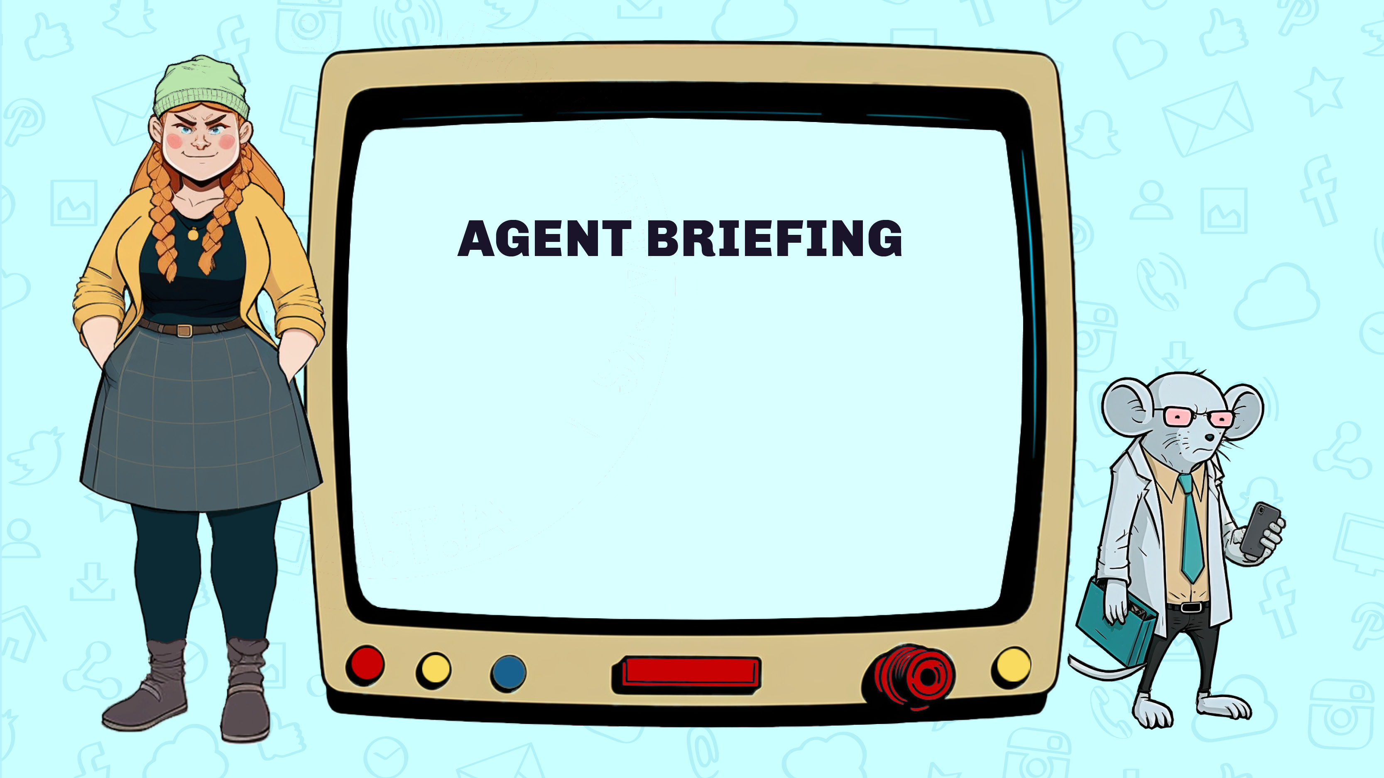
Lilias is a social media troll and wants to gain enough followers to be able to make massive amounts of money from some of her social media accounts.
Our undercover agent has overheard her saying that she will send back posts that went viral so that she can post them first and gain a huge number of followers.

Slide 10
A social media account needs over 10,000 followers to be able to start making money, either through ads, sponsors, or getting paid by the social media company.
Our agents will need to shut down Lilias’ accounts so she can’t make money from fake news and vicious rumours.

Slide 11
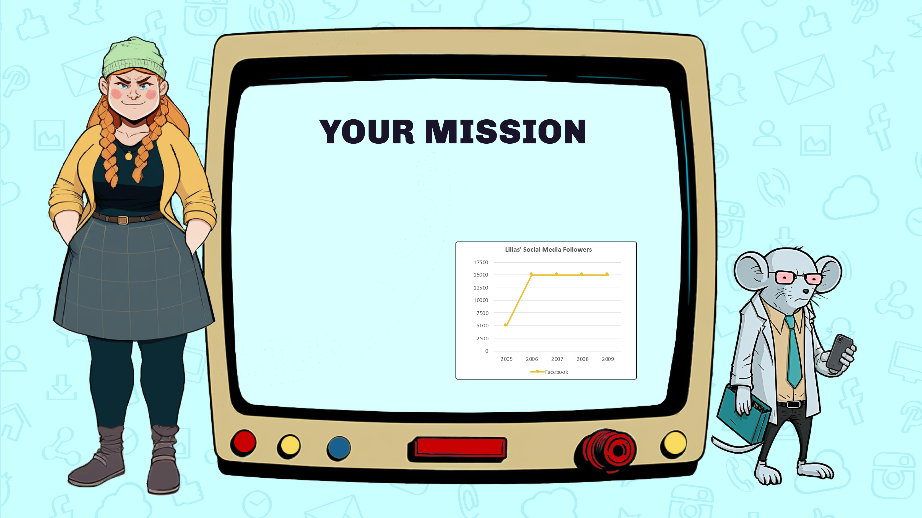
Our agent searched Lilias’ computer and found the usernames of her social media accounts and data on number of followers across different years.
Draw different coloured lines on the graph to show the number of followers over time for each account.

Slide 12

Which accounts are Lilias planning to use to make money?
Which years has she sent viral posts back to? These will be the years where the number of followers started to sharply increase.
Can you find Lilias’ secret message?

Slide 13


Slide 14
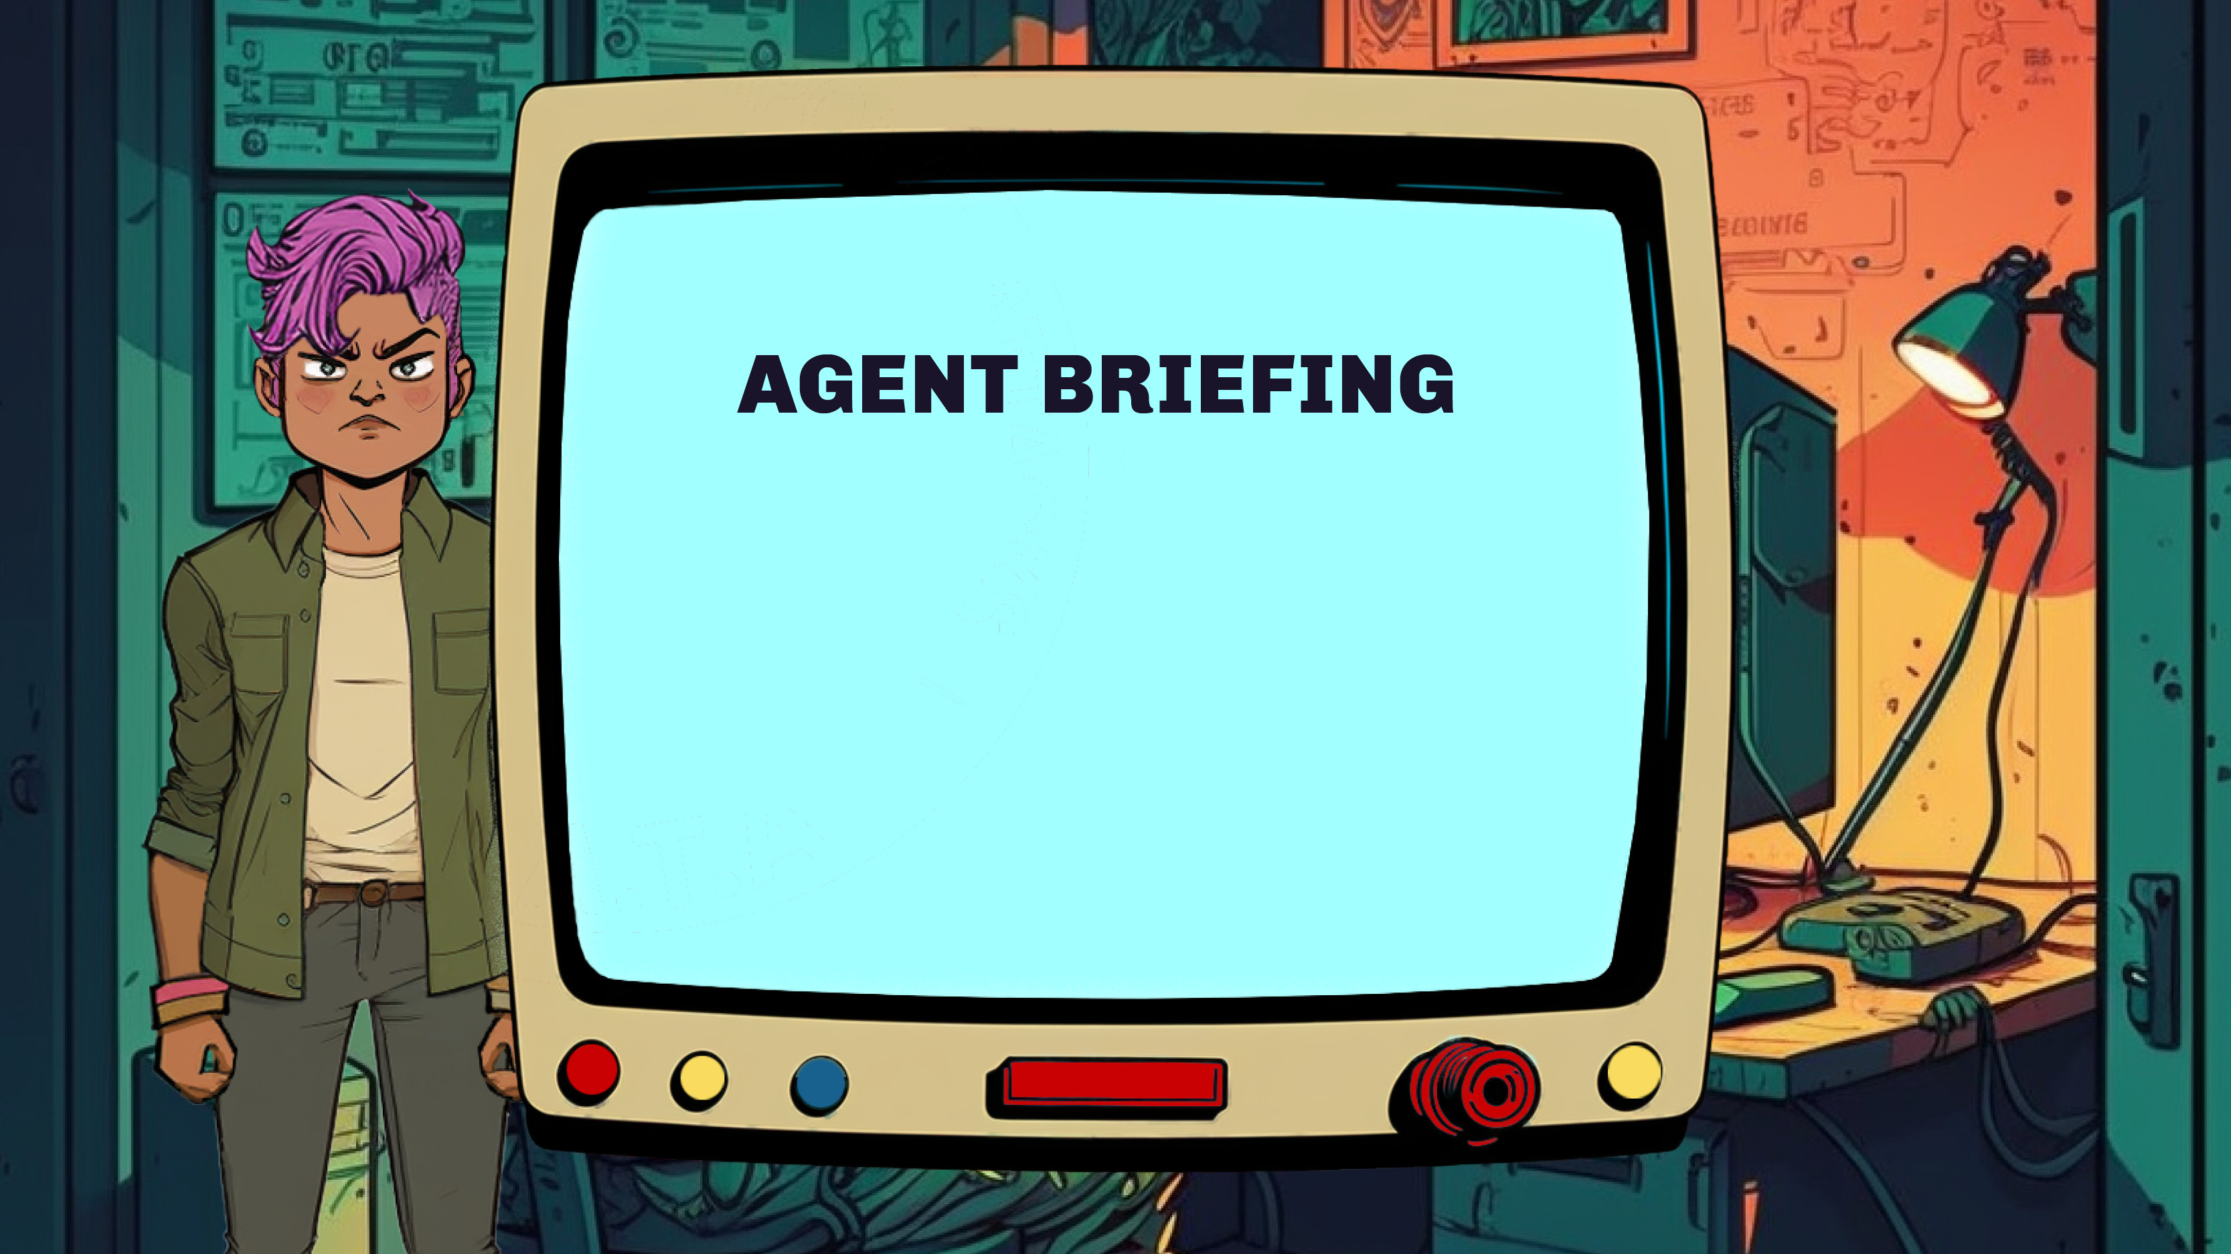
Vi is an exceptionally talented and cunning hacker.
Our undercover agent has found strips of paper in Vi’s shredder. They appear to be from yearly reports of the net worth of some of the wealthiest people in the world.

Slide 15
Our agent thinks Vi is planning to send information back in time to then get the bank details of these individuals. Vi plans to send fake emails to trick them into typing in their bank password.
Vi will hack their bank accounts in the year in which they collectively have the most money for them to steal.

Slide 16

Your mission is to group and sort the strips of paper then add up the amounts of money each year.
Find out which the billionaires have the highest amount of money altogether.

Slide 17

Which year will Vi will target the billionaires?
How much money could Vi steal?

Slide 18


Slide 19
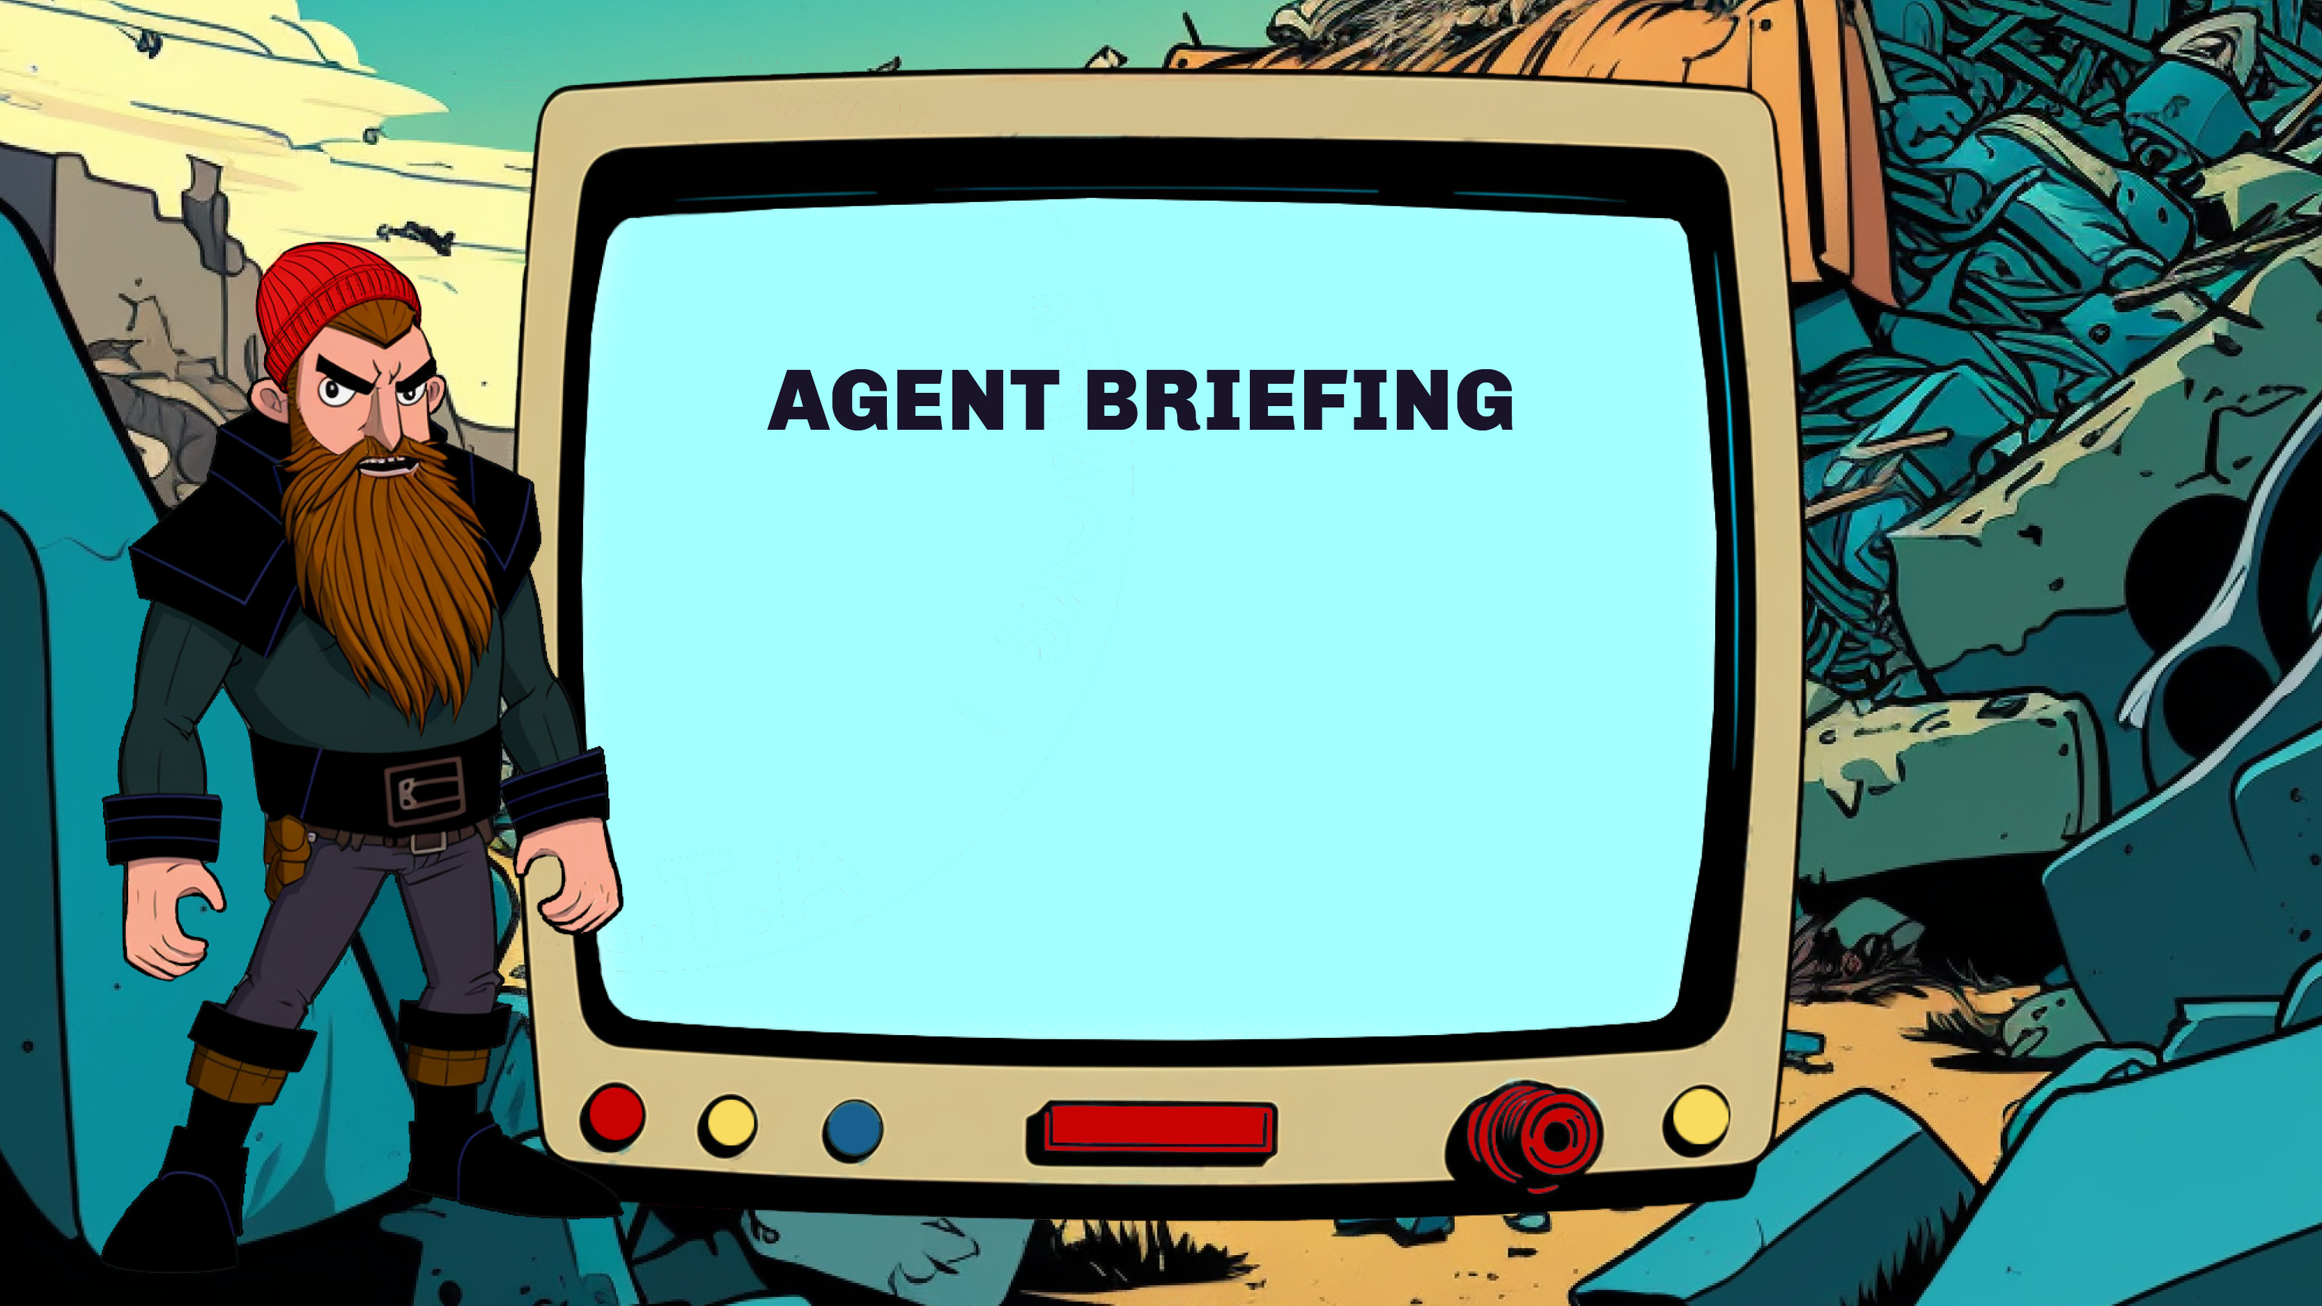
Our undercover agent has found a newspaper article on Jakub’s desk. It’s about someone who stored virtual money on a hard drive but threw it away by accident.
We have also found a map and table of data about the nearby landfi l site. We think Jakub is trying to find the hard drive to steal the money.

Slide 20
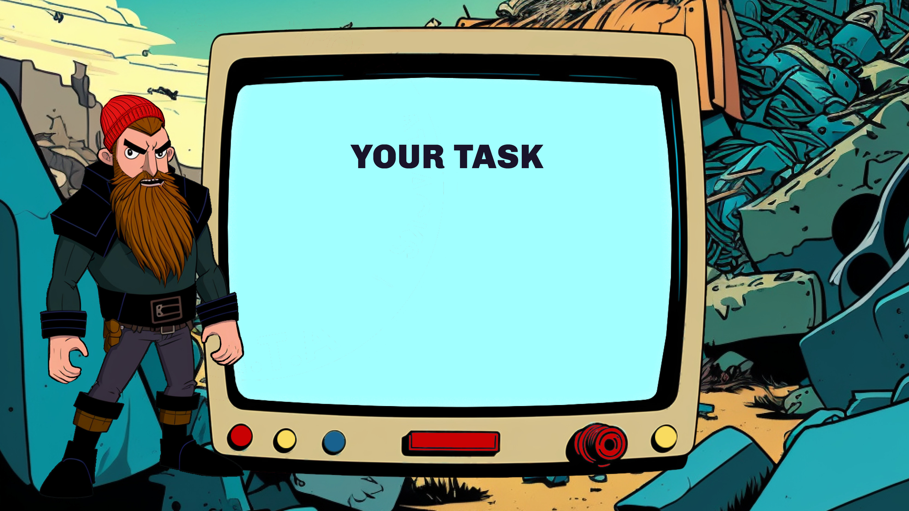
Study the newspaper to find out when the drive was binned and dumped in the landfi l site.
Use the table and map to find out where the hard drive is likely to be in the landfi l site.
You will need a password to access the money.
Work out what the password is.

Slide 21

Which month and year was the hard drive binned?
Where will the VIKINGS search for the hard drive?
  What is the password for the bitcoin wallet?

Slide 22
Use the chart showing the price of Bitcoin since 2010.
Work out when the VIKINGS should sell the stolen bitcoins to get the most money for them.
How much money will they get?

Slide 23


Slide 24

What information would you send back to yourself in the past to do good, not evil? You can only send 144 characters.
What would you send, and when?

Slide 25

Try our print and play escape rooms:
dataschools.education/escape
Share your escape room adventures with us: @Data_schools

