Slide 1
Christmas Graphs Quiz!!

Slide 2
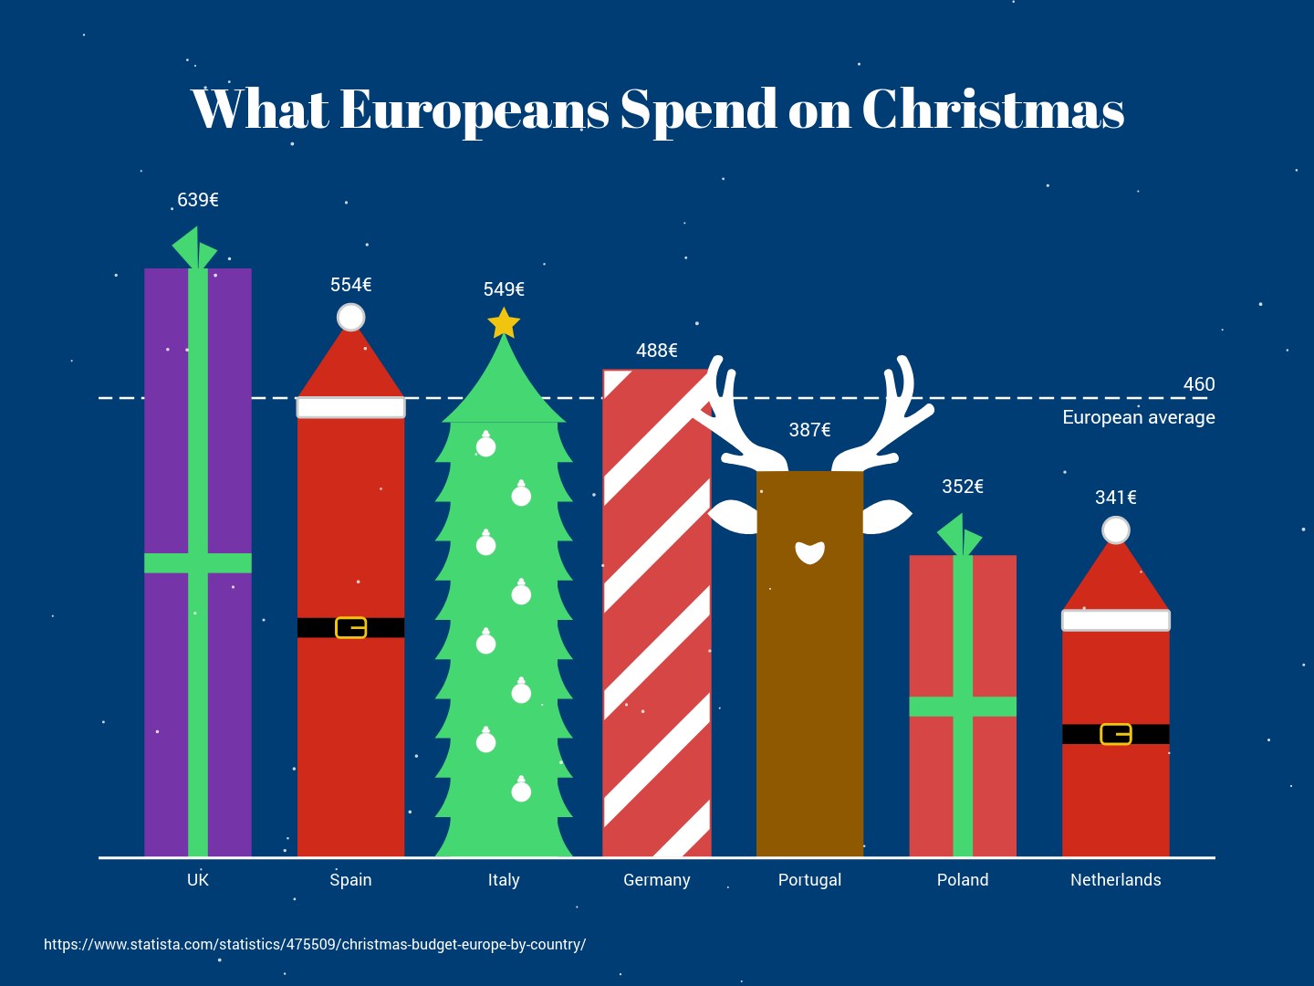
Question 1.
Which country spends closest to the European average at Christmas time?
A: UK
B: Italy
C: Germany
D: Portugal

Slide 3
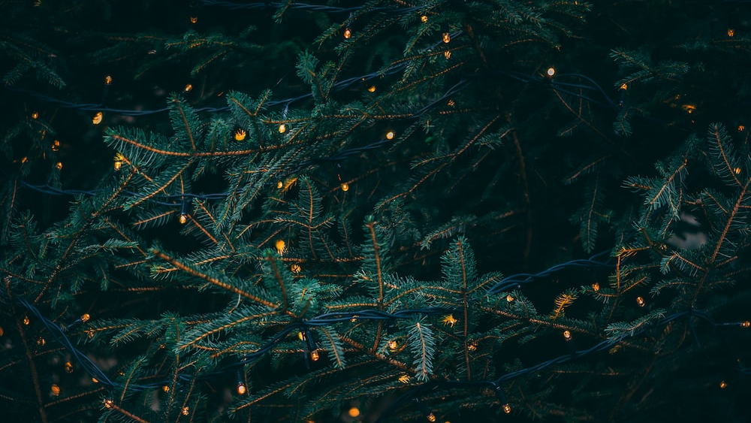
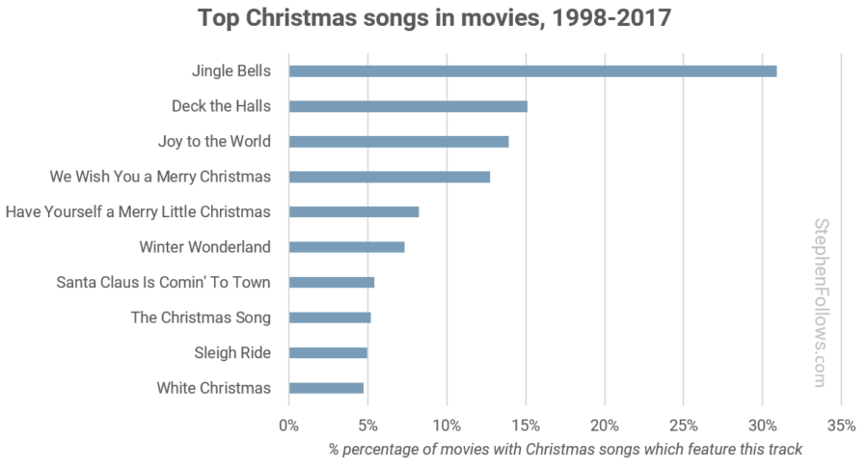
What percentage of films that have Christmas songs in them include the song ‘Sleigh Ride’?
Question 2.
A: 4%
B: 5%
C: 14%
D: 32%

Slide 4
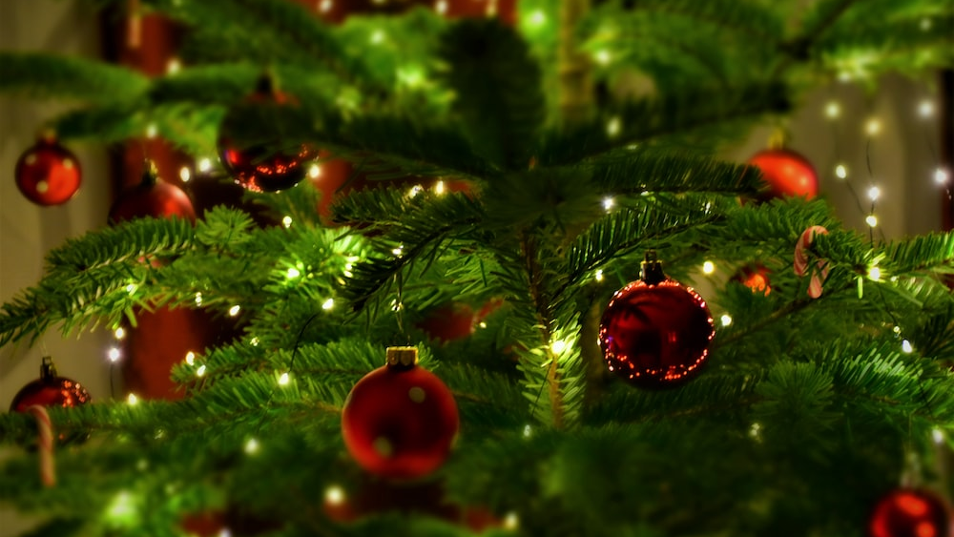
Question 3.
What is the most expensive ingredient for making Christmas Sugar Cookies?
A: Butter
B: Sugar
C: Flour
D: Egg

Slide 5
Question 4.
What is the most popular time of year for babies to be conceived?
A: 9 months after Christmas
B: 2 months after Christmas
C: 12 months after Christmas
D: Christmas
Most common days to be born, ranked from most popular (1) to least popular (365)

Slide 6
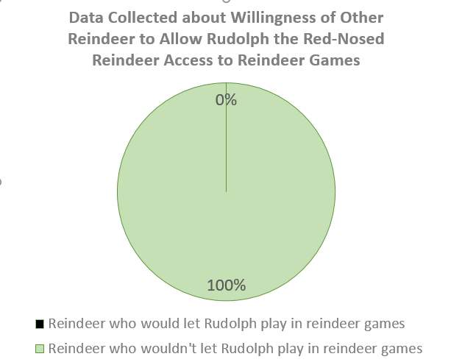
Question 5.
What percent of reindeers let Rudolf play?
A: 100%
B: 7 reindeer
C: 0%
D: 70%

Slide 7
Question 6.
When was the most expensive time to buy a Christmas Tree in the USA?
A: Nov 24th
B: Dec 24th
C: Dec 2nd
D: Nov 27th

Slide 8
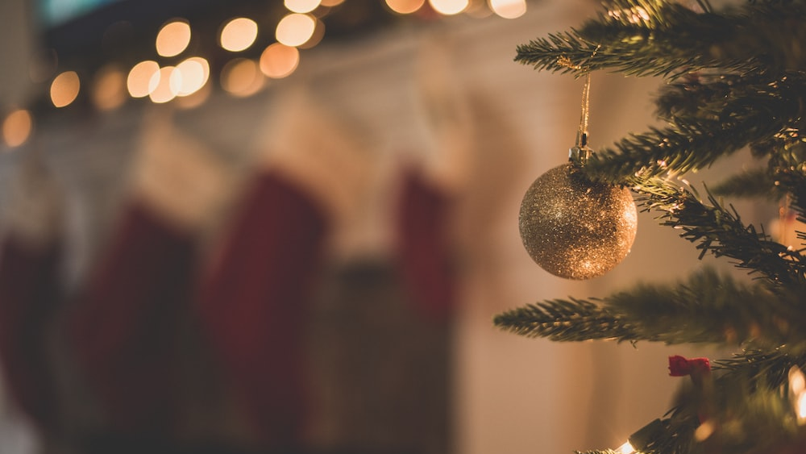
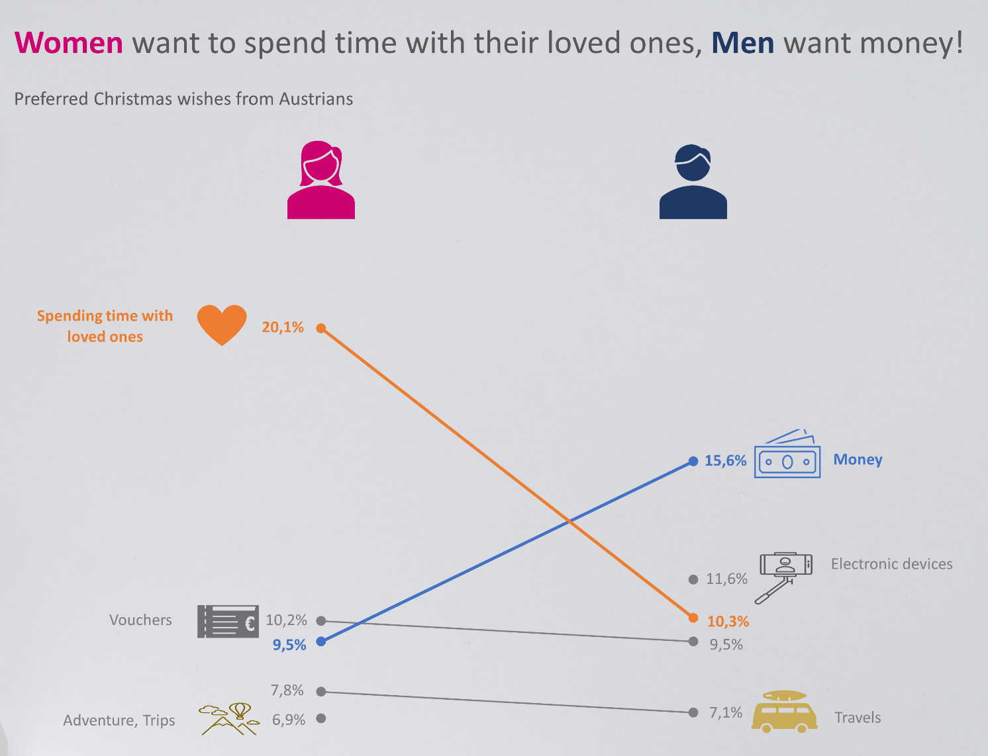
Question 7.
What item is wished for by men in Austria but not by women?
A: Money
B: Electronic devices
C: Adventure, Trips
D: Travels

Slide 9
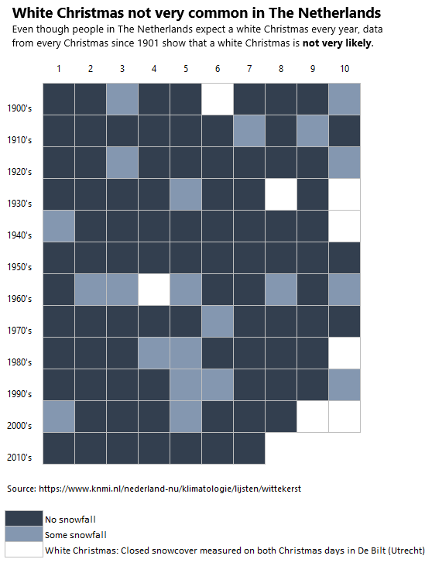
Question 8.
Which decade had the most number of years with some snow on Christmas?
A: 1930’s
B: 1950’s
C: 1960’s
D: 2000’s

Slide 10
On what day did Mary and Joseph reach the highest elevation in their journey?
Question 9.
A: 10th December
B: 15th December
C: 16th December
D: 21st December

Slide 11
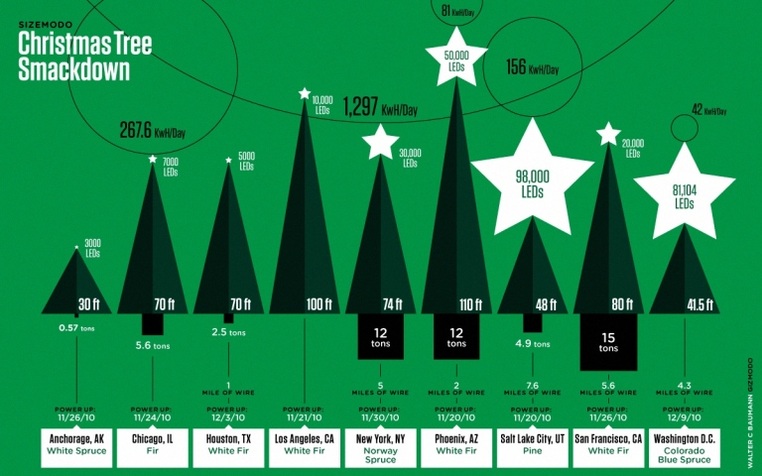
How much energy does the tree with the most number of LEDs use per day?
Question 10.
A: 42 KwH/Day
B: 81 KwH/Day
C: 156 KwH/Day
D: 1,297 KwH/Day

Slide 12
…the answers…

Slide 13
Question 1.
Which country spends closest to the European average at Christmas time?
A: UK
B: Italy
C: Germany
D: Portugal

Slide 14
Question 1.
Which country spends closest to the European average at Christmas time?
A: UK
B: Italy
C: Germany
D: Portugal

Slide 15
What percentage of films that have Christmas songs in them include the song ‘Sleigh Ride’?
Question 2.
A: 4%
B: 5%
C: 14%
D: 32%

Slide 16
What percentage of films that have Christmas songs in them include the song ‘Sleigh Ride’?
Question 2.
A: 4%
B: 5%
C: 14%
D: 32%

Slide 17
Question 3.
What is the most expensive ingredient for making Christmas Sugar Cookies?
A: Butter
B: Sugar
C: Flour
D: Egg

Slide 18
Question 3.
What is the most expensive ingredient for making Christmas Sugar Cookies?
A: Butter
B: Sugar
C: Flour
D: Egg

Slide 19
Question 4.
What is the most popular time of year for babies to be conceived?
A: 9 months after Christmas
B: 2 months after Christmas
C: 12 months after Christmas
D: Christmas
Most common days to be born, ranked from most popular (1) to least popular (365)

Slide 20
Question 4.
What is the most popular time of year for babies to be conceived?
A: 9 months after Christmas
B: 2 months after Christmas
C: 12 months after Christmas
D: Christmas
Most common days to be born, ranked from most popular (1) to least popular (365)

Slide 21
Question 5.
What percent of reindeers let Rudolf play?
A: 100%
B: 7 reindeer
C: 0%
D: 70%

Slide 22
Question 5.
What percent of reindeers let Rudolf play?
A: 100%
B: 7 reindeer
C: 0%
D: 70%

Slide 23
Question 6.
When was the most expensive time to buy a Christmas Tree in the USA?
A: Nov 24th
B: Dec 24th
C: Dec 2nd
D: Nov 27th

Slide 24
Question 6.
When was the most expensive time to buy a Christmas Tree in the USA?
A: Nov 24th
B: Dec 24th
C: Dec 2nd
D: Nov 27th

Slide 25
Question 7.
What item is wished for by men in Austria but not by women?
A: Money
B: Electronic devices
C: Adventure, Trips
D: Travels

Slide 26
Question 7.
What item is wished for by men in Austria but not by women?
A: Money
B: Electronic devices
C: Adventure, Trips
D: Travels

Slide 27
Question 8.
Which decade had the most number of years with some snow on Christmas?
A: 1930’s
B: 1950’s
C: 1960’s
D: 2000’s

Slide 28
Question 8.
Which decade had the most number of years with some snow on Christmas?
A: 1930’s
B: 1950’s
C: 1960’s
D: 2000’s

Slide 29
On what day did Mary and Joseph reach the highest elevation in their journey?
Question 9.
A: 10th December
B: 15th December
C: 16th December
D: 21st December

Slide 30
On what day did Mary and Joseph reach the highest elevation in their journey?
Question 9.
A: 10th Dec
B: 15th Dec
C: 16th Dec
D: 21st Dec

Slide 31
How much energy does the tree with the most number of LEDs use per day?
Question 10.
A: 42 KwH/Day
B: 81 KwH/Day
C: 156 KwH/Day
D: 1,297 KwH/Day

Slide 32
How much energy does the tree with the most number of LEDs use per day?
Question 10.
A: 42 KwH/Day
B: 81 KwH/Day
C: 156 KwH/Day
D: 1,297 KwH/Day

Slide 33
Well done!

