Slide 1
Data Viz Quiz

Slide 2
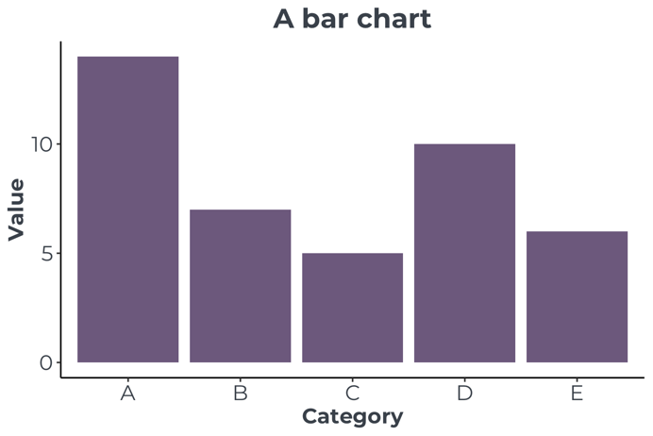
What is a bar chart?
Bar charts use rectangular bars to compare values in different categories.
The bars normally show the counts or sizes of categorical data.
Since there is no connection between the bars, they are normally shown not touching.

Slide 3
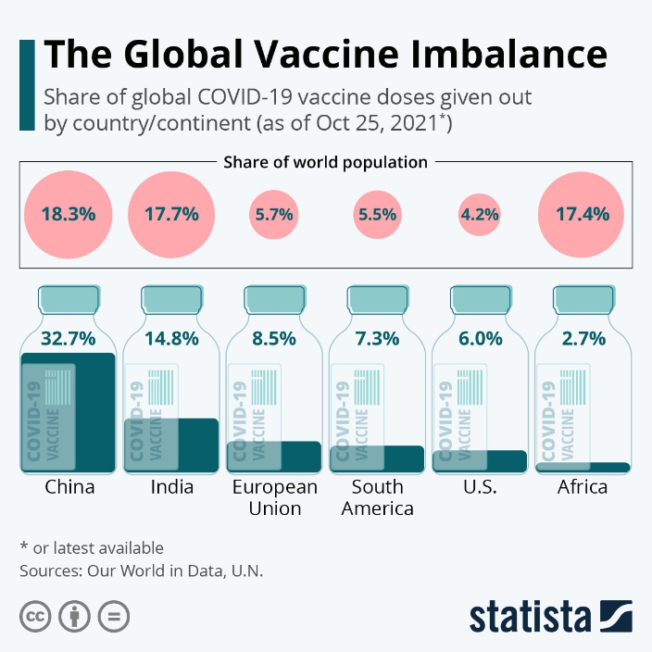
Question 1
Which location has the biggest difference between the share of world population and share of COVID-19 vaccines?
A: Africa B: India C: European Union D: China
https://www.statista.com/chart/26055/share-of-vaccine-doses-covid-19-share-of-world-population/
Notes:
Bar charts use rectangular bars to compare values in different categories.
The bars normally show the counts or sizes of categorical data.
Since there is no connection between the bars, they are normally shown not touching.

Slide 4
Question 1
Which location has the biggest difference between the share of world population and share of COVID-19 vaccines?
A: Africa B: India C: European Union D: China
https://www.statista.com/chart/26055/share-of-vaccine-doses-covid-19-share-of-world-population/
Notes:
Bar charts use rectangular bars to compare values in different categories.
The bars normally show the counts or sizes of categorical data.
Since there is no connection between the bars, they are normally shown not touching.

Slide 5
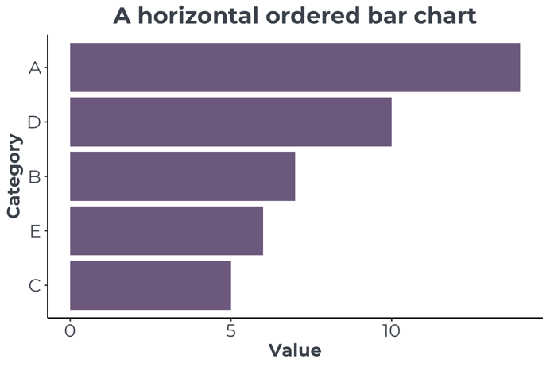
What is a horizontal bar chart?
A horizontal bar graph is often a good option when there are many categories, or the category labels are long.
It is also possible to reorder the bars, which makes it easier to see the smallest and largest categories.
These can also be highlighted by using different colours.

Slide 6
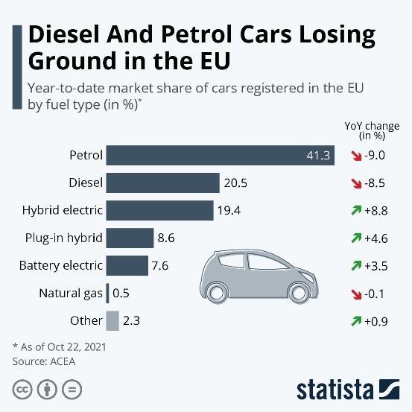
Question 2
What type of cars have had the biggest ‘year-over-year’ increase in market share?
A: Petrol B: Hybrid electric C: Plug-in electric D: Diesel
https://www.statista.com/chart/26037/market-share-of-cars-registered-in-the-eu-by-fuel-type/
Notes:
A horizontal bar graph is often a good option when there are many categories, or the category labels are long.
It is also possible to reorder the bars, which makes it easier to see the smallest and largest categories.
These can also be highlighted by using different colours.

Slide 7
Question 2
What type of cars have had the biggest ‘year-over-year’ increase in market share?
A: Petrol B: Hybrid electric C: Plug-in electric D: Diesel
https://www.statista.com/chart/26037/market-share-of-cars-registered-in-the-eu-by-fuel-type/
Notes:
A horizontal bar graph is often a good option when there are many categories, or the category labels are long.
It is also possible to reorder the bars, which makes it easier to see the smallest and largest categories.
These can also be highlighted by using different colours.

Slide 8
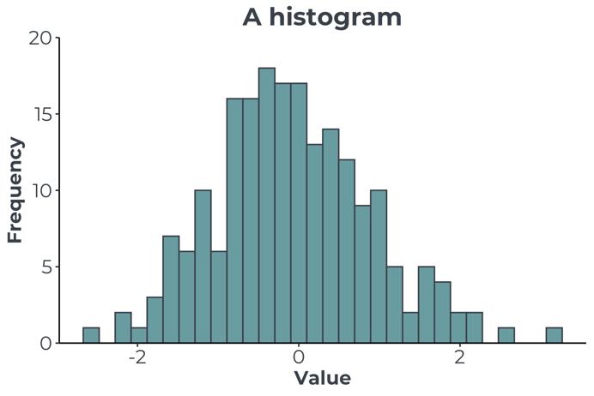
What is a histogram?
A histogram might look very similar to a bar chart, but it is fundamentally different since it is plotting numerical rather than categorical data.
Histograms are used to examine the distribution (spread) of a numerical variable. The x-axis contains the value of the numerical variable, which is then binned into ranges, and the number of points in each range is displayed on the y-axis.
The bars on a histogram should always be displayed as touching, since the variable is continuous. If there are gaps between the bars, then that implies missing data in that range.

Slide 9
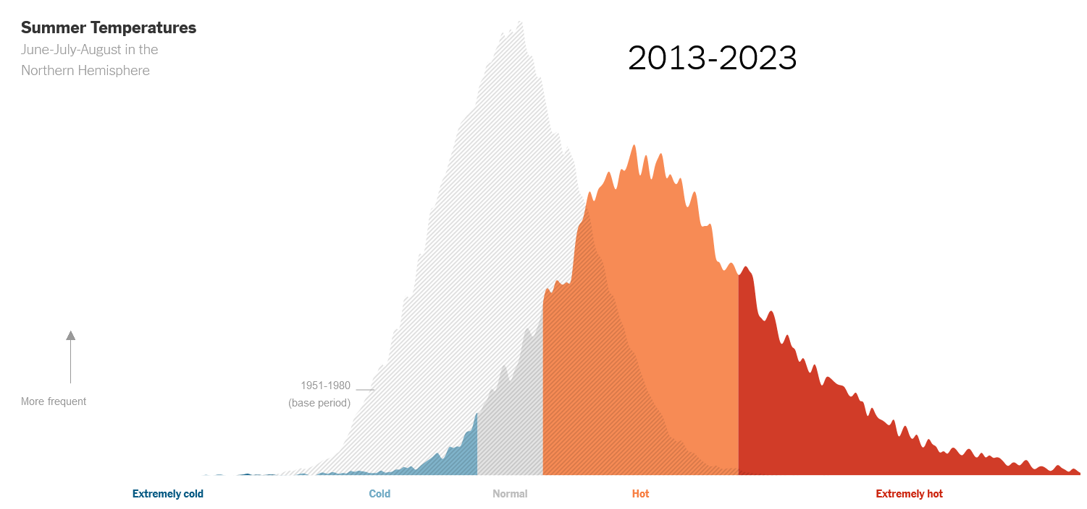
Question 3
Compared to the time period 1951-1980 (the pale grey distribution), summer temperatures in 2013-2023 are:
A: About the same B: The same average value, but with more variation C: Generally hotter, and with more variation D: Generally cooler
https://www.nytimes.com/interactive/2023/climate/extreme-summer-heat.html
Notes:
A histogram might look very similar to a bar chart, but it is fundamentally different since it is plotting numerical rather than categorical data.
Histograms are used to examine the distribution of a numerical variable. The x-axis contains the value of the numerical variable, which is then binned into ranges, and the frequency of points in the range is displayed on the y-axis.
The bars on a histogram should always be displayed as touching, since the variable is continuous. If there are gaps between the bars, then that implies missing data in that range.

Slide 10
Question 3
Compared to the time period 1951-1980 (the pale grey distribution), summer temperatures in 2013-2023 are:
A: About the same B: The same average value, but with more variation C: Generally hotter, and with more variation D: Generally cooler
https://www.nytimes.com/interactive/2023/climate/extreme-summer-heat.html
Notes:
A histogram might look very similar to a bar chart, but it is fundamentally different since it is plotting numerical rather than categorical data.
Histograms are used to examine the distribution of a numerical variable. The x-axis contains the value of the numerical variable, which is then binned into ranges, and the frequency of points in the range is displayed on the y-axis.
The bars on a histogram should always be displayed as touching, since the variable is continuous. If there are gaps between the bars, then that implies missing data in that range.

Slide 11
What is a pie chart?
Pie charts show the proportion of a whole. The total of the pie must add up to 100%.
Pie charts are often not the best choice of graph to use, since it is much more difficult for human brains to estimate relative angles, or segments of the chart.
When they are used with more than two or three segments it is very difficult to pick out slivers or compare relative segment sizes.
A bar chart can always be used in place of a pie chart and is much clearer to read.

Slide 12
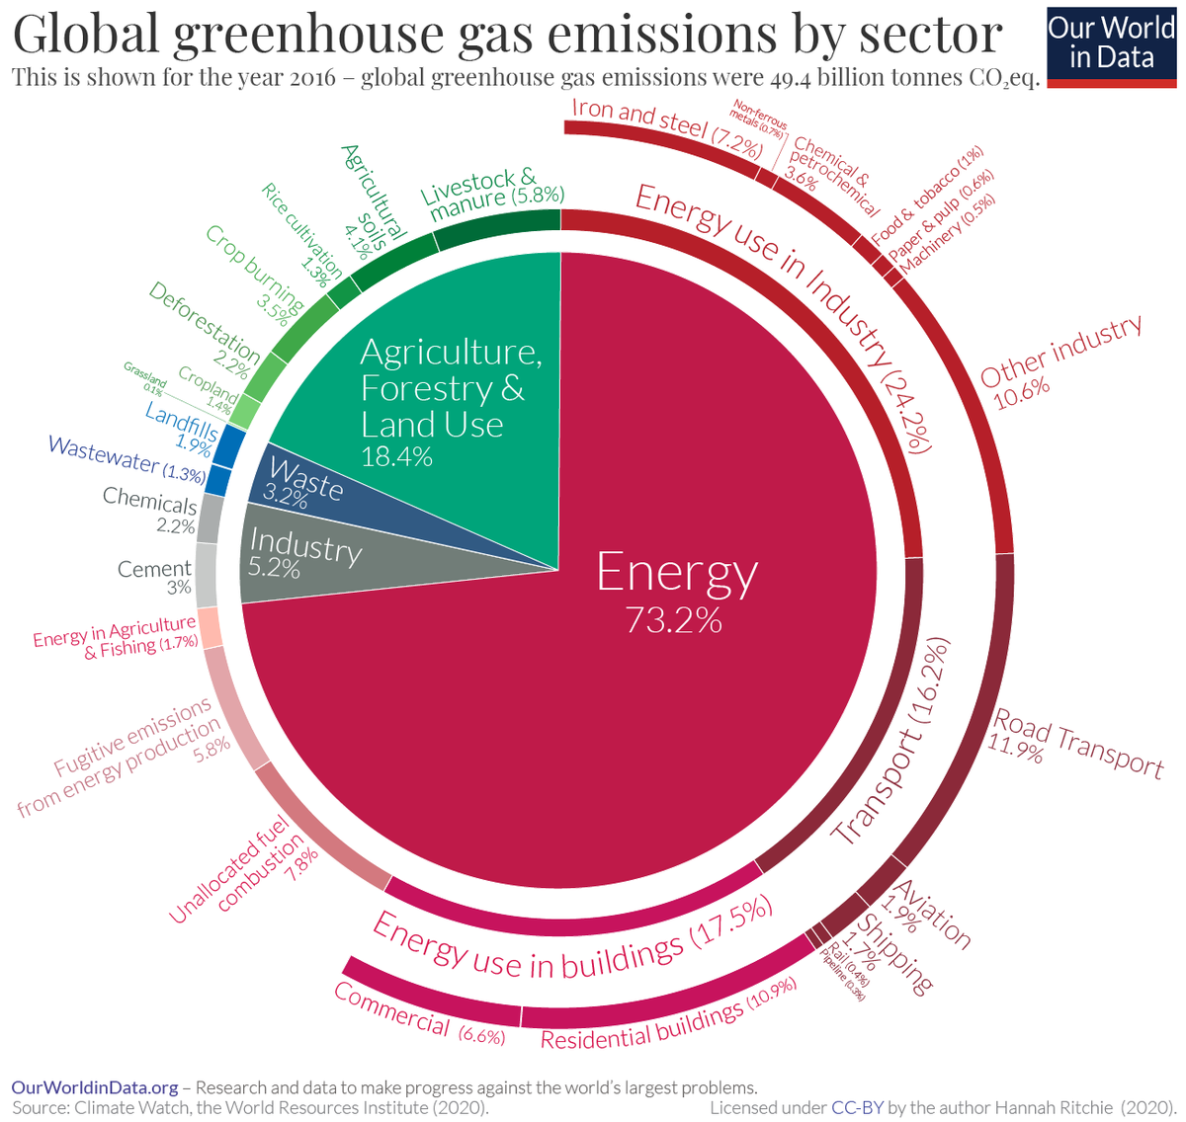
Question 4
Which sector had the lowest greenhouse gas emissions in 2016?
A: Waste B: Energy C: Industry D: Agriculture, forestry and land use
https://www.visualcapitalist.com/a-global-breakdown-of-greenhouse-gas-emissions-by-sector/
Notes:
Pie charts show the proportion of a whole. The total of the pie must add up to 100%.
Pie charts are often not the best choice of graph to use, since it is much more difficult for human brains to estimate relative angles, or segments of the chart.
When they are used with more than two or three segments it is very difficult to pick out slivers or compare relative segment sizes.
A bar chart can always be used in place of a pie chart and is much clearer to read.

Slide 13
Question 4
Which sector had the lowest greenhouse gas emissions in 2016?
A: Waste B: Energy C: Industry D: Agriculture, forestry and land use
https://www.visualcapitalist.com/a-global-breakdown-of-greenhouse-gas-emissions-by-sector/
Notes:
Pie charts show the proportion of a whole. The total of the pie must add up to 100%.
Pie charts are often not the best choice of graph to use, since it is much more difficult for human brains to estimate relative angles, or segments of the chart.
When they are used with more than two or three segments it is very difficult to pick out slivers or compare relative segment sizes.
A bar chart can always be used in place of a pie chart and is much clearer to read.

Slide 14
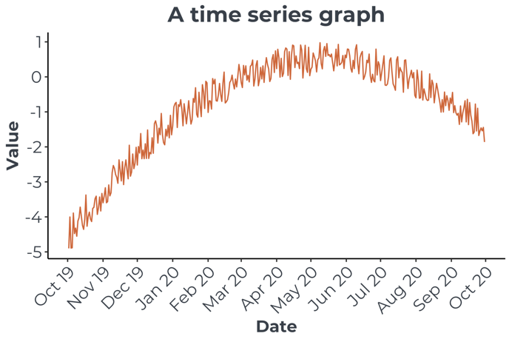
What is a time series graph?
A time series graph is a special type of line graph, with time on the x-axis and regular repeated measurements of a variable on the y-axis.
Time series are good for spotting long term trends like a regular seasonal variation.

Slide 15
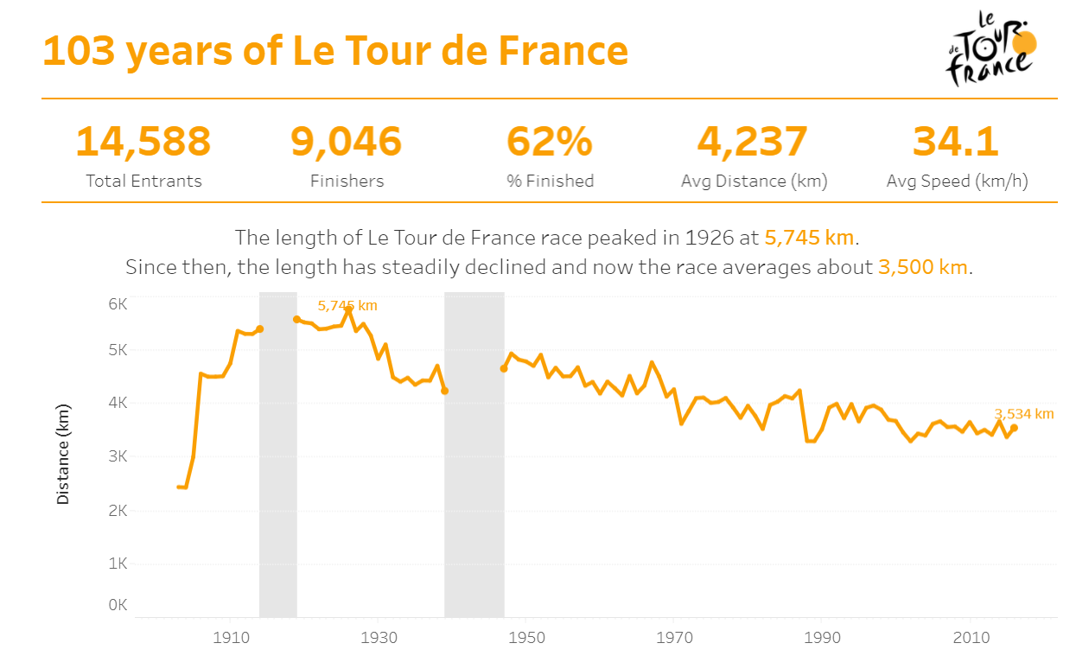
Question 5
The length of the Tour de France peaked in 1926. What distance was it that year?
A: 4,237km B: 34.1km/h C: 5,745km D: 3,534km
https://www.vizwiz.com/2017/07/tour-de-france.html
Notes:
A time series graph is a special type of line graph, with time on the x-axis and regular repeated measurements of a variable on the y-axis.
Time series are good for spotting long term trends like a regular seasonal variation.

Slide 16
Question 5
The length of the Tour de France peaked in 1926. What distance was it that year?
A: 4,237km B: 34.1km/h C: 5,745km D: 3,534km
https://www.vizwiz.com/2017/07/tour-de-france.html
Notes:
A time series graph is a special type of line graph, with time on the x-axis and regular repeated measurements of a variable on the y-axis.
Time series are good for spotting long term trends like a regular seasonal variation.

Slide 17
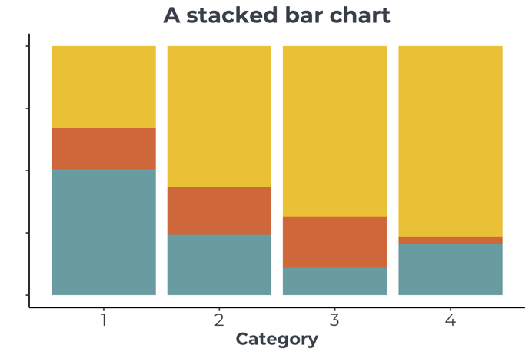
What is a stacked bar chart?
Stacked bar charts can show proportions of a whole and how they change across a varying quantity such as time.
Like an area chart, they are able to demonstrate trends in proportions.

Slide 18
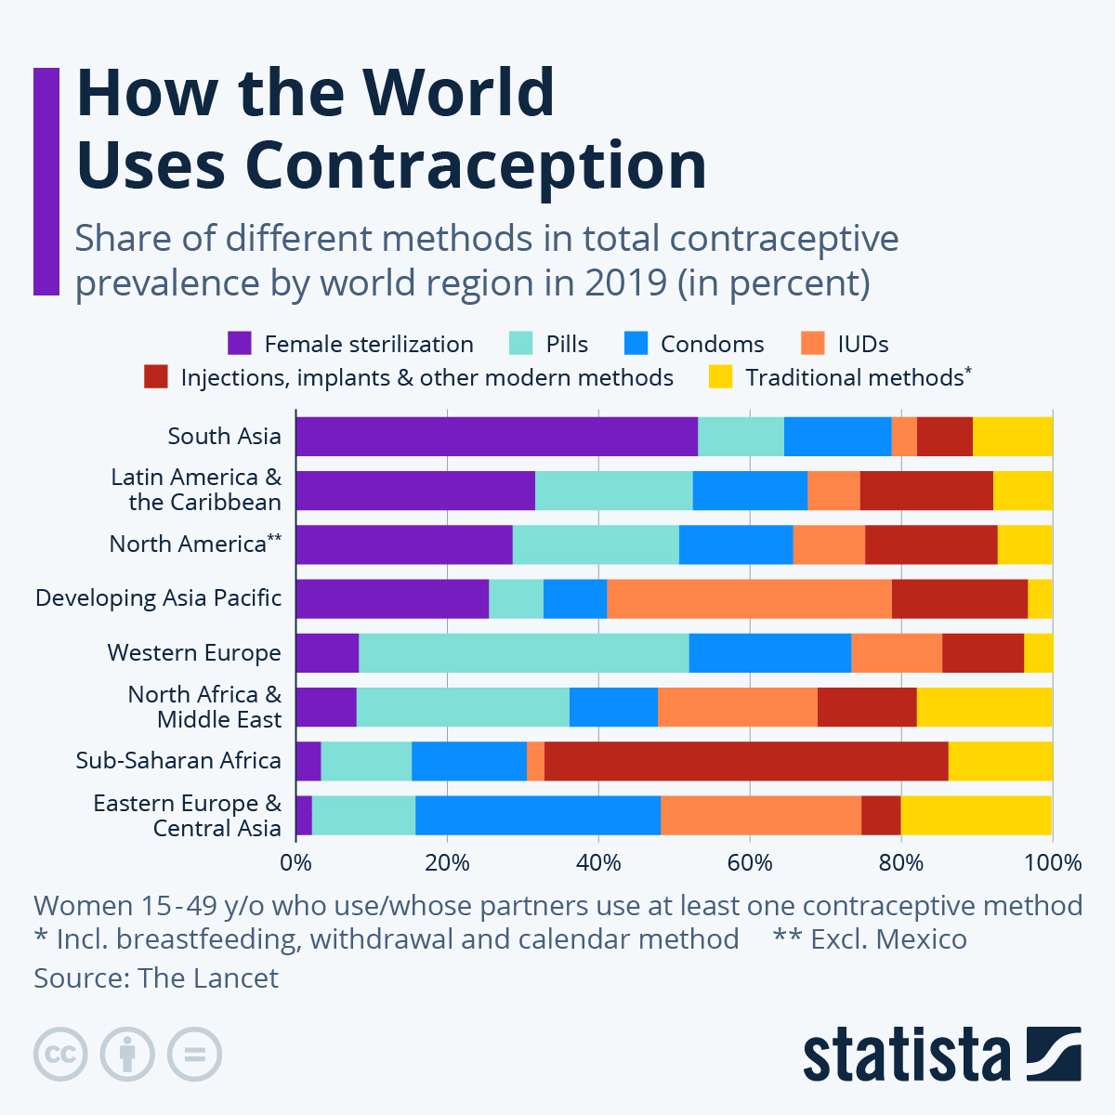
Question 6
Traditional contraceptive methods, including breastfeeding, withdrawal and the calendar method, are considered to be the least secure forms of contraception. Which region has the highest proportion of its population using traditional methods?
A: South Asia B: Eastern Europe & Central Asia C: Western Europe D: North Africa & Middle East
https://www.statista.com/chart/30907/contraceptive-use-by-type/
Notes:
Stacked bar charts can show proportions of a whole and how they change across a varying quantity such as time.
Like an area chart, they are able to demonstrate trends in proportions.

Slide 19
Question 6
Traditional contraceptive methods, including breastfeeding, withdrawal and the calendar method, are considered to be the least secure forms of contraception. Which region has the highest proportion of its population using traditional methods?
A: South Asia B: Eastern Europe & Central Asia C: Western Europe D: North Africa & Middle East
https://www.statista.com/chart/30907/contraceptive-use-by-type/
Notes:
Stacked bar charts can show proportions of a whole and how they change across a varying quantity such as time.
Like an area chart, they are able to demonstrate trends in proportions.

Slide 20
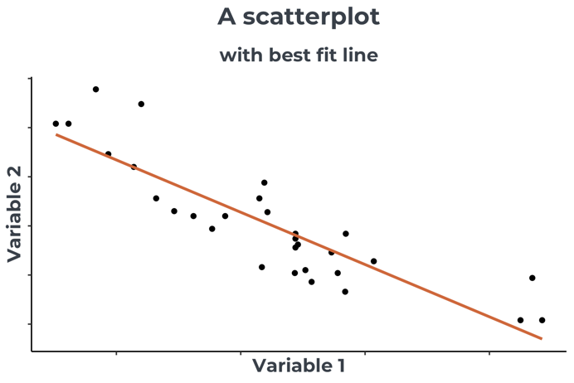
What is a scatter plot?
Scatterplots are used to show the relationship between two numerical variables. Both the x-axis and y-axis contain numerical quantities.
There is often a line of best fit added to demonstrate the relationship between the two variables.

Slide 21
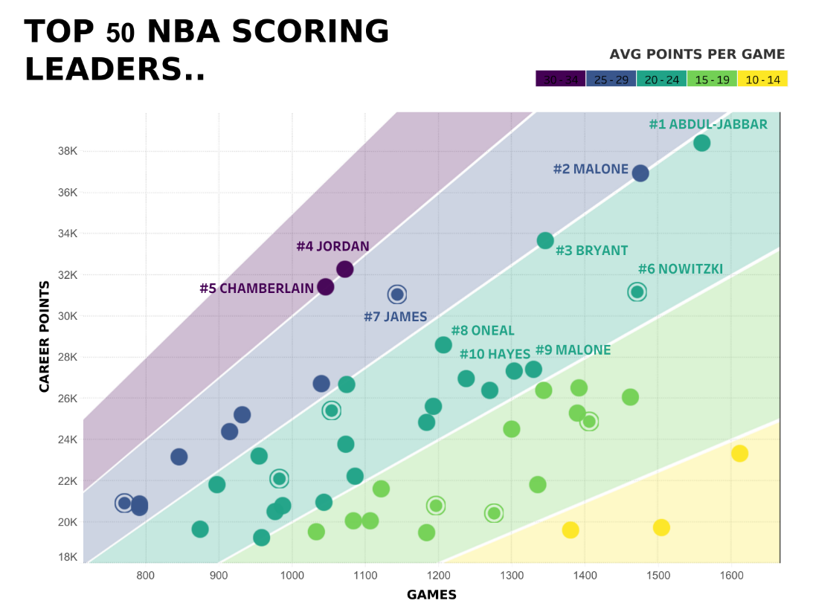
Question 7
Which two NBA basketball players have the highest average points per game? A: Abdul-Jabbar and Malone B: Nowitzki and James C: Abdul-Jabbar and Nowitzki D: Jordan and Chamberlain
https://public.tableau.com/app/profile/rody.zakovich/viz/TOP50NBASCORINGLEADERS/TOP50NBASCORINGLEADERS
Notes:
Scatterplots are used to show the relationship between two numerical variables. Both the x-axis and y-axis contain numerical quantities.
There is often a line of best fit added to demonstrate the relationship between the two variables.

Slide 22
Question 7
Which two NBA basketball players have the highest average points per game? A: Abdul-Jabbar and Malone B: Nowitzki and James C: Abdul-Jabbar and Nowitzki D: Jordan and Chamberlain
https://public.tableau.com/app/profile/rody.zakovich/viz/TOP50NBASCORINGLEADERS/TOP50NBASCORINGLEADERS
Notes:
Scatterplots are used to show the relationship between two numerical variables. Both the x-axis and y-axis contain numerical quantities.
There is often a line of best fit added to demonstrate the relationship between the two variables.

Slide 23
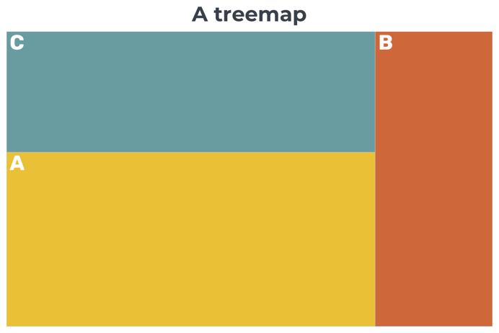
What is a treemap?
A treemap represents the proportions of a whole, but area rather than angles are used. They are useful for showing subcategories as well as high-level categories.

Slide 24
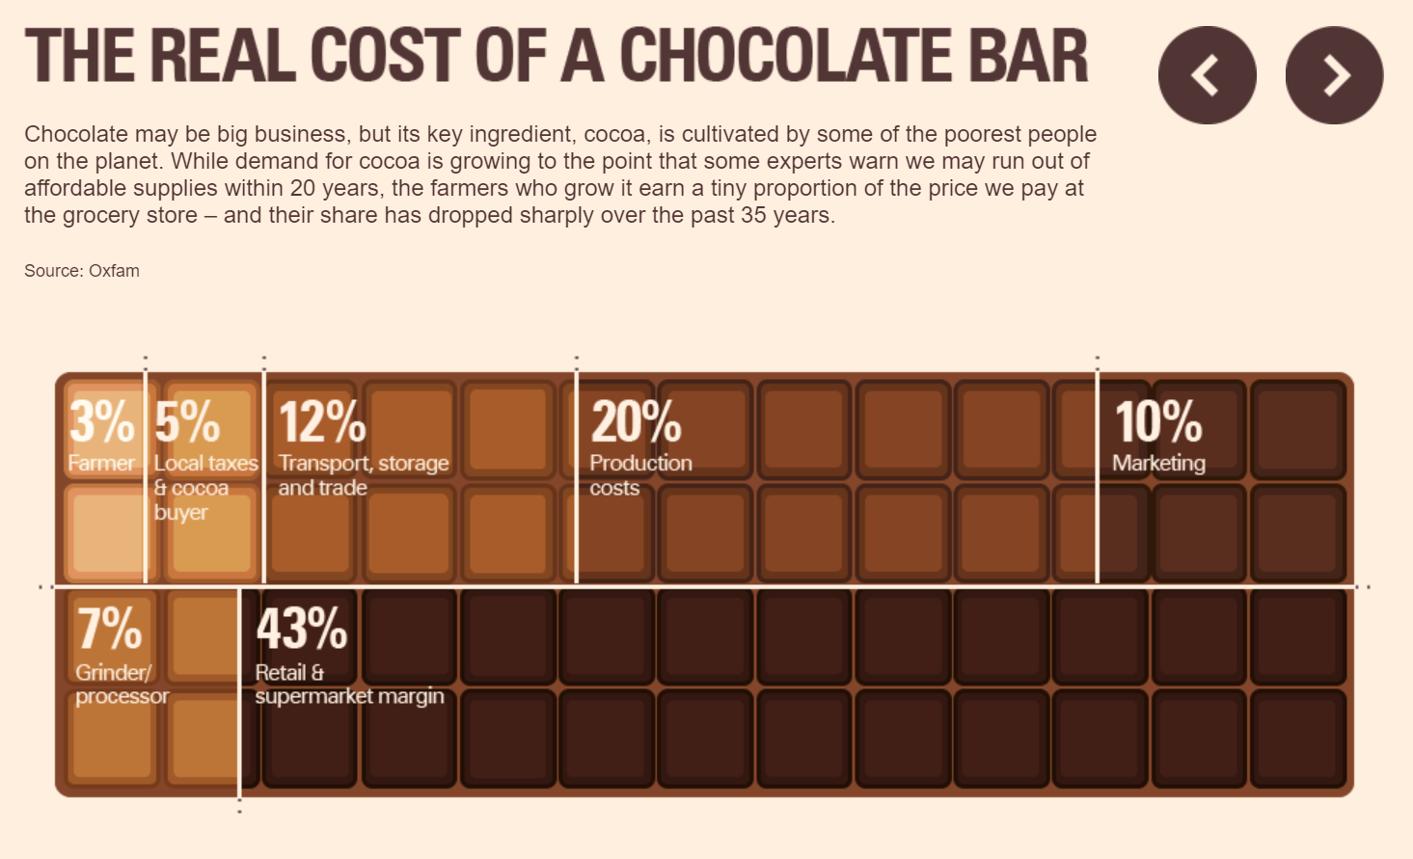
Question 8
When you buy a chocolate bar for £1, how much of the cost goes to the farmer who grew the cocoa beans? A: 12p B: 5p C: 3p D: 43p
https://malmesbury.wilts.sch.uk/wp-content/uploads/2023/07/Economics-bridging-week-1-Choconomics.pdf
Notes:
A treemap represents the proportions of a whole, but area rather than angles are used. They are useful for showing subcategories as well as high-level categories.

Slide 25
Question 8
When you buy a chocolate bar for £1, how much of the cost goes to the farmer who grew the cocoa beans? A: 12p B: 5p C: 3p D: 43p
https://malmesbury.wilts.sch.uk/wp-content/uploads/2023/07/Economics-bridging-week-1-Choconomics.pdf
Notes:
A treemap represents the proportions of a whole, but area rather than angles are used. They are useful for showing subcategories as well as high-level categories.

Slide 26
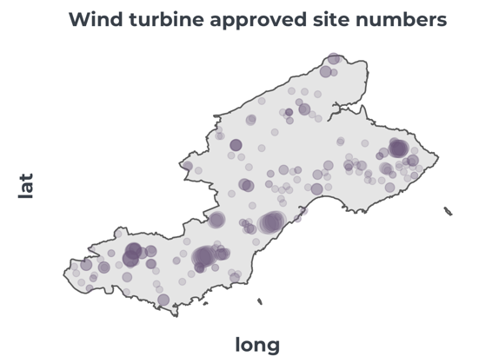
What is a bubble map?
A bubble map shows the magnitude of the variable as well as the spatial distribution of points in a geographic area.
It is good for spotting clusters, however with a large number of bubbles, they can be overplotted and make it more difficult to spot patterns.
It is not easy to extract exact values from bubble maps.

Slide 27
Question 9
What has caused food insecurity and hunger in Guatemala? A: Conflict B: Pests C: Economic shocks D: Weather extremes
https://www.visualcapitalist.com/covid-19-global-food-insecurity/
Notes:
A bubble map shows the magnitude of the variable as well as the spatial distribution of points in a geographic area.
It is good for spotting clusters, however with a large number of bubbles, they can be overplotted and make it more difficult to spot patterns.
It is not easy to extract exact values from bubble maps.

Slide 28
Question 9
What has caused food insecurity and hunger in Guatemala? A: Conflict B: Pests C: Economic shocks D: Weather extremes
https://www.visualcapitalist.com/covid-19-global-food-insecurity/
Notes:
A bubble map shows the magnitude of the variable as well as the spatial distribution of points in a geographic area.
It is good for spotting clusters, however with a large number of bubbles, they can be overplotted and make it more difficult to spot patterns.
It is not easy to extract exact values from bubble maps.

Slide 29
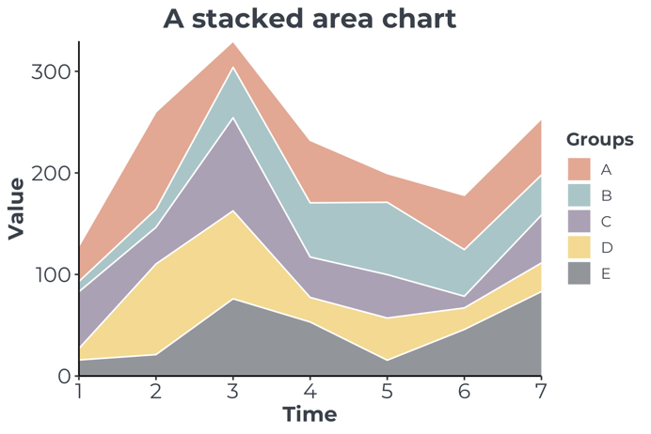
What is a stacked area chart?
An area chart or a stacked area chart highlights proportions changing over the varying quantity.
As well as raw data volumes, this can also be done as proportions of the whole, which is useful for example in demonstrating the change in survey results over time.

Slide 30
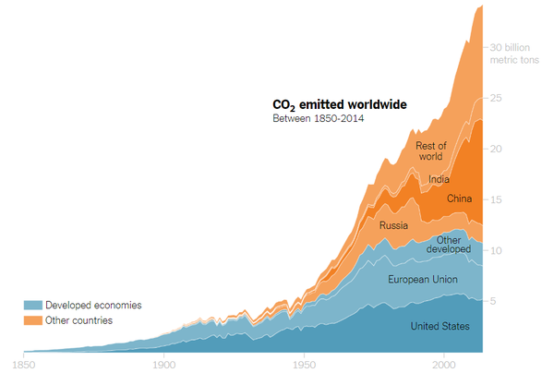
Question 10
How much CO2 is emitted by the United States in 2014? A: 5% B: 2000 C: 5 billion metric tons D: 34 billion metric tons
https://www.nytimes.com/2019/02/28/learning/teach-about-climate-change-with-these-24-new-york-times-graphs.html
Notes:
An area chart or a stacked area chart highlights proportions changing over the varying quantity.
As well as raw data volumes, this can also be done as proportions of the whole, which is useful for example in demonstrating the change in survey results over time.

Slide 31
Question 10
How much CO2 is emitted by the United States in 2014? A: 5% B: 2000 C: 5 billion metric tons D: 34 billion metric tons
https://www.nytimes.com/2019/02/28/learning/teach-about-climate-change-with-these-24-new-york-times-graphs.html
Notes:
An area chart or a stacked area chart highlights proportions changing over the varying quantity.
As well as raw data volumes, this can also be done as proportions of the whole, which is useful for example in demonstrating the change in survey results over time.

Slide 32
Well done!

