Slide 1
Spooky Data
Learning about Data using Witches!

Slide 2
What are we going to learn?
What:
I will understand what a database is and what it is used for.
I will be able to search a database for different information.
I will be able to extract information from a database and organise into an appropriate format.

Slide 3
How are we going to learn?
How:
We are going to learn more about databases by exploring The Scottish Witchcraft Trials
We will use The Scottish Witchcraft Survey and the Scottish Witchcraft database to research the stories of Scottish people accused of being witches.

Slide 4
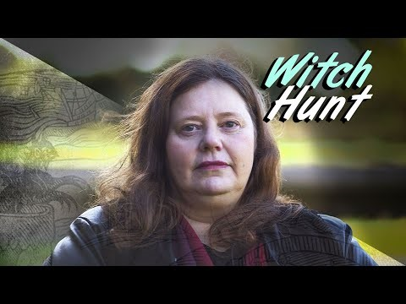
Gellis Duncan – The start of the witch trials
Video Source: The BBC

Slide 5
The Scottish Survey of Witchcraft
A group of people interested in history gathered information from books and reports.
They had computing experts help them add the information to a database.
The database is now on the internet and we can use it to learn more about witches.

Slide 6
The Scottish Witchcraft Database
A database is a way of organising data held in a computer. It allows data to be connected in different ways.
Databases are part of every day life;
The witchcraft database contains information on:
Names of accused witches
Cases of witchcraft (events or accusations)
Trial Process for witchcraft

Slide 7
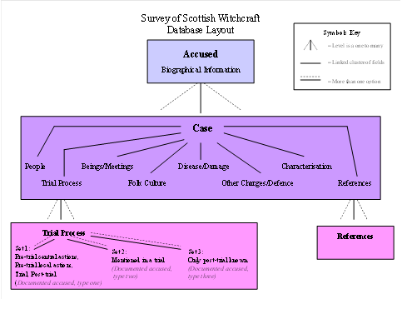
Database Layout Diagram
The diagram shows how the data is related.
What can you understand from the diagram?
What biographical information is stored in the database?
Credit: The Scottish Witchcraft Database

Slide 8
Activity 1- Witchcraft in Scotland
Read http://www.shca.ed.ac.uk/Research/witches/introduction.html
Find out the following:
How many accused witches were women and how many were men?
What was the average age of most of the accused witches?
What was the name of the law that was used to prosecute accused witches?
Write down one other thing you found interesting

Slide 9
Activity 2 – Find out more about Gellis Duncan
Use the Scottish Witchcraft Database and read more about the Gelie Duncan case (Note the alternative spelling of her name)
http://witches.shca.ed.ac.uk/index.cfm?fuseaction=home.accusedform

Slide 10
Activity 2 – Find out more about Gellis Duncan
Look at the information about Gelie Duncan and the Database layout diagram and do the following:
Identify biographical data. Update the database diagram; show the different data stored for an accused witch.
Identify case data. How many different examples of case data are noted?
Identify Trial Process Data. Which sets of data are shown in her record?

Slide 11
Activity 3 – Data Mapping
Use Scottish Witchcraft Maps to understand more about Scotland’s witches. https://witches.is.ed.ac.uk/timeline/
Find out:
How many witches lived in your town?
Look at the map what do you notice about where the witches lived?
Select a place where an accused witch lived and use www.googlemaps.com to compare the map today with

Slide 12
Activity 4 – Data over time
Use the timeline map (https://witches.is.ed.ac.uk/timeline/), click filter to show different ways you can view the data.
Which time period had the most trials? (each 25 year block)
What happened to the number of witch trials over time?
Explore the impact of social class. What do you notice?
Use the filter to find a witch that has a Wikipedia page. Make notes on your chosen witch and be ready to explain to the class.

Slide 13
Activity 5 – Searching & Organising data
Use the witchcraft database to research the following witches.
http://witches.shca.ed.ac.uk/index.cfm?fuseaction=home.accusedform
Select 3 bits of data and create a summary table of information.

Slide 14
Activity 5 – Searching & Organising data
Some things to consider:
Find out about the other people involved in the case
What witchcraft were they accused of?
Was there a trial?
What happened to the accused witch?

Slide 15
Activity 6 – Witch Hunters
Learn more about the Witch Hunters by following the story of John Kincaid. Start by looking him up. What can you find out?
Now use the interactive map to follow his story: https://witches.is.ed.ac.uk/john/
Explore the stories noted in the map and use the database to search for people, places trials.
Decide what you think is them most interesting part of the story and be ready to talk to the class.

