Slide 1
Dear Data
Lesson 2: What’s the story?

Slide 2
Starter Task: From last week, what depth questions could you ask for these topics?
The emotions you feel
The sounds you hear

Slide 3
Learning Intentions
To find a story in the data collected
To complete a more complex tally chart
Use a more complex tally chart to explore your data for unusual patterns

Slide 4
Success Criteria
Found a story in your data
Worked on (hopefully completed) your complex tally chart
Identified any unusual data in your collection

Slide 5
A simple visualisation

Slide 6
Finding the question for your visualisation
What you did
Where you did it
The size of books you own
How much you have drunk
The clothes you wear (or don’t)
Where you spend your time
What do you do with your days
Where you keep your books
The answer to the question will be shown in our visualisation.
To get started we are going to find how many unique answers there are to each of our data depth questions.

Slide 7
Step 1: Analyse Level 1
Make a copy of the table on the right.
The first question was:
How did I consume the media?
Look at the example answers on the next slide. There are 4 possible answers in Level 1.
Enter the number 4 in your table at Level 1

Slide 8
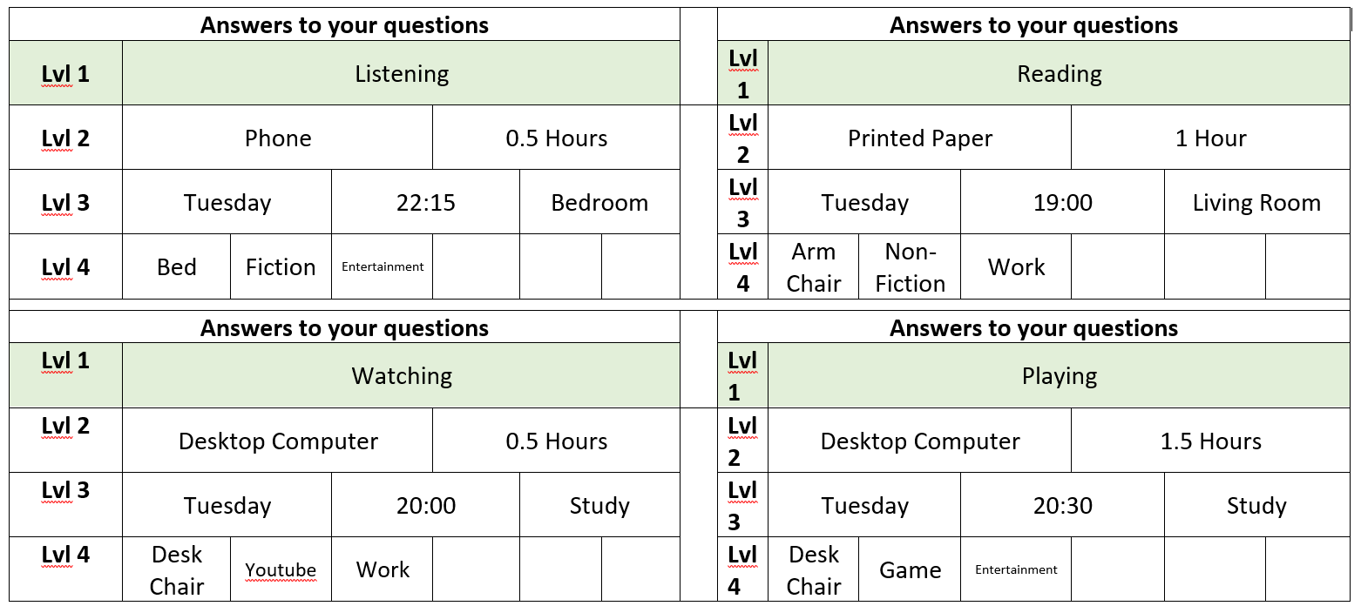
Example Answers – How did I consume the media?

Slide 9
Step 2 – Analyse Step 2
The second question was:
What did I consume the media on?
Look at the example answers on the next slide. There are 8 possible answers in Level 2.
Enter the number 8 in your table at Level 2

Slide 10
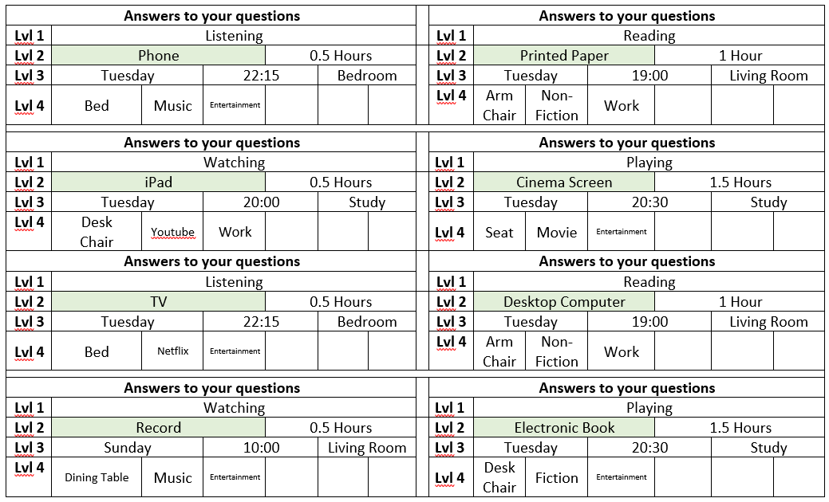
Example Answers – What did I consume the media on?

Slide 11
Finish your analysis
Continue the same way through all your questions.
Sometimes you may want to group data rather than collecting individually for example
times(06:15, 15:00, 22:00) to time of day (morning, afternoon, night)
Duration into <2hours 2 to 4 hours 5+ hours
Once you have finished analysing your data you have a simple visualisation like this

Slide 12
A more complex tally chart

Slide 13
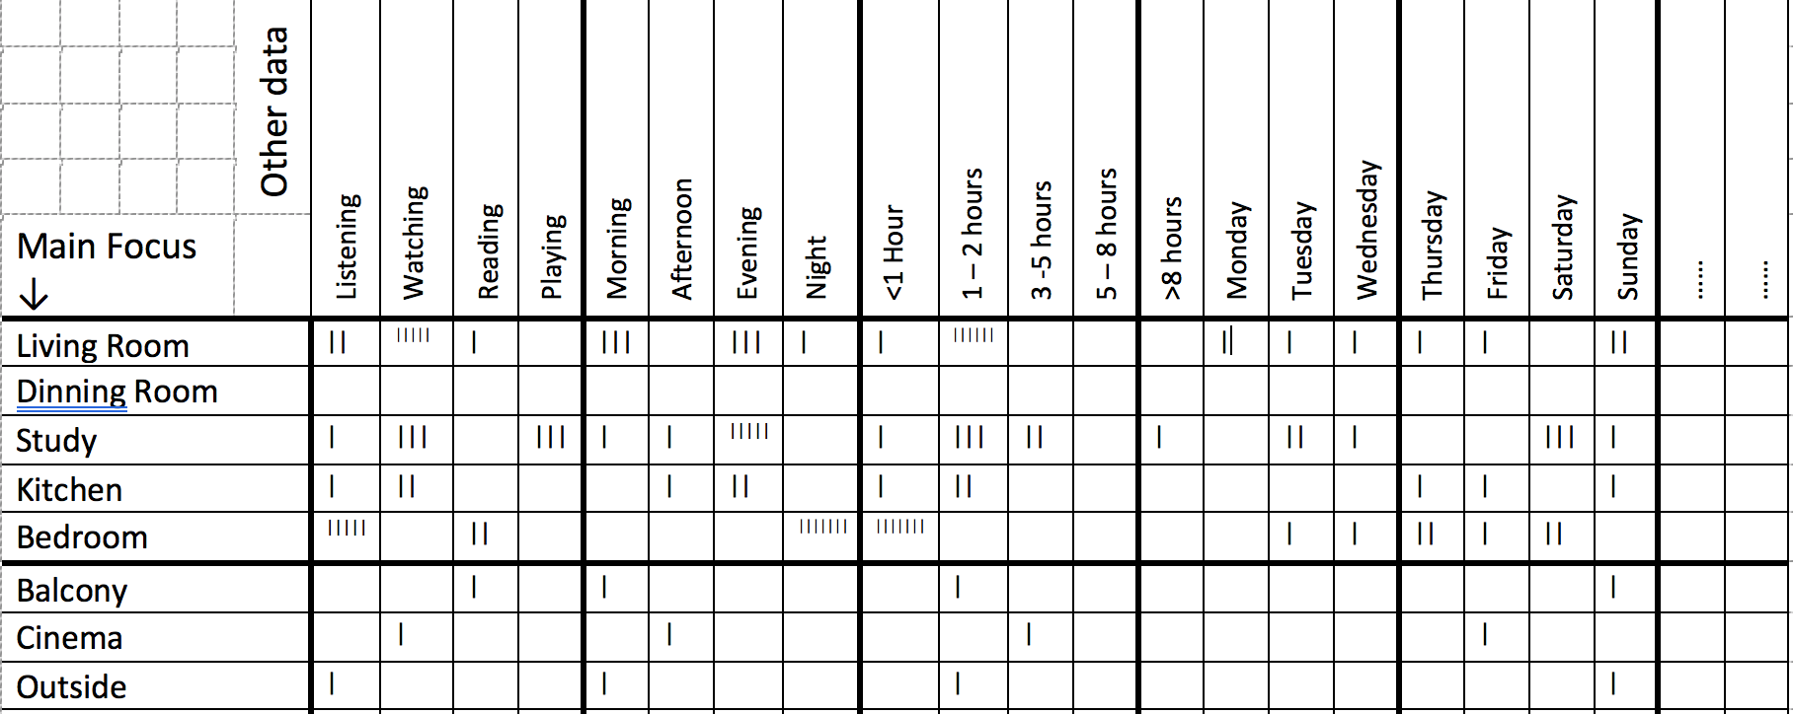
Our Goal
We are going to create a more detailed tally chart.
What do you think it is telling you?
Our goal is to make one of these for the data you collected in part 1.
Dining Room

Slide 14
Step 1 – What is our main question?
The first focus is on the question we are going to create our visual around.
These are the two areas of the sheet to focus on with this task.
Lets look at some examples with the sample data

Slide 15
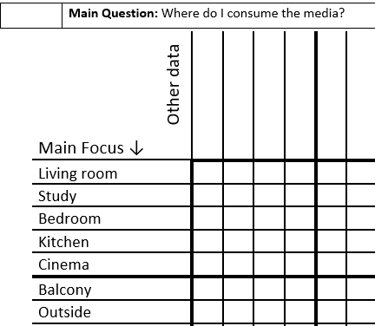
Main Focus on location
Look through the answer cards and find the unique answers to the “where” question.
Put these answers in the main focus column

Slide 16
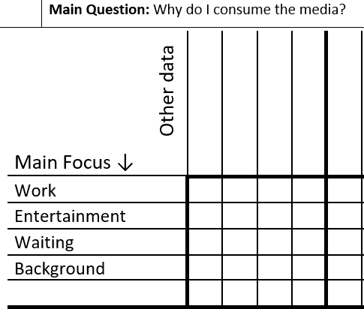
Main Focus on why
Another way to look at the data is to change our main focus to answer the question “why did I consume the media”
Look through the answer cards and find the unique answers to the “why” question.
Put these answers in the main focus column

Slide 17
Step 2 – Adding more data
The next focus is on the answers to the unique answers to the other questions
The top row of the sheet will be used to add this new information
Lets look at some examples with the sample data (using the location main focus)
Living Room

Slide 18
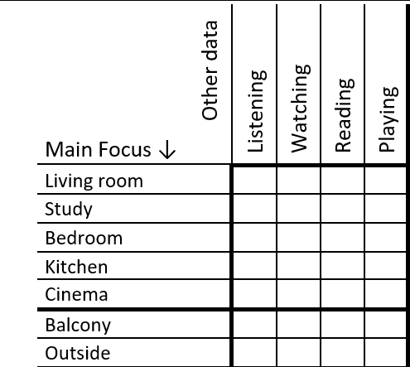
Step 2 – How I consumed the media
Start with the example where the main focus is location.
Add the answers to the “how” question to the top row of the table.

Slide 19
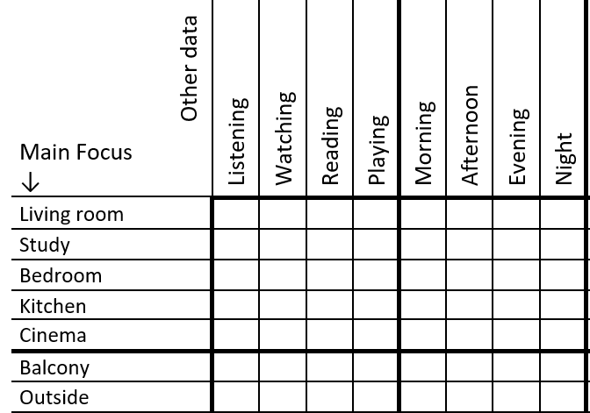
Step 3 – When did I consume the media?
Now add the answers to the question “When did I consume the media”

Slide 20
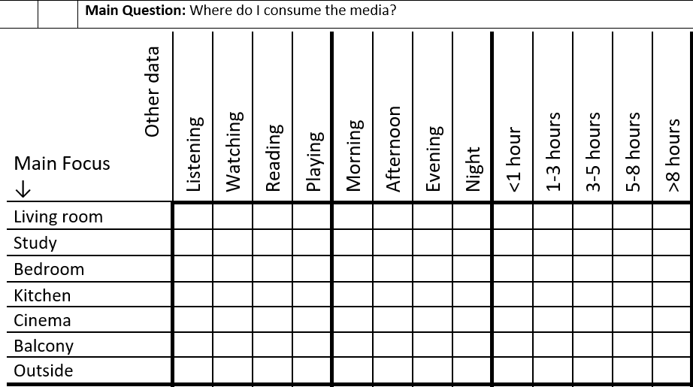
Step 4 – For how long did I consume the media?
Now add the answers to the question “For how did I consume the media?”
Carry on adding information to the table until you have the answers to all your remaining questions along the top row

Slide 21
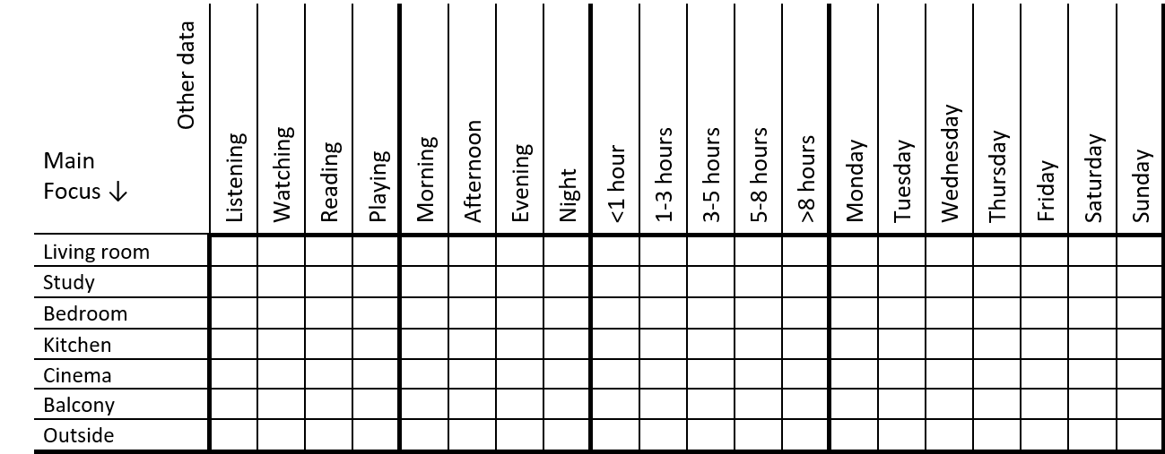
Step 4 – Preparing to add the data
The next focus is tallying all the combinations of data so that we can find something interesting in the data.
Start with your empty table as shown here.

Slide 22
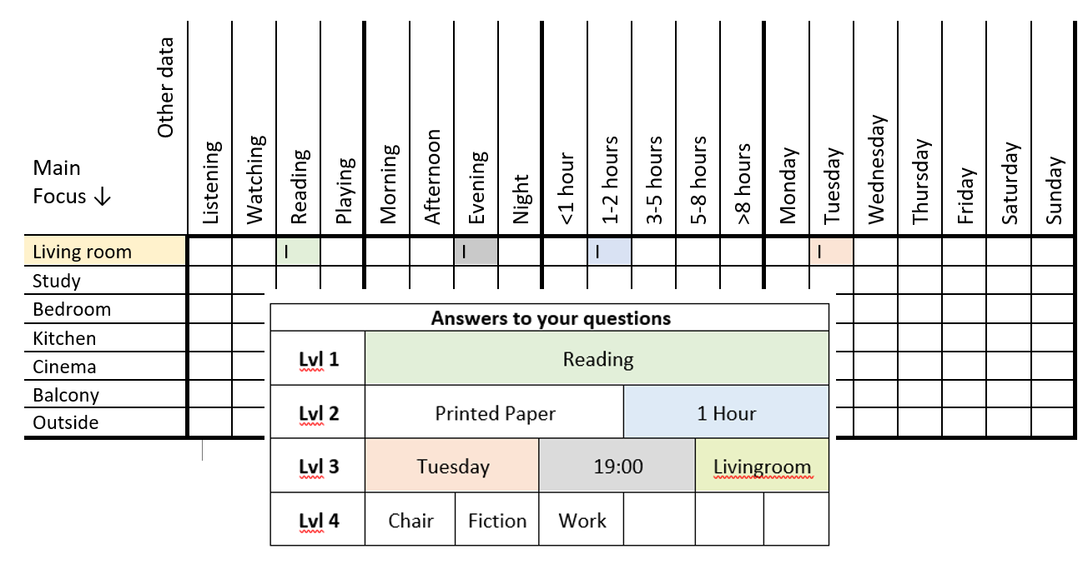
Step 5 Reviewing answers and adding the data
Review each set of answers and add the data to your empty table.
Repeat the steps until you have added answers from all your cards to the tally chart

Slide 23
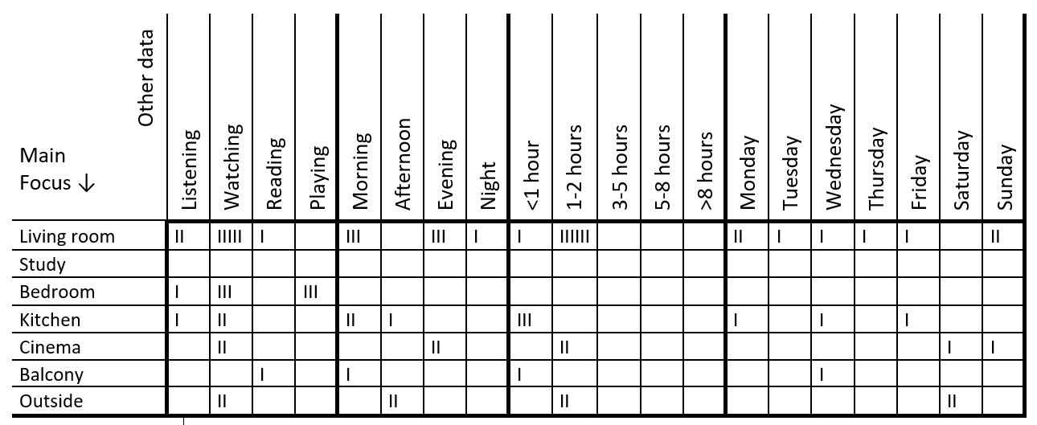
Continue until all your data is in the tally chart!

Slide 24
TASK: Tallying your homework data
Using the sheet and the examples we have looked at create a tally of the data you collected for homework

Slide 25
Missing (or extra) Data, is it important?
During the week that you collected data did anything happen that changed the data you collected?
For example:
A holiday may increase the amount of media consumed on a day compared to the norm
A family dinner out may lead to a day when there is less phone usage compared to the norm
These should be noted in our final visualization if they effect the chosen data, the example data has very little for Monday as there was an event attended all day.

Slide 26
TASK: Unusual Data
Is there any unusual data in your collected data?
If there is note it on your sheet somewhere to remind you when you start on your visualizations.
Finish you tally chart of data

