Slide 1
Dear Data
Lesson 3: What is it going to look like?

Slide 2
Learning Intentions & Success Criteria
Learning Intentions:
How to find your interesting data within the tally chart
Success Criteria
Identified the interesting data in your tally chart
Designed three concepts to represent your data
Designed to layouts on how to divide your final visualisation

Slide 3
Finding something interesting in the tally chart
A piece of data is interesting if:
That data is bigger than the other data in its category
That data is smaller than the other data in its category
All data in a category is the same (or exceptionally close to it)
TASK: Bearing these three things in mind what stands out in your tally chart, circle the column of that category of data.
Discuss your interesting data with your group and be ready to tell the class

Slide 4
Planning your visualisation theme concept
You are going to experiment with ways to represent your data in a visualisation, without worrying about the actual data
This process will involve:
Choosing a theme for your visualisation (or pick a random theme)
Sketching how that theme could be used to convey data
We are going to look at some theme examples and how they can be changed to show data

Slide 5
Example of concept plan: Theme leaves
What can we change about a leaf to show data?
The colour of the leaf
The size of the leaf
The Shape of the leaf
There are many more (including angle of leaf, number of points, number of veins inside, pattern of the leaf … …)
Notes:
Change data carried - in to be Information can be shown by changing the

Slide 6
Example of concept plan: Theme lines
What can we change about a line to show data?
The pattern of the line

Slide 7
What can we change about a line to show data?
Thickness
Angle
End
There are many more (colour of the line, length of the line, bump in the line

Slide 8
TASK: Your three concept designs
Choose a theme (or select from the options)
Develop the concept for your theme:
As many changes as you can think of shown in a colour sketch as in the examples we just looked at

Slide 9
Dividing your visualisation into sections
Now that we know how we can use our theme to show data, we are going to think about how we show our main focus in our visualisation.
This involves dividing the visualisation into sections (1 for each answer to the main focus questions.

Slide 10
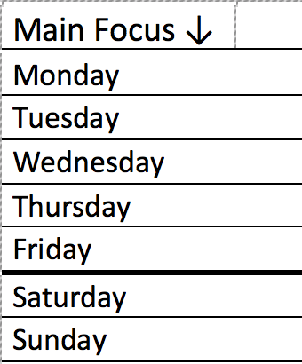
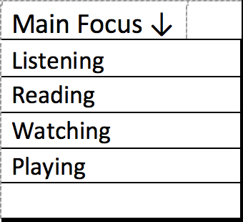
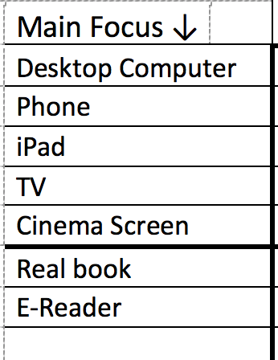
STEP ONE: How many sections?
From the sample data set:
4 Sections
7 Sections
7 Sections

Slide 11
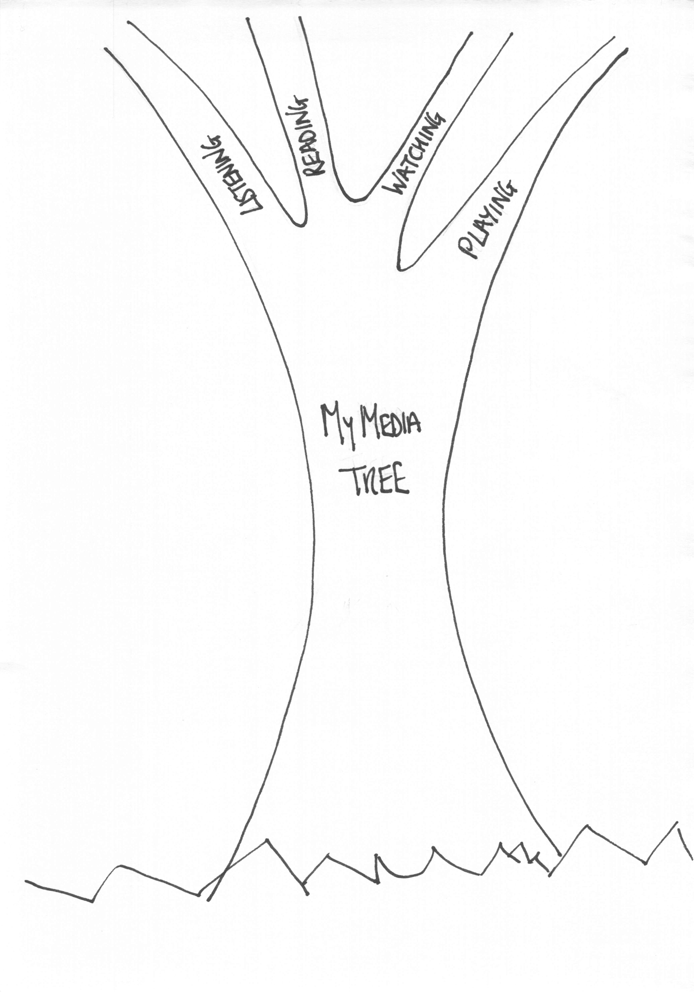
STEP TWO: Sections to match the theme
Themed sections for the leaves theme:
Trees have leaves, each branch could be a main idea

Slide 12
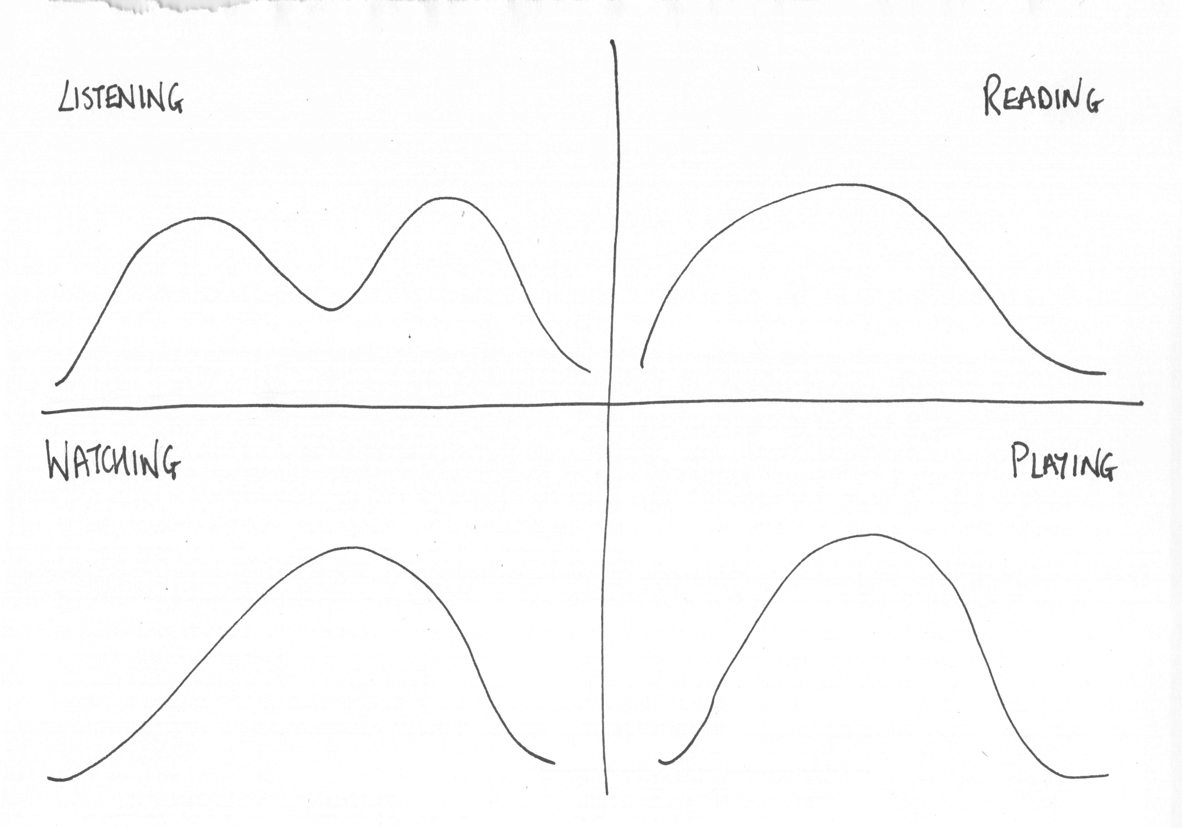
Piles of leaves as a theme
Themed sections for the leaves theme:
Trees have leaves, each branch could be a main idea
Trees lose their leaves in autumn, so piles of leaves one for each main focus

Slide 13
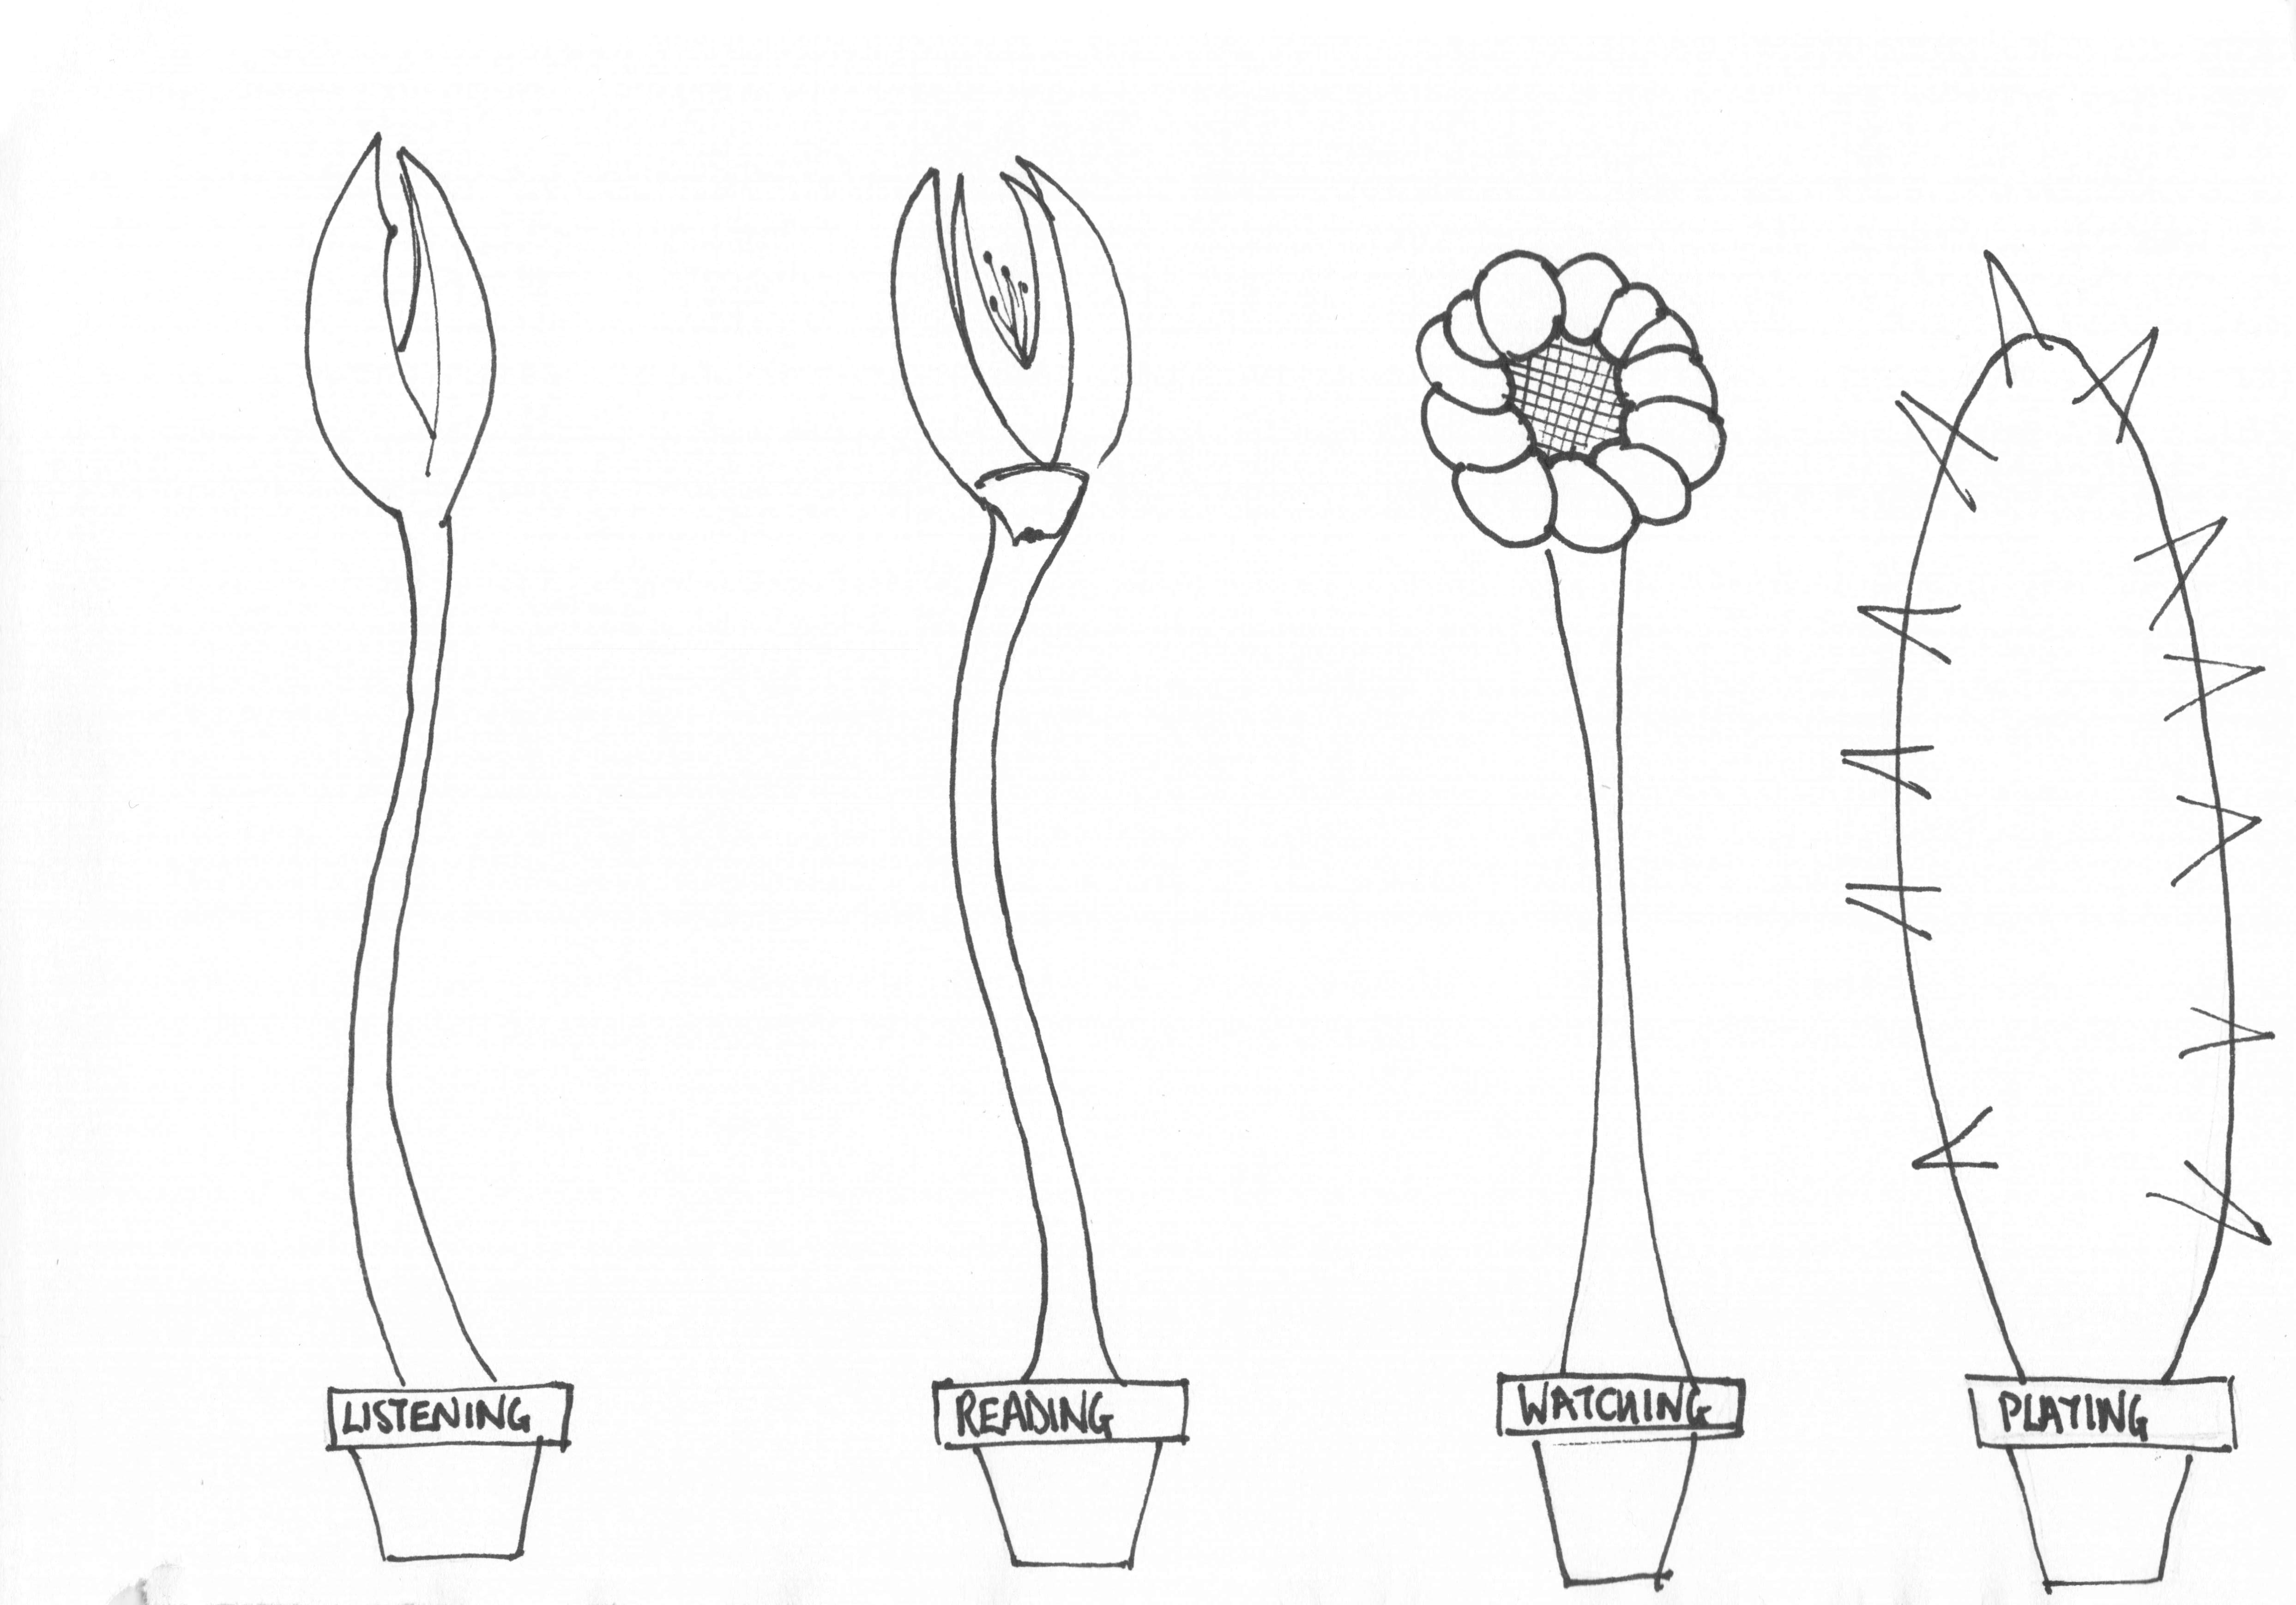
Plants as a theme
Themed sections for the leaves theme:
Trees have leaves, each branch could be a main idea
Trees lose their leaves in autumn, so piles of leaves one for each main focus
Plants have leaves each plant could be a main focus

Slide 14
Summary of theme ideas
Themed sections for the leaves theme:
Trees have leaves, each branch could be a main idea
Trees lose their leaves in autumn, so piles of leaves one for each main focus
Plants have leaves each plant could be a main focus
There are more ideas for you to find …

Slide 15
Different ideas for different topics
Themed sections for a theme of cars:
Roads have cars, each lane could be a main focus
Car parks have cars, each area of the car park could be a main focus
Themed sections for a theme of houses:
Streets have houses, each street could be a different main focus
Cities have blocks of houses, each block could be a different main focus

Slide 16
TASK: Create your own visualisation
Create your own visualisation for the data you have in your tally chart. Think about:
How many different items are in your main category?
how you are going to divide your visualisation to allow that many sections?
Now complete your visualisation

