Slide 1
Dear Data
Lesson 5: The Visualisation Comes together

Slide 2
Using the key
To create a successful visualisation the data we collected needs to be identifiable.
Last time we created a key, now we will use the key to translate our data into a visualisation element.

Slide 3
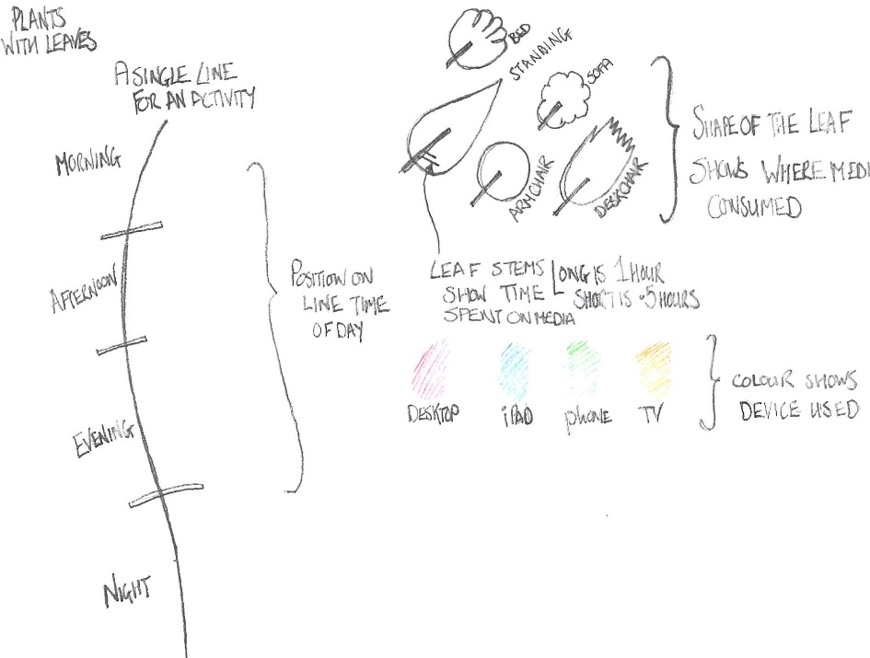
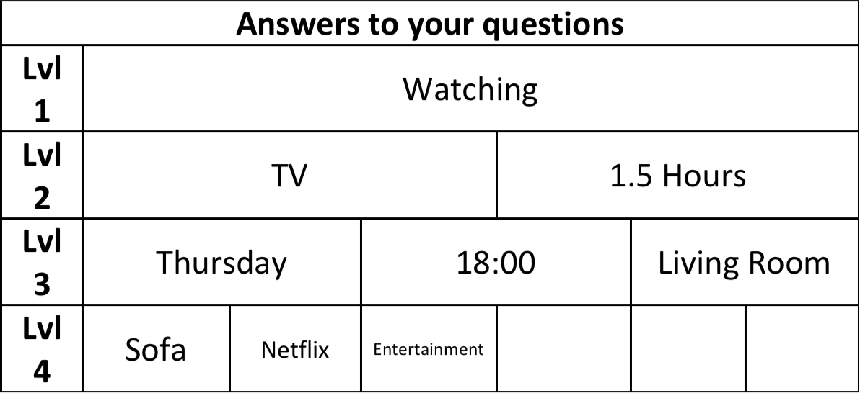
Some Practice
Using this key what would this data look like?

Slide 4
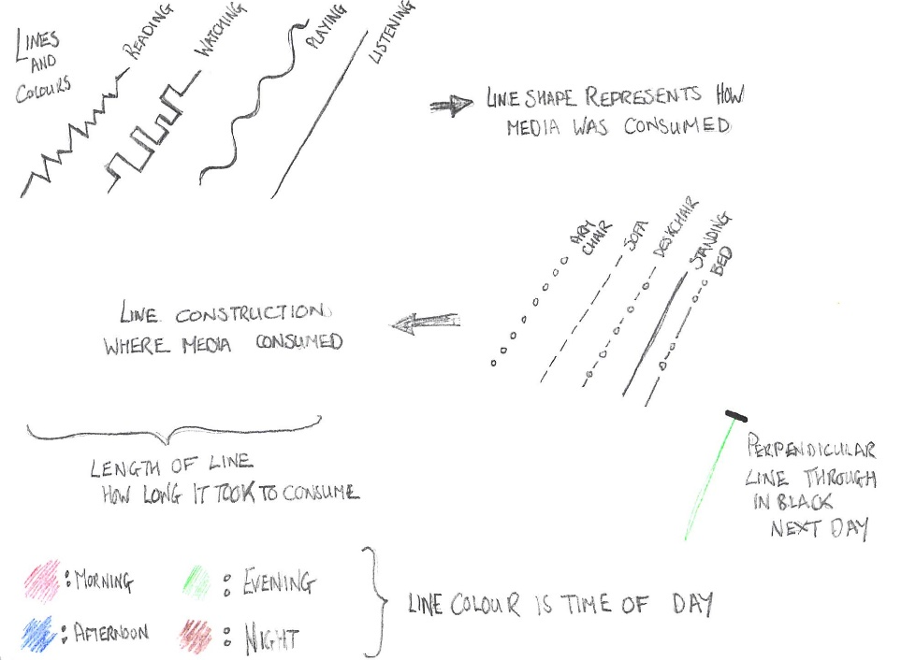
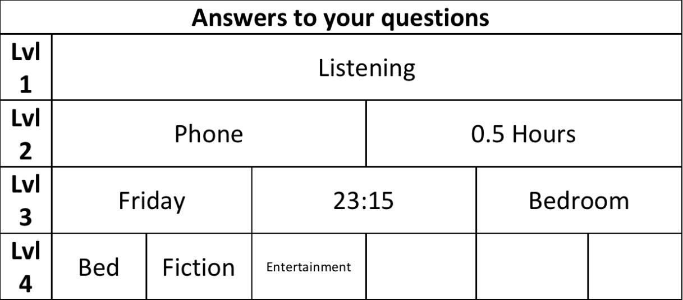
Some Practice
Using this key what would this data look like?

Slide 5
Your TASK:
Finish your key, make sure that every combination of data can be represented by your key
THEN
Start on your visualisation, each of the pieces of data in your homework (collections of answers) should be able to be identified using your final visualisation and your key.
Take you time sketch lightly with a pencil first and make sure you can fit everything in

