Slide 1
Zero-Waste Data Physicalisation

Slide 2
Zero-Waste Data Physicalisation
…or Fizzy Data?!

Slide 3
Mean Appropriateness Ratings
Here’s your data!
 | Kiss | Eat | Fight | Cry | Laugh
Class | 2 | 4 | 1 | 2 | 6
Date | 9 | 8 | 4 | 3 | 8
Bus | 4 | 5 | 2 | 3 | 7
Family dinner | 5 | 8 | 2 | 3 | 7
Park | 8 | 8 | 3 | 5 | 8
Job Interview | 1 | 2 | 1 | 1 | 6
Bar | 5 | 8 | 2 | 3 | 8
Lift | 5 | 5 | 2 | 3 | 7
Toilets | 3 | 2 | 2 | 5 | 6
Pick one or two aspects, like a location or a behaviour
Can you represent this information in a fun, interesting way?
Notes:
Your group should choose an aspect or a couple of aspects of the data and represent that physically using the objects available to you.

Slide 4
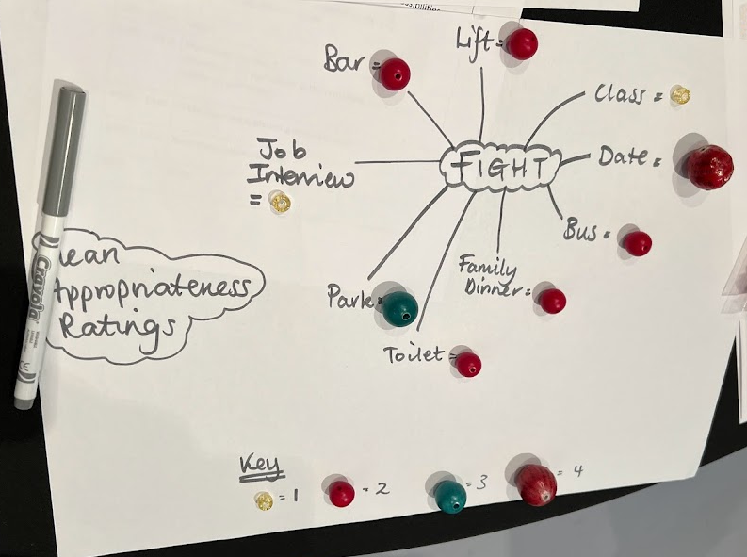
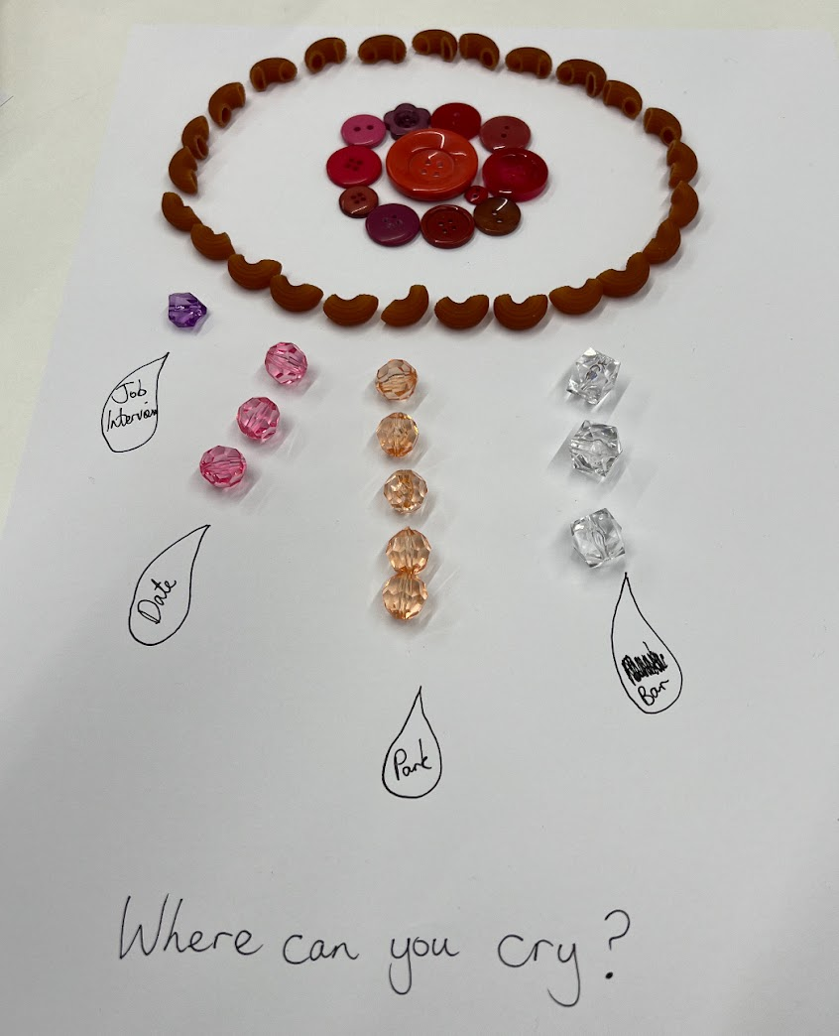
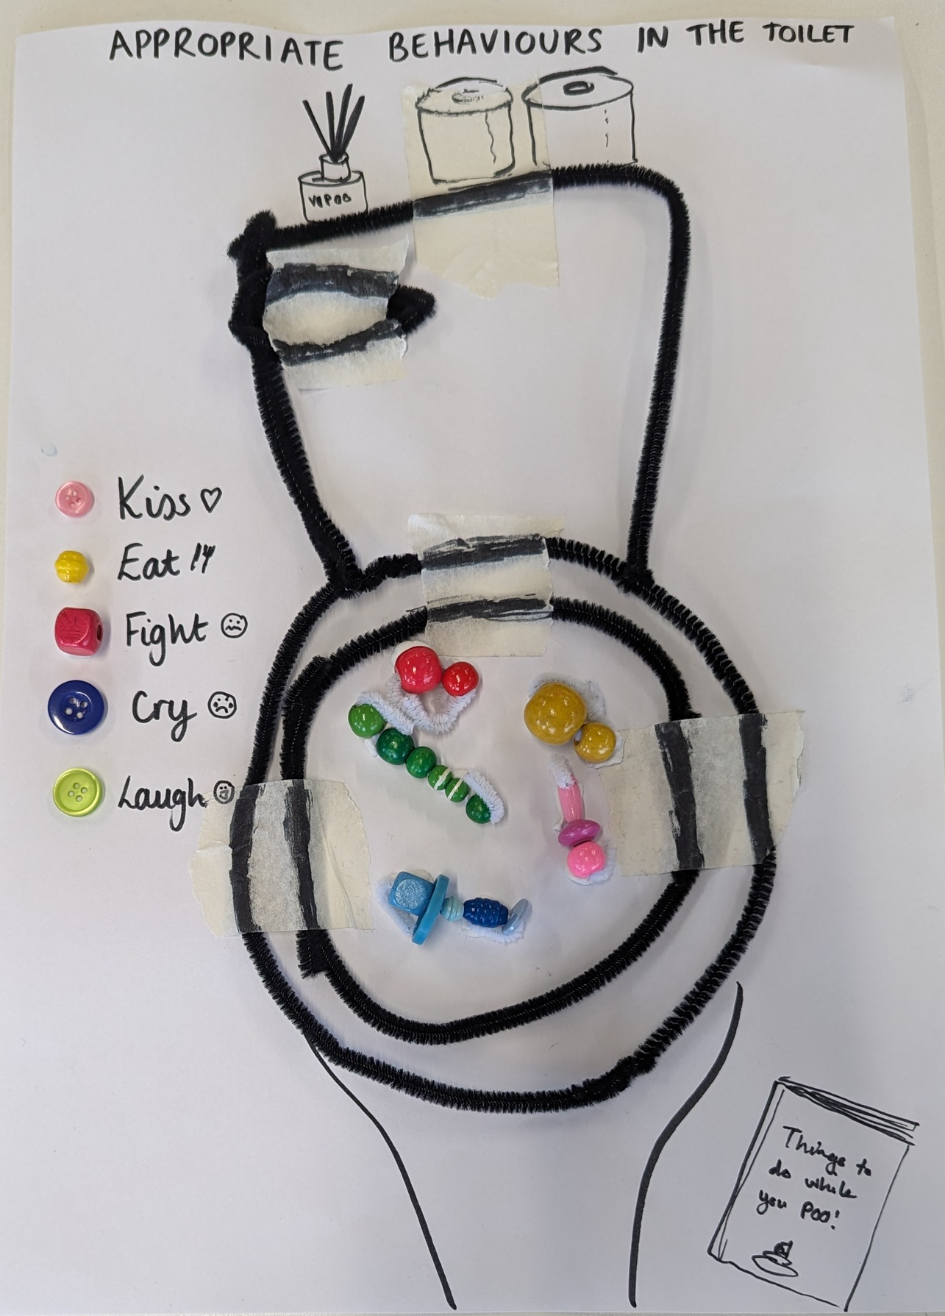
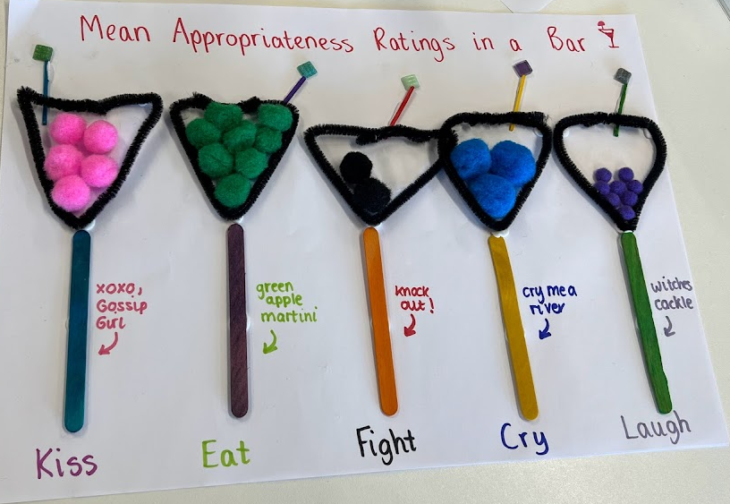
You could draw a data viz…
Notes:
Your group should choose an aspect or a couple of aspects of the data and represent that physically using the objects available to you.

Slide 5
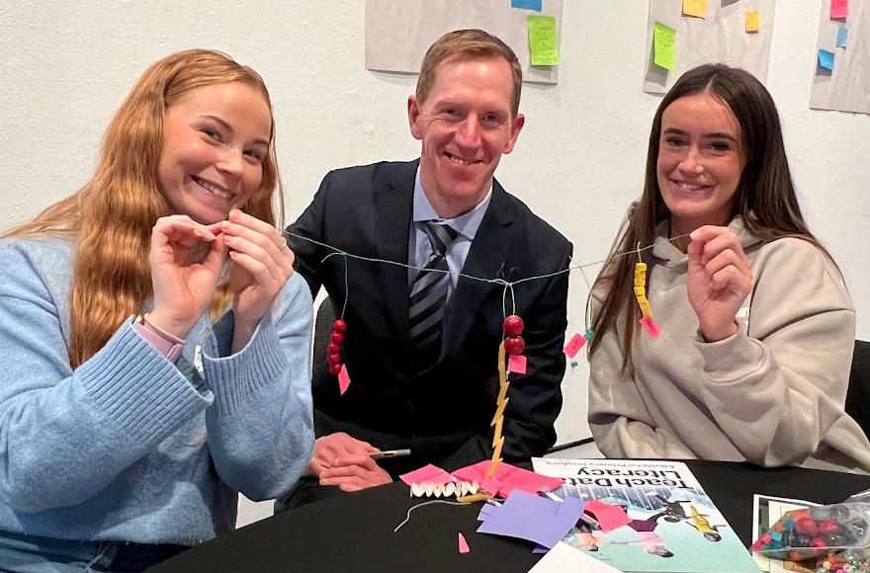
You could make jewellery or a mobile…
Notes:
Your group should choose an aspect or a couple of aspects of the data and represent that physically using the objects available to you.

Slide 6
You could make shapes…
Appropriate dinner behaviour as a napkin and napkin ring
Appropriate places to eat shown on a giant paper fork
Notes:
Your group should choose an aspect or a couple of aspects of the data and represent that physically using the objects available to you.

Slide 7
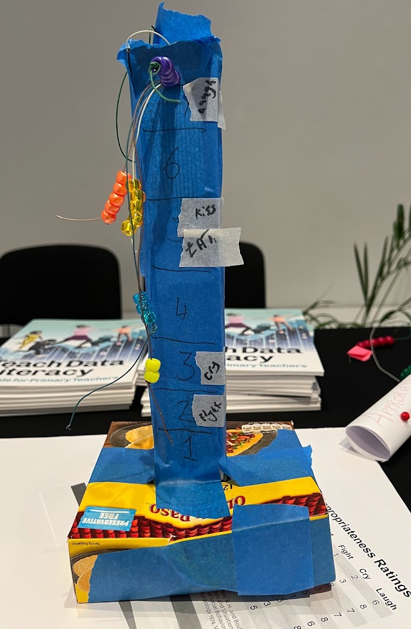
…or you could make sculptures!
Physical line graph showing appropriate things to do on a date or in class
Appropriate behaviours in a lift, shown as different floors
Notes:
Your group should choose an aspect or a couple of aspects of the data and represent that physically using the objects available to you.

Slide 8
Mean Appropriateness Ratings
 | Kiss | Eat | Fight | Cry | Laugh
Class | 2 | 4 | 1 | 2 | 6
Date | 9 | 8 | 4 | 3 | 8
Bus | 4 | 5 | 2 | 3 | 7
Family dinner | 5 | 8 | 2 | 3 | 7
Park | 8 | 8 | 3 | 5 | 8
Job Interview | 1 | 2 | 1 | 1 | 6
Bar | 5 | 8 | 2 | 3 | 8
Lift | 5 | 5 | 2 | 3 | 7
Toilets | 3 | 2 | 2 | 5 | 6
Notes:
Your group should choose an aspect or a couple of aspects of the data and represent that physically using the objects available to you.

Slide 9
Finished?
Take a photo of your artwork. Please share it: @data_schools #fizzydata
What other tables of data could you use with learners?
Tidy the materials back into the kit. How much waste do you have that can’t be reused or recycled?
What materials could you gather to make your own zero waste physical data kits?
Notes:
Your group should choose an aspect or a couple of aspects of the data and represent that physically using the objects available to you.

