Slide 1
Appropriate behaviours for different places
Create a data physicalisation!
Here’s the data!
Pick one or two aspects, like a location or a behaviour
 | Burp | Eat | Jump | Cry | Laugh
Class | 2 | 4 | 2 | 2 | 6
Bus | 2 | 5 | 3 | 3 | 7
Family dinner | 3 | 8 | 2 | 3 | 7
Park | 5 | 8 | 7 | 5 | 8
Job Interview | 1 | 2 | 1 | 1 | 6
Lift | 3 | 5 | 2 | 3 | 7
Toilets | 5 | 2 | 4 | 5 | 6
Can you represent this information in a fun, interesting way?
0 is not at all appropriate in that place, 9 is really appropriate in that location
Notes:
Your group should choose an aspect or a couple of aspects of the data and represent that physically using the objects available to you.

Slide 2

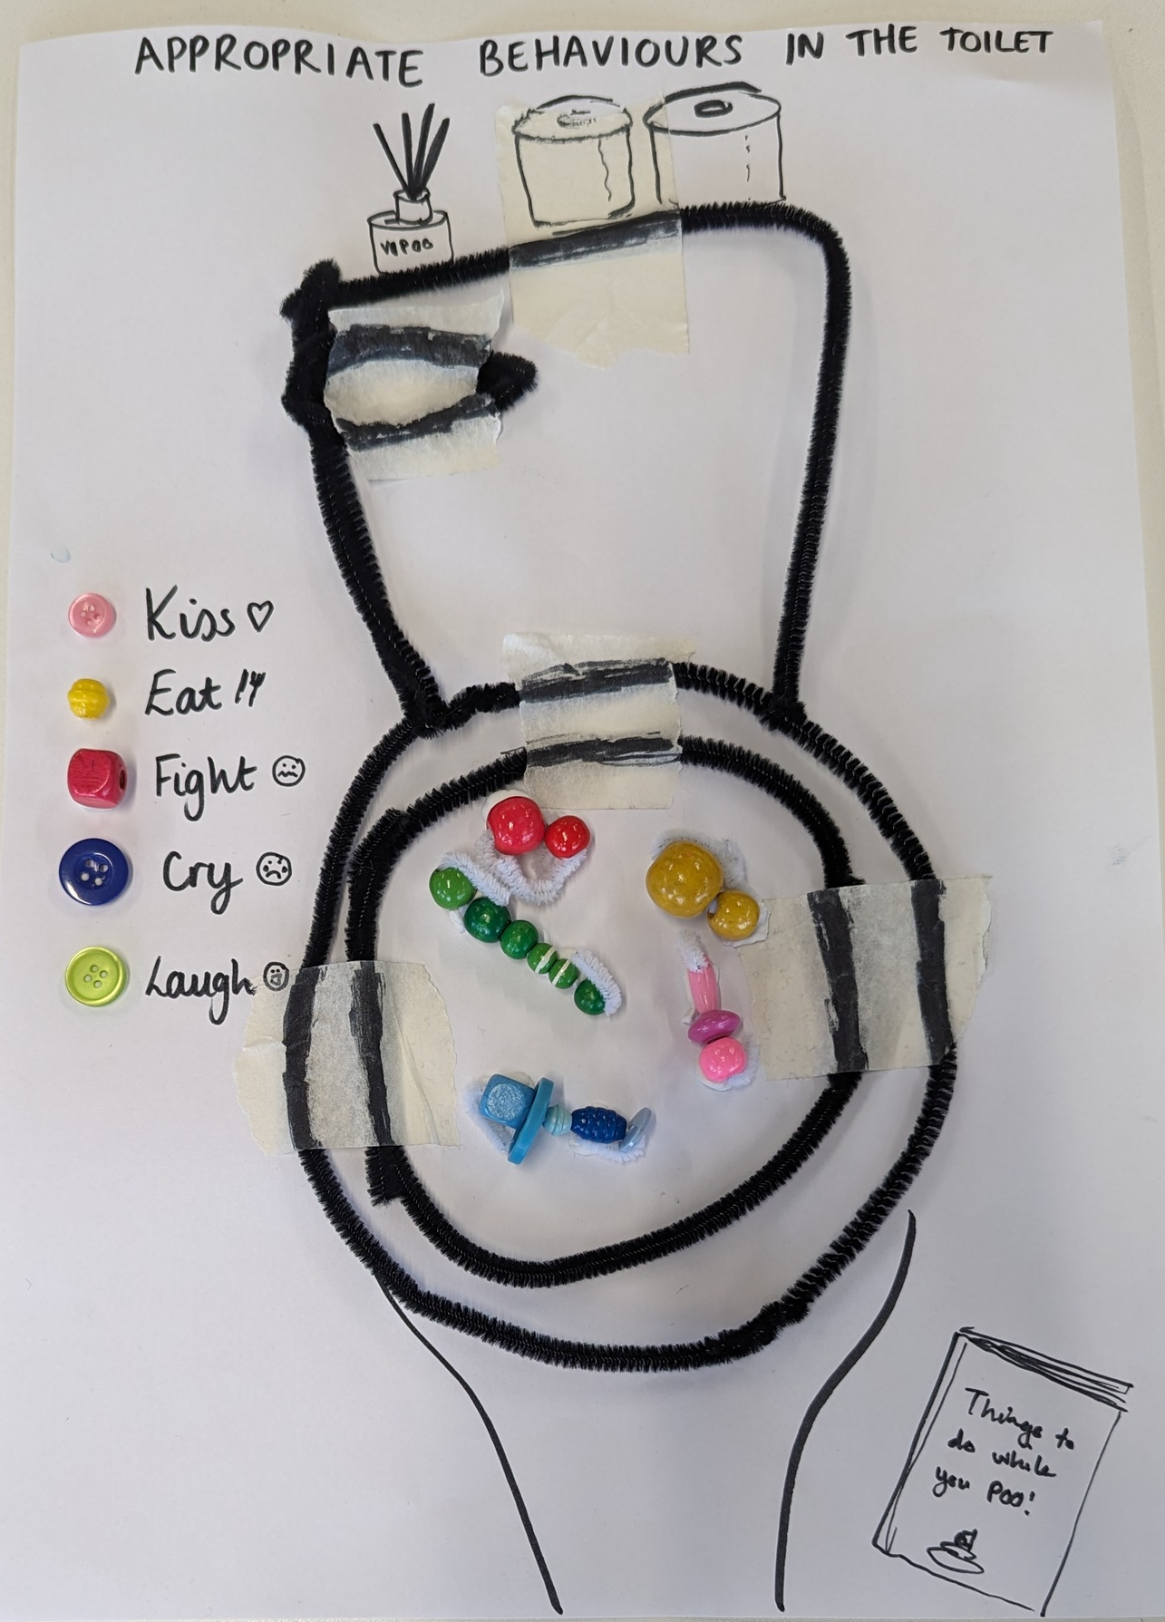
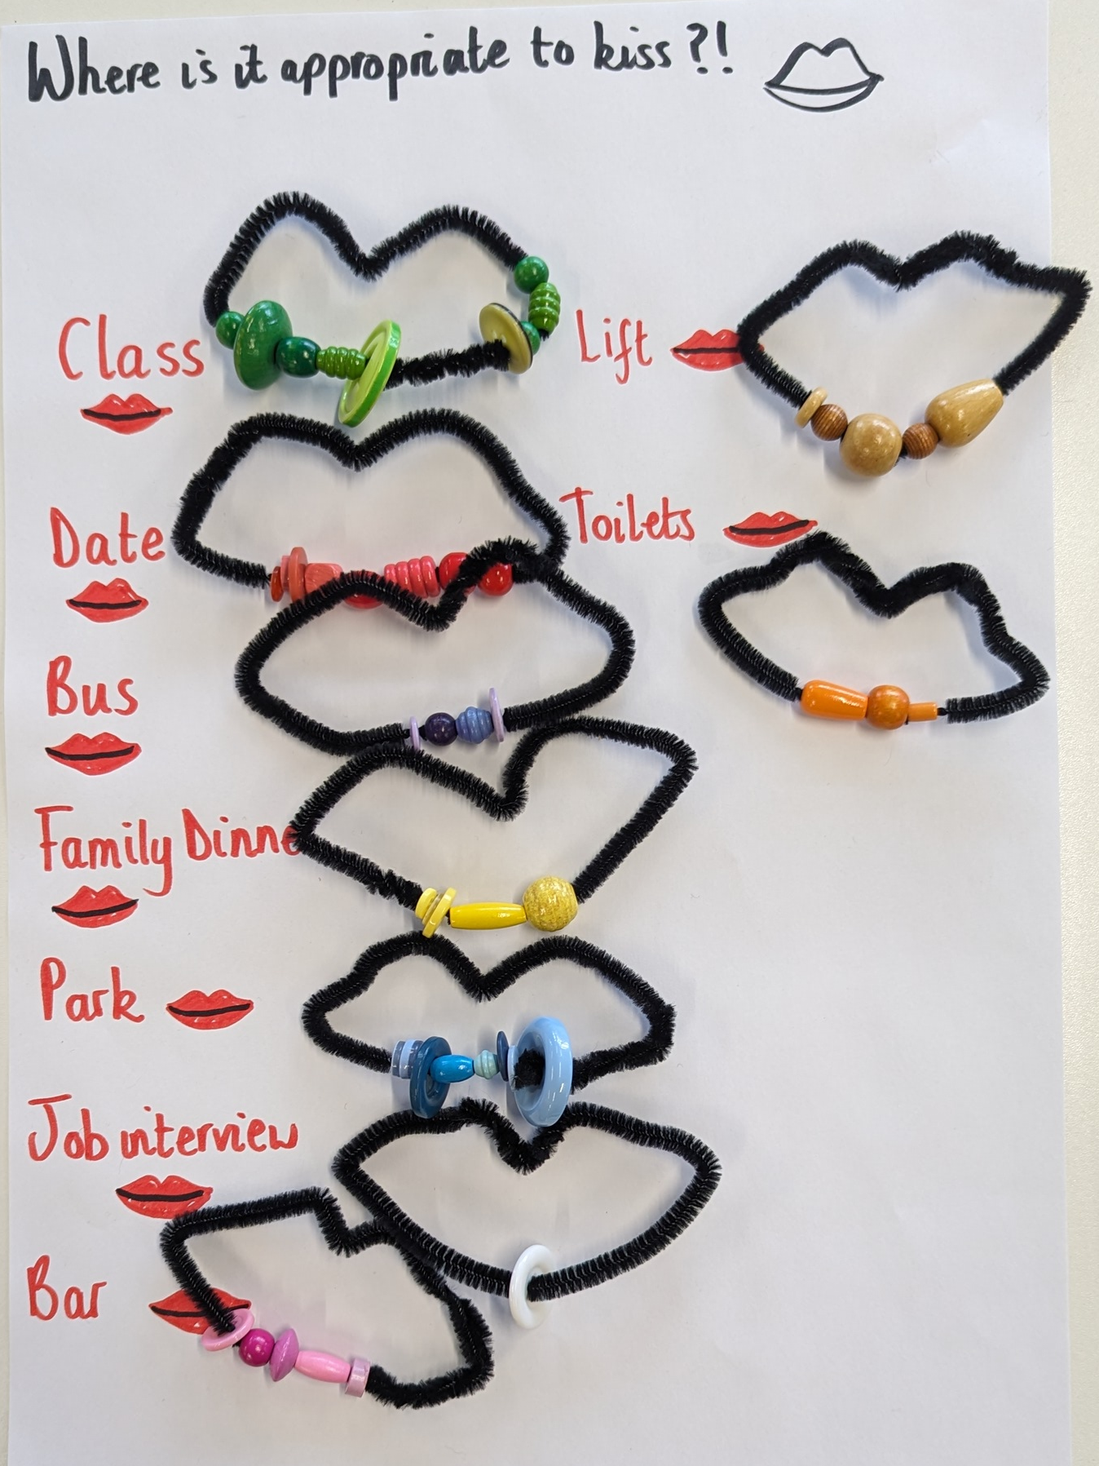
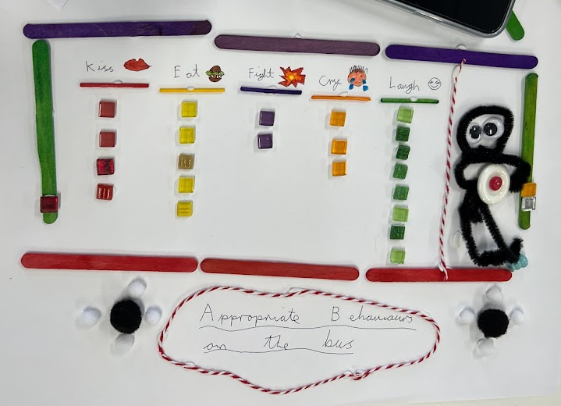
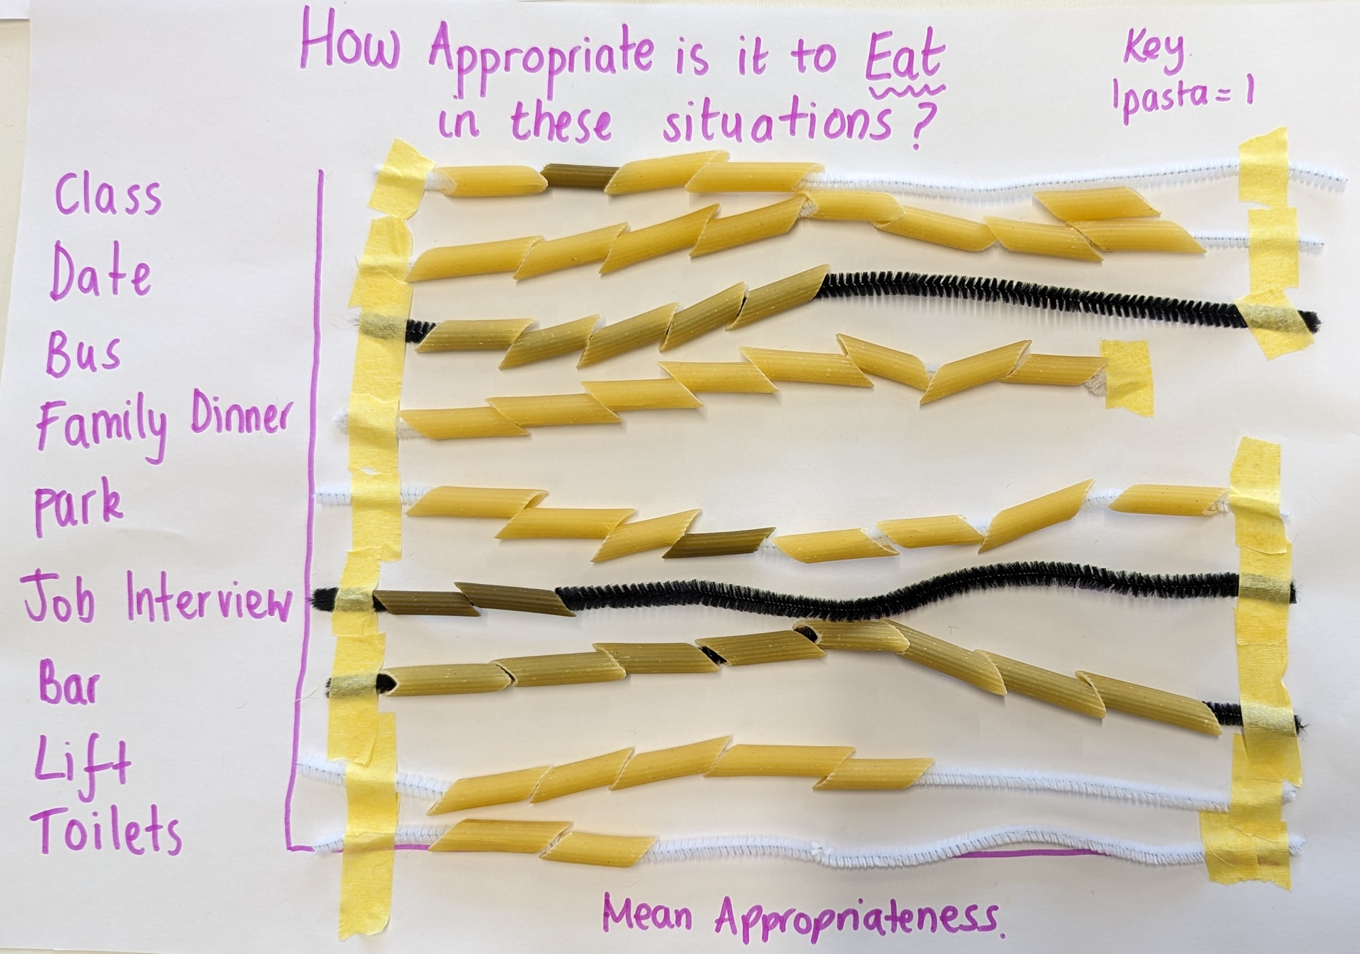
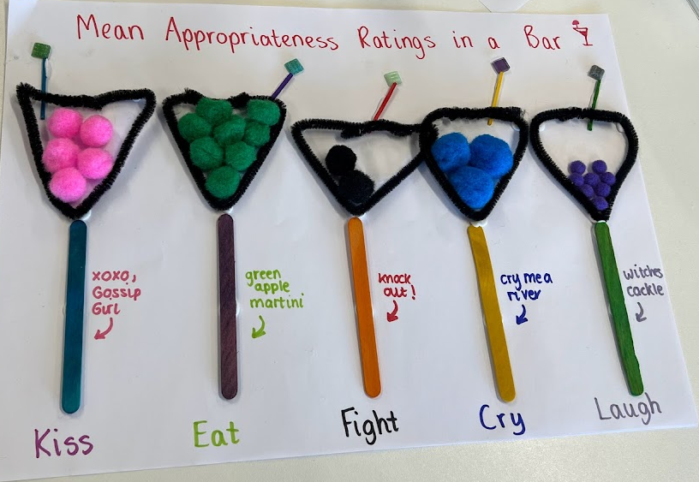
Make a graph… data jewellery… or something else fun!
Notes:
Your group should choose an aspect or a couple of aspects of the data and represent that physically using the objects available to you.

Slide 3
Appropriate behaviours for different places
 | Burp | Eat | Jump | Cry | Laugh
Class | 2 | 4 | 2 | 2 | 6
Bus | 2 | 5 | 3 | 3 | 7
Family dinner | 3 | 8 | 2 | 3 | 7
Park | 5 | 8 | 7 | 5 | 8
Job Interview | 1 | 2 | 1 | 1 | 6
Lift | 3 | 5 | 2 | 3 | 7
Toilets | 5 | 2 | 4 | 5 | 6
0 is not at all appropriate in that place, 9 is really appropriate in that location
Notes:
Your group should choose an aspect or a couple of aspects of the data and represent that physically using the objects available to you.

