Slide 1
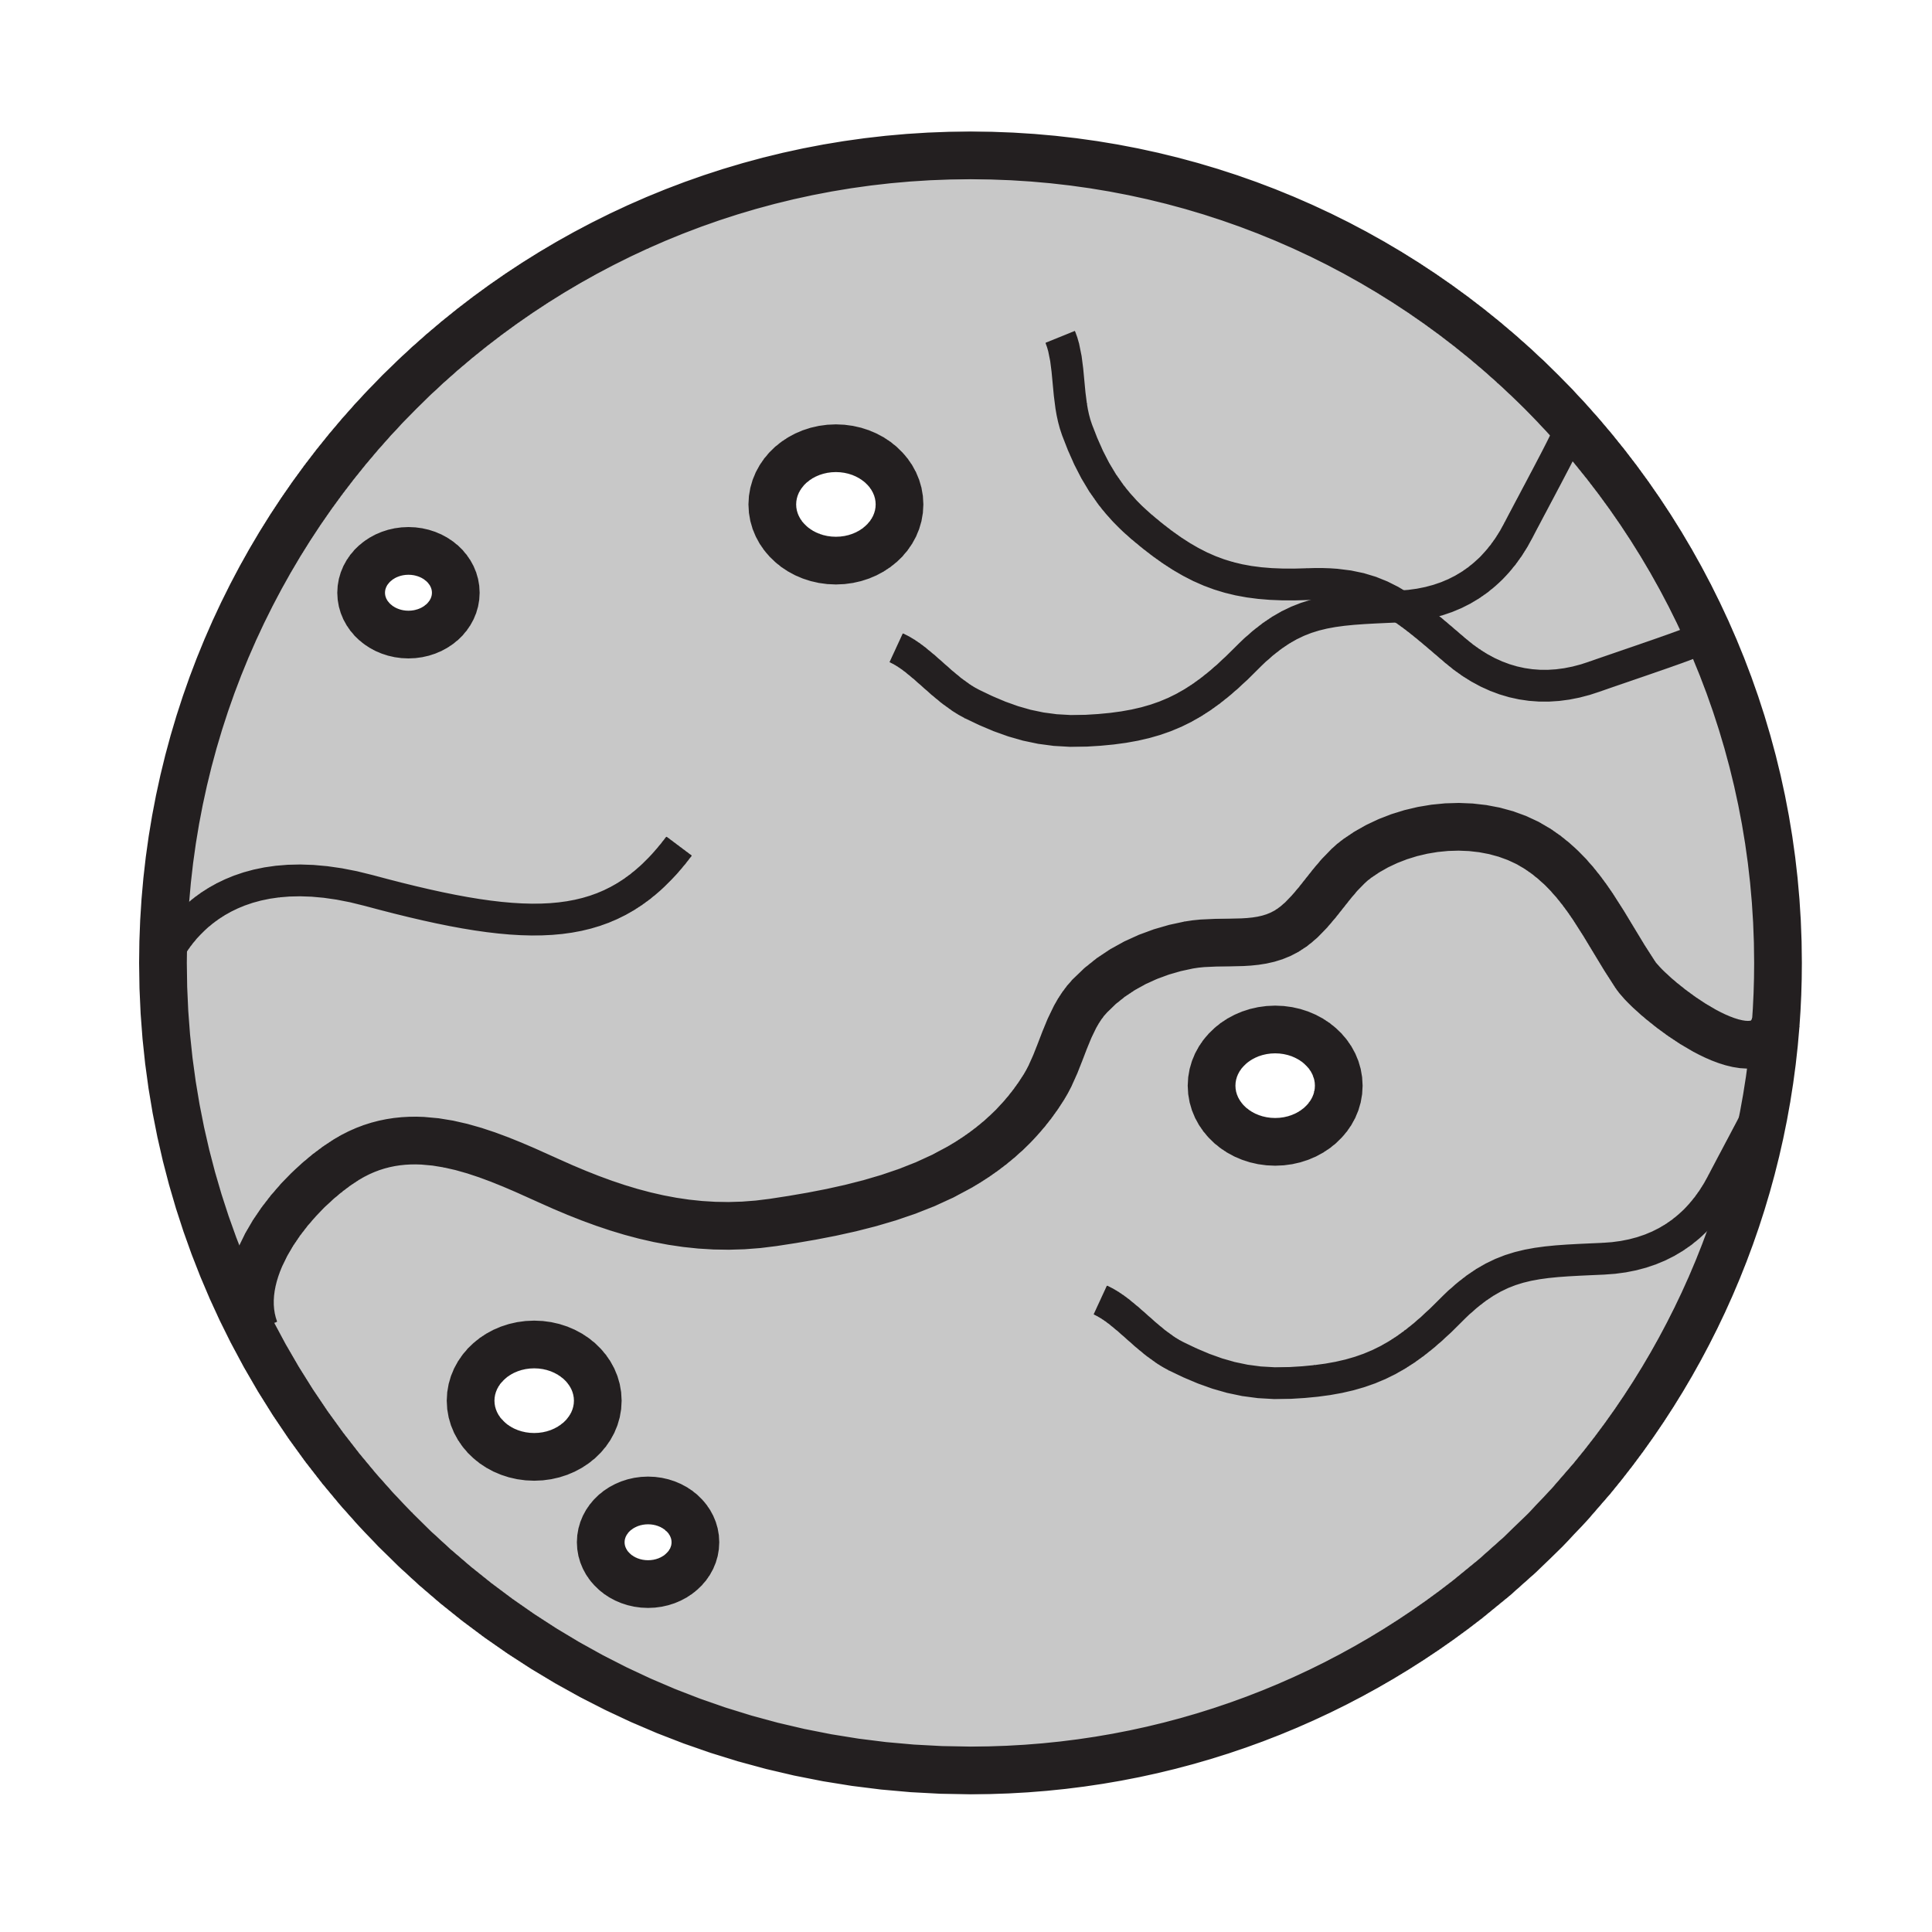
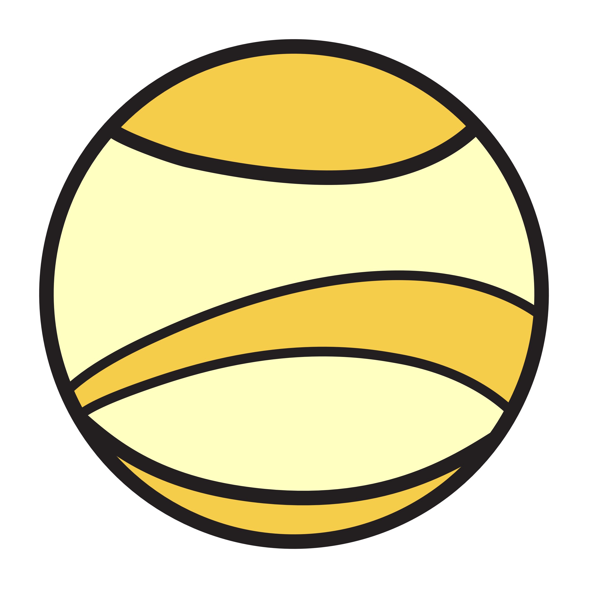
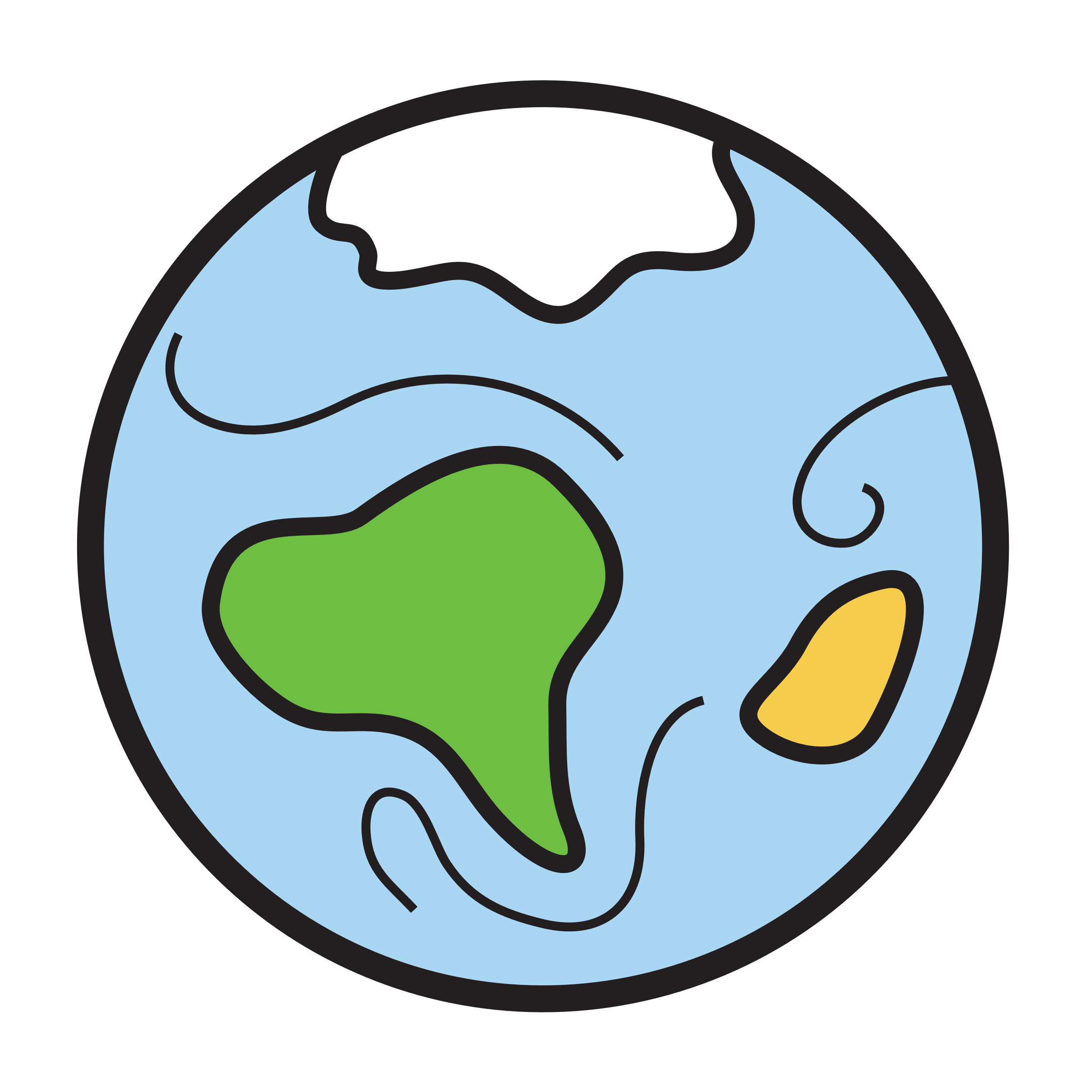
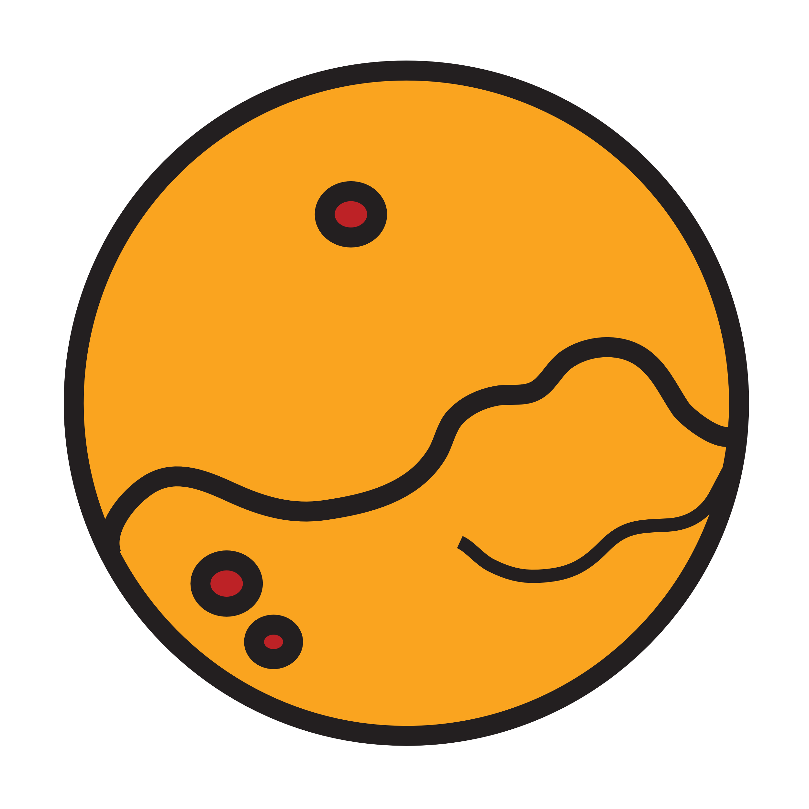
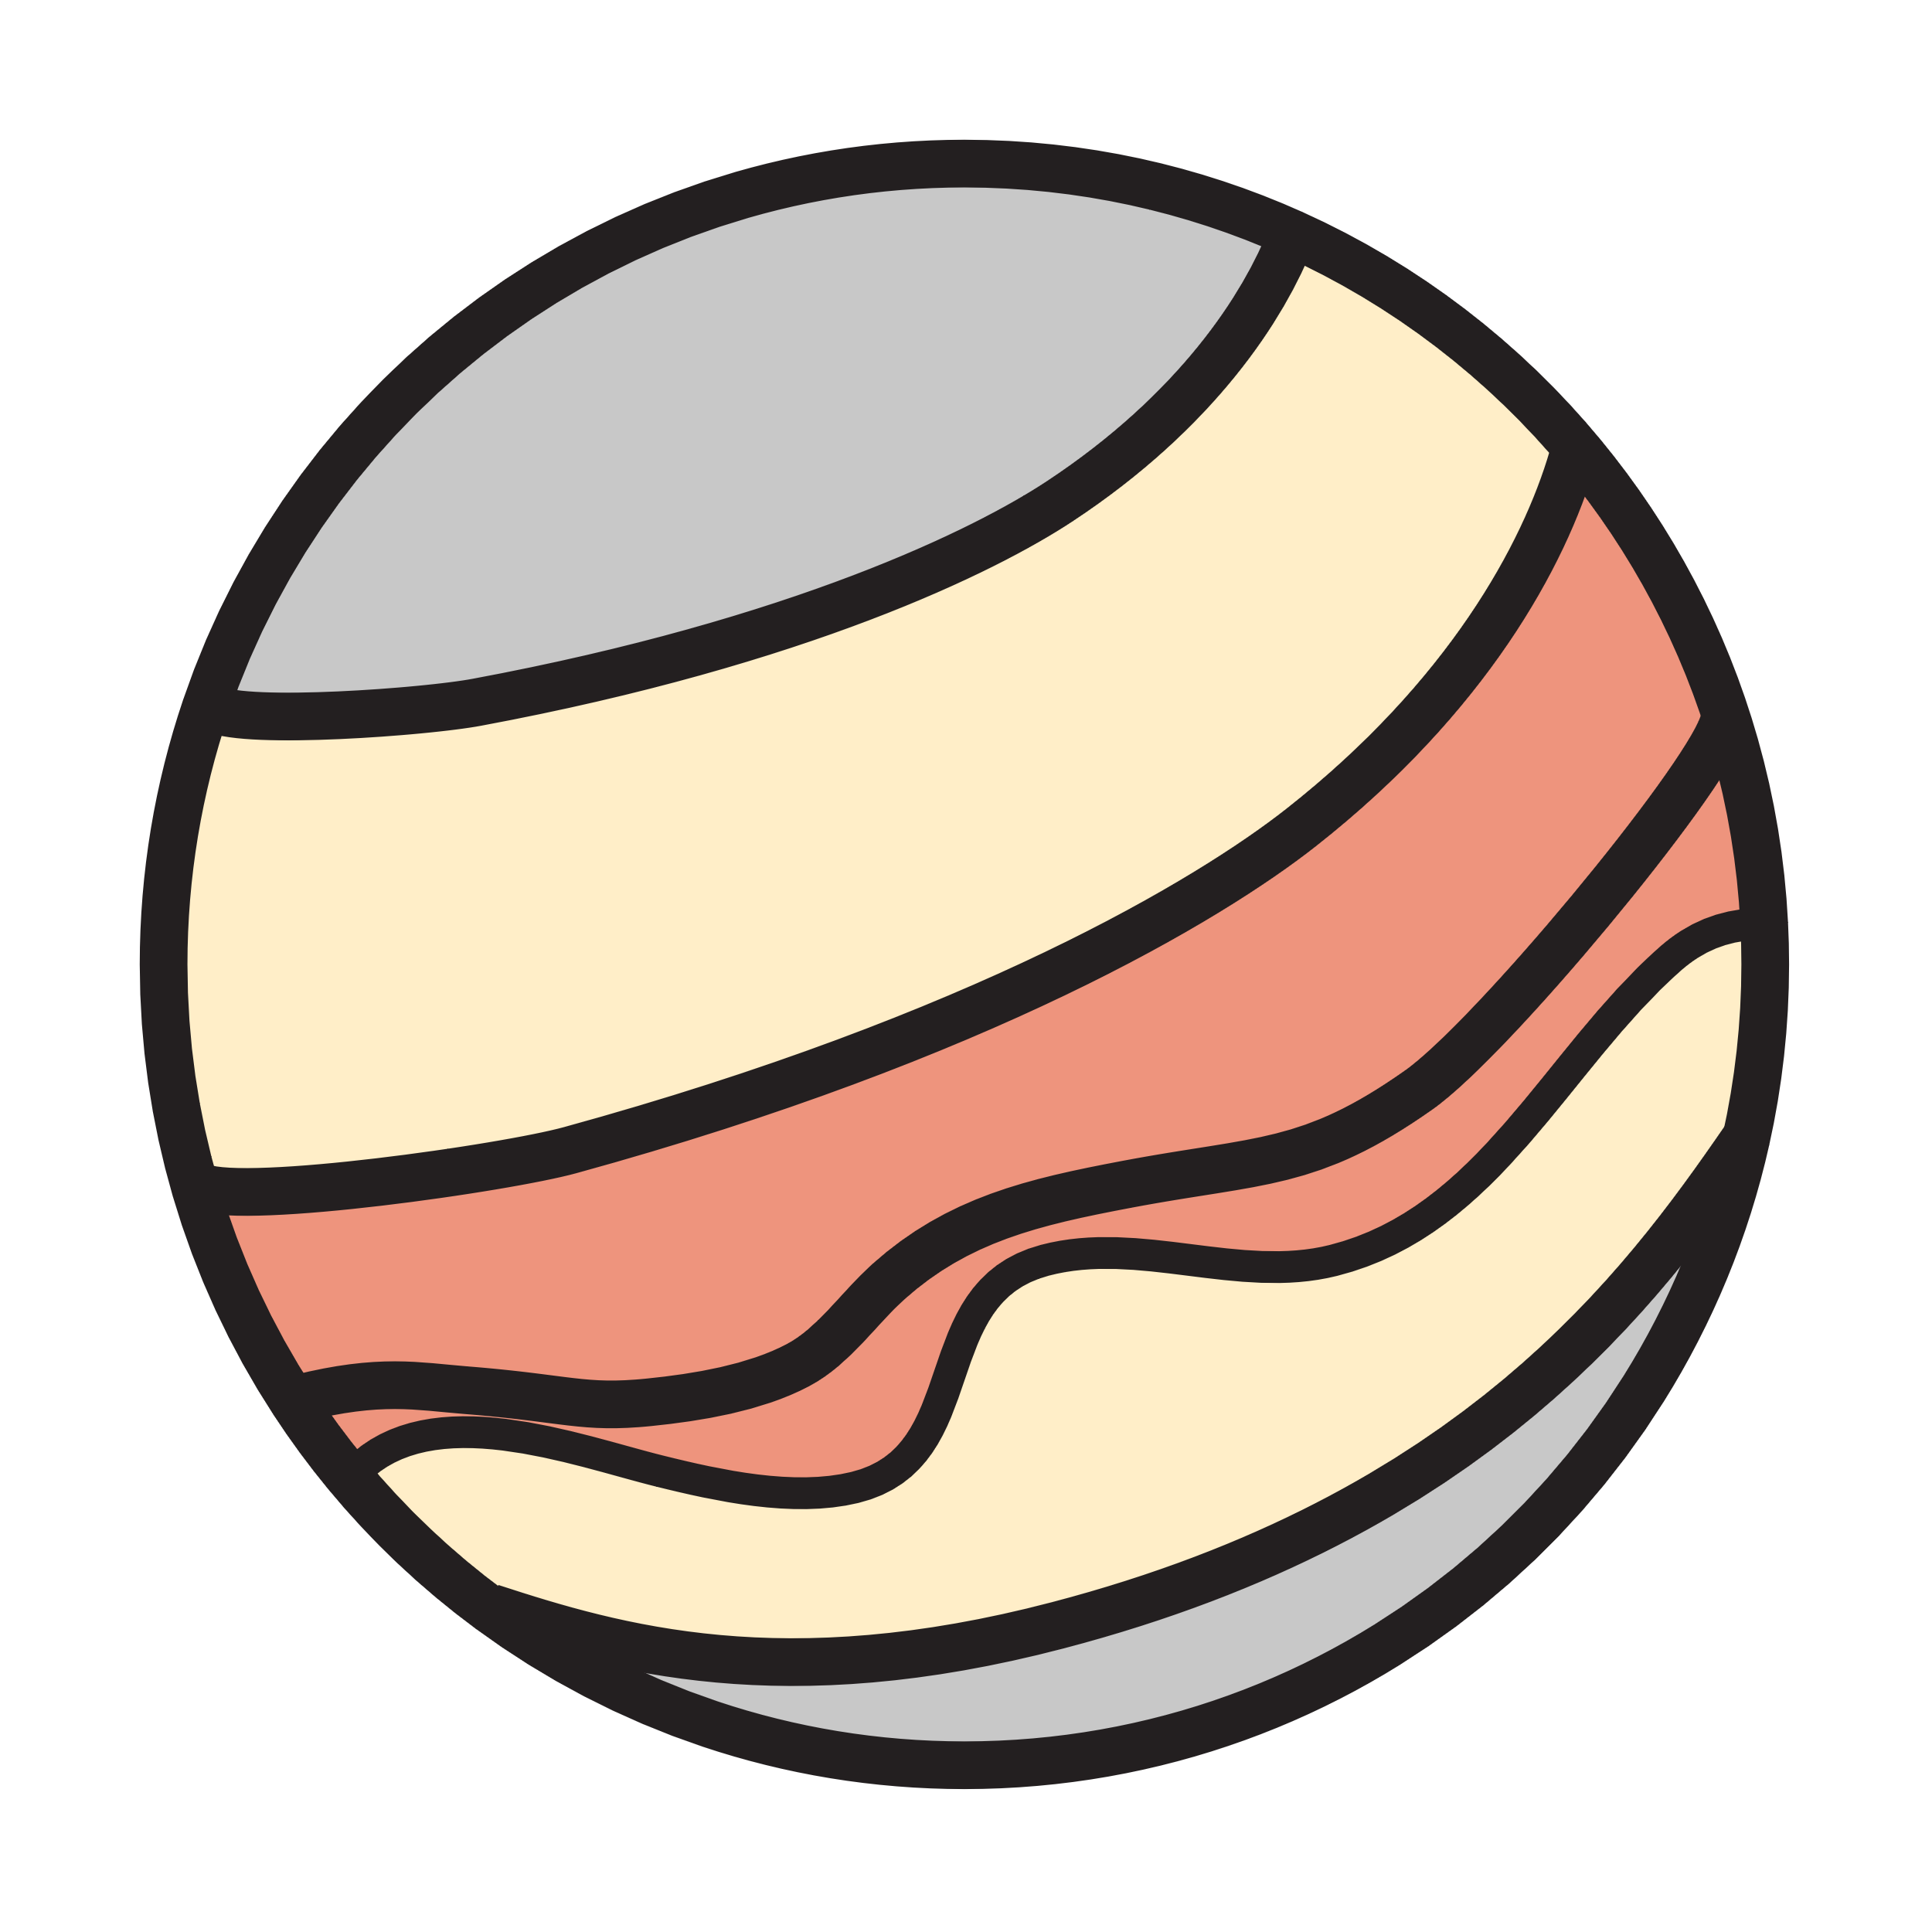
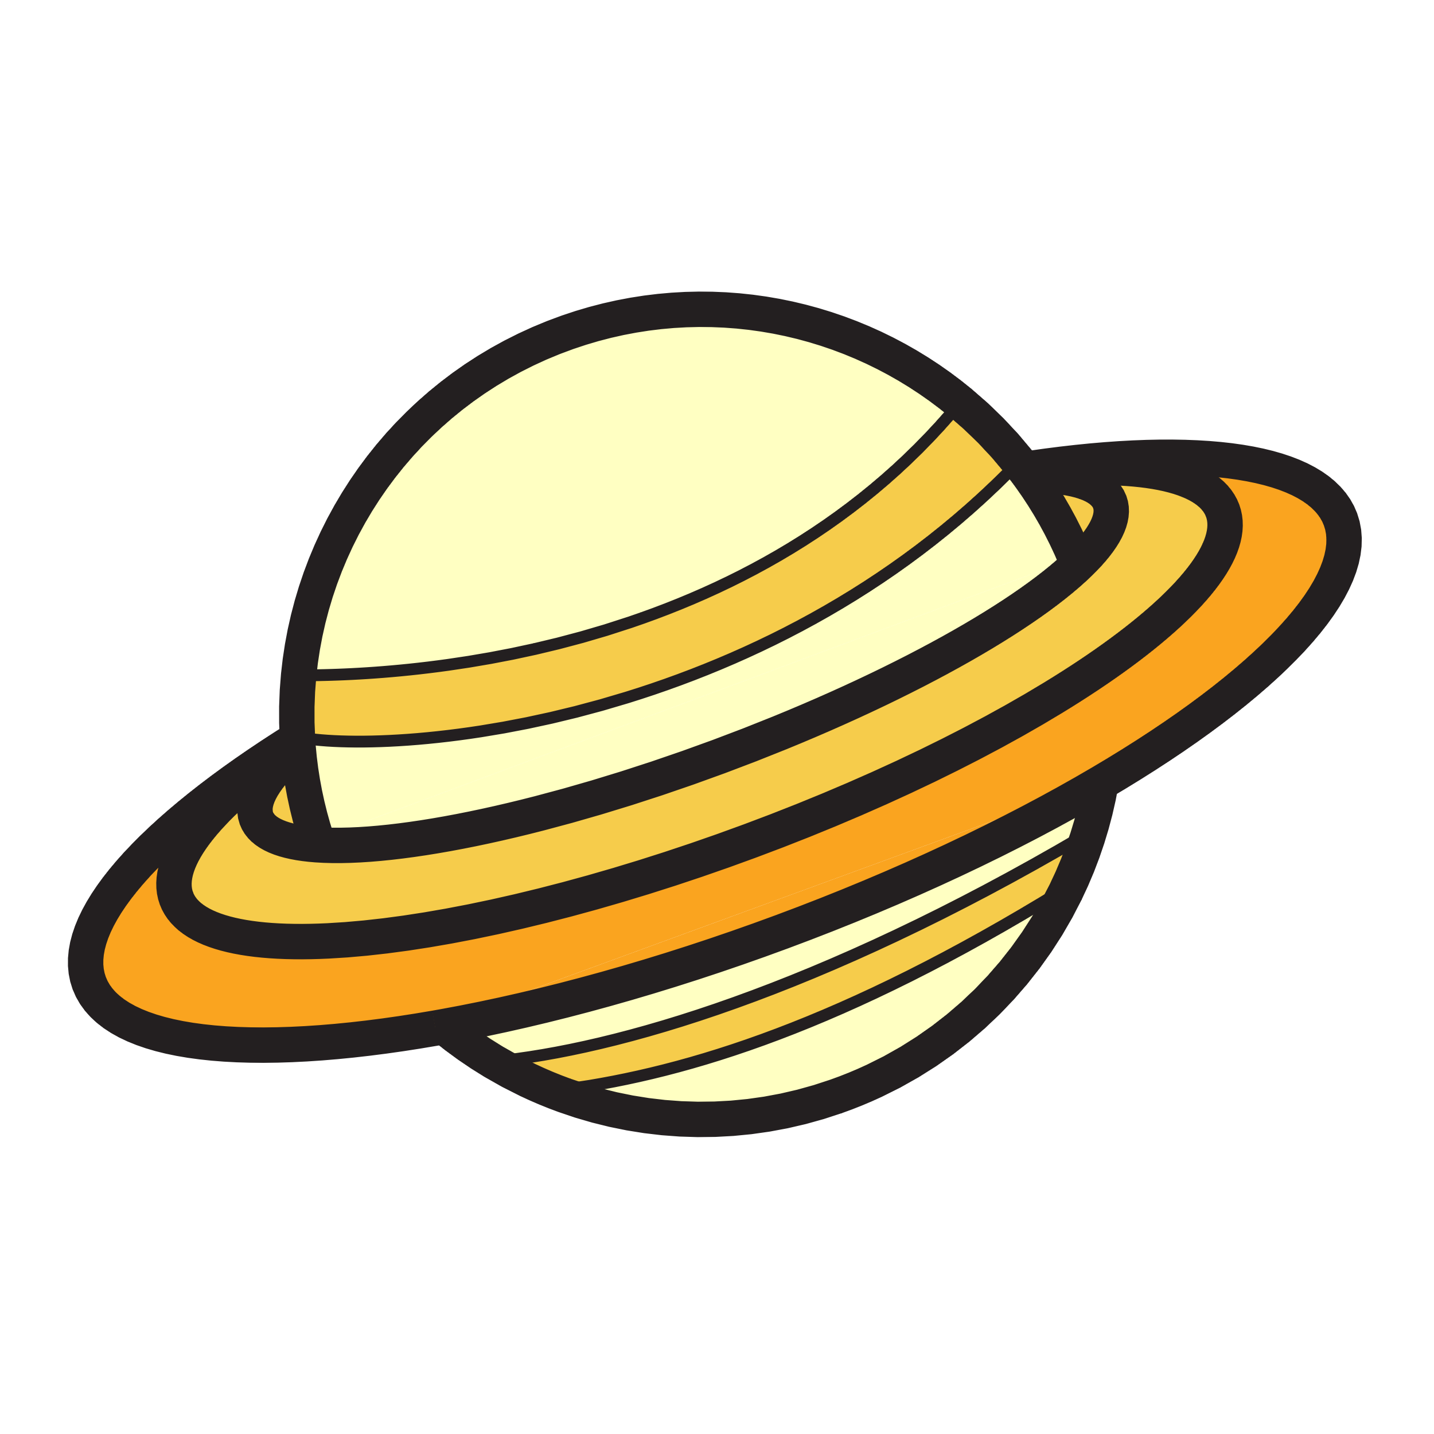
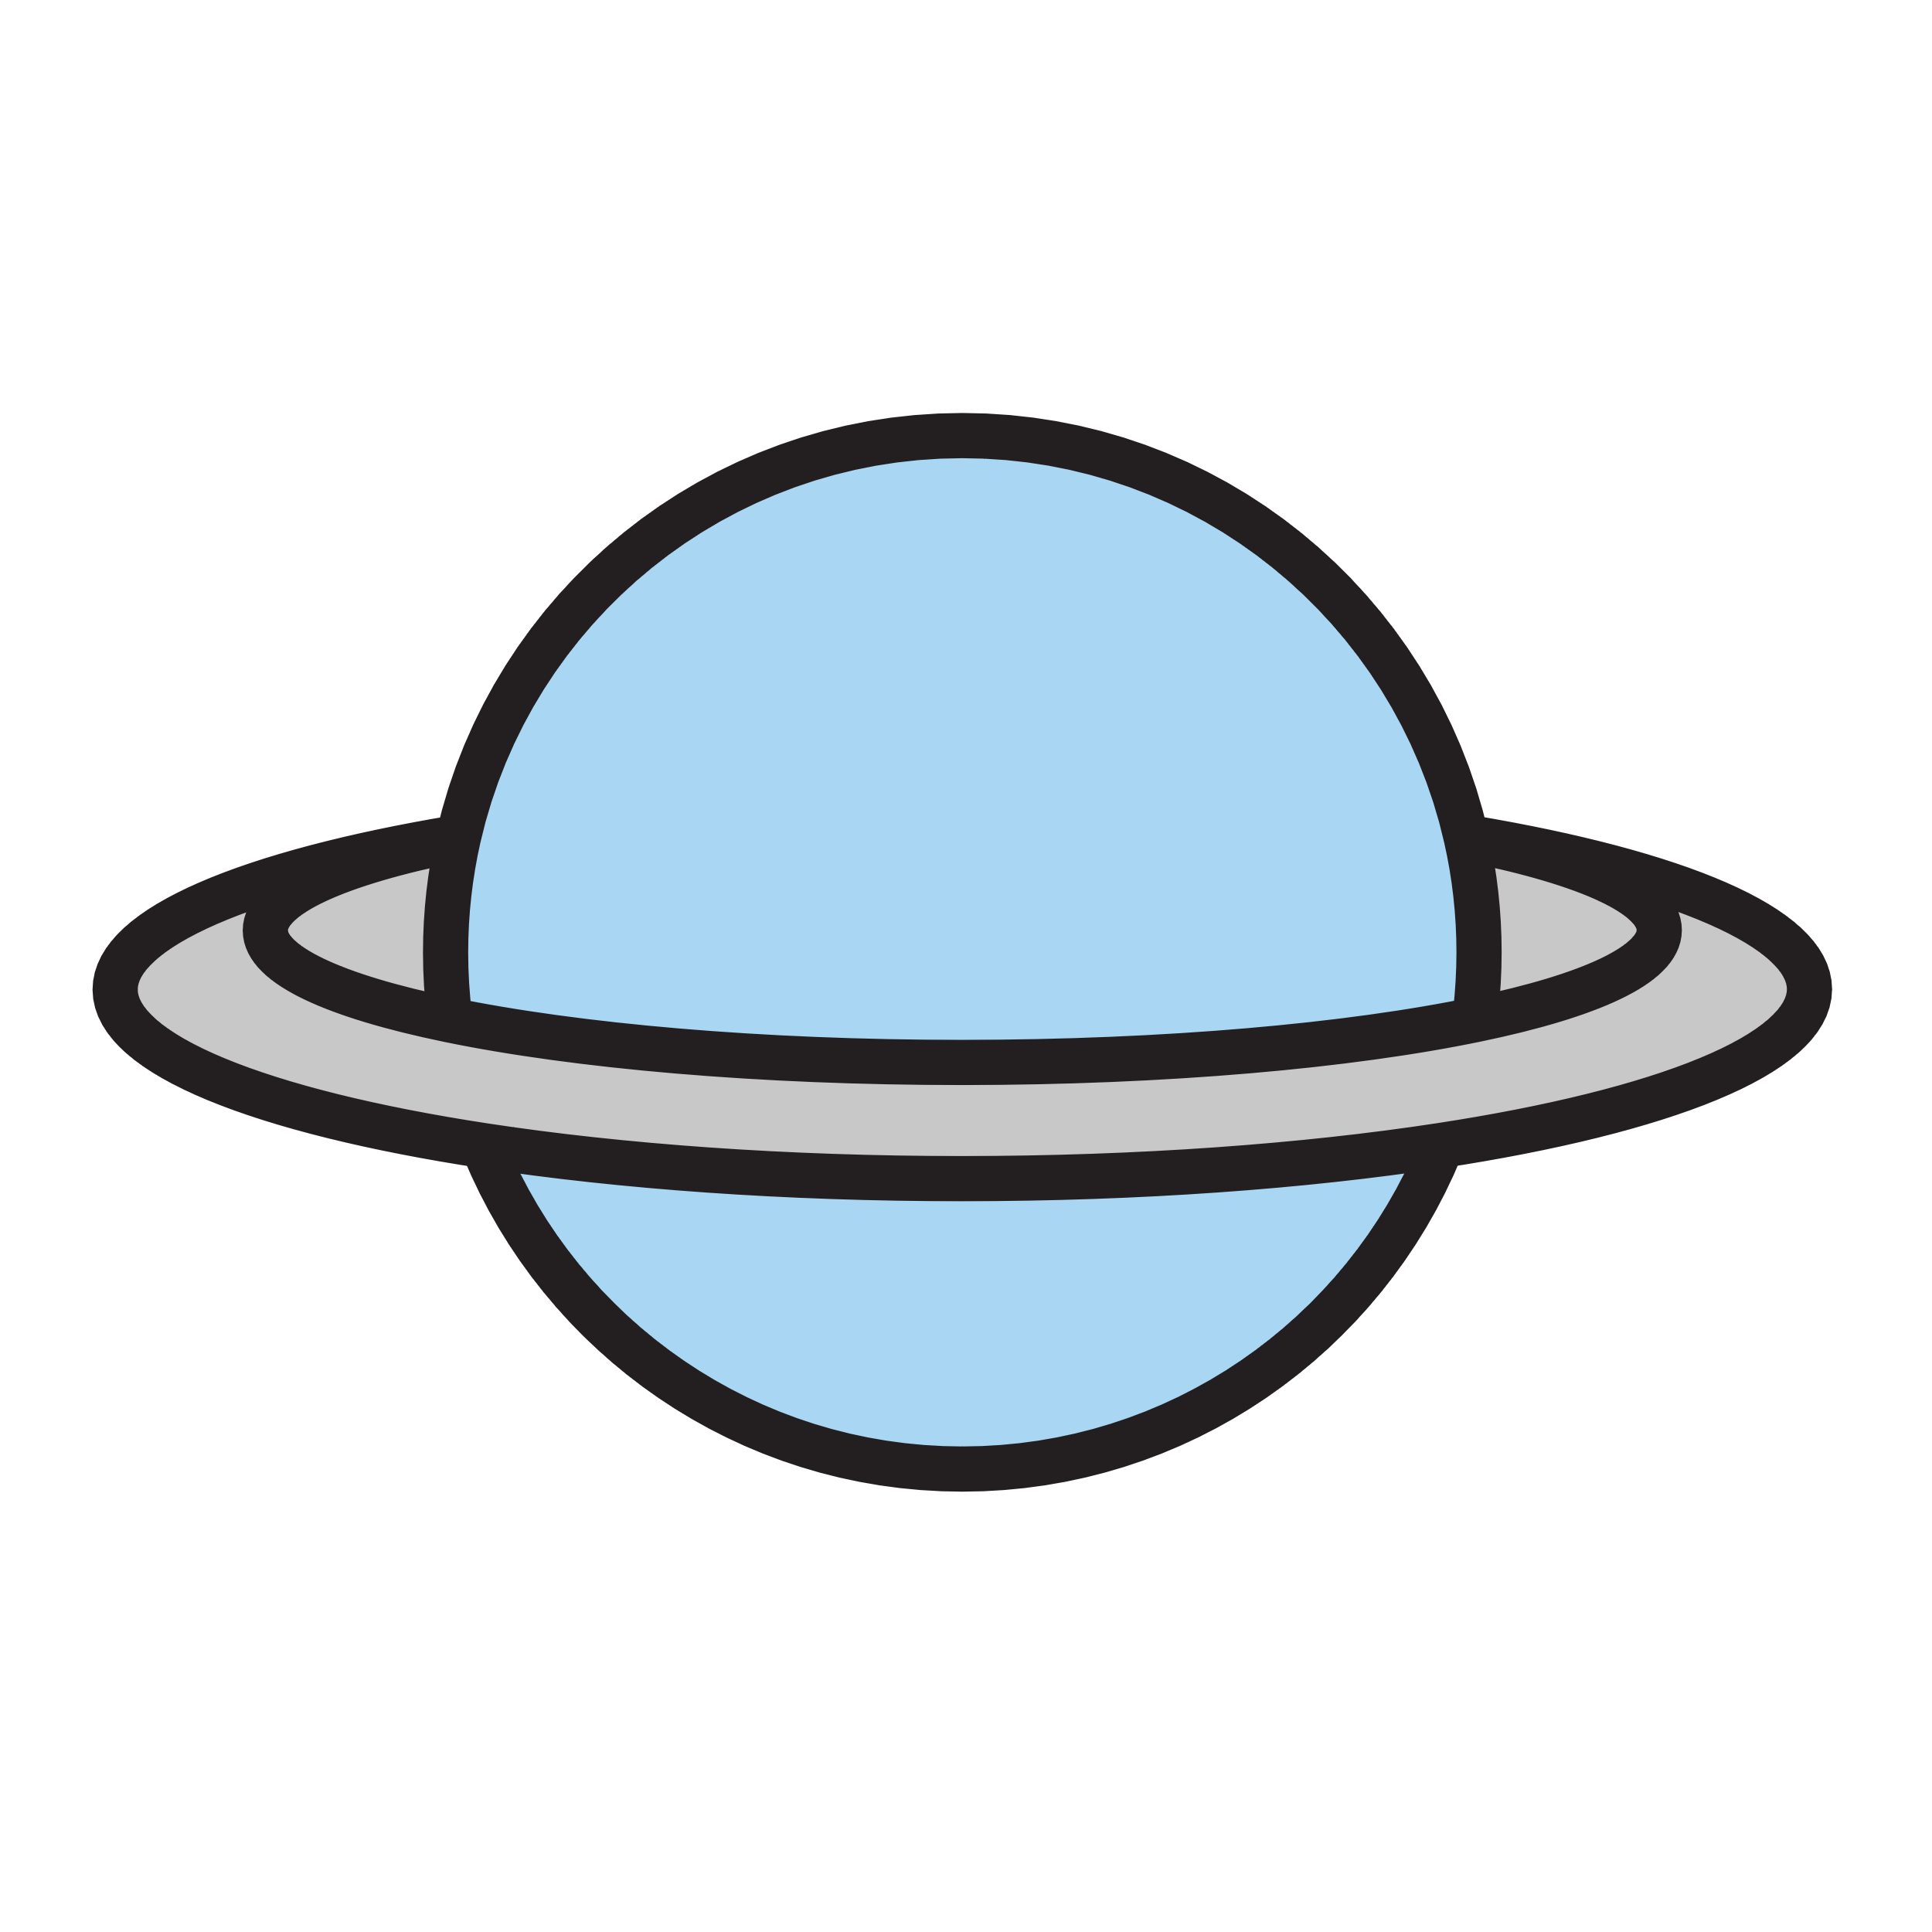
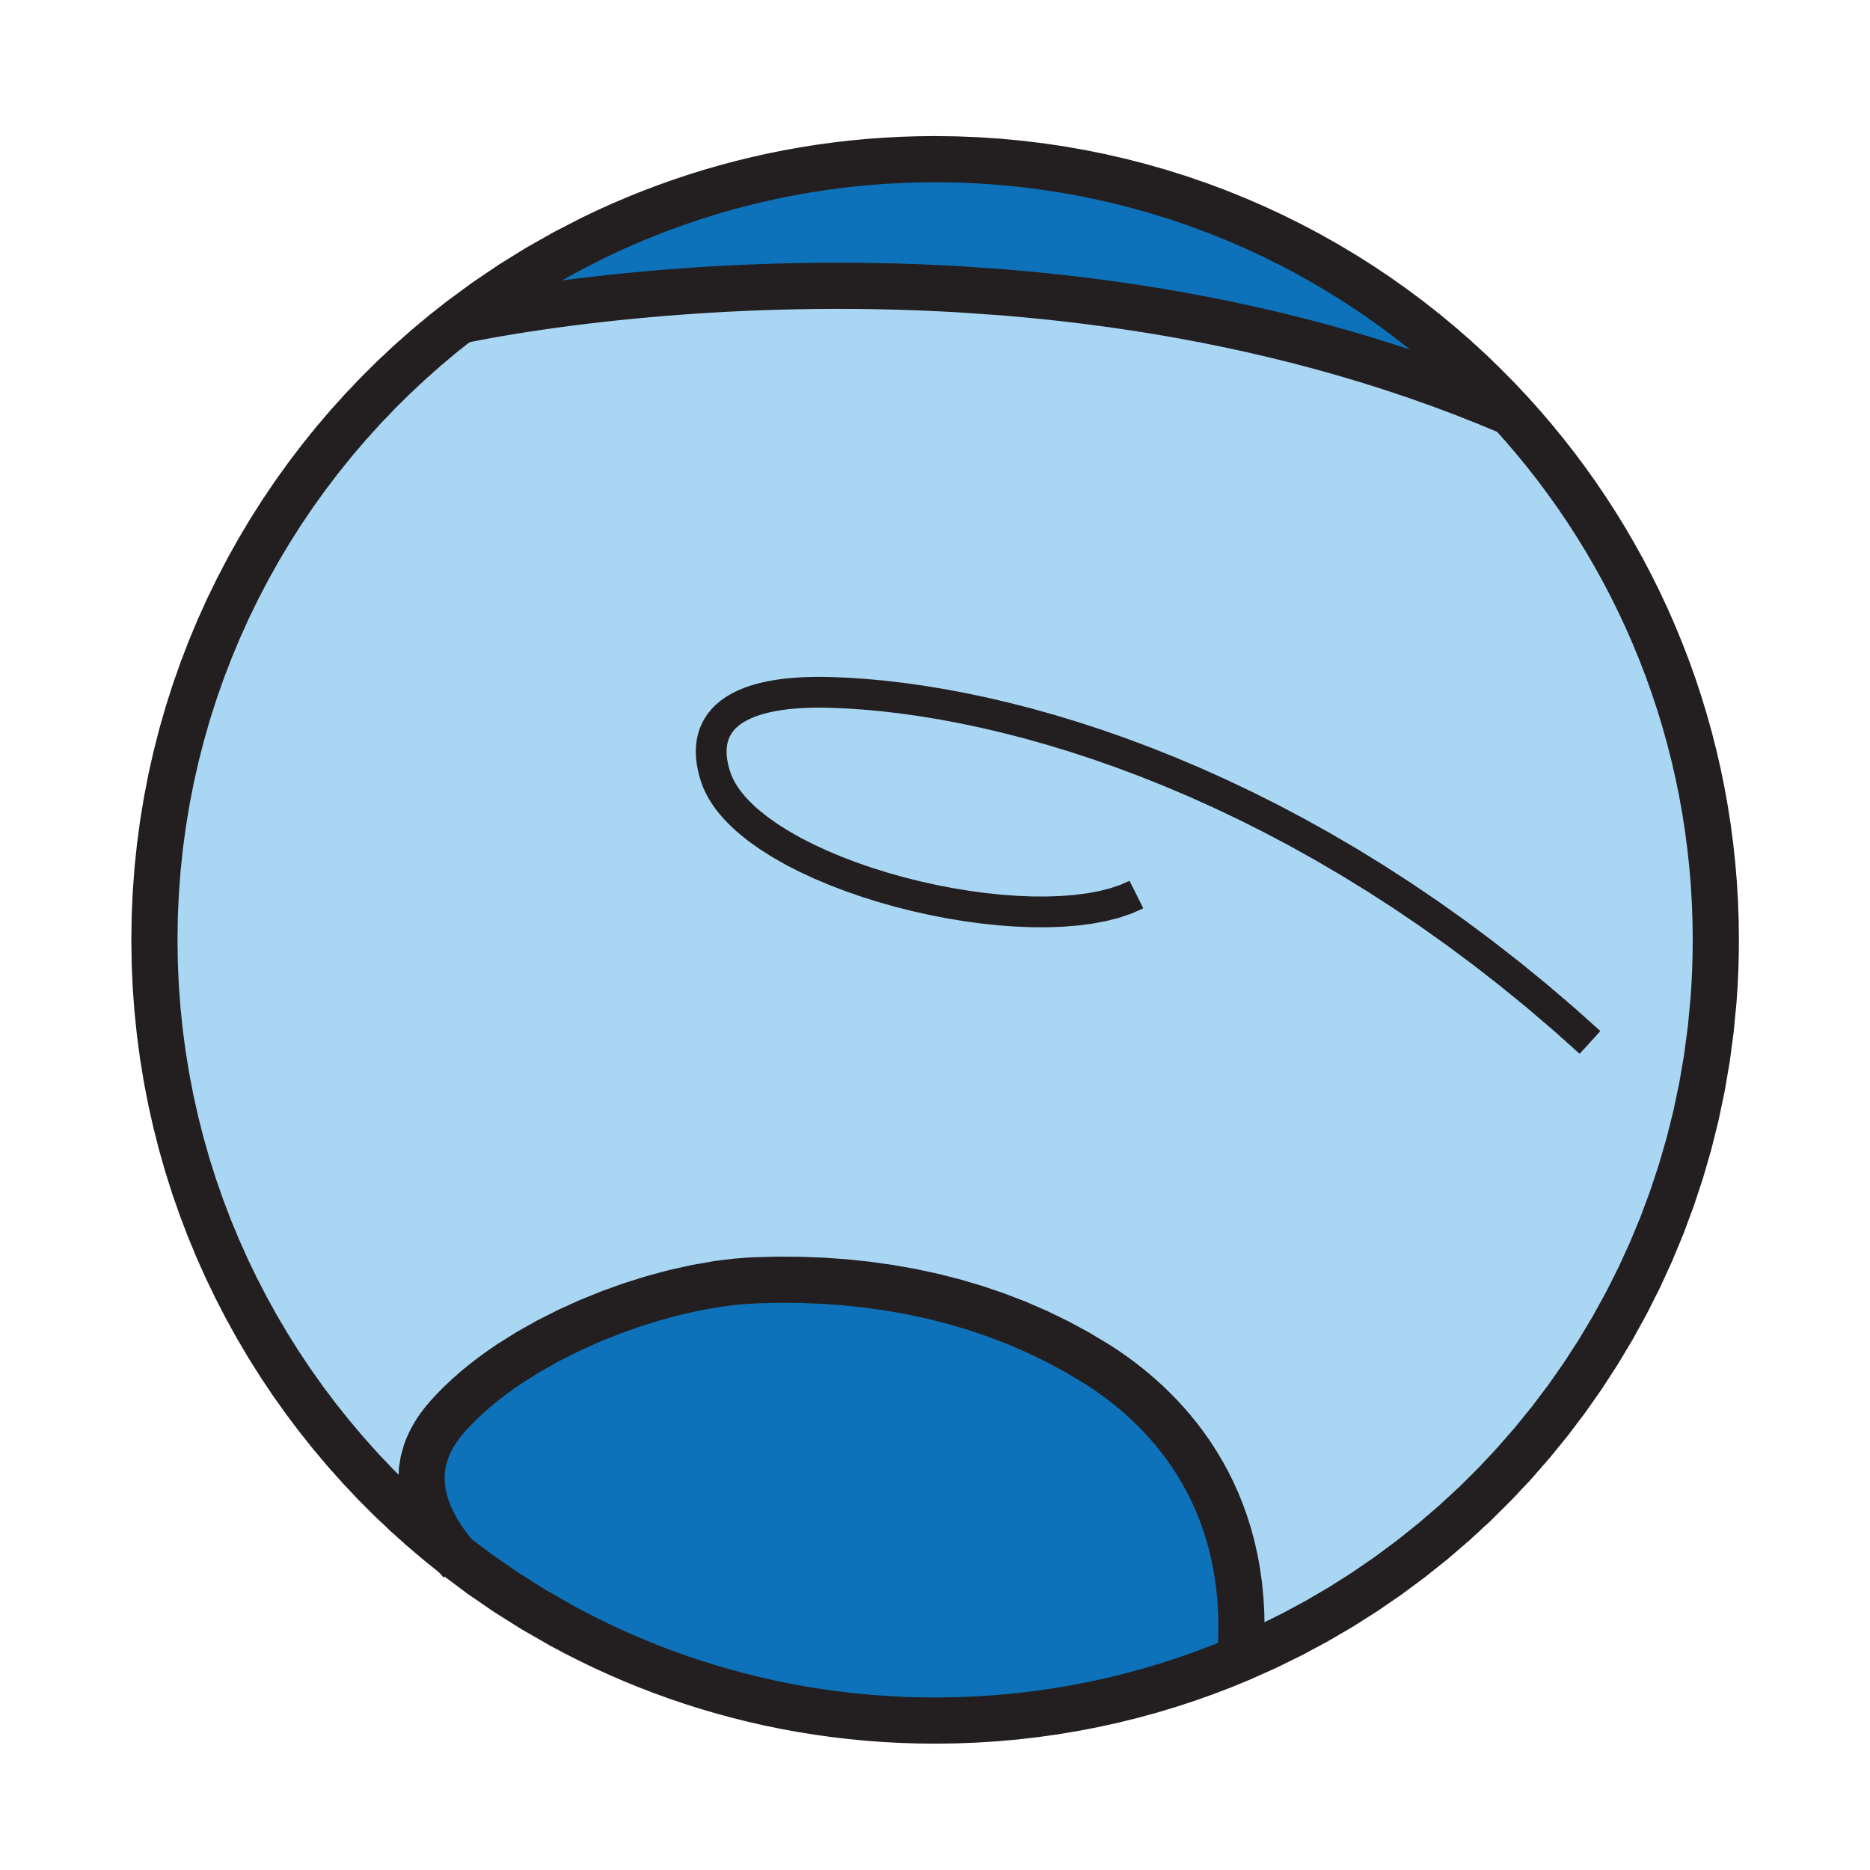
 | Mass (Earths) | Orbit (AU: Earth orbits) | Day Length (Earth days) | Year Length (Earth yrs) | No. of Moons
Mercury | 0.1 | 0.4 | 59 | 0.2 | 0
Venus | 0.8 | 0.7 | 243 | 0.6 | 0
Earth | 1 | 1 | 1 | 1 | 1
Mars | 0.1 | 1.5 | 1 | 2 | 2
Jupiter | 318 | 5 | 0.4 | 12 | 61
Saturn | 94 | 10 | 0.4 | 29 | 33
Uranus | 15 | 19 | 0.7 | 84 | 26
Neptune | 17 | 30 | 0.7 | 165 | 13

