Slide 1
Prediction Engines
Thanks to Dr Marc Cicchino
NJ AI Summit
dataed.in/njai
Notes:
We’re going to play a little activity to help demystify AI to try and explain in a very simple way how machine learning works, what the chat bots we’re using are actually doing, what are large language models actually doing?
At the end of the day, they are software, they’re prediction engines.
This is an activity called “Is this a Zegah?” and it was developed for the New Jersey AI Literacy Summit. The person who developed it asked their 4-year-old kid for a made up word, and the child very seriously responded “Zegah”

Slide 2
Is this a Zegah?
Notes:
So we’re going to play it right now. My question to you is “Is this a Zegah?”
I’m going to show you a picture and I’d like you to raise your hand if you think this is a Zegah, and keep your hand down if you think it’s not.
“Is this a Zegah?”

Slide 3
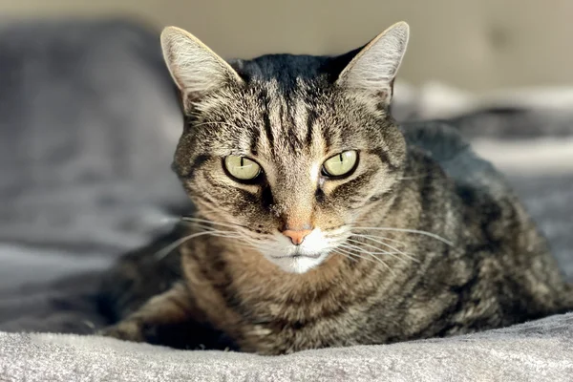
Is this a Zegah?
Notes:
yes (you’re baby GPTs right now!)

Slide 4
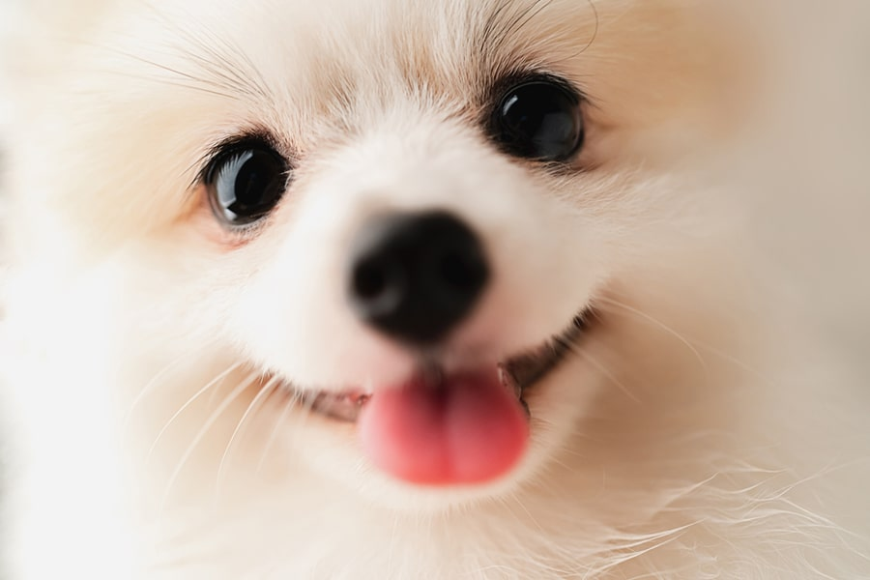
Is this a Zegah?
Notes:
No

Slide 5
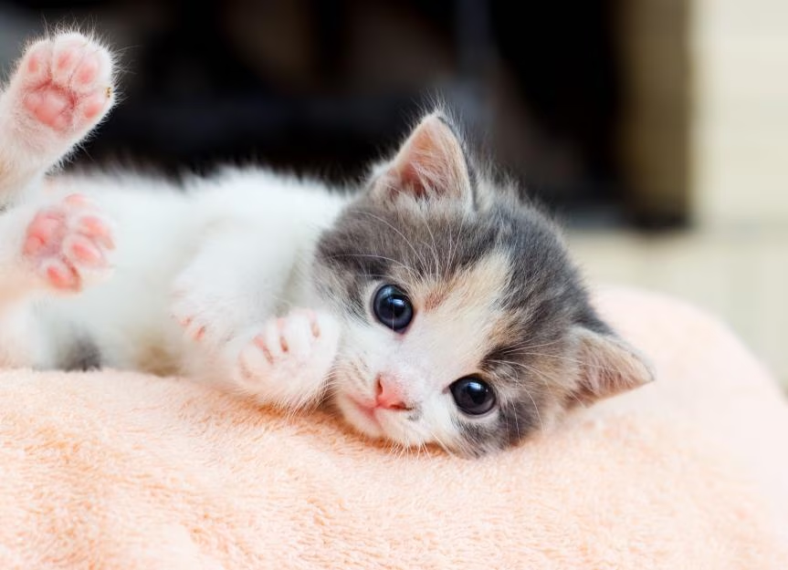
Is this a Zegah?
Notes:
no (the model is learning!)

Slide 6
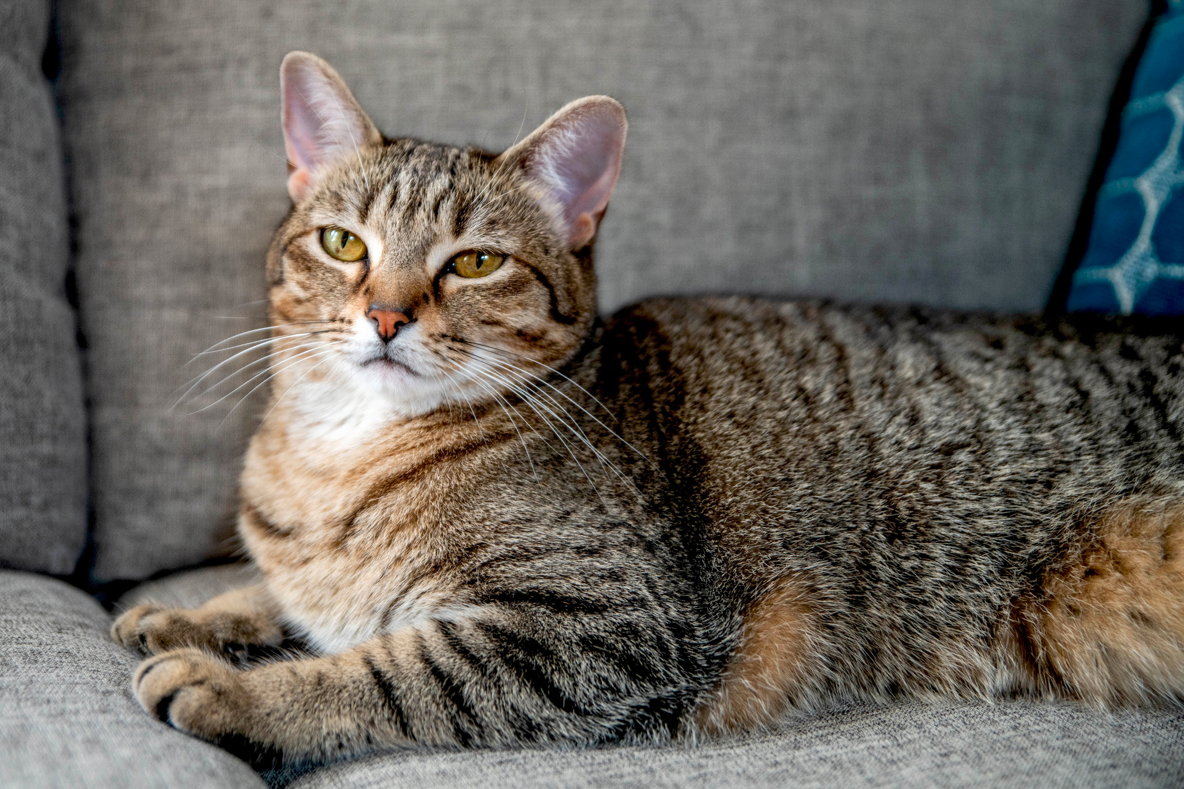
Is this a Zegah?
Notes:
yes

Slide 7
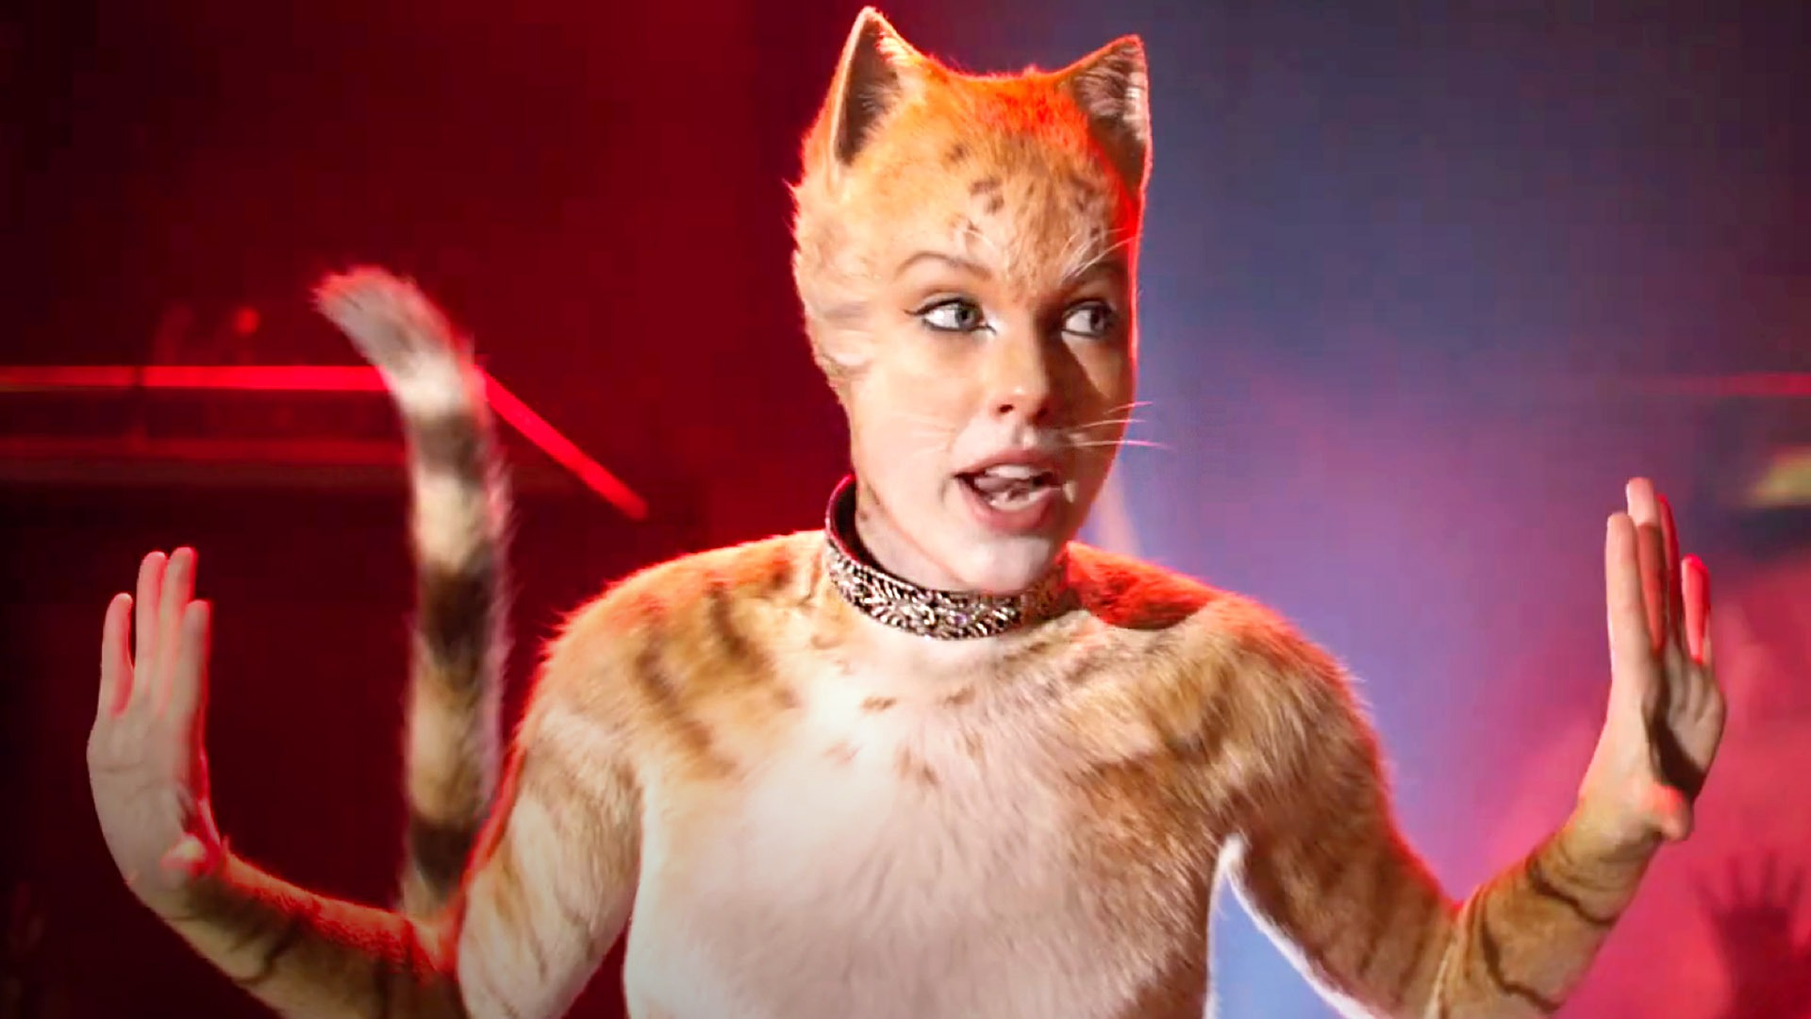
Is this a Zegah?
Notes:
no

Slide 8
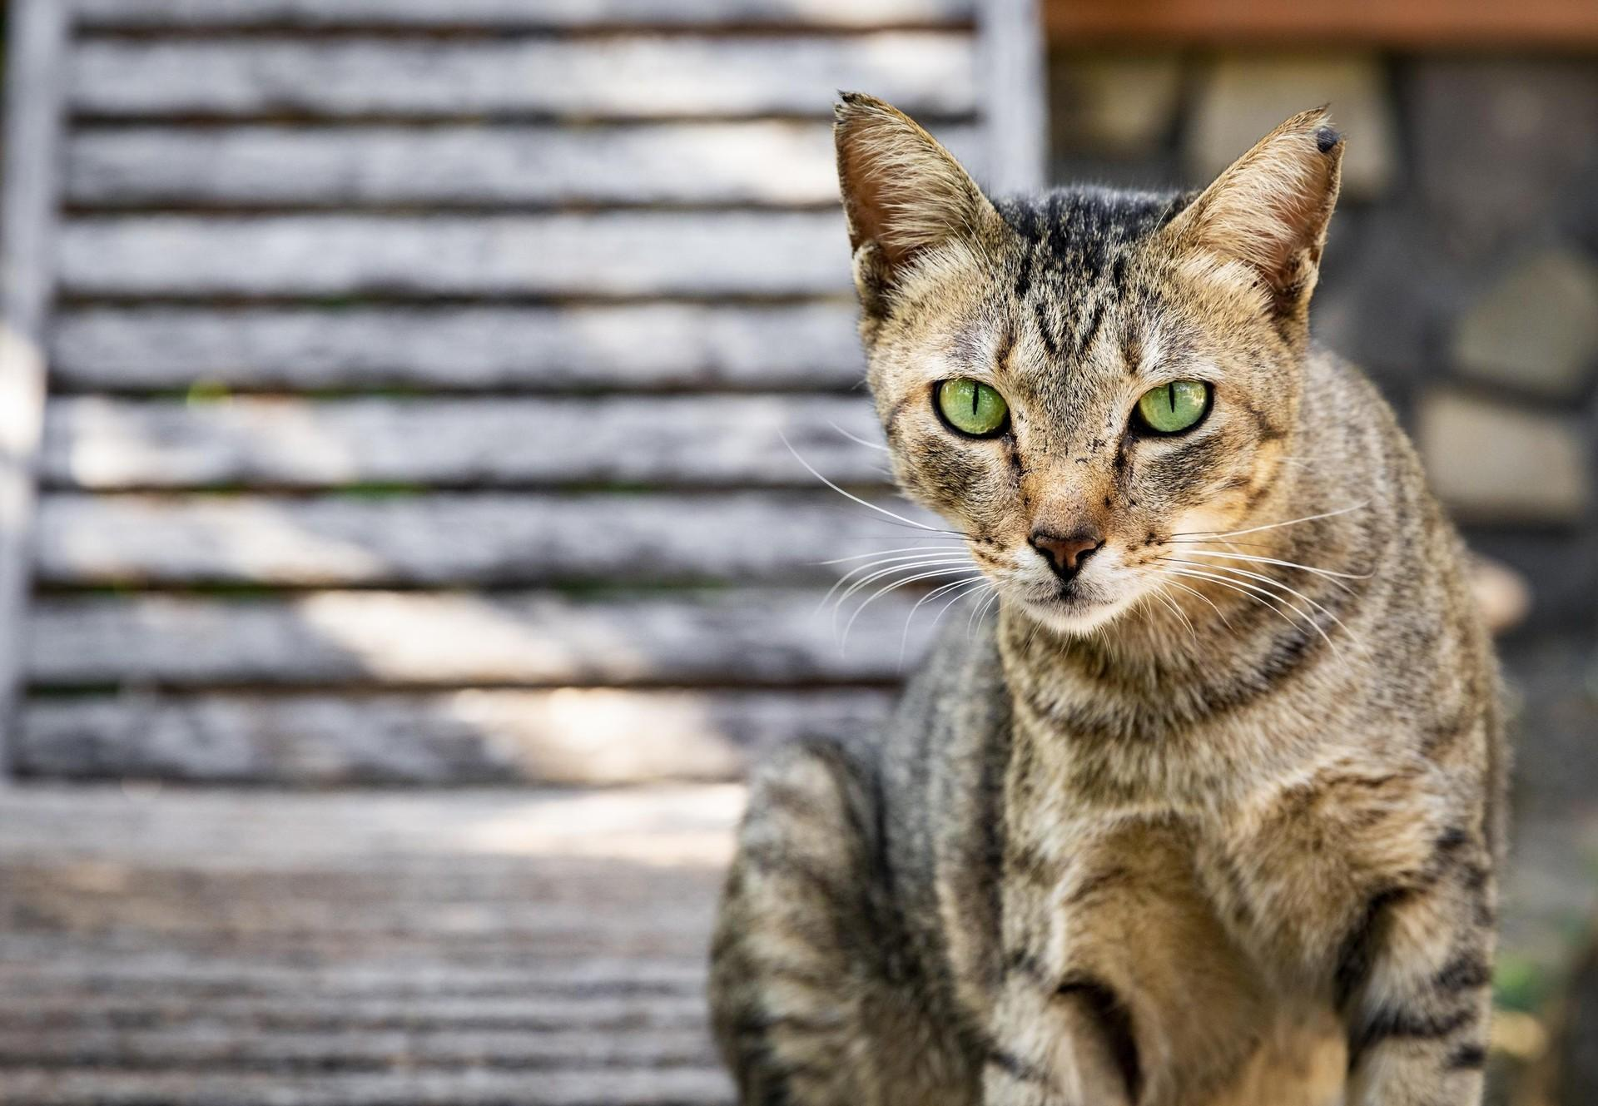
Is this a Zegah?
Notes:
yes

Slide 9
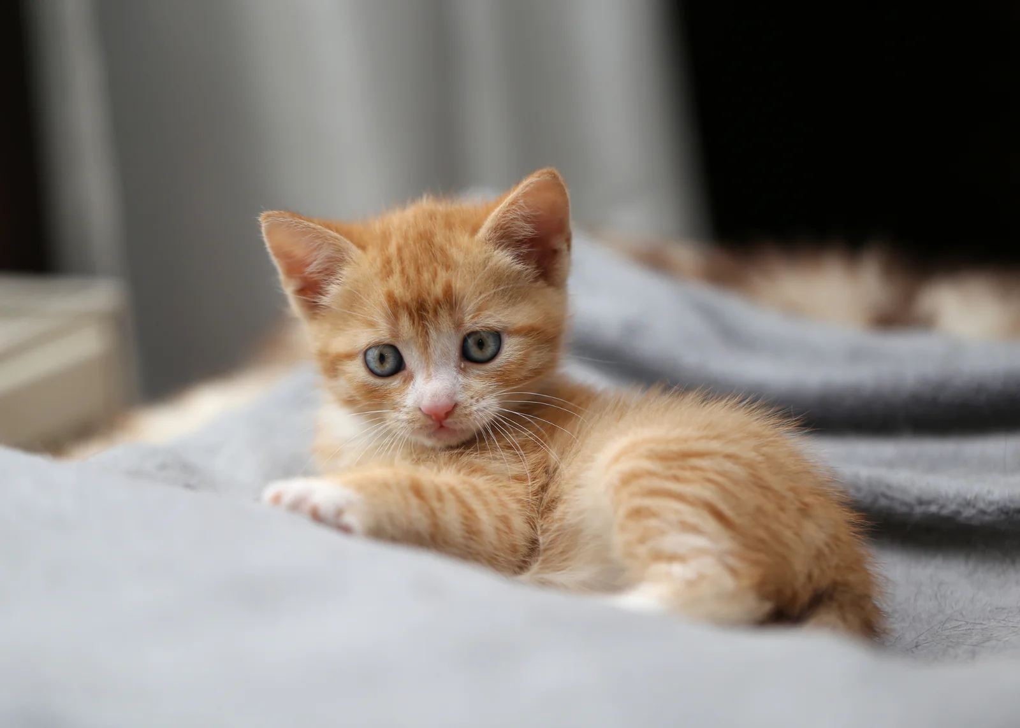
Is this a Zegah?
Notes:
no

Slide 10
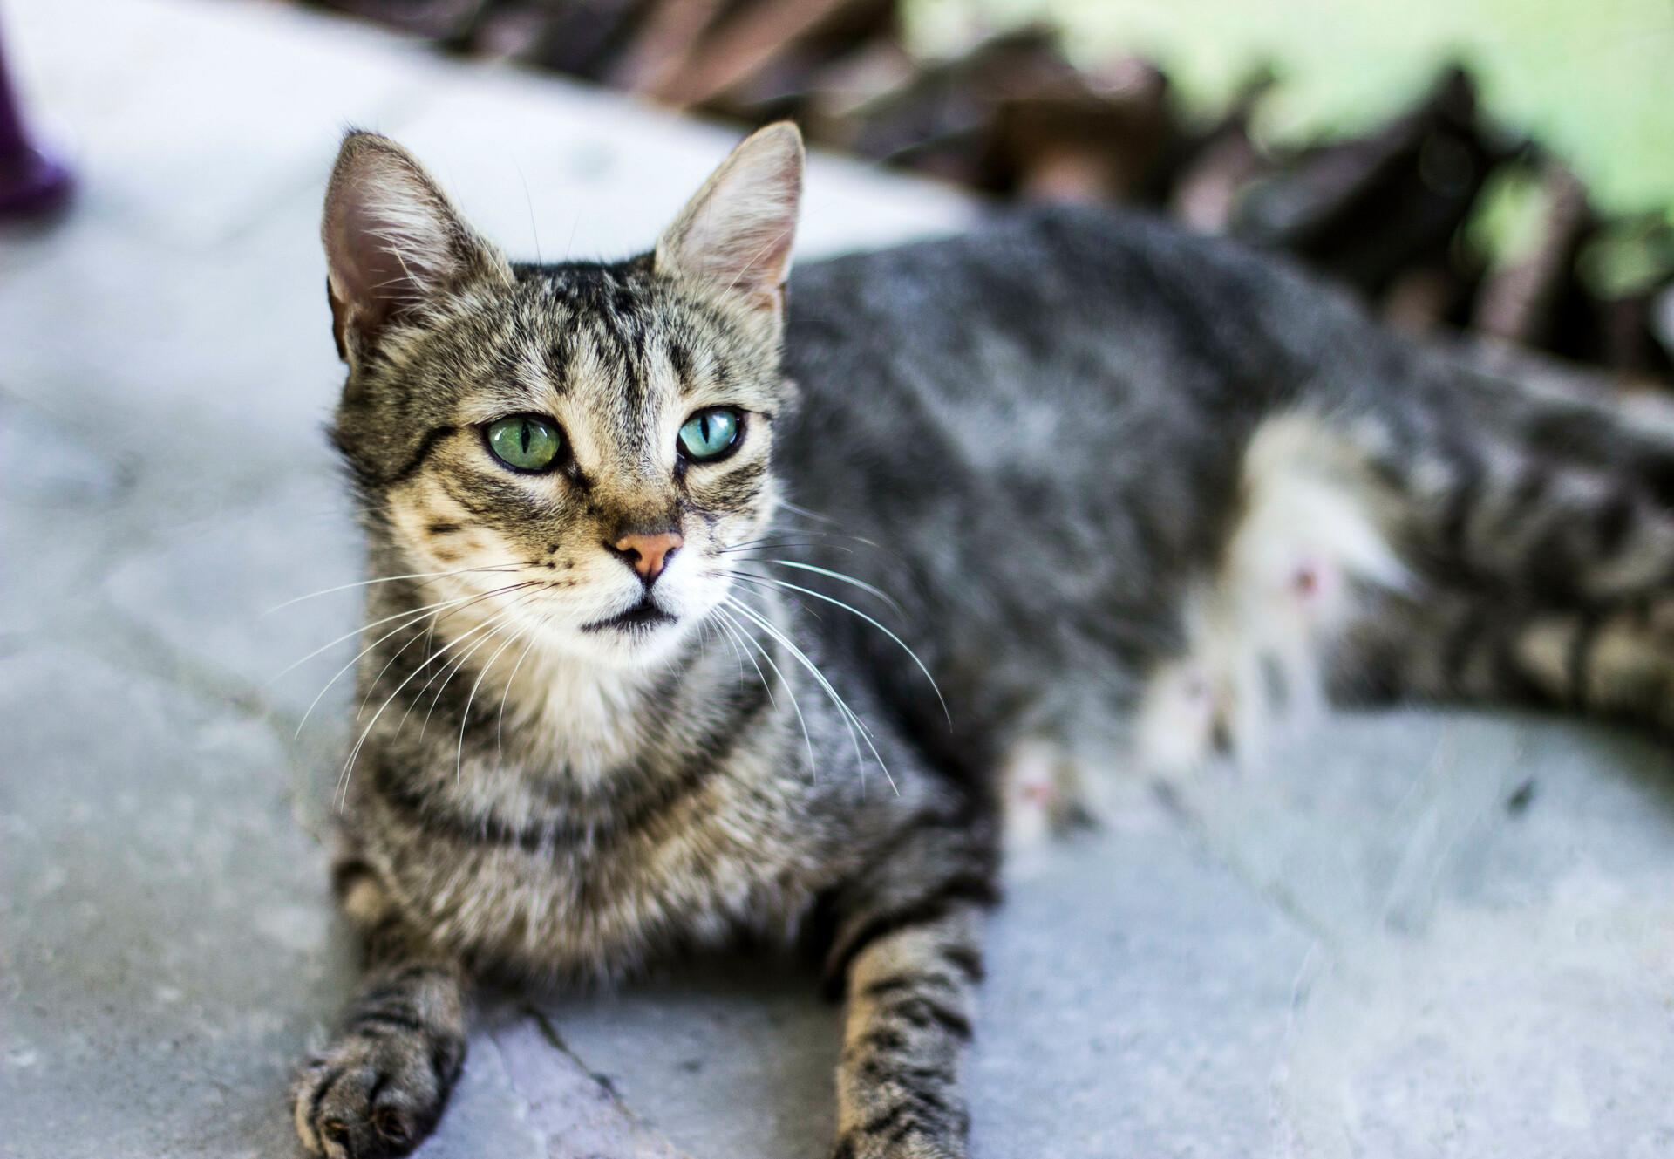
Is this a Zegah?
Notes:
Yes

Slide 11
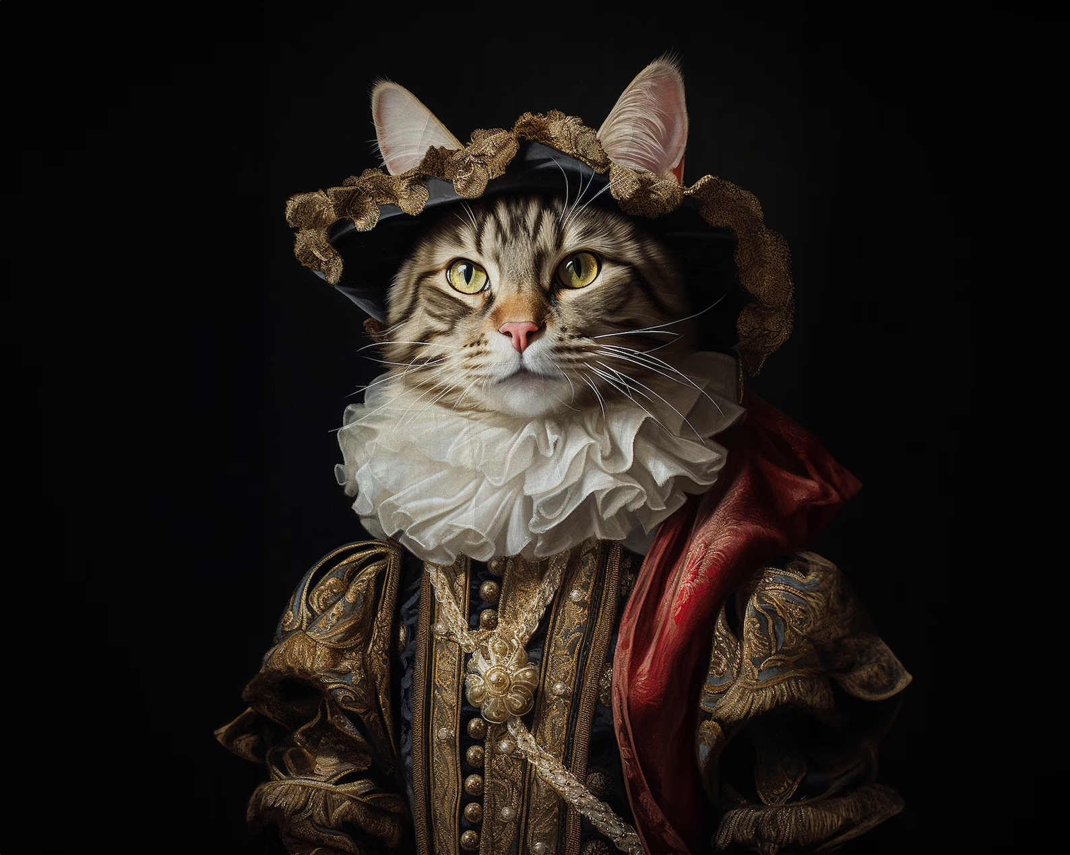
Is this a Zegah?
Notes:
yes (this is where ChatGPT spins!)

Slide 12
Is this a Zegah?
Notes:
no

Slide 13
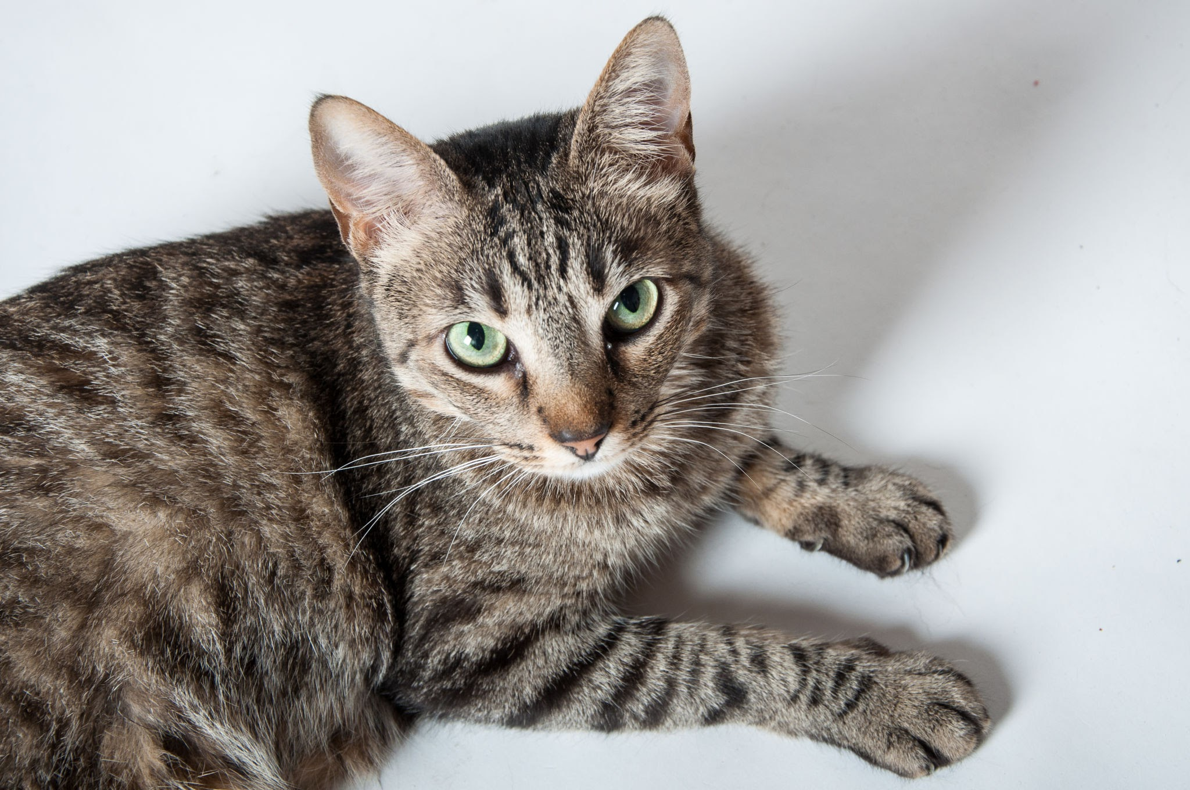
Is this a Zegah?
Notes:
yes

Slide 14
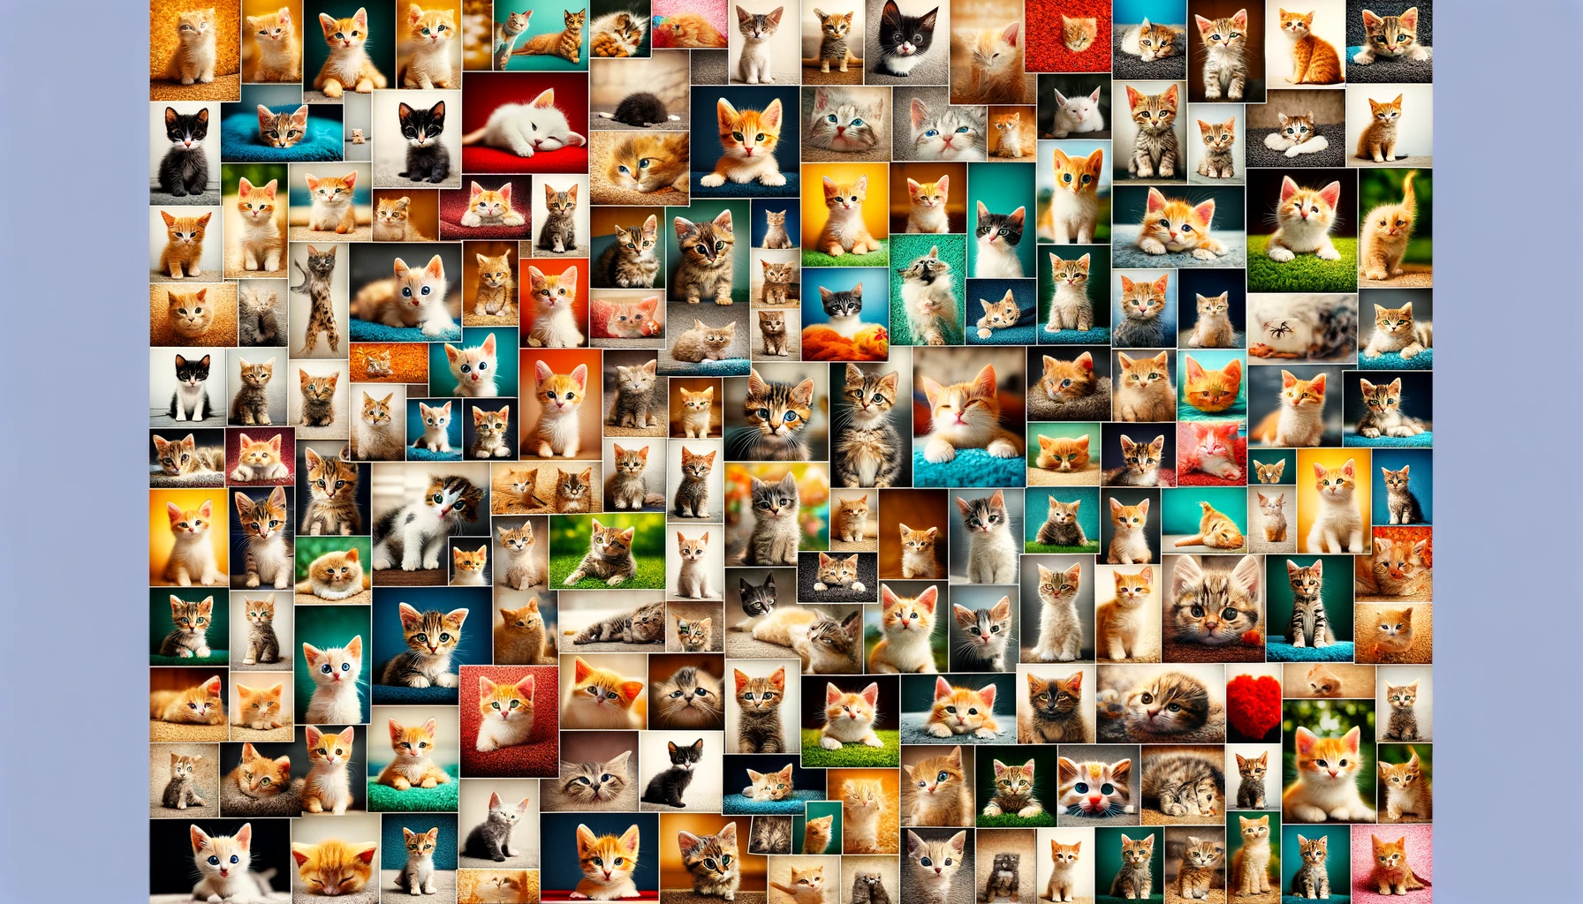
Notes:
What are the LLMs kicking out – it’s predictive analytics, they’re looking for the next syllable, the next token, the next letter or word or pixel. You may not have known you’re looking for a brown tabby cat, probably didn’t have that language but you figured out enough patterns – you didn’t need to be trained on the entirety of the internet or Twitter or whatever but just a few images and you were able to work it out.

Slide 15
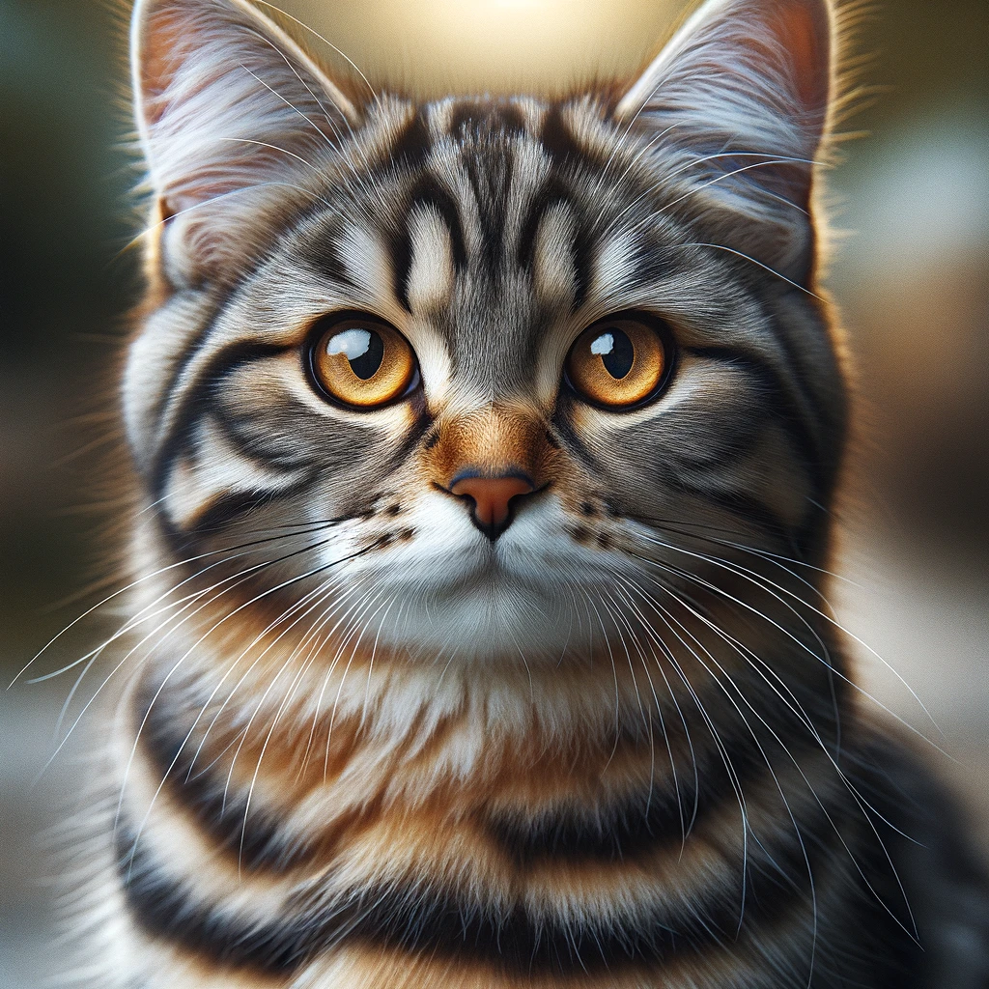
Notes:
When trained on a lot more cat pictures LLMs can do a lot more than this, they can predict the pixels in generative art.

Slide 16
Notes:
Sometimes they don’t get it right, it makes more sense of ‘hallucinations’ – they’re not actually hallucinating, it’s just a mis-forecast. This is a cat that AI generated without ears for some reason.

Slide 17
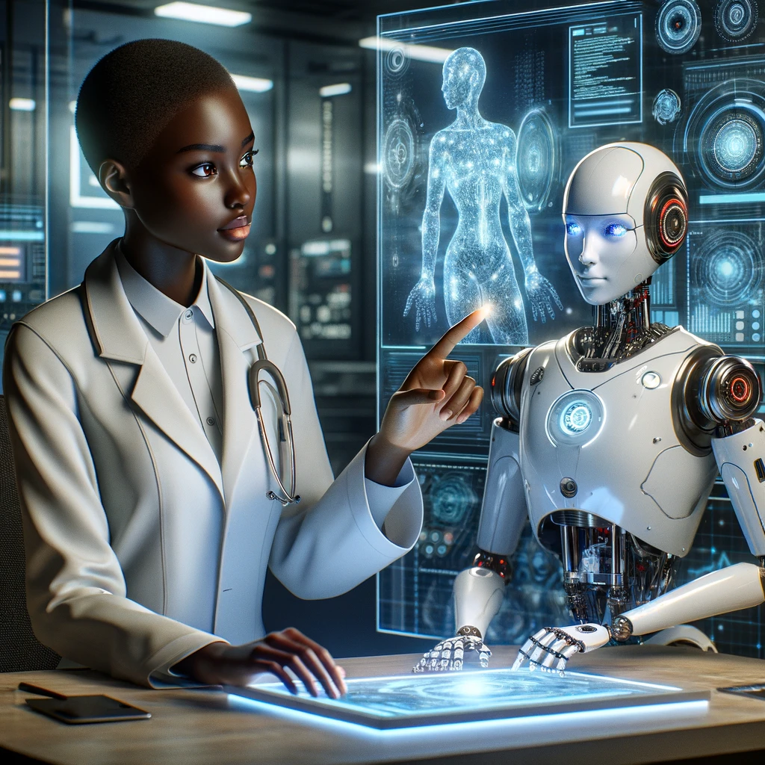
“Human In The Loop”
Notes:
This brings us to the importance of human beings being in the loop, with the idea it is problematic and irresponsible to use AI outputs without having a human in the loop to consider it, to prove it, because it’s just predictive pattern sequence software, you need a human there to help out when you get images of cats without ears, or deal with more serious repercussions depending the purpose of the AI.

