Slide 1
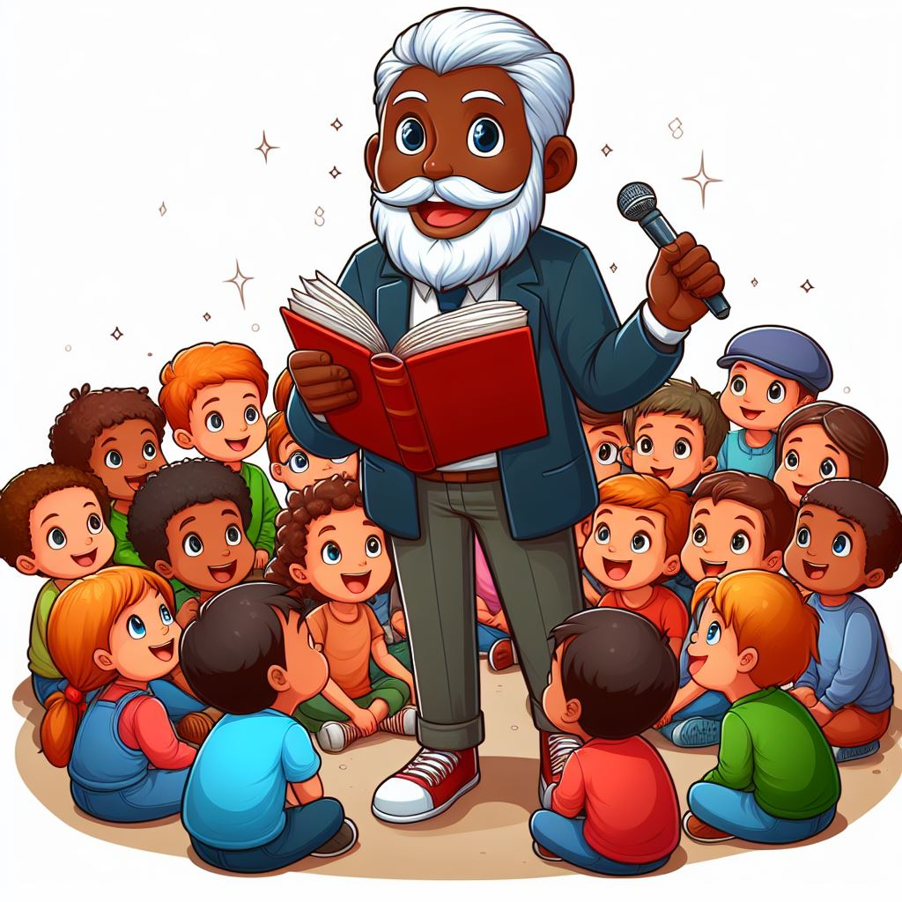
Let’s tell a story!

Slide 2
Let’s tell a story!
We are going to be a ChatGPT program.
Your prompt is:
Write a story about Spider-Man visiting Edinburgh

Slide 3
Let’s tell a story!
Write a word. Pass the paper on.
Write a second word below the first. Pass the paper on.
Write a third word. Fold the paper to cover the first word. Pass the paper on.
Write another word. Fold the paper and pass it on. Only two words to be visible at any time
Repeat!

Slide 4
Let’s tell a story!
Write a word. Pass the paper on.
Write a second word below the first. Pass the paper on.
Write a third word below the second. Pass the paper on.
Write a fourth word. Fold the paper to cover the first word. Pass the paper on.
Write another word. Fold the paper and pass it on. Only three words to be visible at any time
Repeat!

