Slide 1
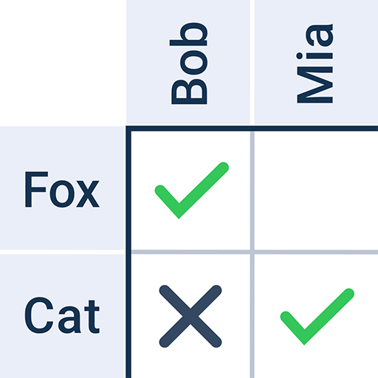
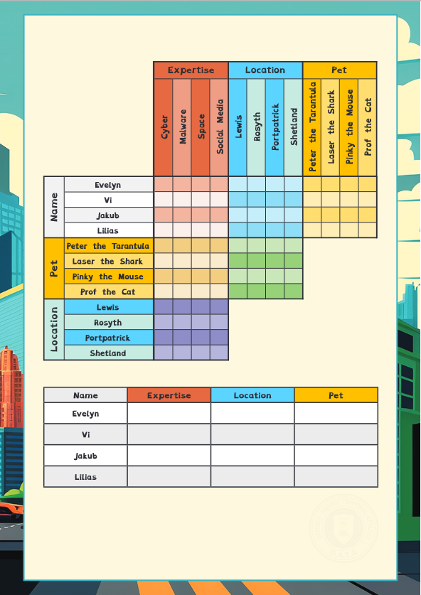
Agent Briefing logic puzzle
In this activity, you will solve a logic grid puzzle.
You will get a worksheet with instructions. You will need a pencil.
You can work in a pair or by yourself.
To solve the puzzle, you need to match each V.I.K.I.N.G. character with their expertise, location, and pet.
Read the clues to work out which boxes to put a tick or a cross in.
Put a tick in the boxes where the row and column definitely do match.
Put a cross in the boxes where the row and column definitely don’t match.

