Slide 1
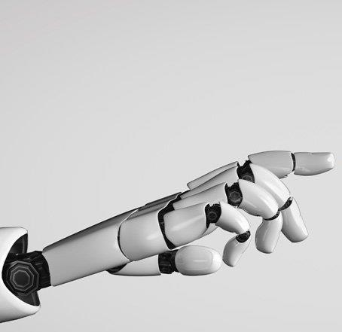
Level 4 RMPS
AI and Religion

Slide 2
Level 4 RMPS
AI and Religion

Slide 3
Starter: Which of these images have been created by AI?
1
Lesson 1
2
3
Lesson 2
Lesson 3

Slide 4
Starter: Which of these images have been created by AI?
Lesson 1
1
2
3
Lesson 2
Lesson 3

Slide 5
Starter: Which of these images have been created by AI?
Lesson 1
1
2
3
Lesson 2
Lesson 3

Slide 6
Starter: Which of these have been created by AI?
4
Lesson 1
Click on videos to start.
5
Lesson 2
Lesson 3

Slide 7
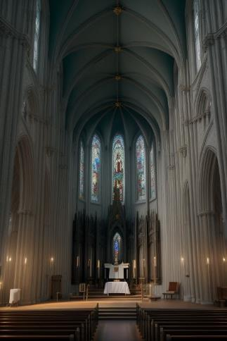
Starter: Which of these have been created by AI?
Lesson 1
1
2
3
4
5
Lesson 2
Which of these were created by AI?
Lesson 3
Answer: All of them

Slide 8
Unit Overview
Lesson 1
Learn about the developments of AI and
the consequences for religious beliefs and practices
Lesson 2
Learn about the moral issues surrounding AI and if it can be trusted to make moral decisions.
Lesson 3
Learn about the philosophical questions arising from the development of AI

Slide 9
Lesson 1
Lesson Overview
Learning Intentions:
Learn about the developments of AI and the consequences for religious beliefs and practices.
Identify some of the impacts AI might have on religious belief and practice
Explain how the values of Christianity might contribute to the development of AI
Consider the responses of World religions to AI and their relevance to your own beliefs and values.

Slide 10
Task 1: The coming AI revolution
Watch the following video interview with representatives of religious/ non religious groups. As you do note any benefits/ concerns they have about the AI revolution.
Benefits | Concerns
Example AI is already driving advancements in many fields such as development of new drug treatments. | Example AI chatbots have significant inbuilt bias that are expressed in what they communicate.

Slide 11
Lesson 1
Lesson 2
Lesson 3

Slide 12
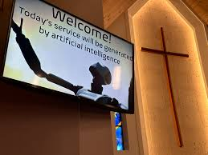
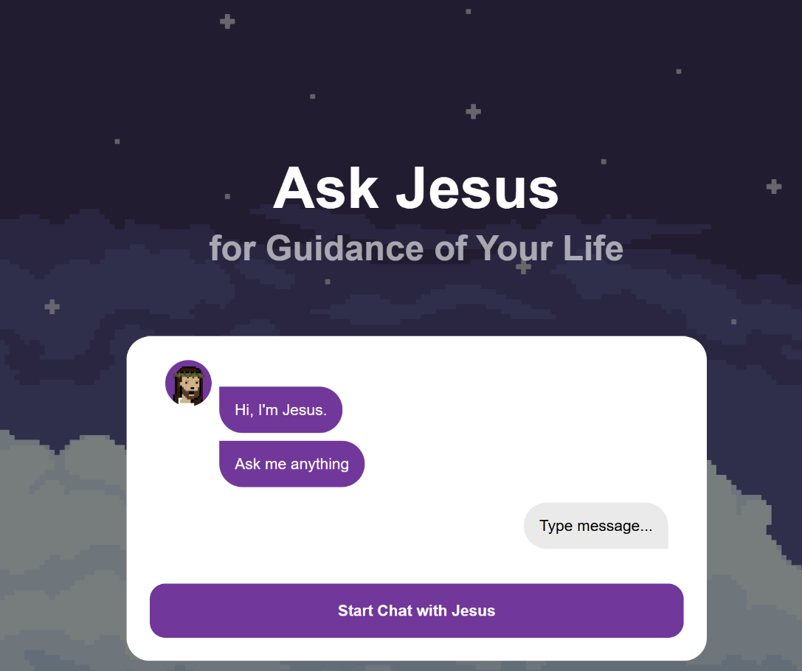
How is AI changing religious belief and practice?
The rapid rise of AI tools is already having significant effects on religious beliefs and practices. This includes…

Slide 13
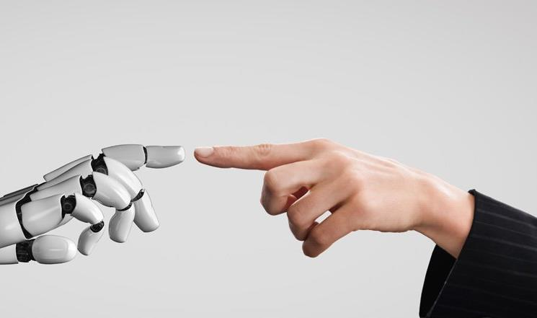
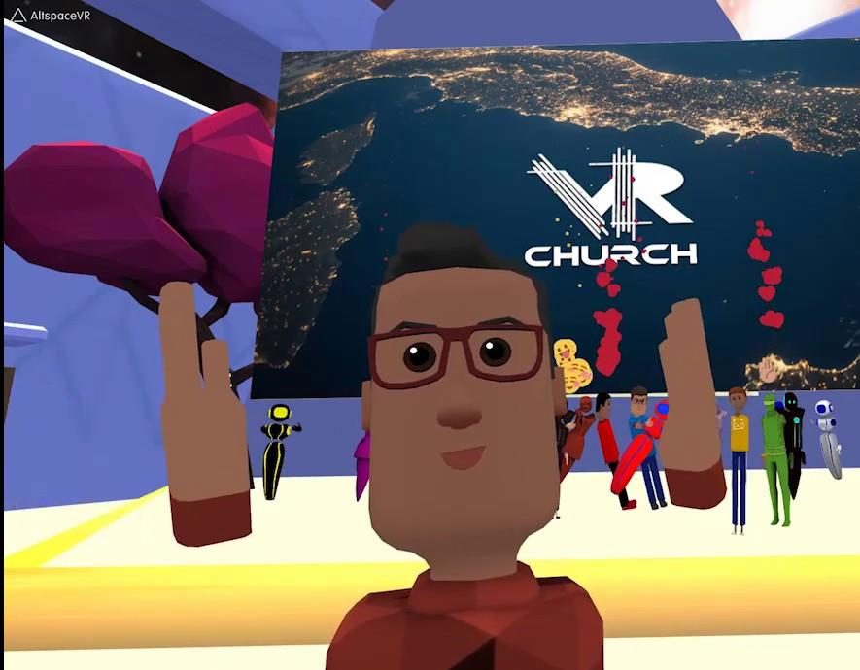
How is AI changing religious belief and practice?
The rapid rise of AI tools is already having significant effects on religious beliefs and practices. This includes…

Slide 14
How is AI changing religious belief and practice?
The rapid rise of AI tools is already having significant effects on religious beliefs and practices. This includes…

Slide 15
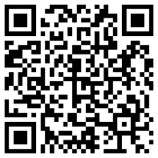
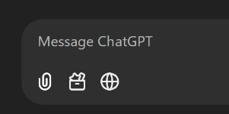
Task 1: AI and Religion Research task
Use an AI chatbot to analyse the articles about the use of AI by religious groups found in the Lesson 1 Task 1 document. Ask the AI Chatbot questions to complete the research grid below.
To complete this task, you could use one of the following AI chatbots.
Ask the chatbot to provide short, simple answers.
Ask the Chatbot to summarise the articles in three bullet points each. Read the summary. | One consequence of AI for religious practice | One impact of AI on religious belief | Does the Chatbot think it could assist with religious practices
Create and ask your own enquiry question | Two examples of how AI is being used by religious groups. | A concern some have about AI | One benefit of AI to religious groups
An argument against using AI | An argument for using AI | Give your own view on one of the uses of AI in religious practices. | The most controversial use of AI in these articles.
Copy the text in the word document and paste it into the Copilot chat box
Upload the document to NotebookLM by using the “Add Source” button or use this link
AI Research Notebook
Upload the document to ChatGPT using the attachment button next to the chat box.

Slide 16
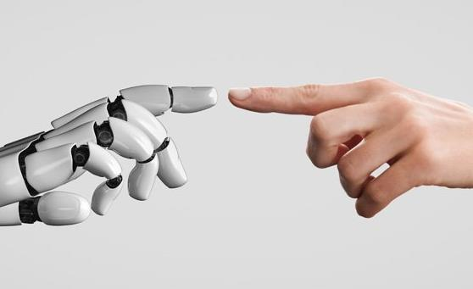
Task 1: AI and Religion Research task
Use an AI chatbot to analyse the articles about the use of AI by religious groups found in the Lesson 1 Task 1 document. Ask the AI Chatbot questions to complete the research grid below.
Ask the Chatbot to summaries the articles in three bullet points each. Read the summary. | One consequence of AI for religious practice | One impact of AI on religious belief | Does the Chatbot think it could assist with religious practices
Create and ask your own enquiry question | Two examples of how AI is being used by religious groups. | Ask the chatbot to quiz you on the articles. | One benefit of AI to religious groups
An argument against using AI | An argument for using AI | Give your own view on one of the uses of AI in religious practices. | The most controversial use of AI in these articles.
To complete this task, you could use one of the following AI chatbots.
Copy the text in the word document and paste it into the Copilot chat box
Upload the document to NotebookLM by using the “Add Source” button or use this link
AI Research Notebook
Upload the document to ChatGPT using the attachment button next to the chat box.

Slide 18
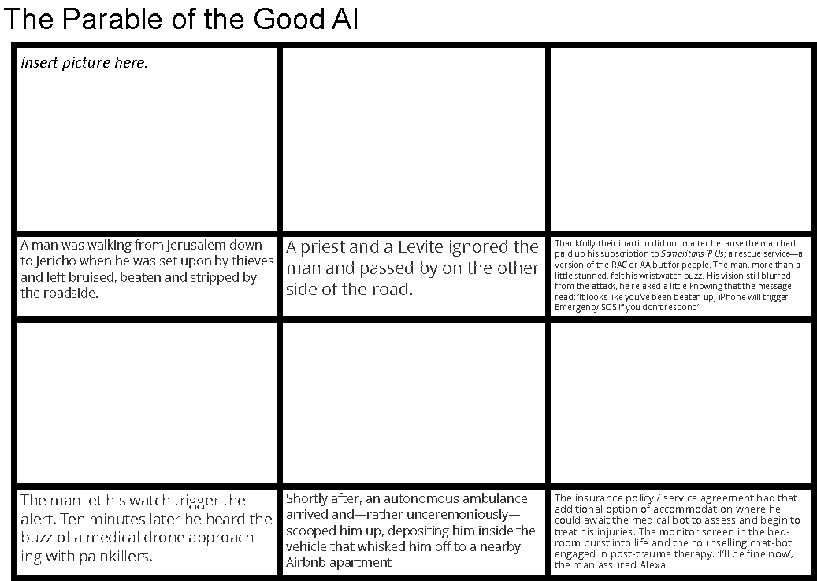
Task 2: The parable of the Good AI
Read the story of the Parable of the Good AI and use an image generator such as ChatGPT, Canva Magic Media or OpenArt.AI to create an image for each scene of this story. Insert your images into the storybook template document. You could do this task in a group adding one or two pictures each.
To complete this task, you could use one of the following AI tools.
Ask Copilot to create and image. Provide a short clear description.
Go to
canva.com/ai-image-generator
Ask ChatGPT to create and image. Provide a short clear description.
https://chatgpt.com/share/67d05842-62a0-800f-ad8f-355be319fe8d

Slide 19
Task 2: The parable of the Good AI
Read the story of the Parable of the Good AI and use an image generator such as ChatGPT, Canva Magic Media or OpenArt.AI to create an image for each scene of this story. Insert your images into the storybook template document. You could do this task in a group adding one or two pictures each.
To complete this task, you could use one of the following AI tools.
Ask Copilot to create and image. Provide a short clear description.
Go to
canva.com/ai-image-generator
Ask ChatGPT to create and image. Provide a short clear description.

Slide 20
Task 3: The Parable of the Good AI
When you have finished creating your Parable of the Good AI storybook answer the following questions. If you have completed this task collaboratively you could share your learning before you record your answers.
This parable was based on the Parable of the Good Samaritan a story that Jesus told. He used this story to teach people we are all responsible to care for those in need. Often this is referred to as the “Golden rule” which could be summarised as “Do to others as you would to yourself”.
Q2. a) Should AI be made to obey the Golden rule? Why/ Why not?
b) Can you suggest any other rules/ laws AI should be held to?

Slide 21
Check your learning
Success Criteria
Tell your partner…
Identify some of the impacts AI might have on religious belief and practice
One thing you have learned about a place of worship
Explain how the values of Christianity might contribute to the development of AI
One thing you might find in a church
Consider the responses of World religions to AI and their relevance to your own beliefs and values.
One reason a Christian might go to church

