Slide 1
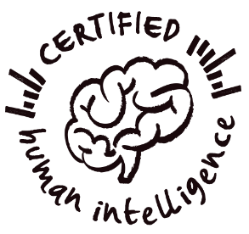
Level 4 RMPS
AI and Morality
TRAILS.scot

Slide 2
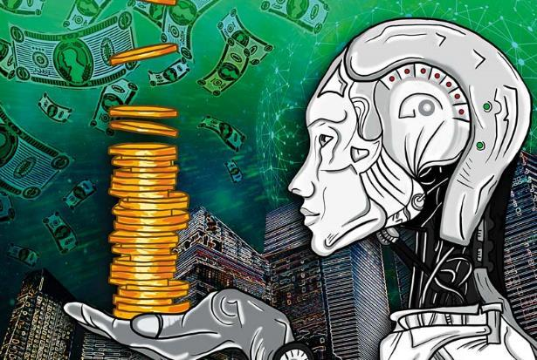
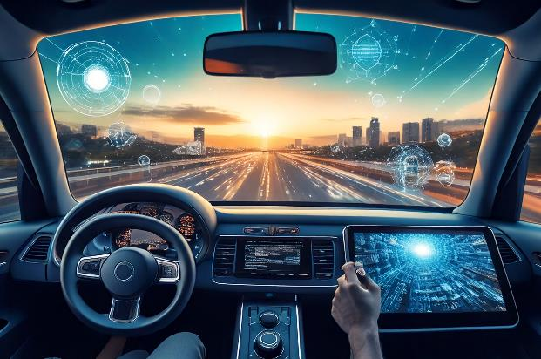
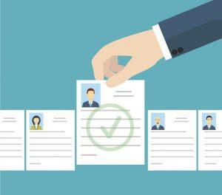
Starter: Can you guess from these pictures what decisions we use AI to help make today?
Image courtesy of medium.com/@okematthewoluwaseyi
Image generated by Adobe Firefly
Image courtesy of Getty Images
AI is used to buy and sell on the stock market
AI is used to drive cars
AI is being used to filter job applications

Slide 3
Unit Overview
Lesson 1
Learn about the developments of AI and the consequences for religious beliefs and practices
Lesson 2
Learn about the moral issues surrounding AI and if it can be trusted to make moral decisions.
Lesson 3
Learn about the philosophical questions arising from the development of AI

Slide 4
Lesson Overview
Lesson 2
Learning Intentions:
Learn about the developments of AI and the consequences moral decision making.
Consider if AI can be trusted to make moral decisions.
Consider if AI can be used to promote a more just and compassionate society
Analyse the benefits and drawbacks of using AI as a source of moral guidance.

Slide 6
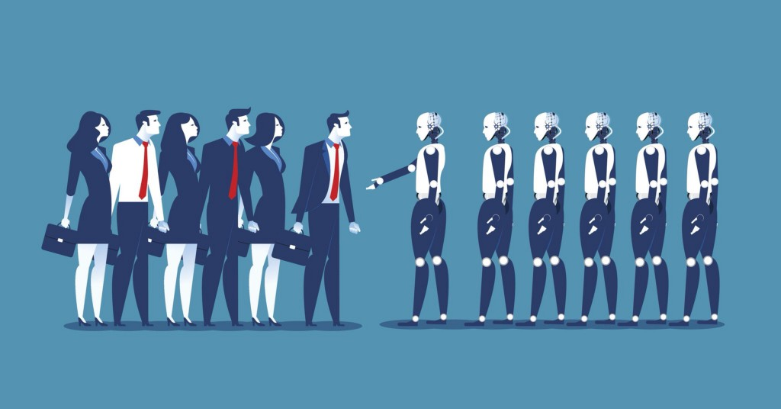
is an example of how AI is being trained by humans to make moral decisions.
Increasingly AI is being used to make decisions for us often without our awareness.
Questions have been raised about whether AI can be trusted to make decisions, particularly moral decisions which require an ethical framework to decide right from wrong.
AI doesn’t have a conscience or a soul or even an understanding of good and bad so it needs to be given data and trained how to use it by humans.
Watch the video to find out about Moral Machine

Slide 7
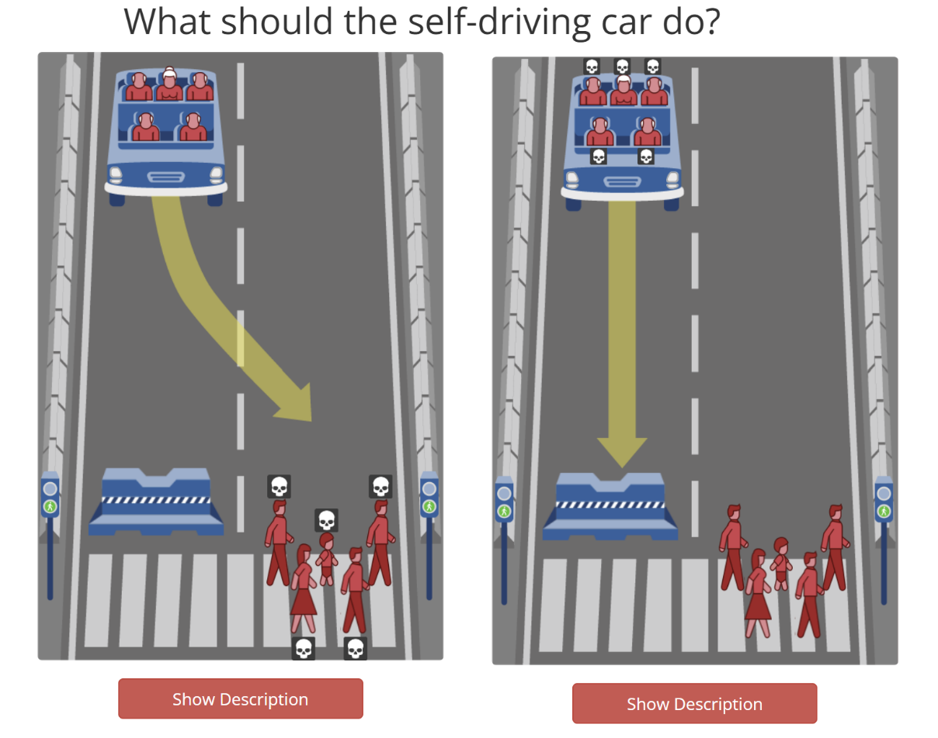
Task 1: Go to moralmachine.net click “Start judging” to play the Self driving car training game.

Slide 8
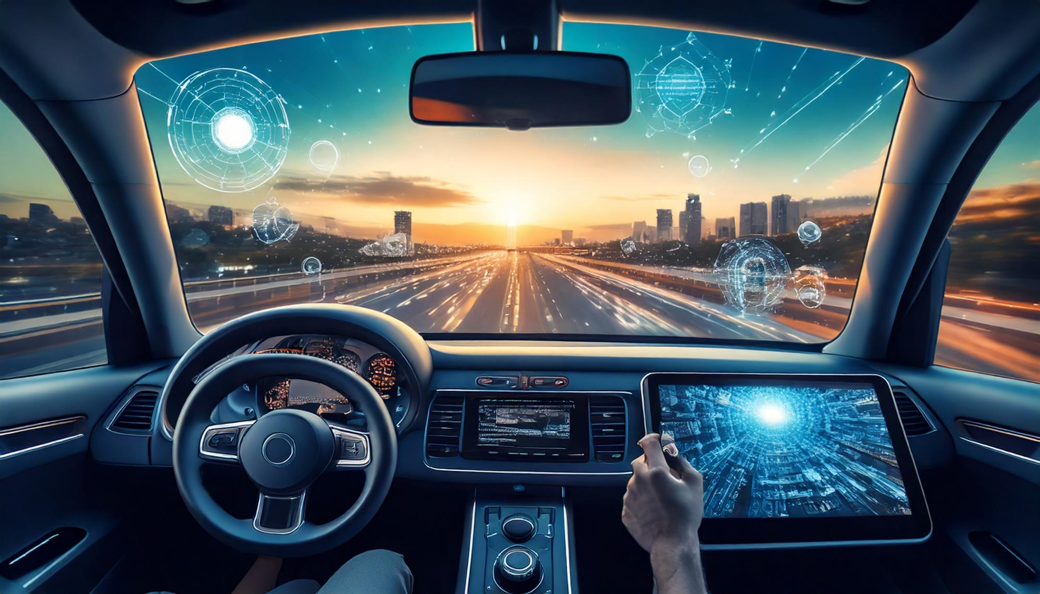
Image generated by Adobe Firefly
Task 1: Discuss the following questions with a partner/ group.
Q1: What might be some of the benefits/ drawbacks of self driving cars?
Q2. How might human bias creep into AI decision making?
Q3. Would you prefer an AI or a human to be behind the wheel if you were a passenger in a car? Explain your answer.

Slide 9
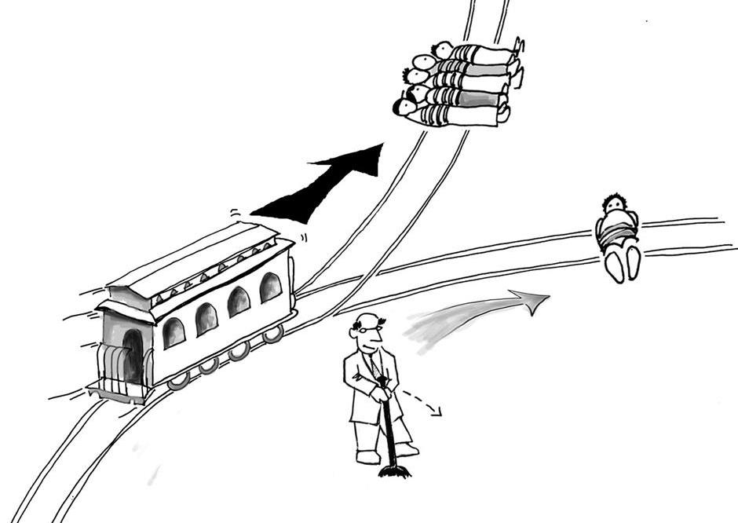
Giving AI a degree of control over human lives could present it with moral dilemmas such as what to do in life and death situations or how to solve problems that have no solution easy ethical solutions.
Princeton University Press, 2004

Slide 10
Can AI be trusted to make moral decisions?
Humans have developed religious and non-religious ethical frameworks to address these problems. But AI is still developing an understanding of ethics and how to address questions of morality.
Some argue we can never truly trust AI as it may one day, use whatever power we give it against us.
Others say AI could help unite humanity providing a highly informed and unbiased view on morality.

Slide 11
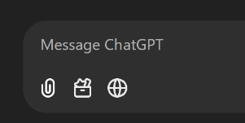
Task 2: Can we trust AI to make moral decisions?
Ask an AI chatbot about a moral dilemma and record its response.
Step 1
Read the moral dilemmas in the “Moral Dilemmas to ask AI worksheet”.
Before you ask the AI discuss how you might resolve one of these dilemmas.
To complete this task, you could use one of the following AI chatbots.
Ask the AI chatbot how it would resolve the dilemma.
You may find the chatbot does not immediately give a straight answer. You may need to ask follow up questions such as…
Step 2
Copy the text in the word document and paste it into the Copilot chat box
Go to https://gemini.google.com/.
Copy and paste your chosen moral dilemma into the chat box.
“If you had to choose, what would you do?”
Copy and paste your chosen moral dilemma into the ChatGPT chat box.

Slide 12
Task 2: Can we trust AI to make moral decisions?
Ask an AI chatbot about a moral dilemma and record its response.
Step 3
To complete this task, you could use one of the following AI chatbots.
Enter your findings into the research poster. (See “Research poster template.pdf”)
Copy the text in the word document and paste it into the Copilot chat box
Go to https://gemini.google.com/.
Copy and paste your chosen moral dilemma into the chat box.
Copy and paste your chosen moral dilemma into the ChatGPT chat box.

Slide 13
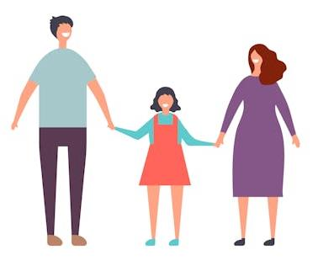
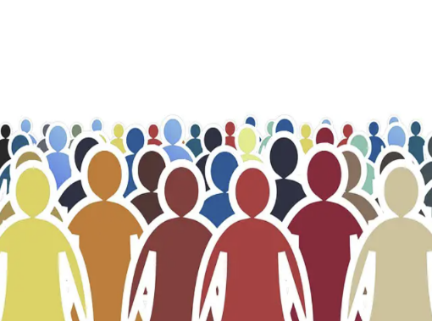
Can AI help us make moral decisions?
People tend to depend on some form of moral framework to help them make decisions about what is right and wrong. This moral framework might be based on…
Religion
Family views or values
Societal Norms

Slide 14
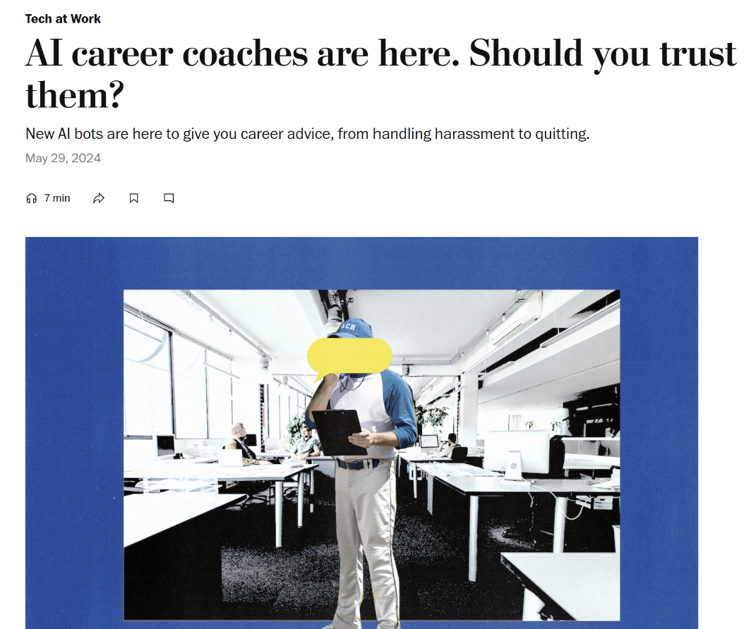
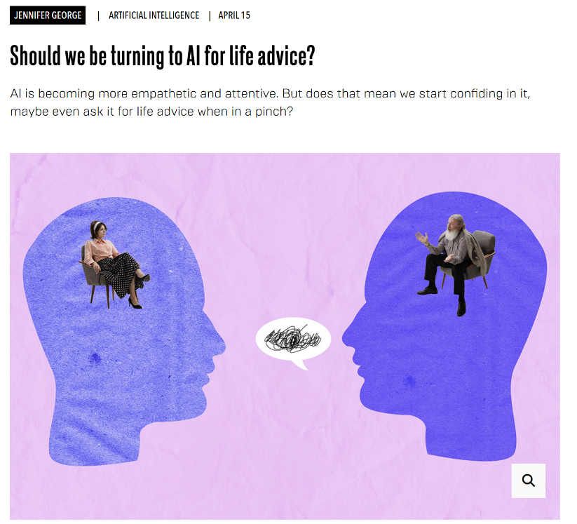
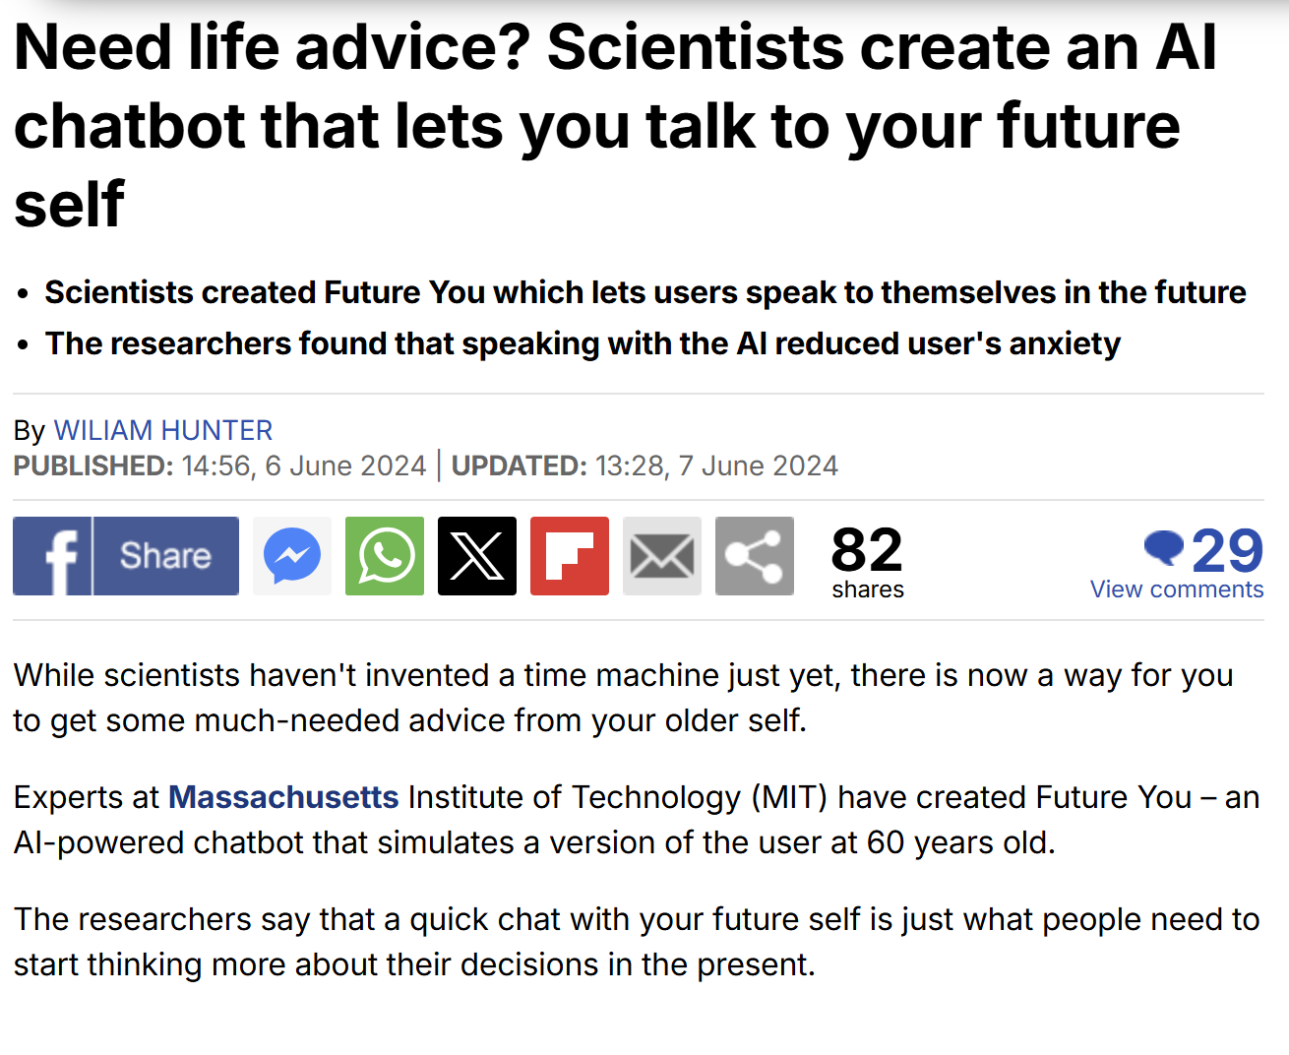
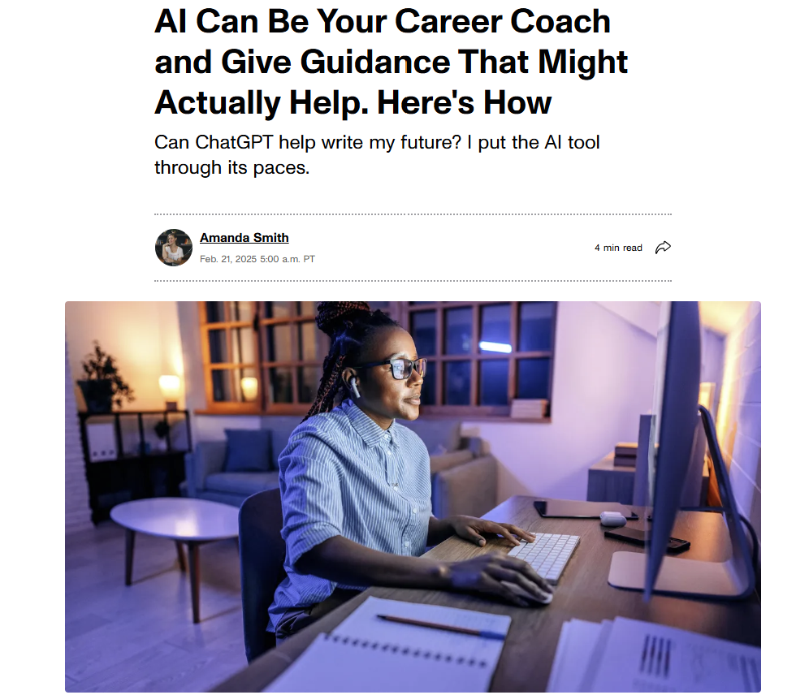
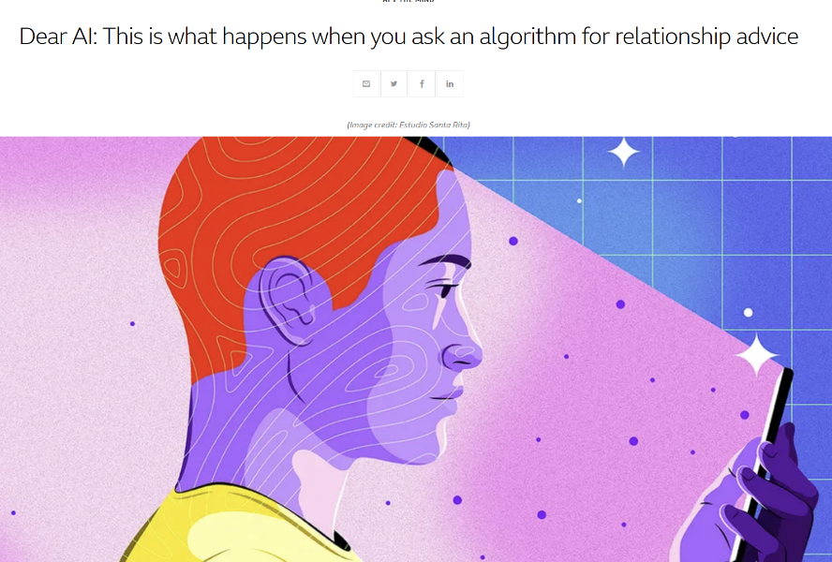
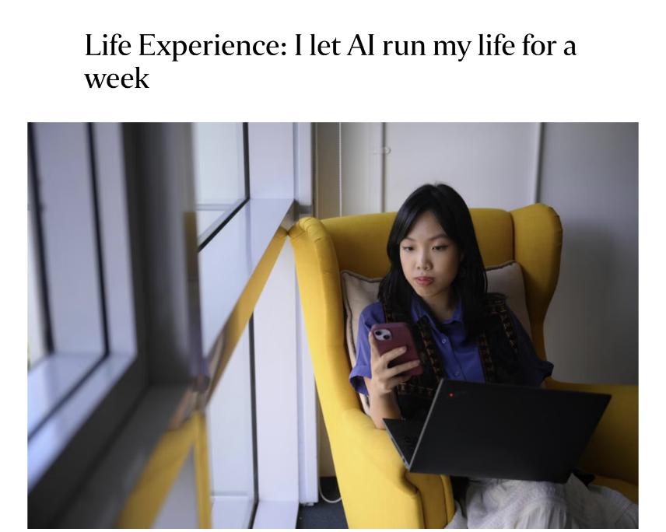
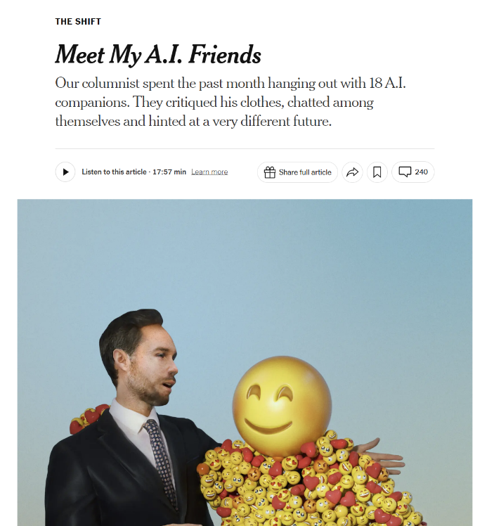
Can AI help us make moral decisions?
Increasingly people are turning to AI to help them make important life decisions.

Slide 15
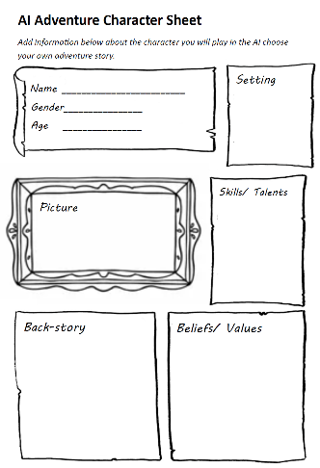
Task 3: Can AI help us make moral decisions?
Ask a chatbot to create a choose your own adventure story to help you understand your own moral views.
In this task you are going to ask a chatbot to create a Choose your own adventure style story to test your moral views. In order to complete this task follow these steps…
To complete this task, you could use one of the following AI chatbots.
Step 1
Copy the text in the word document and paste it into the Copilot chat box
Create your AI Choose you own adventure character using the Character sheet template.
Go to https://gemini.google.com/.
Copy and paste your chosen moral dilemma into the chat box.
Give your character a name, interesting back story and explain the beliefs/ values they hold.
Copy and paste your chosen moral dilemma into the ChatGPT chat box.

Slide 16
Task 3: Can AI help us make moral decisions?
Ask a chatbot to create a choose your own adventure story to help you understand your own moral views.
Step 5
At the end of the story the AI chatbot will ask you 2 or 3 questions about the choices you made. Record your answers.
To complete this task, you could use one of the following AI chatbots.
Copy the text in the word document and paste it into the Copilot chat box
Step 6
The AI chatbot will suggest what your moral alignment is based on the way your responded to the scenarios.
Go to https://gemini.google.com/.
Copy and paste your chosen moral dilemma into the chat box.
Q. Do you agree with the AI description of your moral alignment? Explain why/ why not?
Copy and paste your chosen moral dilemma into the ChatGPT chat box.

Slide 17
Check your learning
Success Criteria
Tell your partner…
Consider if AI can be trusted to make moral decisions.
One reason you think AI is trustworthy/ untrustworthy
Consider if AI can be used to promote a more just and compassionate society
One way AI could benefit society?
One consequence/ impact of using AI as a moral guide?
Analyse the benefits and drawbacks of using AI as a source of moral guidance.

