Slide 1

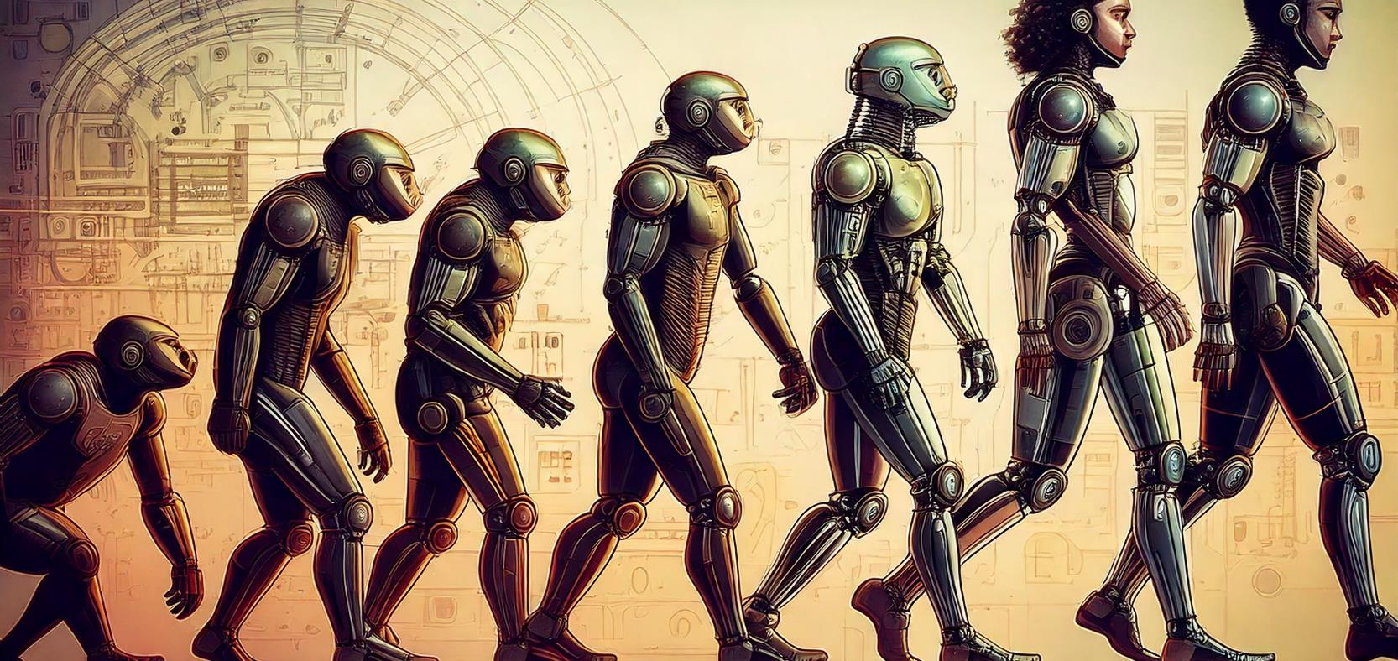

AI and Philosophy
TRAILS.scot

Slide 2

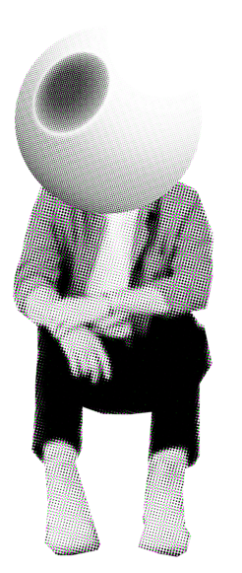
Unit Overview
Lesson 1
Learn about the developments of AI and the consequences for religious beliefs and practices
Lesson 2
Learn about the moral issues surrounding AI and if it can be trusted to make moral decisions.
Lesson 3
Learn about the philosophical questions arising from the development of AI

Slide 3


Lesson 3
Lesson Overview
Learning Intention:
Learn about the developments of AI and the philosophical questions it raises.
Identify some of the philosophical questions raised.
Explain the differences and similarities between humans and AI
Create a test to determine what is an AI or human response.

Slide 4
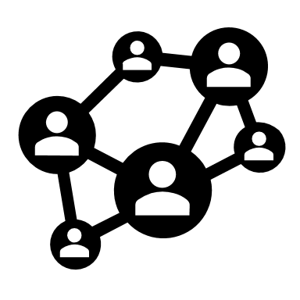




Social Interaction
Consciousness and Emotions
Learning and Adaptation
Physical Presence
Decision Making
Starter: Make a list of the differences between humans and AI

Slide 5


Social Interaction
Consciousness and Emotions
Learning and Adaptation
Physical Presence
Decision Making
If in the future AI overcomes these differences, should we treat AI like a human?

Slide 6


Slide 7
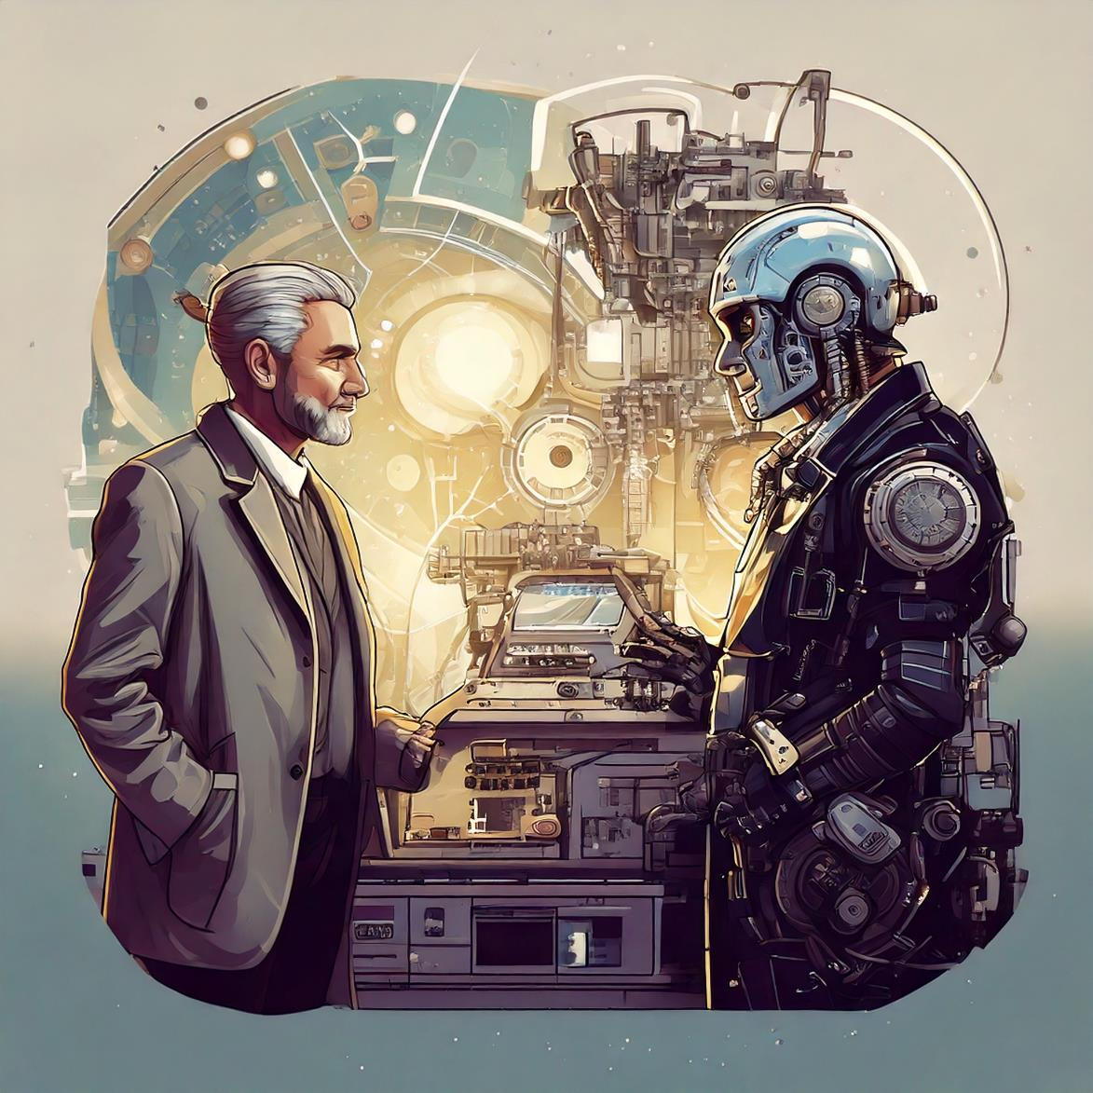
The Turing Test
Helps us understand how smart computers can become.
Tests if machines can "think" or just copy human behaviour.
Raises big questions:
Named after Alan Turing, a famous computer scientist.
A test to see if a machine (like a chatbot) can act like a human.
If a human talks to the machine and can’t tell weather its an AI or a person, the machine "passes"!
Image generated by Adobe Firefly

Slide 8
The Turing Test
Some modern chatbots have fooled people!
In 2014, a chatbot called Eugene Goostman convinced people it was a real 13-year-old boy.
Today, AI like ChatGPT can often have human-like conversations too.
Helps us understand how smart computers can become.
Tests if machines can "think" or just copy human behaviour.
Raises big questions:
  Should we create machines that pretend to be human?
Can machines ever truly think?
Can machines ever truly think?
Image generated by Adobe Firefly

Slide 9
The Turing Test
Some modern chatbots have fooled people!
In 2014, a chatbot called Eugene Goostman convinced people it was a real 13-year-old boy.
Today, AI like ChatGPT can often have human-like conversations too.
A new Turing Test is needed to determine if modern day Chatbots demonstrate human-like intelligence.
Image generated by Adobe Firefly

Slide 10




Task 1: Create your own Turing Test
Create a test to discover if you are talking to an AI or a human.
Step 1
To complete this task, you could use one of the following AI chatbots.
Create 5 questions you will ask an AI chatbot.
Step 2
Ask a partner your questions and record their answers.
Type your questions into the chat box and record the answers
Step 3
Ask an AI chatbot your questions and record the answers. You will need to prompt it you are conducting a Turing Test.
Go to https://gemini.google.com/.
Type your questions into the chat box and record the answers
“Answer the questions in such a way as to convince the reader you are human not AI”
Type your questions into the chat box and record the answers

Slide 11
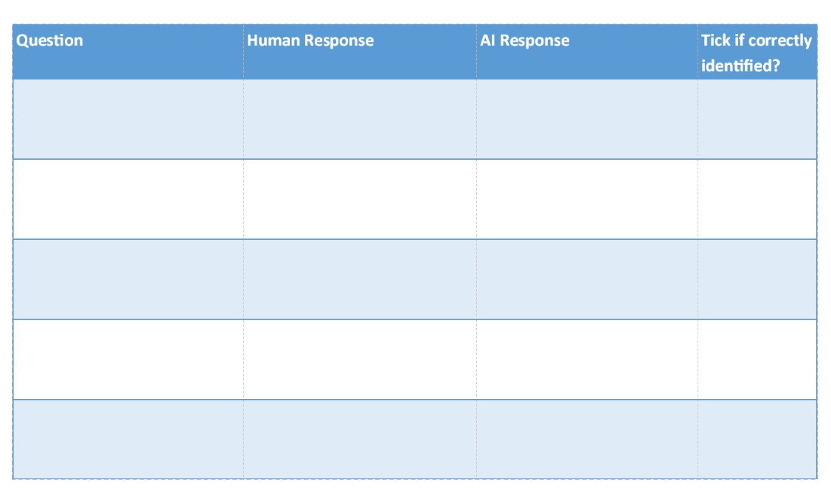
Task 1: Create your own Turing Test
Create a test to discover if you are talking to an AI or a human.
Step 4
Find another partner.
Tell them the questions and the two sets of answers. Ask them to guess which one is a human response and which is the AI.
If your partner correctly identified which answers were AI/ Human at least 3 times you have succeeded in creating a test which can identify an AI.
You can use the Lesson 3 worksheet to record your results.

Slide 12
Task 2: Answer the following questions.
If a machine can have a conversation just like a human, does that mean it is thinking? Why or why not?
What dangers might there be if we can’t tell the difference between humans and AI?
Should we treat advanced AI with respect, like we treat other humans? Give reasons for your answer
Would it be wrong to switch off or delete a robot that acts like a human?

Slide 13




Check your learning
Success Criteria
Tell your partner…
Identify some of the philosophical questions raised.
Do you think AI will become as intelligent as humans?
Explain the differences and similarities between humans and AI
Do humans have a soul?
Can AI develop a soul?
Create a test to determine what is an AI or human response.
Did your test work? Why/ Why not?

