Slide 1
How AI creates content
TRAILS.scot

Slide 2
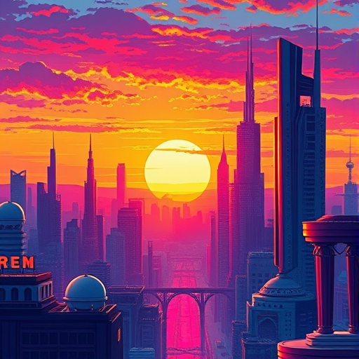
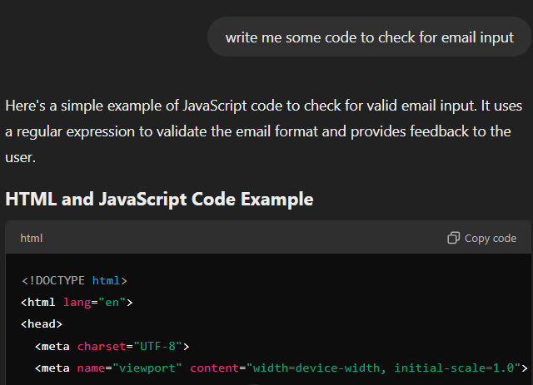
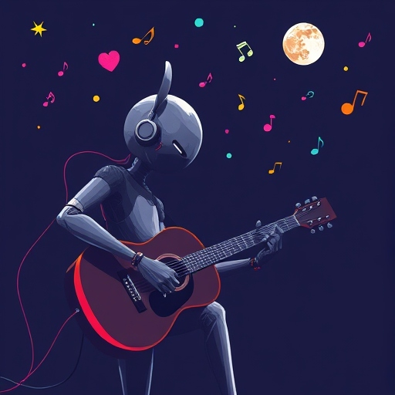
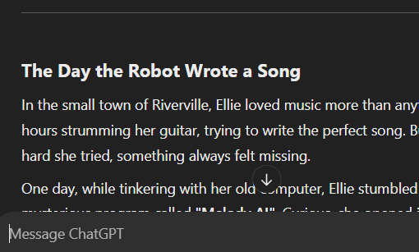
What is Generative AI?
Generative AI (Gen AI) is a type of artificial intelligence that can create things. It can make pictures, stories, songs, computer code, and more—all by learning patterns from data.
Notes:
This slide explains simply what Generative AI is.

Slide 3
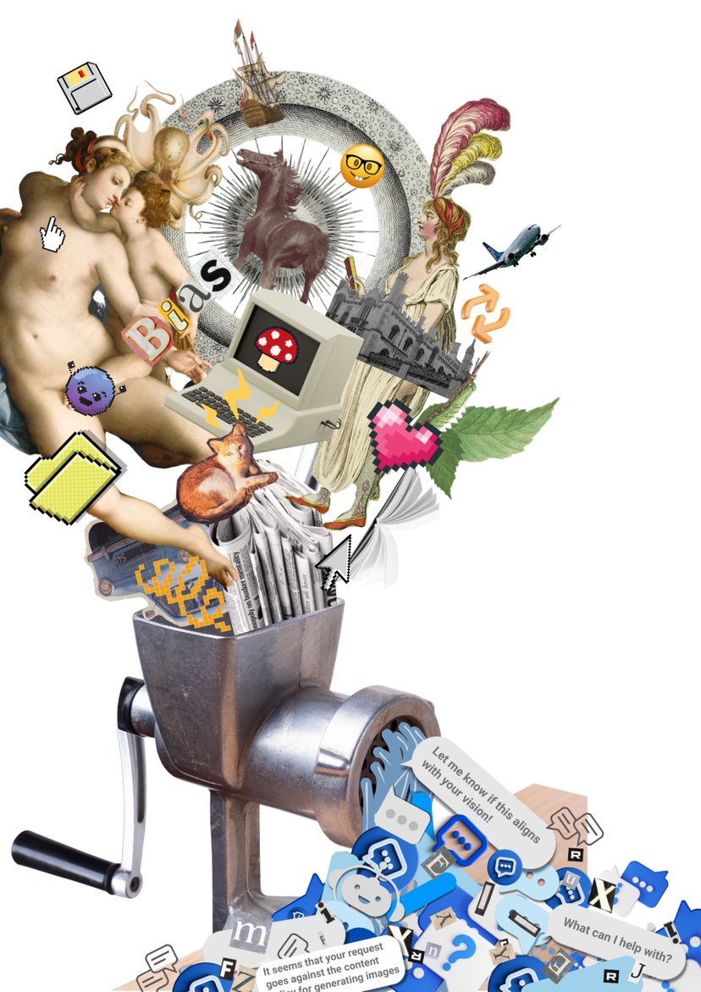
How does Generative AI work?
For Gen AI to create, it first needs to learn.
Gen AI models are trained on vast numbers of examples (like photos, songs, or text) to discern patterns.
After training, it can use the learned patterns to generate “new” content.
Janet Turra & Cambridge Diversity Fund / https://betterimagesofai.org / https://creativecommons.org/licenses/by/4.0/

Slide 4
Watch this 2 minute video for an introduction GenAI.

Slide 5
Examples of Gen AI Usage
Image Generation: For use in webpages, advertisements, branding, and illustration.
Text Generation: Chatbots, creating web content for search engine optimisation, summarising text, generating quizzes, writing emails, articles, and computer code.
Music Composition: Songs and melodies for use in video games or films.

Slide 6
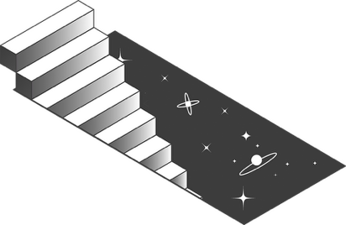
Text Generation with Large Language Models

Slide 7
RESOURCE TITLE
Examples of LLMs include:
How is text generated?
Text is generated using Large Language Models (LLMs)
LLMs are a type of Generative AI used specifically for generating text.
Examples of LLMs include
TRAILS.scot

Slide 8
Watch this 2.5 minute video for more details on how LLMs work.
TRAILS.scot

Slide 9
RESOURCE TITLE
Now, let’s take part in an exercise that will help us understand the very basics of how LLMs work.
In this activity, we’ll work together to generate a sentence in a similar (but much simpler) way to LLMs.
Let’s generate a sentence
02
03
04
Link to exercise on DES site
TRAILS.scot

Slide 10
RESOURCE TITLE
You are going to train our model by giving examples of:
An animal (like ‘cat’ or ‘aardvark’)
A past tense verb (like ‘sat’ or ‘spoke’)
A preposition (such as ‘on’ or ‘opposite’)
And an object (like ‘mat’ or ‘pencil case’)
Let’s generate a sentence
02
03
04
Link to exercise on DES site
TRAILS.scot

Slide 11
RESOURCE TITLE
Let’s write a story
Alice was beginning to get very tired of sitting by her sister on the bank, and of having nothing to do: once or twice she had peeped into the book her sister was reading, but it
had no pictures or conversations in it, "and what is the use of a book," thought Alice, "without pictures or conversations?"
The previous method just used frequency (most popular word) to choose each word in the sentence.
But LLMs use context as well, including looking at the prompt, and a certain window of words that came before in the text to determine the most probable next word.
In this next activity, we’ll use a prompt and a context window to help us generate a story!
https://dataschools.education/resource/lets-write-a-story/
Context window
What word should come next?
TRAILS.scot

Slide 12
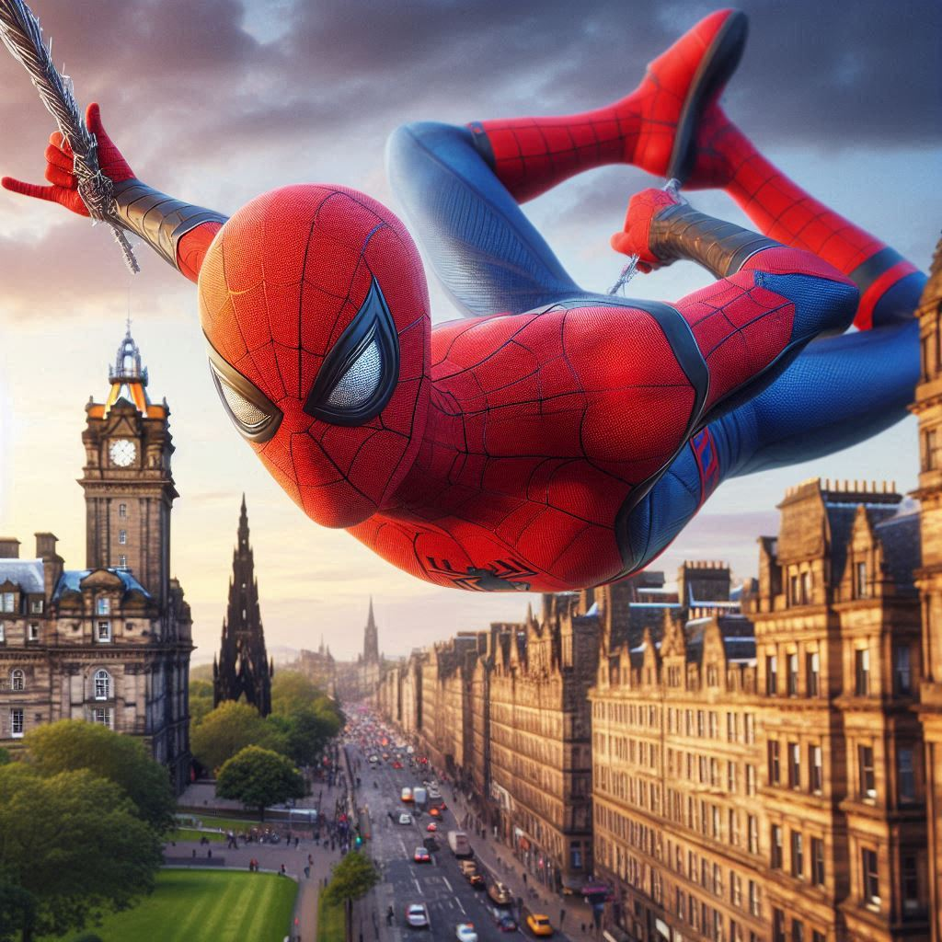
RESOURCE TITLE
Let’s write a story
Your prompt is:
Write a story about Spider-Man visiting Edinburgh
TRAILS.scot

Slide 13
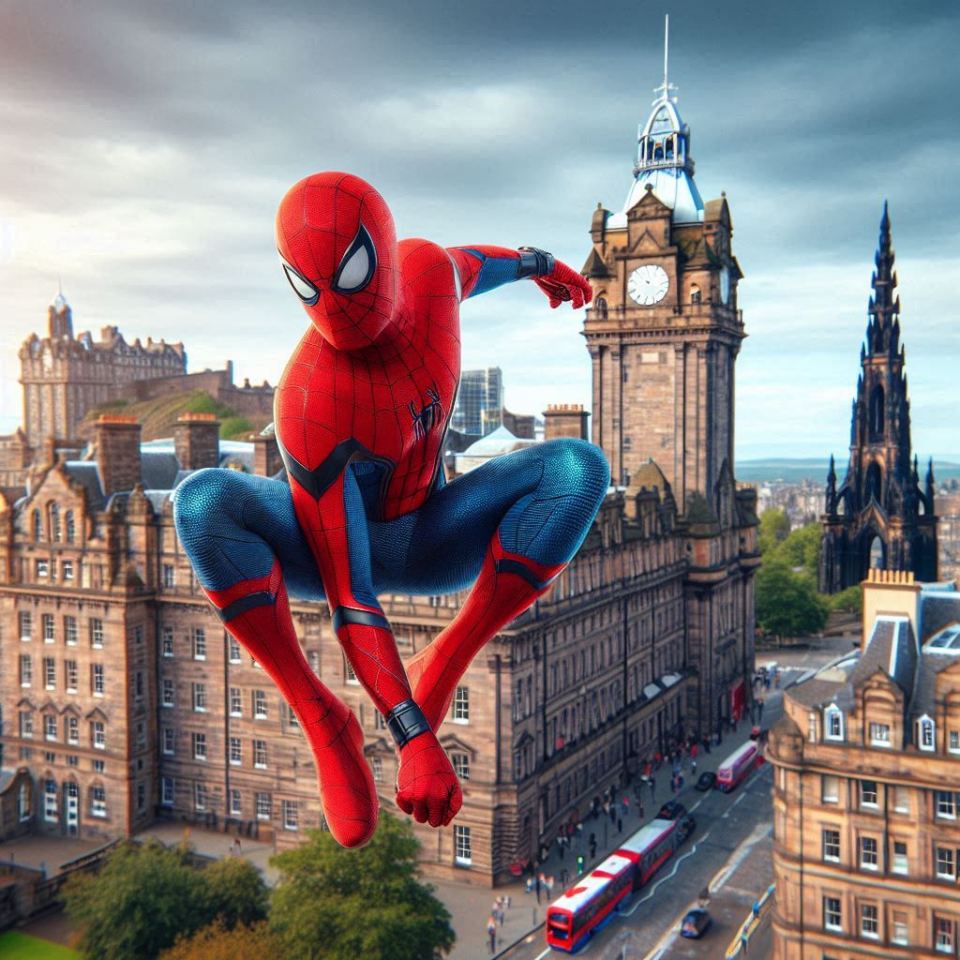
RESOURCE TITLE
Let’s write a story
Write a word. Pass the paper on.
Write a second word below the first. Pass the paper on.
Write a third word below the second. Pass the paper on.
Write a fourth word. Fold the paper to cover the first word. Pass the paper on.
Write another word. Fold the paper and pass it on. Only three words to be visible at any time
TRAILS.scot

Slide 14
Image Generation

Slide 15
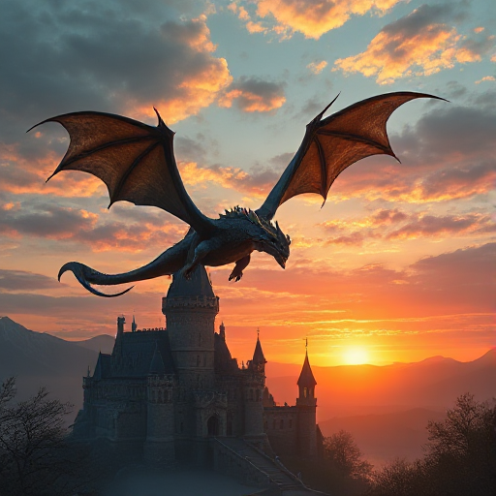
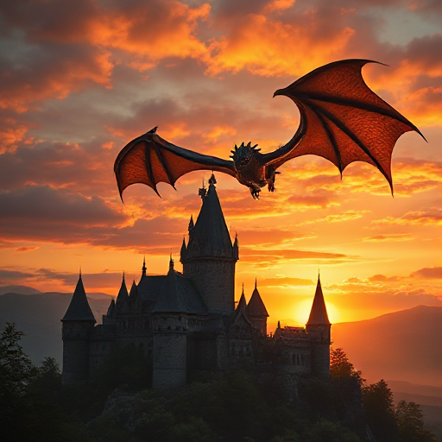
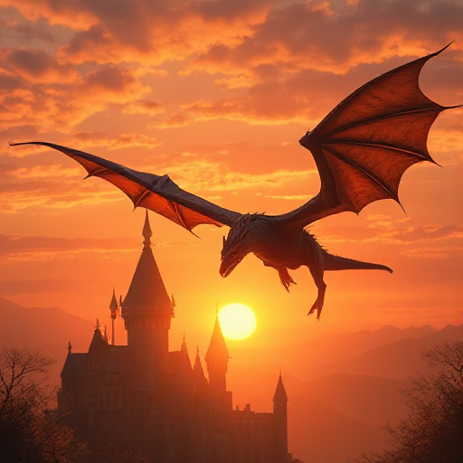
How does image generation work?
Image generation models are a type of Generative AI used to create pictures and artwork.
These models are trained on millions of images, many of which have labels or captions (e.g., "dog," "sunset"). The labels help the AI learn how to connect words to pictures.
When you give a description (e.g., “a dragon flying over a castle at sunset”), the model uses what it has learned to create a brand-new image that matches your request.

Slide 16
How does image generation work?
This 5 minute video provides an excellent explanation of how AI image generators take your prompt and turn it into an image.

Slide 17
Prompt Battle
Now let’s start trying out an AI image generation tool!
Your task is to create the best image of “The School of the Future” using an AI image generation tool.
Work in teams using the Prompt Crafting Worksheet and choose your best image to enter into the battle. Vote as a class on the winning image!

Slide 18
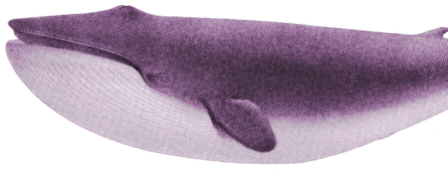
Generate like an AI!
Let’s get a taste of how AI image generators work.
I’m going to train you on some images you’ve never seen before.
Pay close attention to patterns in the images.
Notes:
Optional: Test your Gen AI creation
Remember when we looked at classifiers…..
https://teachablemachine.withgoogle.com/

Slide 19
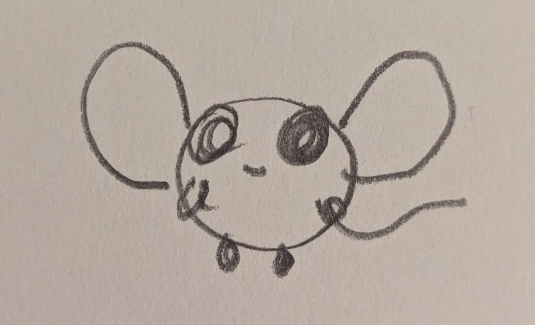
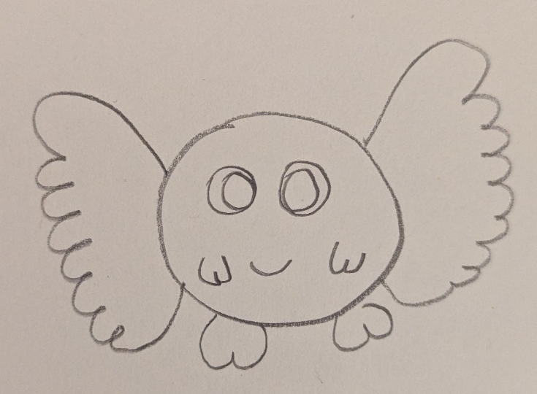
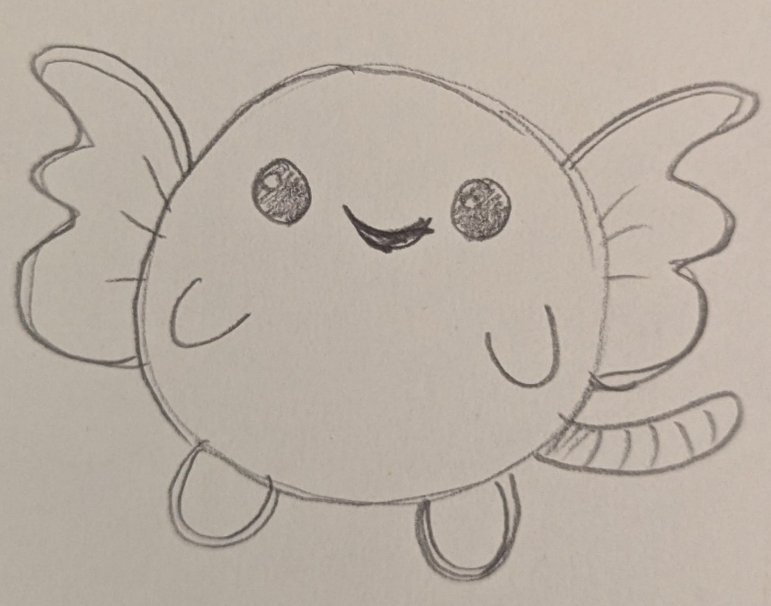
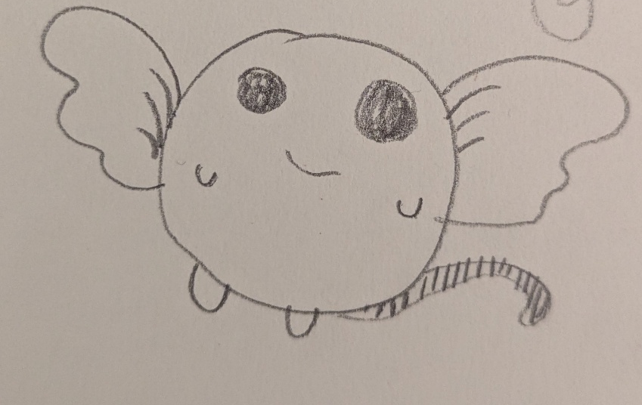
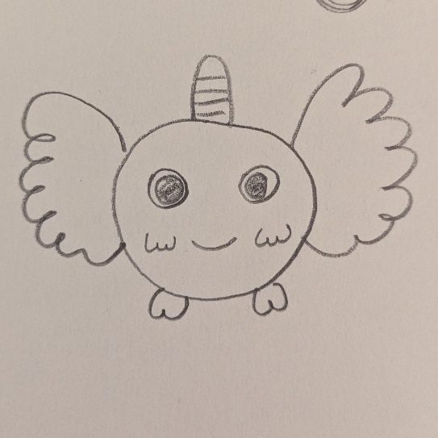
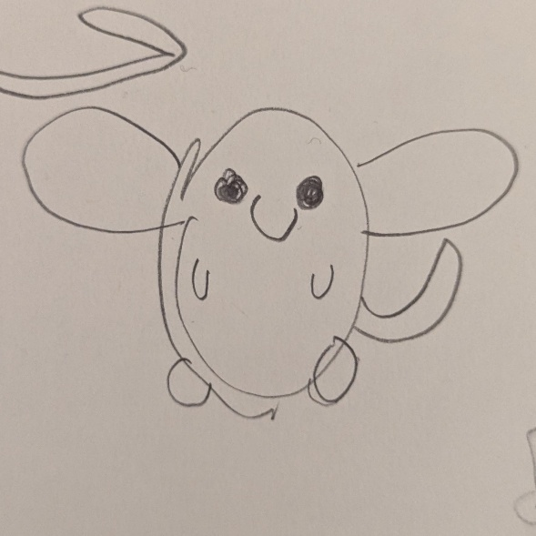
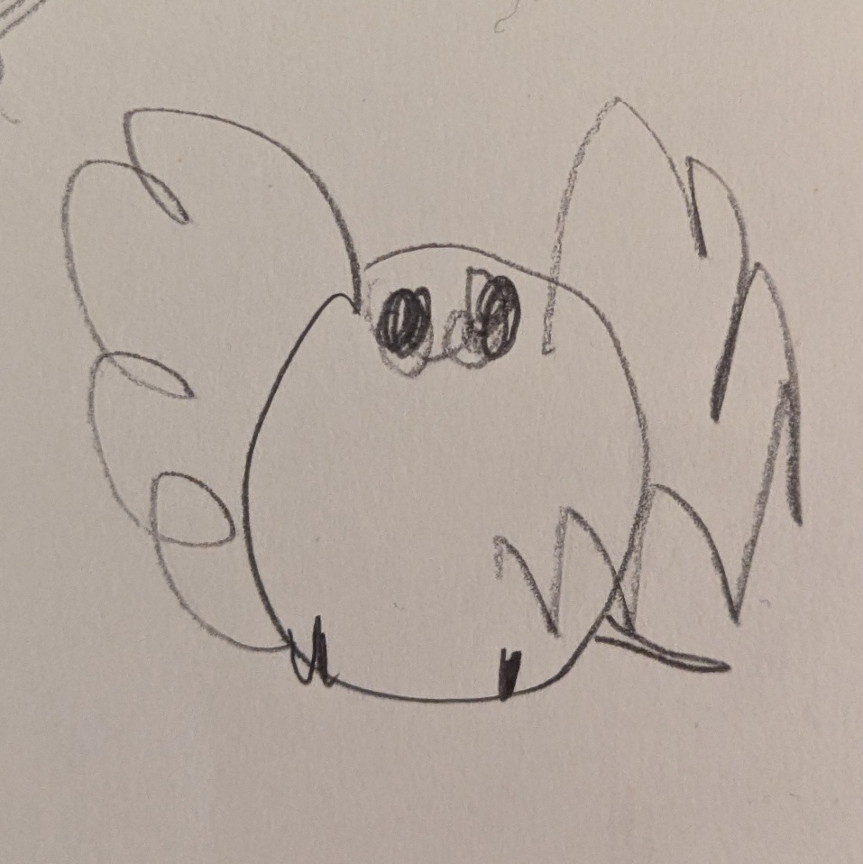
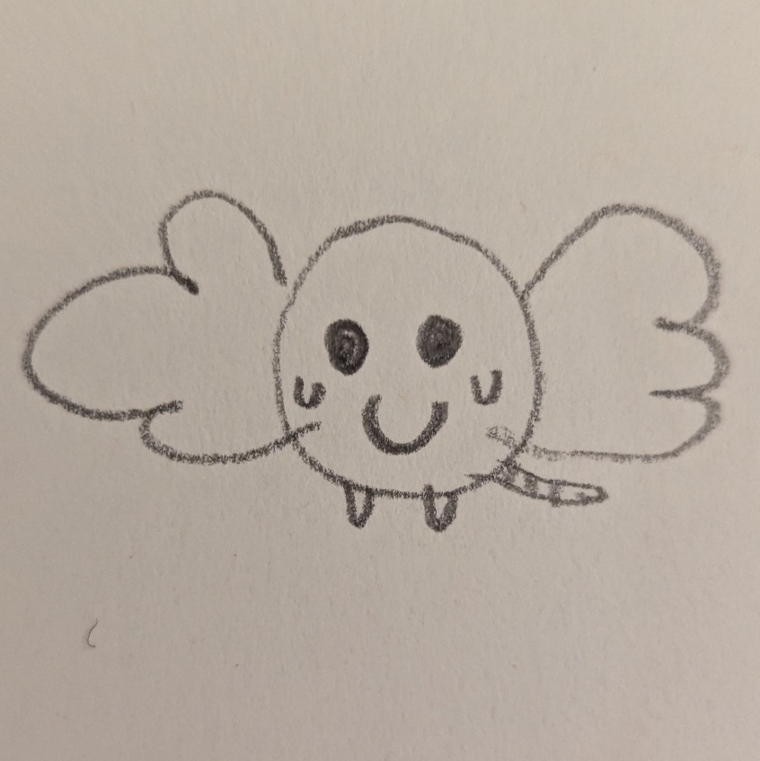
Blorp
Here are some images of “Blorps”. Through looking at them and knowing they are blorps, you are training as an AI model would do.
TRAILS.scot

Slide 20
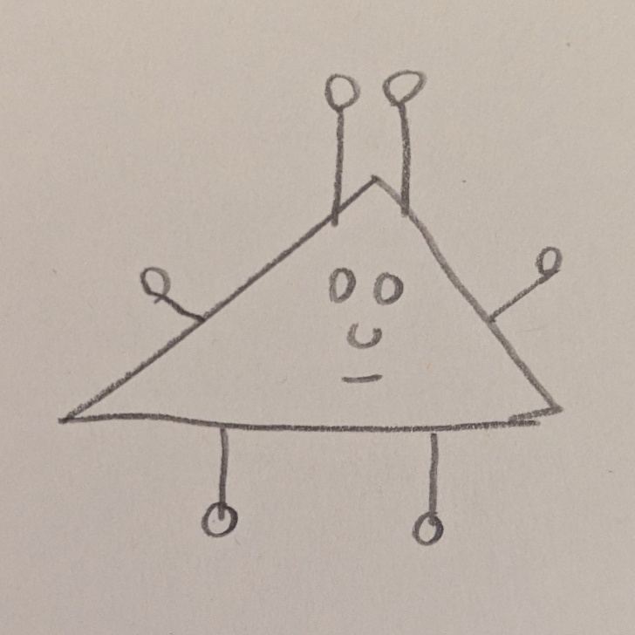
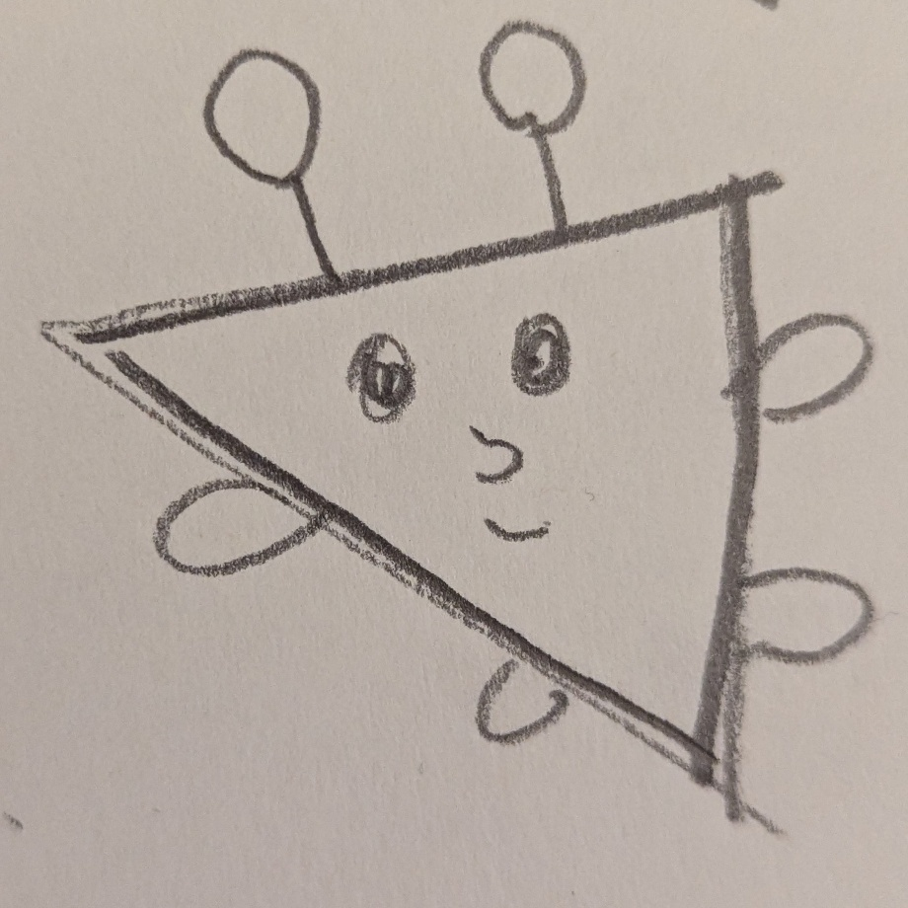
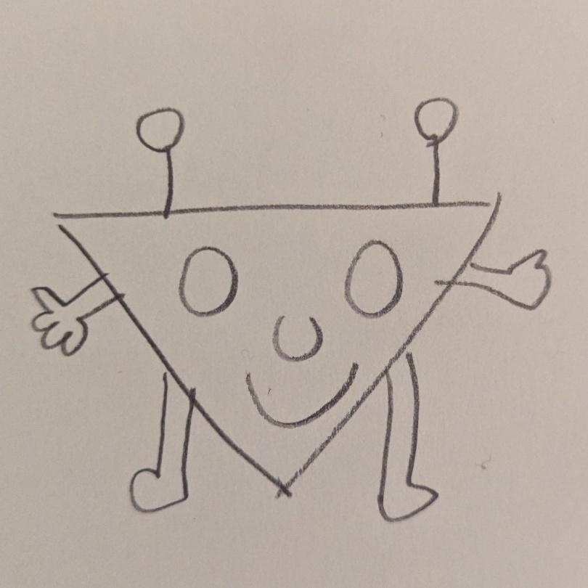
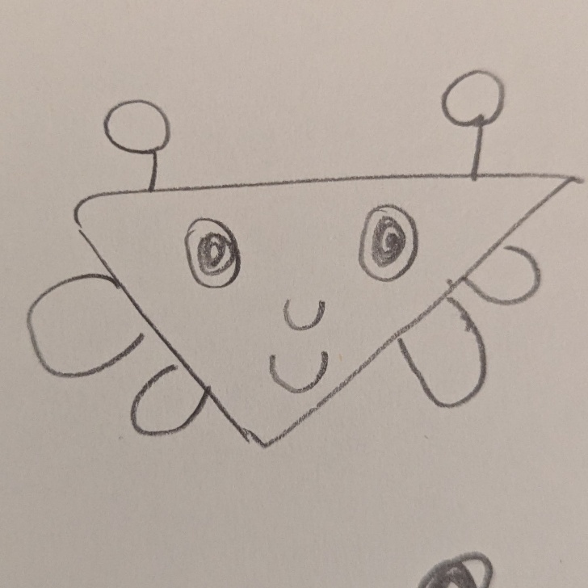
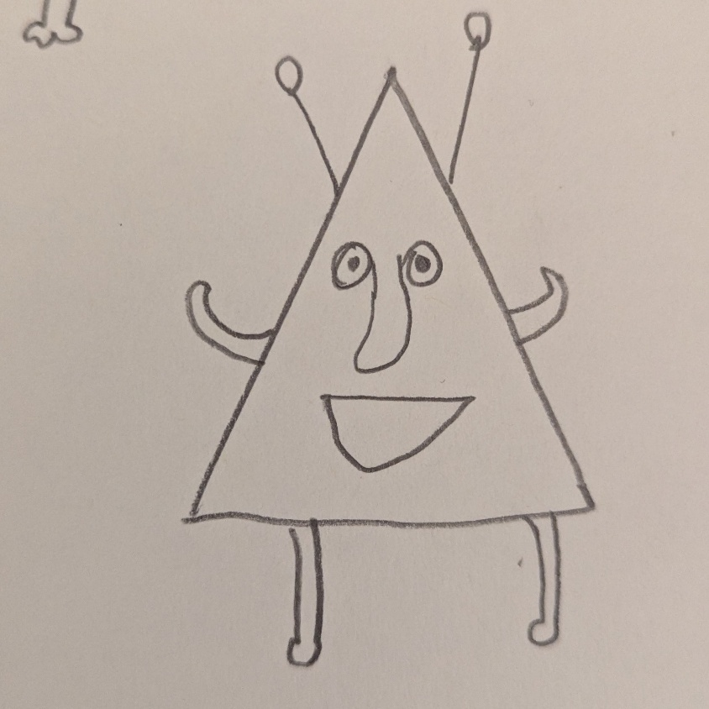
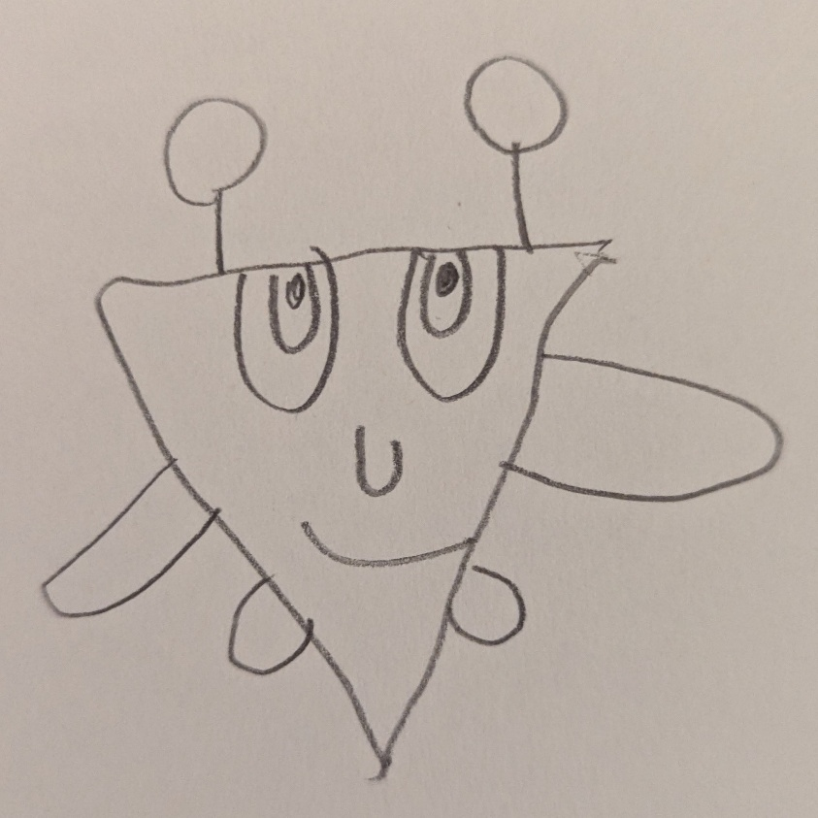
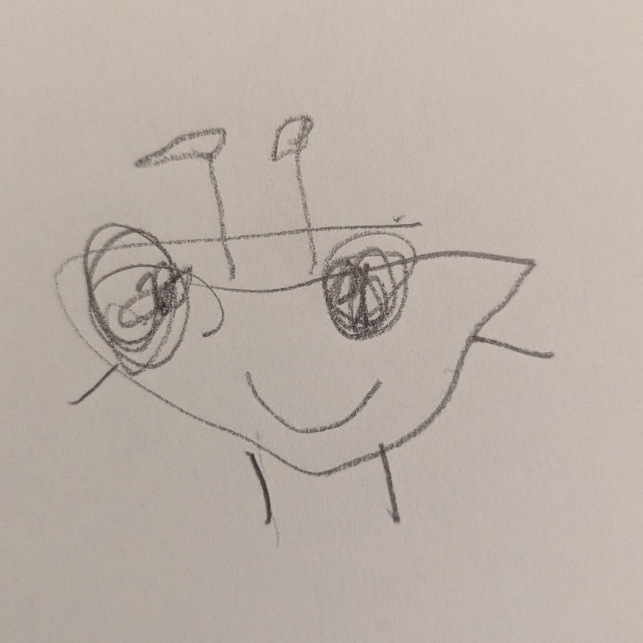
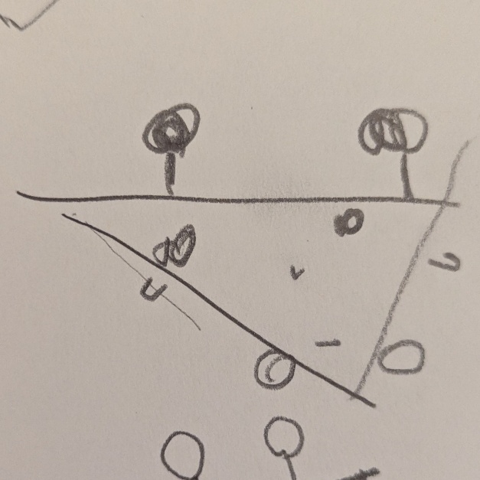
Glixer
Here are some images of “Glixers”.
TRAILS.scot

Slide 21
Generate like an AI!
Now you will be told to draw either a Blorp or a Glixer.
For 2 minutes, draw your creature. Try not to copy one specific image of either creature, create your own image from what you know about the species! (Go to the next slide for reference images of Blorps and Glixers)
Have a look at the drawings around you. Do you recognise which are Blorps and which are Glixers?
Notes:
Optional: Test your Gen AI creation
Remember when we looked at classifiers…..
https://teachablemachine.withgoogle.com/

Slide 22
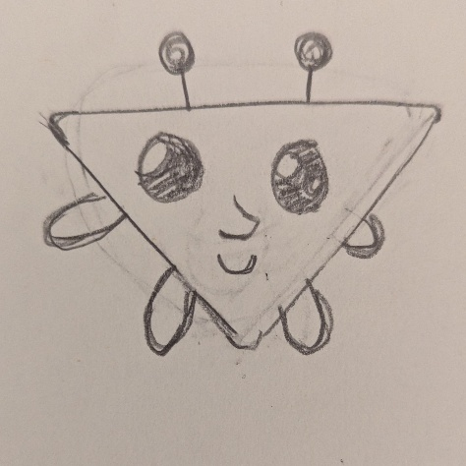
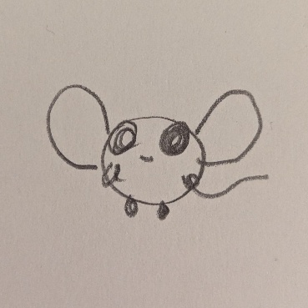
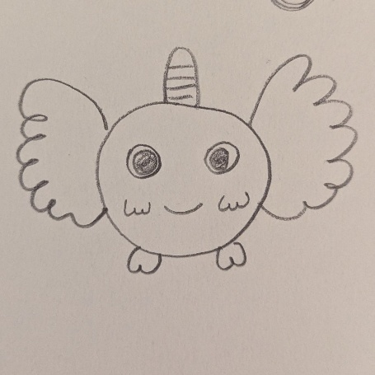
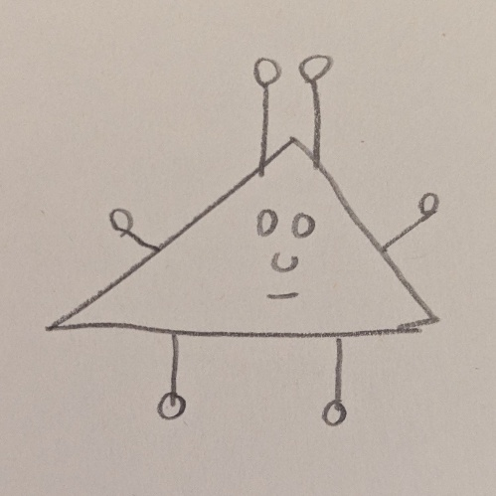
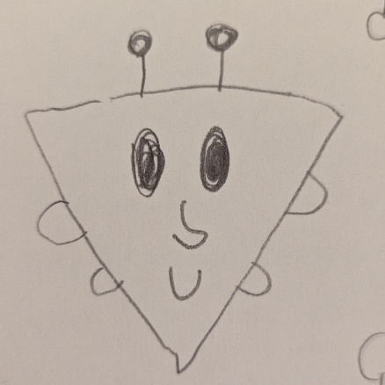
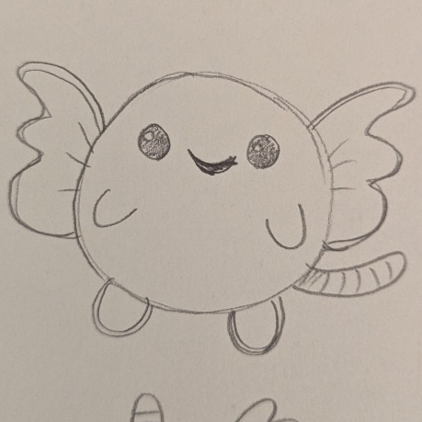
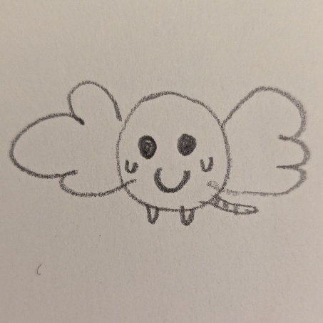
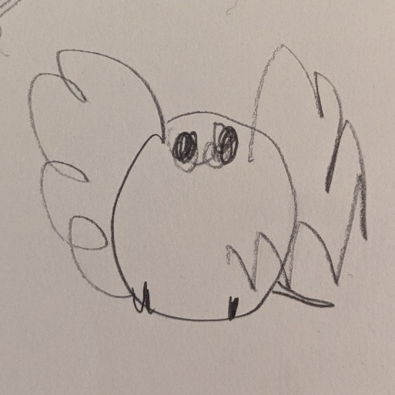
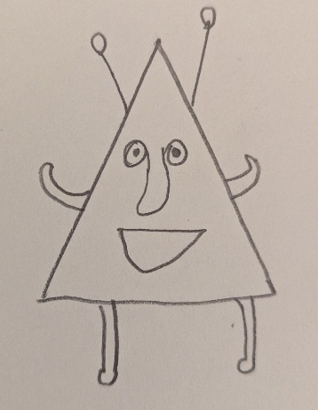
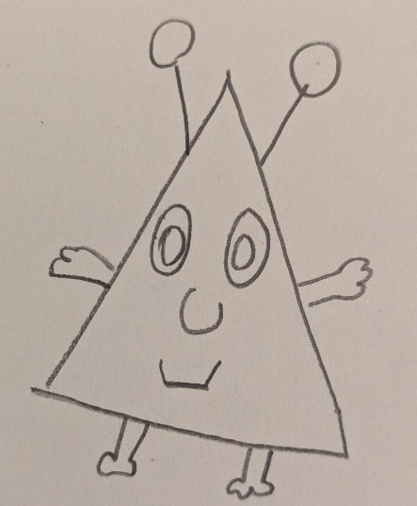
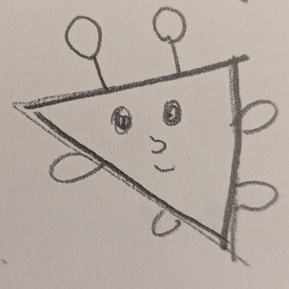
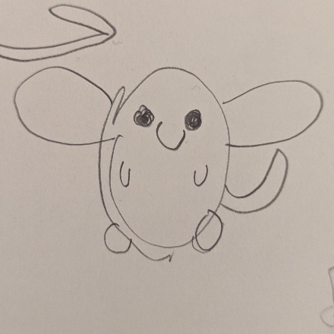
Glixers
Blorps
TRAILS.scot

Slide 23
Optional Extension Activity
Creature | Verb | Place
Blorp | Dancing | Swimming Pool
Glixer | Writing | Cinema
Cat | Painting | Park
Dog | Smiling | School
Fish | Sleeping | House
Generate an image of (draw):
The [Creature] is [Verb] at the [Place]
Notes:
Extra slide… Not sure yet whether or not to include this.
Would be an extra / alternative image generation task. But I have concerns about

Slide 24
Ethics and Safety of Gen AI
Choose some of the following prompts to discuss
(AI Snapshots are sourced from https://www.aiedu.org/ai-snapshots)

Slide 25
RESOURCE TITLE
AI models sometimes make mistakes when generating images. Why do you think that happens?
Questions to consider
TRAIL.scot

Slide 26
If an AI is trained only on certain types of images, what could go wrong?
Questions to consider
TRAIL.scot

Slide 27
Some Risks of Generative AI
Risks include:
Misinformation and fake content
Bias in outputs
Loss of jobs
Over-reliance on technology
Privacy Concerns
Environmental impact
Lack of Accountability
Model Collapse

Slide 28
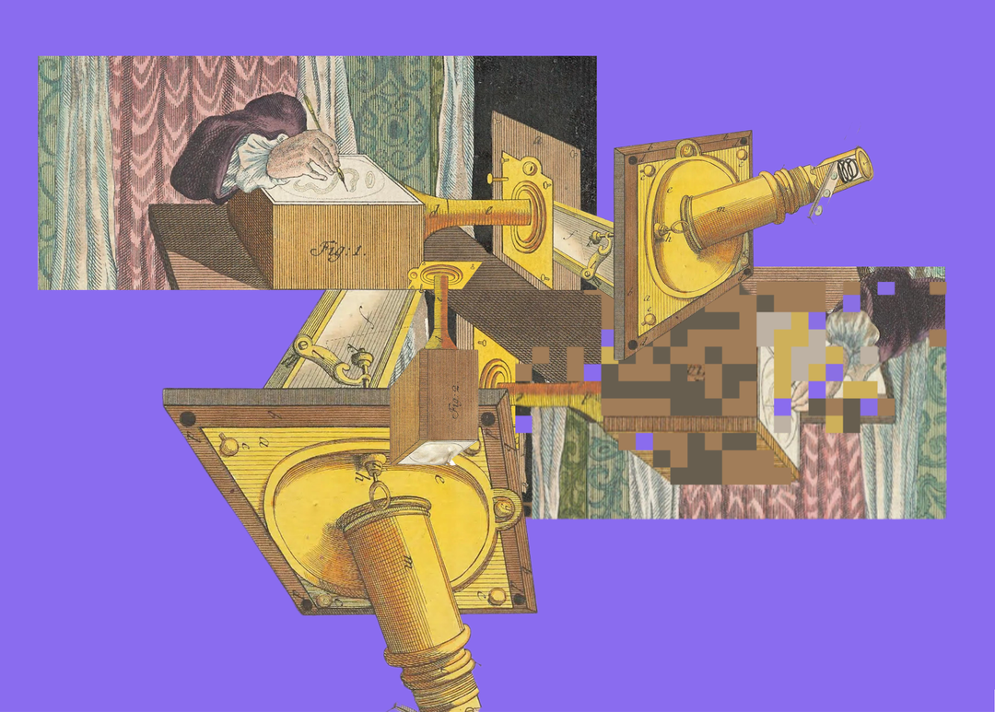
What is Model Collapse?
Model collapse occurs when a Generative AI model starts producing repetitive or similar outputs after being trained on its own generated data, rather than on a diverse set of real-world examples.
What are some consequences this could lead to?
Have you noticed any consequences like this already?
Nadia Piet & Archival Images of AI + AIxDESIGN / https://betterimagesofai.org / https://creativecommons.org/licenses/by/4.0/
Notes:
You could mention “search engine optimisation” content on the internet. Recipe web pages are a good example of web pages which are bloated with AI-generated text. These are then being “scraped” along with the rest of the internet to train more AI models. Would these websites get more and more bloated to the point of no longer being readable by a human? Would we need an AI to summarise and shorten the text for us?

