Slide 1
How AI influences you
TRAILS.scot

Slide 2
Unit Overview
This unit is divided into three shorter lessons, which can be delivered all together (~2 hrs) or stand alone.
Learn how recommender systems work by creating simple, unplugged versions of a content filtering and collaborative filtering system, to recommend movies to your classmates. (45 min)
Play the game “Survival of the Best Fit” and think about the consequences of using an algorithm to make more consequential recommendations, like who gets a job or a loan. (30 min)
Play the “Customise your feed” card game to learn about the role of recommender systems in social media, and discuss the ethical implications of personalised online content. (45 min)
BUTTON EXAMPLE
TRAILS.scot

Slide 3
How AI influences you
Learning Outcomes
Learners will gain a conceptual understanding of how “content filtering” and “collaborative filtering” recommender systems work, by taking part in an unplugged activity recommending films to their classmates.
Learners will consider the ethical implications of using recommender systems to make consequential decisions, in light of data bias and algorithmic bias.
Learners will explore how AI recommender systems work to create individualised social media feeds.
Finally, learners will consider the potential consequences of personalised feeds, including: echo chambers; misinformation; and exposure to increasingly extreme content.
BUTTON EXAMPLE
TRAILS.scot

Slide 4
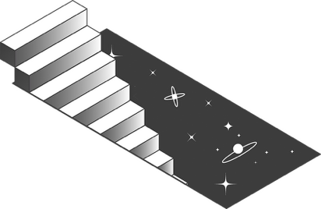
Movie Night
Create your own film recommender system

Slide 5
What is a recommender system?
A “recommender system”, or “recommendation system”, is an AI algorithm that uses data to recommend content to consumers.

Slide 6
Examples of recommender systems
E-commerce
Job Applicants
Book
Suggestions
Online Dating
Social Media Feeds
Adverts
Video/Audio Streaming Services
Can you think of any others?

Slide 7
Video
A short (3 min) introduction to where on the internet and for what purposes recommender systems are used.
https://www.youtube.com/watch?v=ztkOUyTk9XI

Slide 8
Two main types of filtering
These can also be combined—“hybrid filtering”—and contextual information like date, time, and sequence can also be included—“context-aware filtering”
Content Filtering
Collaborative Filtering
Notes:
Content filtering: based on content, e.g. movie genre, shopping item category or description, clothing colour or type
Collaborative filtering: based on comparing user behaviour – other people who watched/bought/liked this item also watched/bought/liked this. You’ll get recommendations based on what other people with similar preferences to you have liked or bought.

Slide 9
Movie Night Activity
It’s movie night at home and you’re faced with endless options to scroll through. How do you choose a new film to watch?
You know what you’ve already seen and liked, but how do you know whether you’ll actually like a film you’ve never seen before?
Luckily, you’ve got access to some very useful data – the films that your classmates have seen and liked!
Notes:
Note to teacher: you can change this activity to be about TV Shows, Books, Music, YouTube Channels, Video Games…whatever type of media suits your group best!

Slide 10
Movie Night Activity
In this activity, you’ll first create a film recommender system using the “content filtering” method, and then one using the “collaborative filtering” method.
Notes:
Note to teacher: you can change this activity to be about TV Shows, Books, Music, YouTube Channels, Video Games…whatever type of media suits your group best!

Slide 11
Movie Night Activity
The BBC’s list of the 21st Century’s 100 greatest films: dataed.in/100films
IMDb 250 Most Popular films:
dataed.in/250films
IMDb 250 Most Popular TV shows:
dataed.in/250tv
Notes:
Note to teacher: you can change this activity to be about TV Shows, Books, Music, YouTube Channels, Video Games…whatever type of media suits your group best!

Slide 12
Creating the collaborative-filtering system
Collaborative Filtering
Step 1, Data collection: Write down ten films/TV shows you like on your worksheet. You can ignore the genres for now.
Step 2, Finding patterns in the data: Walk around the room and compare your list with others. Can you find any overlap with anyone else? Find the two people that have the most overlap with you (you may find you end up in a larger “cluster”).
Step 3, Using the data to make predictions: Any items on the lists of the others in your cluster that aren’t on your list count as recommended items. Write them down.
Notes:
Content filtering: based on content, e.g. movie genre, shopping item category or description, clothing colour or type
Collaborative filtering: based on comparing user behaviour – other people who watched/bought/liked this item also watched/bought/liked this. You’ll get recommendations based on what other people with similar preferences to you have liked or bought.

Slide 13
Creating the collaborative-filtering system
Collaborative Filtering
Step 4, Testing the accuracy of the model: Of the films/shows that were recommended to you, have you already seen any of them? Did you like them?
How well has our collaborative-filtering recommender system worked?
Notes:
Content filtering: based on content, e.g. movie genre, shopping item category or description, clothing colour or type
Collaborative filtering: based on comparing user behaviour – other people who watched/bought/liked this item also watched/bought/liked this. You’ll get recommendations based on what other people with similar preferences to you have liked or bought.

Slide 14
Creating the content-filtering system
Step 1, Data collection: You will use your same list of ten films/shows from before.
Step 2, Data labelling: Using the ten common genres listed in the table, put a tick in as many columns as you think apply.
Step 3, Finding patterns in the data: In the bottom row, sum up the totals for each genre. Circle your top three genres.
Content Filtering
Notes:
Content filtering: based on content, e.g. movie genre, shopping item category or description, clothing colour or type
Collaborative filtering: based on comparing user behaviour – other people who watched/bought/liked this item also watched/bought/liked this. You’ll get recommendations based on what other people with similar preferences to you have liked or bought.

Slide 15
Creating the content-filtering system
Step 4, Using the data to make predictions: Now walk around the room and compare your list with others. Can you find an item on anyone’s list that fits two out of your top three genres, that isn’t already on your list?
This counts as a recommended item. Write it down.
For example, if your top three genres are comedy, romance, and animation, then if you find a film on someone’s list that is comedy and animation, you can add it as a recommendation.
Content Filtering
Notes:
Content filtering: based on content, e.g. movie genre, shopping item category or description, clothing colour or type
Collaborative filtering: based on comparing user behaviour – other people who watched/bought/liked this item also watched/bought/liked this. You’ll get recommendations based on what other people with similar preferences to you have liked or bought.

Slide 16
Creating the content-filtering system
Step 5, Testing the accuracy of the model: Of the films/shows that were recommended to you, have you already seen any of them? Did you like them?
How well has our content-filtering recommender system worked?
Content Filtering
Notes:
Content filtering: based on content, e.g. movie genre, shopping item category or description, clothing colour or type
Collaborative filtering: based on comparing user behaviour – other people who watched/bought/liked this item also watched/bought/liked this. You’ll get recommendations based on what other people with similar preferences to you have liked or bought.

Slide 17
Discussion
Which system seemed to work better, the content filtering or the collaborative filtering system?
Are there scenarios where one model might work better than another, e.g. when you first open a new video streaming account?
Which system do you think needs more data to work?
Would you get even better predictions if you combined the two approaches?
Notes:
Note to teacher: you can change this activity to be about TV Shows, Books, Music, YouTube Channels, Video Games…whatever type of media suits your group best!

Slide 18
Extension Activity
Do these use content filtering or collaborative filtering?
Did you get any of the same recommendations from the Movie Night activity?
What are some possible reasons why or why not?
Try out the movie recommenders at https://www.gnovies.com/ and https://www.movie-map.com.
Notes:
Note to teacher: you can change this activity to be about TV Shows, Books, Music, YouTube Channels, Video Games…whatever type of media suits your group best!

Slide 19
Extension Activity
Create a custom thumbnail image or movie poster for a film that was recommended by you to a classmate, that would convince them to watch it, based on the other films they like.
Option: You could use an AI image generator for this, if you have access to one.
Notes:
Note to teacher: you can change this activity to be about TV Shows, Books, Music, YouTube Channels, Video Games…whatever type of media suits your group best!

Slide 20
Using AI algorithms to make decisions

Slide 21
Using AI algorithms to make decisions
In the last activity, you used a recommender system to recommend films to each other.
But what happens when we use an AI algorithm to recommend…
Job candidates?
Who gets a loan?
Who we should stop and search?
Exam grades?

Slide 22
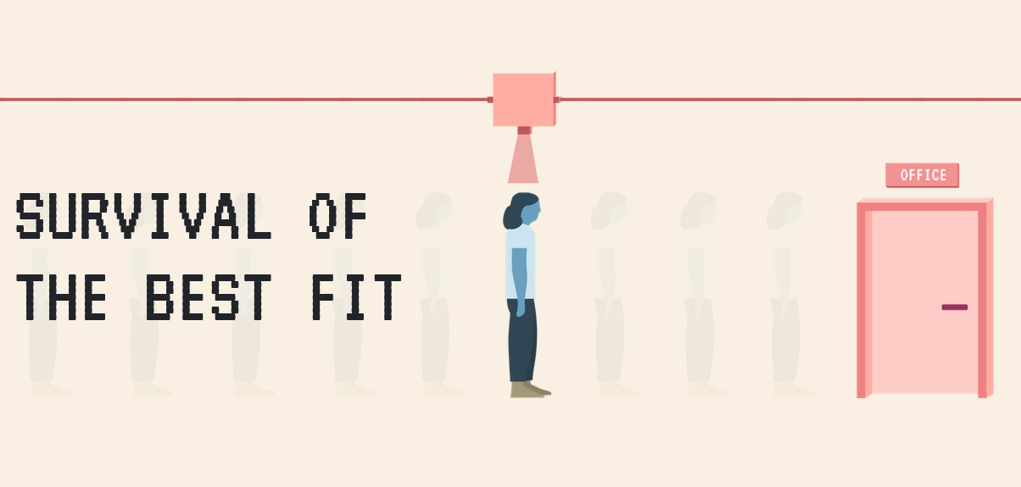
Play the game!
survivalofthebestfit.com

Slide 23
Discussion
What are some things we can do to avoid biased decisions being made by AI algorithms?
Notes:
Note to teacher: you can change this activity to be about TV Shows, Books, Music, YouTube Channels, Video Games…whatever type of media suits your group best!

Slide 24
Optimise social media feeds

Slide 25
Optimise social media feeds
This section of the lesson will be updated and improved shortly.

Slide 26
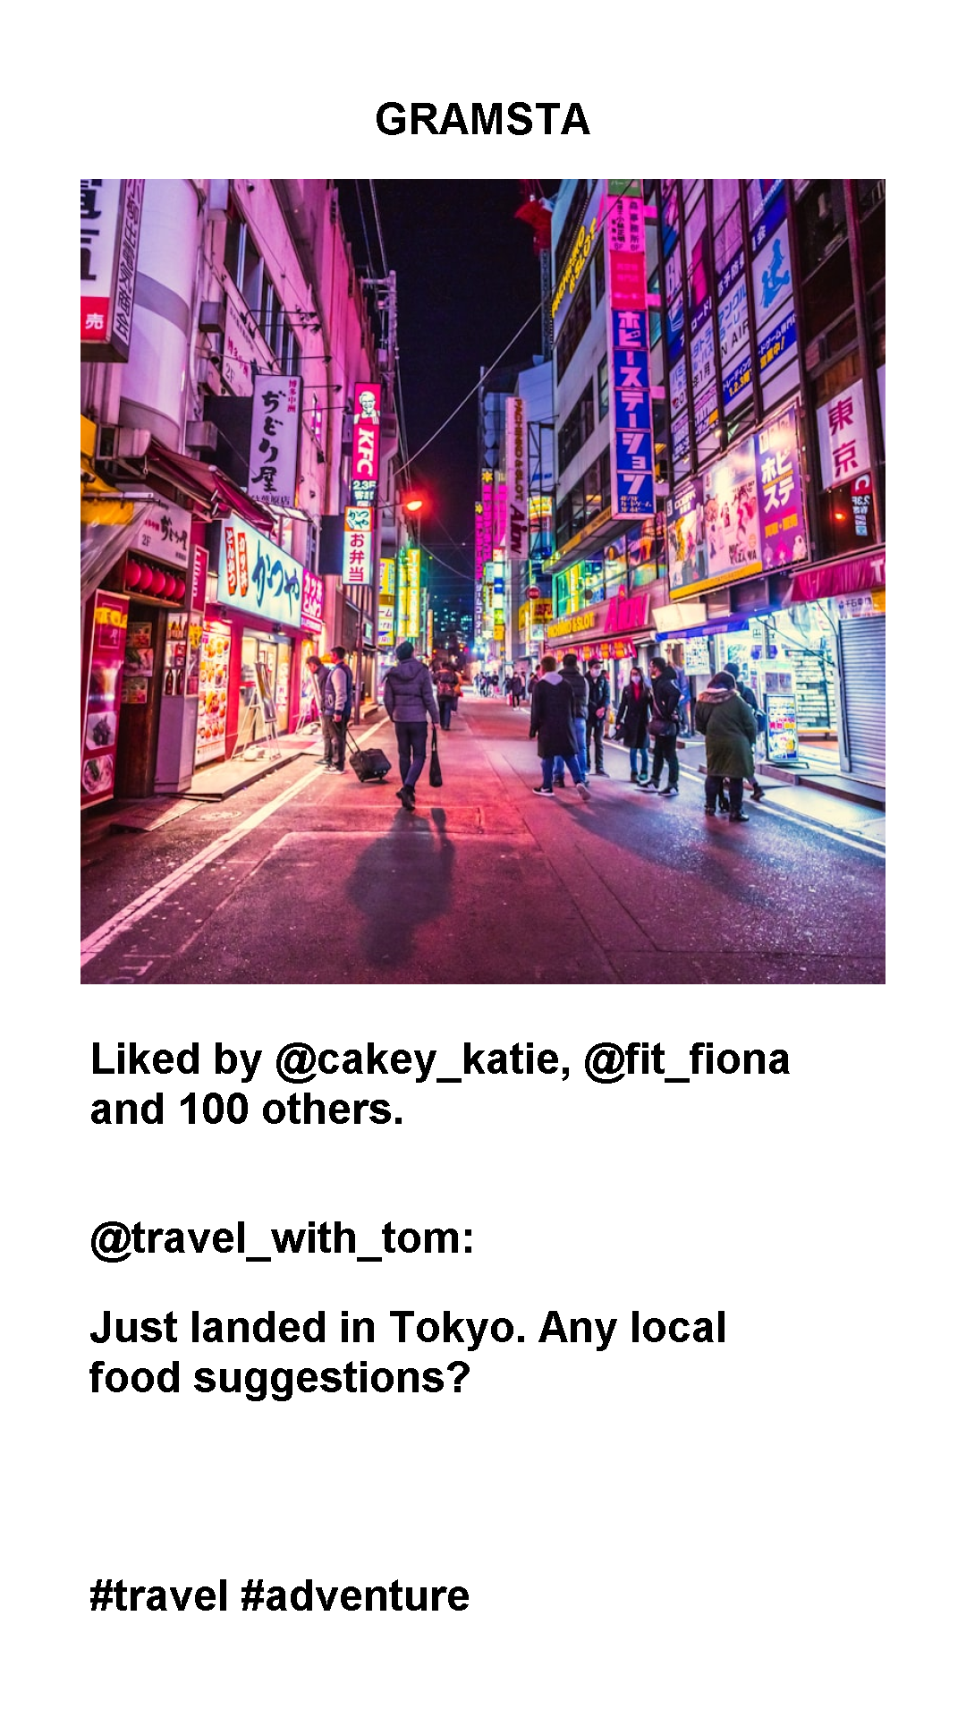
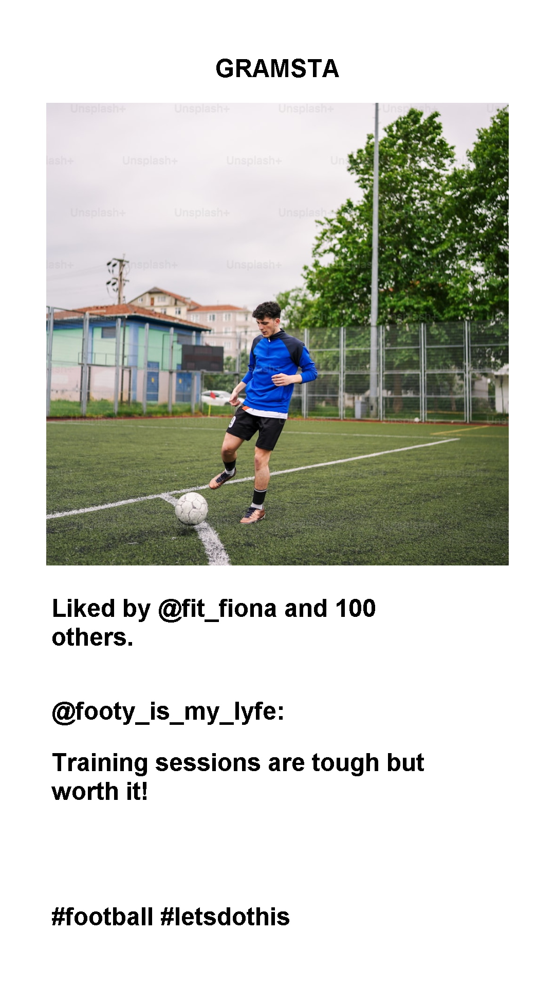
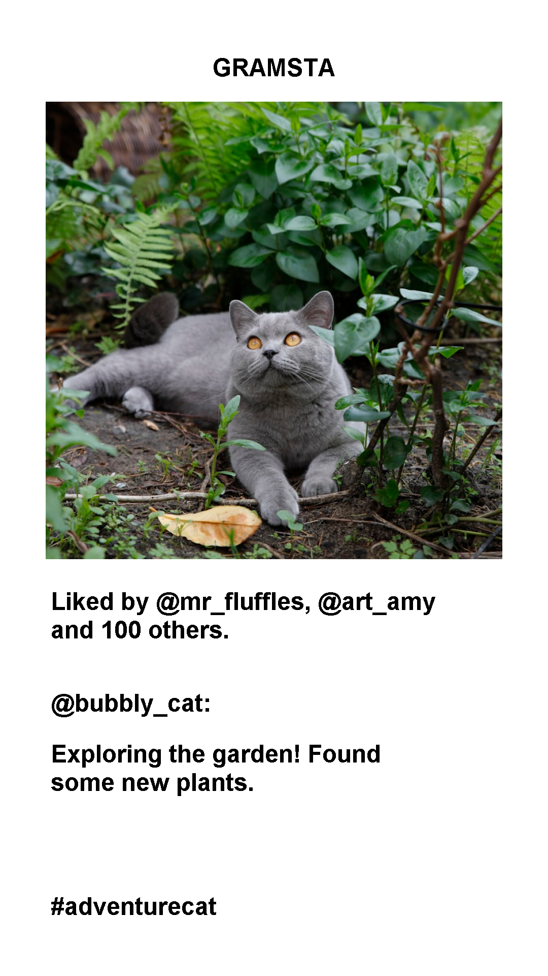
Optimise your feed
In this activity, you will create a simple version of a social media feed algorithm.
Can you create the optimal feed to keep your target users hooked?

Slide 27
Optimise your feed
Step 1: Get into groups. Each group will be given some user profiles. Can you optimise the social media feed of your users to keep them hooked and scrolling?
Step 2: Looking at your user profiles and all the posts, identify 5 posts you think each user will like. Why did you choose these?

Slide 28
Optimise your feed
Step 3: Now we’re going to create an algorithm to optimise the users’ social media feeds. Using the algorithm worksheet, decide in your group on the weights to assign to each variable.

Slide 29
Optimise your feed
Step 4: Next, for each user, go through the social media posts and use your algorithm to calculate the total number of points to assign each post for that user.
Step 5: Identify the top 5 posts for each user, in order. Did this match what you chose before using the algorithm?

Slide 30
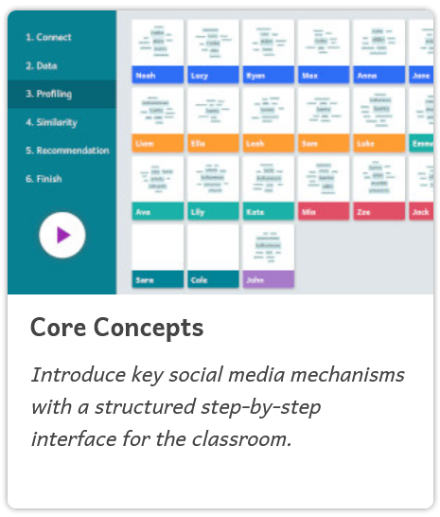
RESOURCE TITLE
Somekone Social Media Simulator
(Optional online alternative activity)
This is an activity developed by educators in Finland and will require each learner to have a device connected to the internet.
Step 1: Teacher goes to https://somekone.gen-ai.fi/start and clicks “Create New Session” and chooses “Core concepts”.
TRAIL.scot

Slide 31
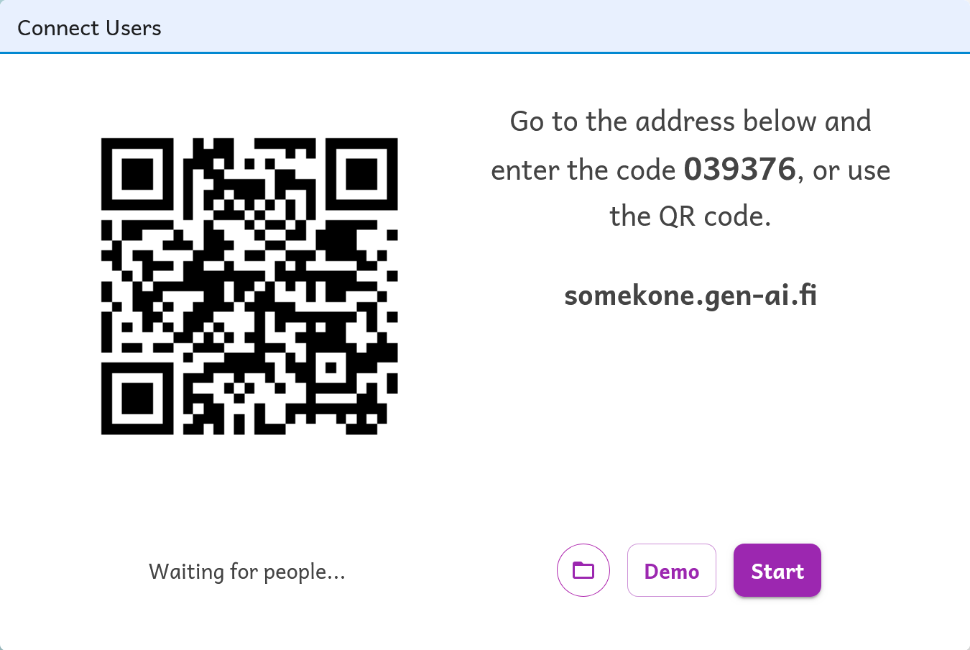
RESOURCE TITLE
Somekone Social Media Simulator
(Optional online alternative activity)
Step 2: This will generate a QR code and code, which learners can use to access the social network.
Learners either use the QR code, or go to https://somekone.gen-ai.fi/start and enter the code to join the social network.
Your custom QR code will be here
######
TRAIL.scot

Slide 32
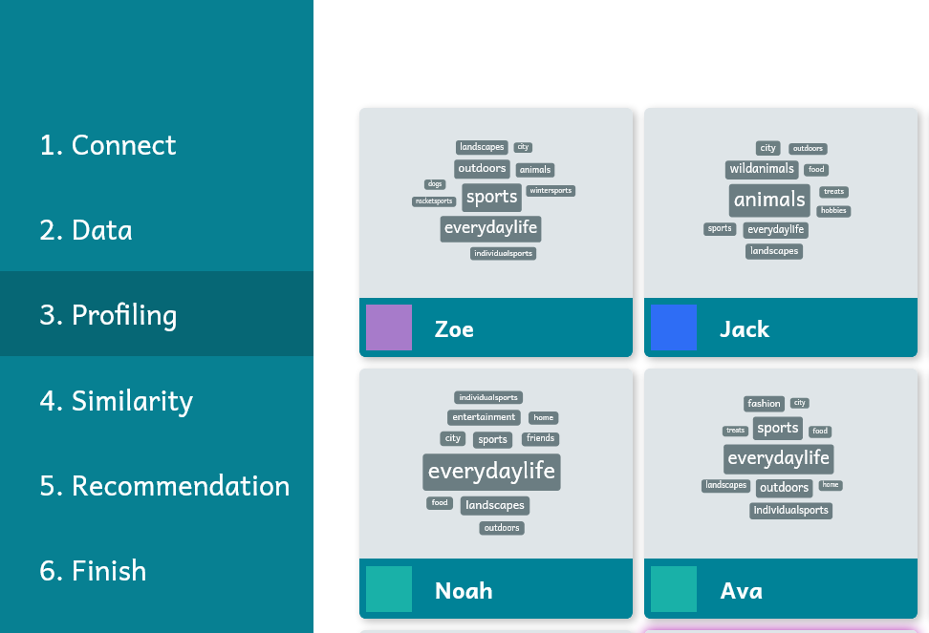
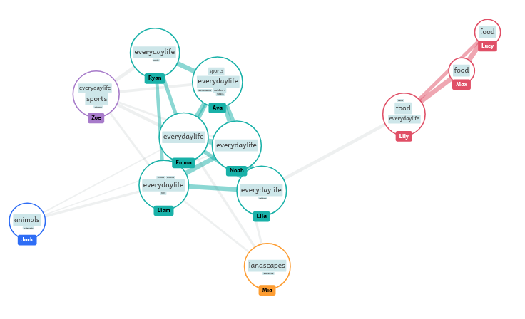
RESOURCE TITLE
Somekone Social Media Simulator
(Optional online alternative activity)
Step 3: Follow the prompts to work through the different stages of the activity.
TRAIL.scot

Slide 33
Video
Watch this video (9 min) from Common Sense Media’s AI Literacy Collection, and answer the questions on the next slide.
https://www.youtube.com/watch?v=tPqI0n44zP8

Slide 34
Discussion
Why do social media apps use recommendation algorithms?
How do they benefit from this?
How do you benefit from this?
What are some of the pitfalls and dangers of these algorithms? Discuss:
Echo chambers
Misinformation
Extreme content
How can you make social media algorithms "work" better for you?
Notes:
Note to teacher: you can change this activity to be about TV Shows, Books, Music, YouTube Channels, Video Games…whatever type of media suits your group best!

Slide 35
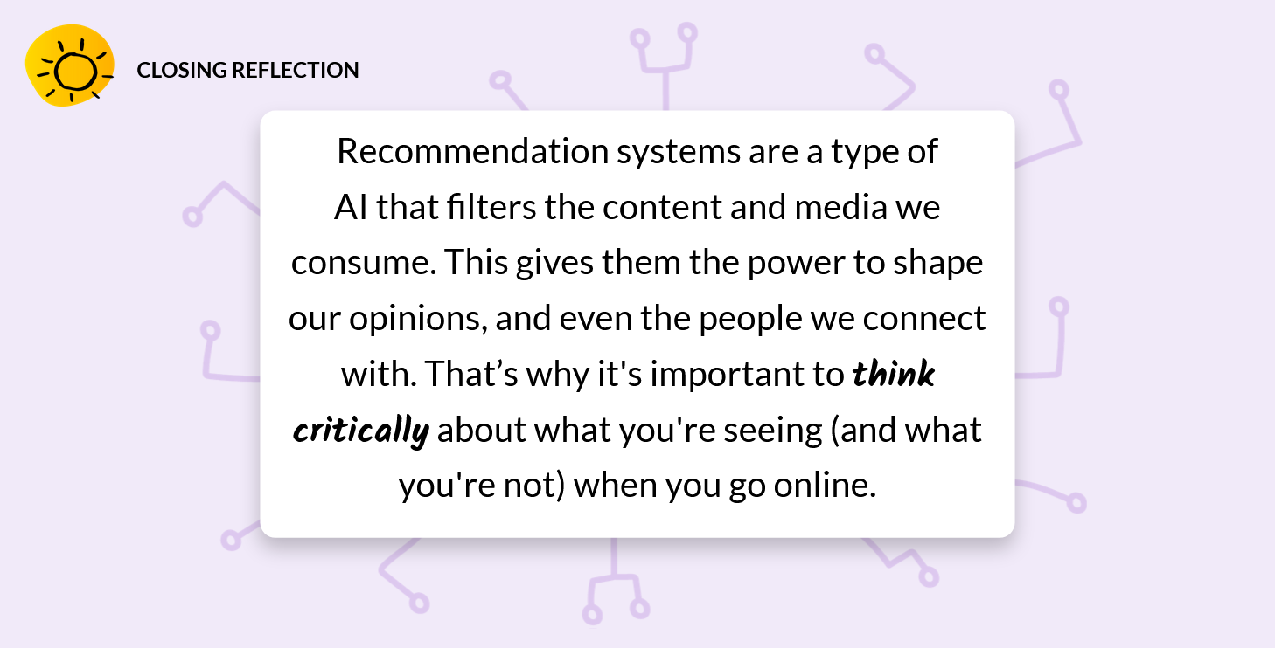
Discussion
Notes:
Note to teacher: you can change this activity to be about TV Shows, Books, Music, YouTube Channels, Video Games…whatever type of media suits your group best!

Slide 36
RESOURCE TITLE
More resources
More resources
Ethical issues of Social Media Recommender Systems:
Common Sense Media’s lesson on AI Algorithms: https://www.commonsense.org/education/digital-citizenship/lesson/ai-algorithms-how-well-do-they-know-you (20 min lesson)
University of Bristol’s “Thinking Science” resources for teachers on AI Recommender Systems (click on the “Information Technology and People” resource and go to page 12-13) https://www.bristol.ac.uk/philosophy/thinking-science/resources/
BBS Bitesize “How algorithms and filter bubbles decide what we see on social media”: https://www.bbc.co.uk/bitesize/articles/zd9tt39
TED Talk (17 min): Machine intelligence makes human morals more important https://www.ted.com/talks/zeynep_tufekci_machine_intelligence_makes_human_morals_more_important
TRAILS.scot

Slide 37
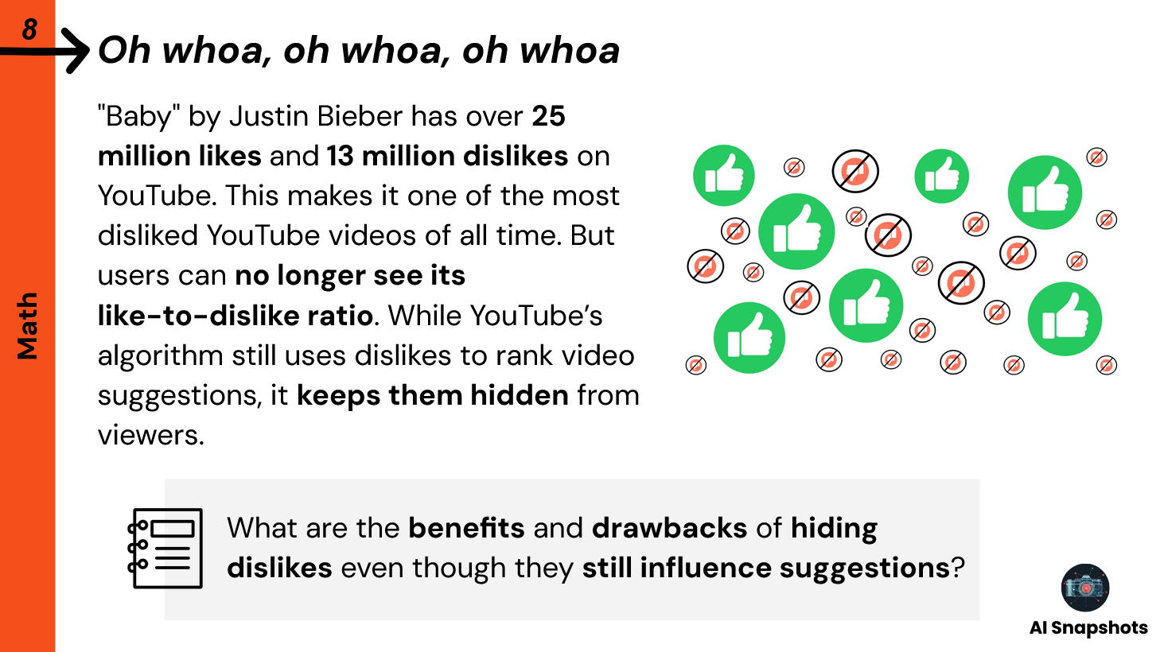
Optional extra discussion prompt
Notes:
Note to teacher: you can change this activity to be about TV Shows, Books, Music, YouTube Channels, Video Games…whatever type of media suits your group best!

Slide 38
Optional extra discussion prompt
Notes:
Note to teacher: you can change this activity to be about TV Shows, Books, Music, YouTube Channels, Video Games…whatever type of media suits your group best!

