Slide 1
How AI labels the world
TRAILS.scot

Slide 2
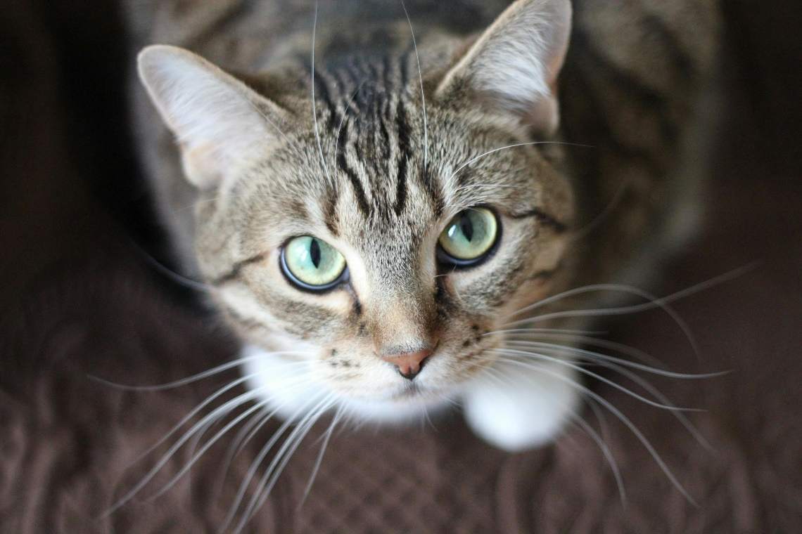
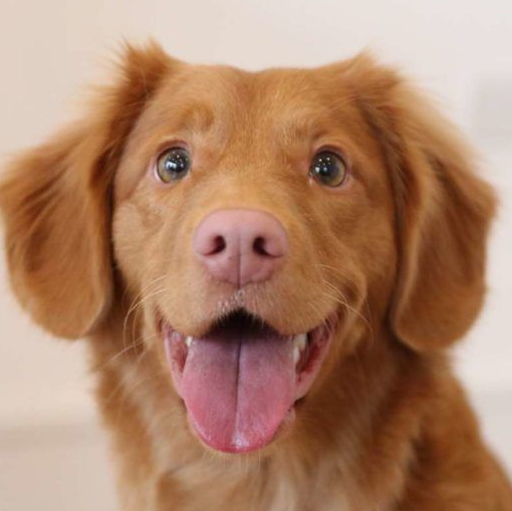
Starter Discussion: Cat or Dog?
Is this a Cat or a Dog?
How do you know?
What makes a cat a cat and a dog a dog?
Can you come up with rules? E.g. If x has y then y is a cat

Slide 3
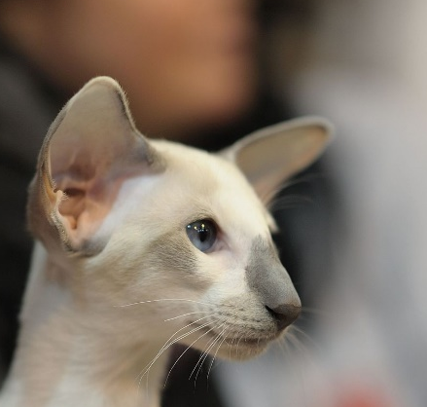
Starter Discussion: Cat or Dog?
What about these?
Humans don’t differentiate between cats and dogs using simple IF, THEN rules.
We recognise patterns.

Slide 4
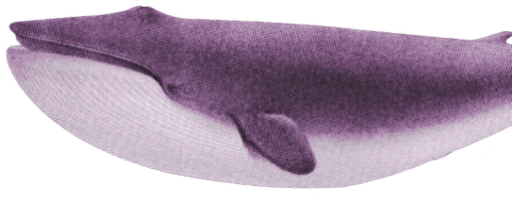
What are Classification Systems?
Classification/Classifier Systems are types of AI systems that categorise or identify data based on learned patterns.
They use machine learning models which are trained on large datasets to recognise patterns and make predictions.
AI, is this a cat or a dog?
Notes:
Note to teacher: you can change this activity to be about TV Shows, Books, Music, YouTube Channels, Video Games…whatever type of media suits your group best!

Slide 5
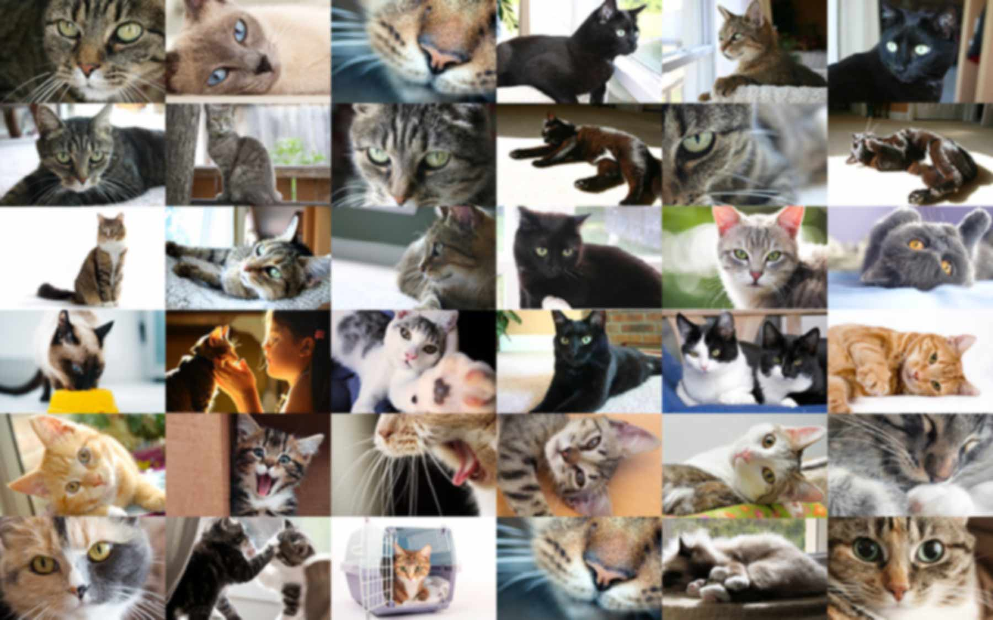
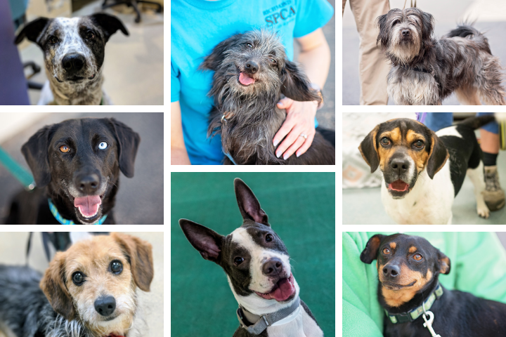
How does Classification AI work?
First, AI models are trained on lots of labelled data
For example:
Images of cats and dogs with labels.
Annotated speech audio.
Video clips from cars with labelled road signage, vehicles or pedestrians
Cats
Dogs

Slide 6
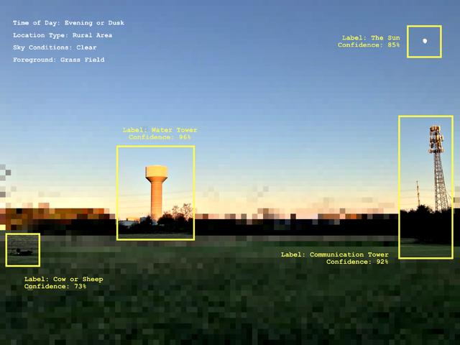
How does Classification AI work?
After the training phase, the system can analyse new data and assign it a probability of being in each of the predefined categories – it outputs the category with the highest probability.
Elise Racine / https://betterimagesofai.org / https://creativecommons.org/licenses/by/4.0/

Slide 7
Can you think of any examples of AI classification systems being used in the world right now?
TRAILS.scot

Slide 8
Here are some examples of AI Classification Systems
Are all of these technologies helpful?
Are any of them potentially harmful?
Audio Recognition
Voice recognition
Speech transcription
Song recognition (e.g. Shazam)
Image Recognition
Facial Recognition
Handwriting Recognition
Medical Imaging
Wildlife monitoring
Text Classification
Spam Detection
Sentiment Analysis
Language Detection
Plagiarism Detection
Sensor-based Classification
Weather Prediction
Fraud Detection
Self-Driving Cars
Health Monitoring

Slide 9
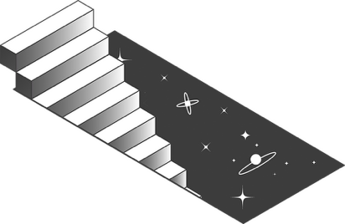
Exploring real-world uses of AI Classifiers

Slide 10
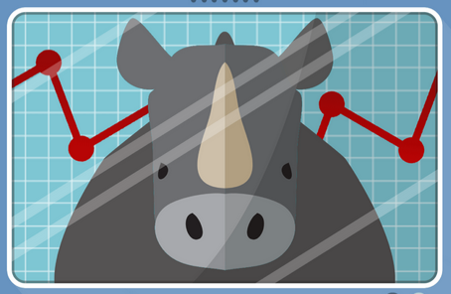
Defend the Rhino
Did you know that AI Image Classification is helping with wildlife conservation?
Get a taste for how by playing this exciting, interactive online activity!
cyberskillslive.com/activity/defend-the-rhino/

Slide 11
Classify like an AI!

Slide 12
Classify like an AI!
We are going to learn to classify two different alien species: Blorps and Glixers.
In order to learn to tell which is which, you will look at images of them. This is a bit similar to how an AI classification system learns.

Slide 13
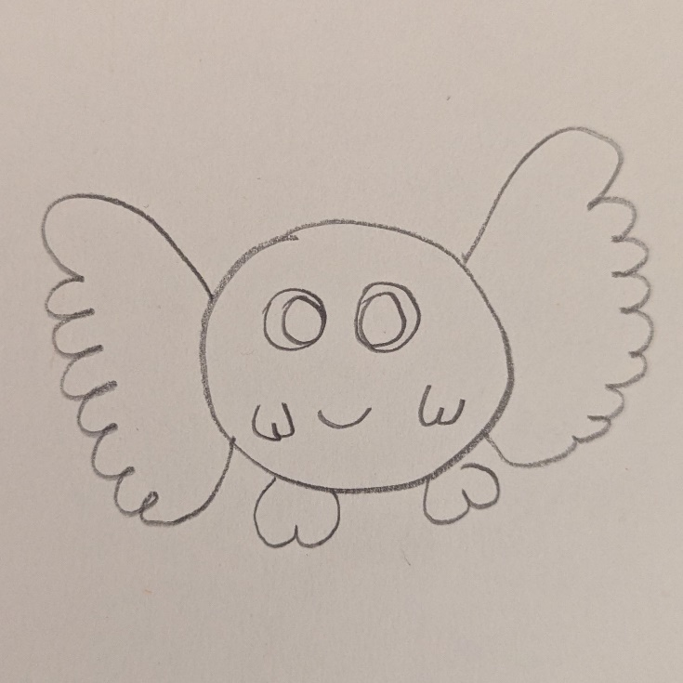
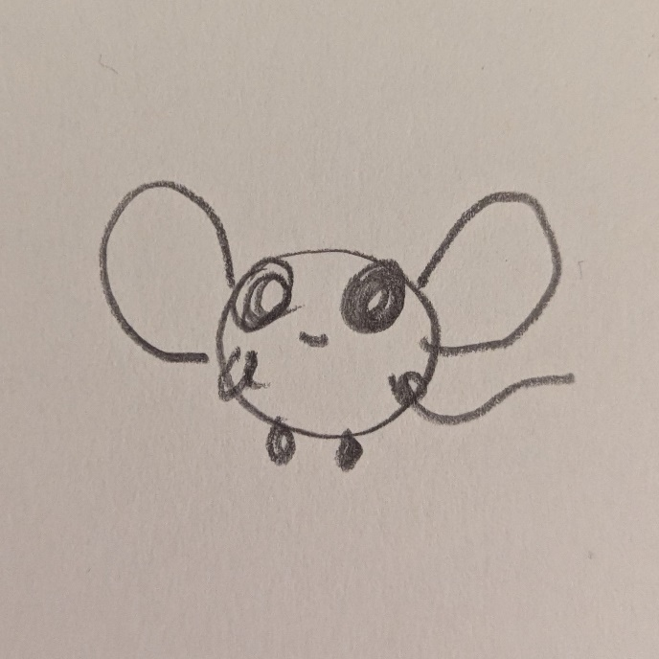
Blorp
Here are some images of “Blorps”.

Slide 14
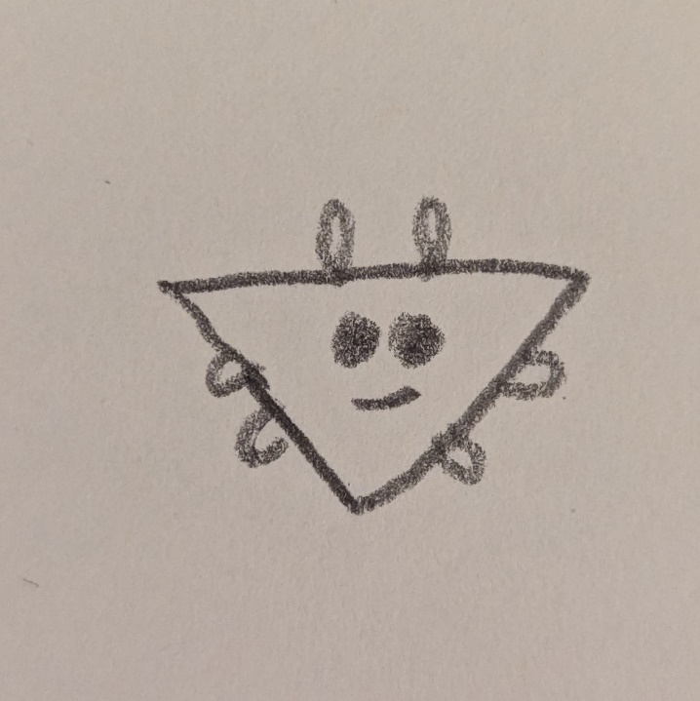
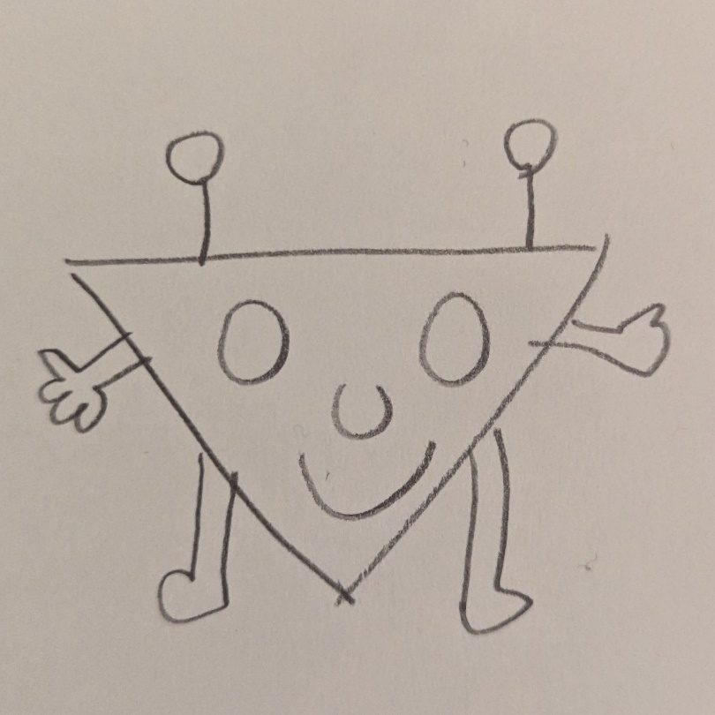
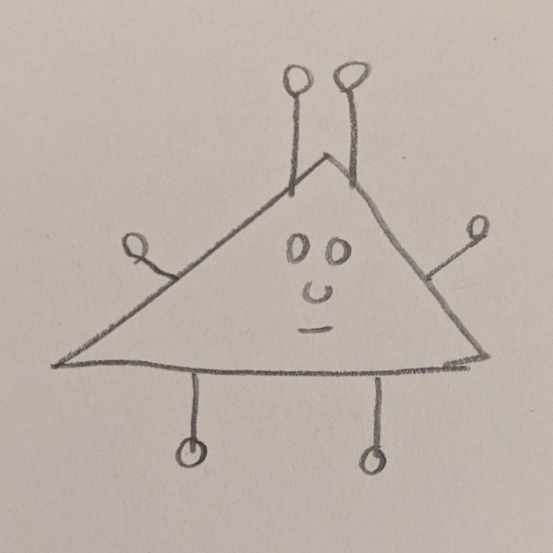
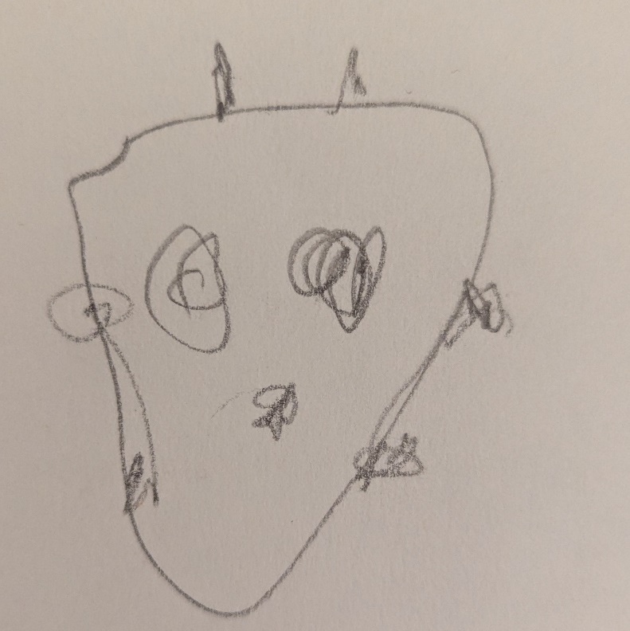
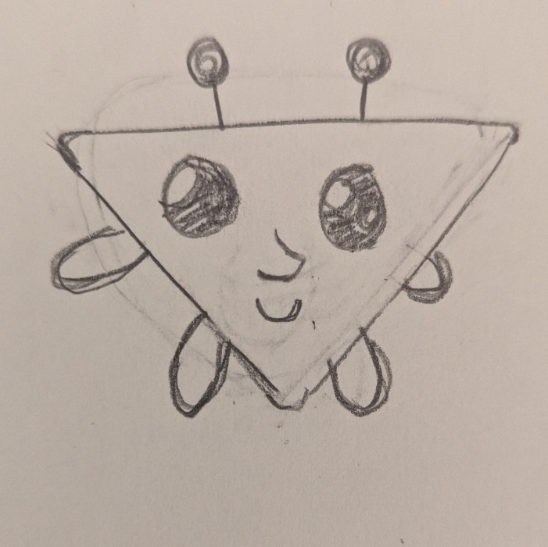
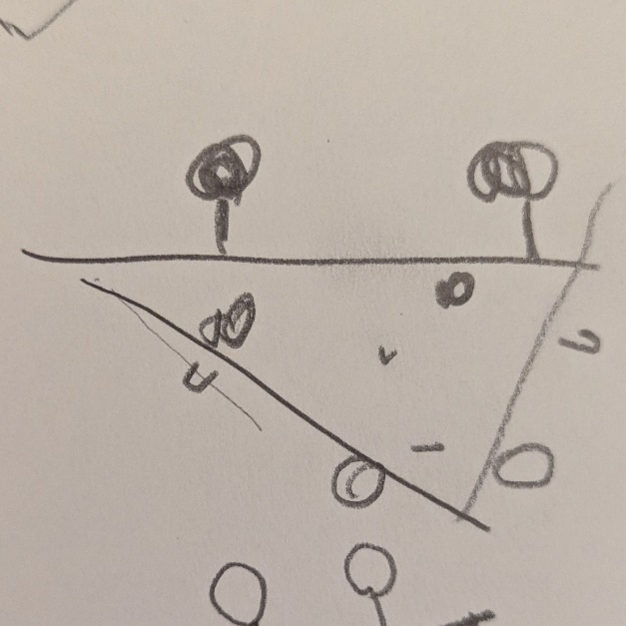
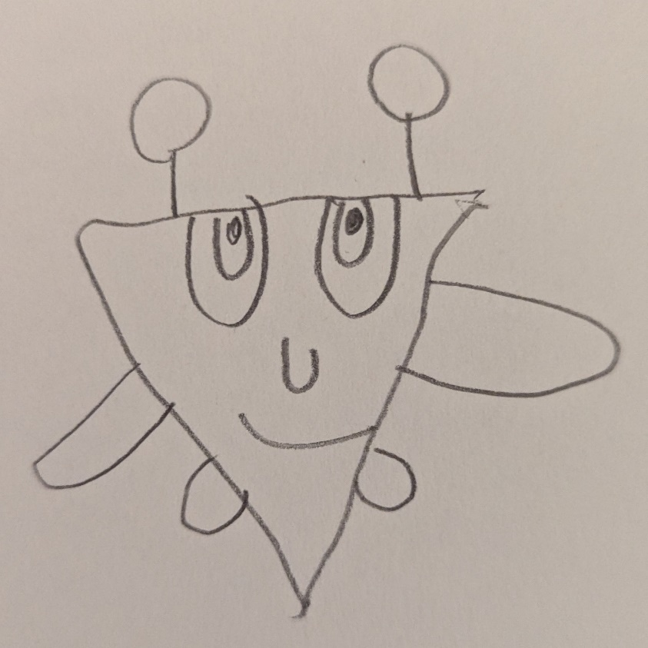
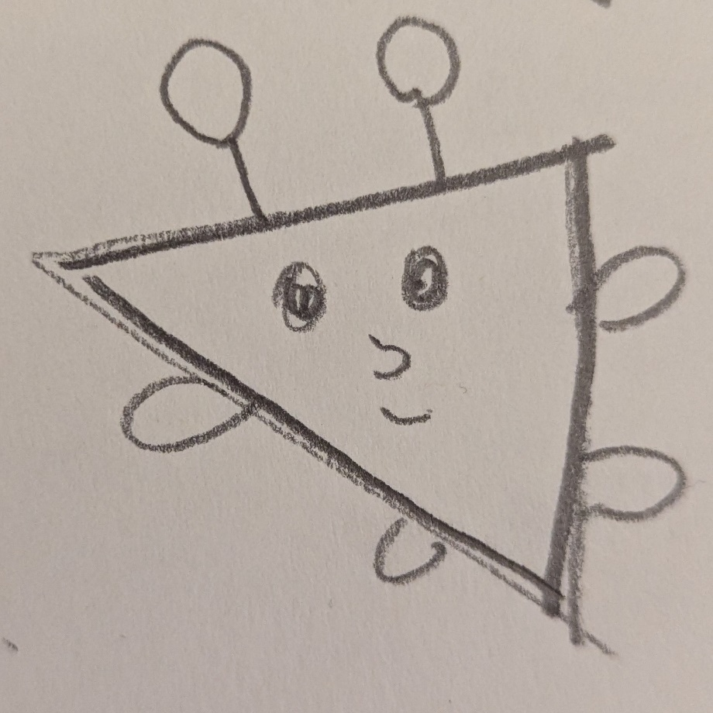
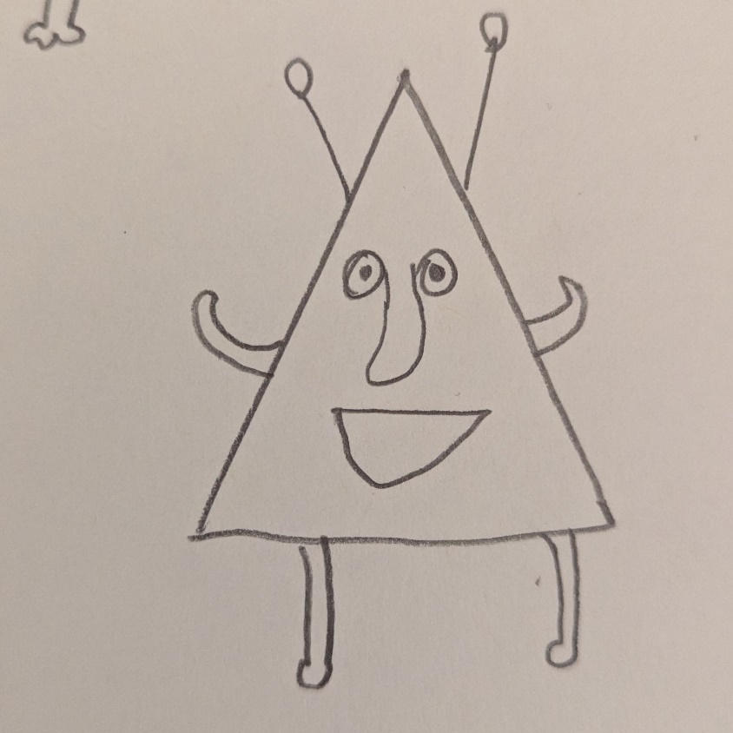
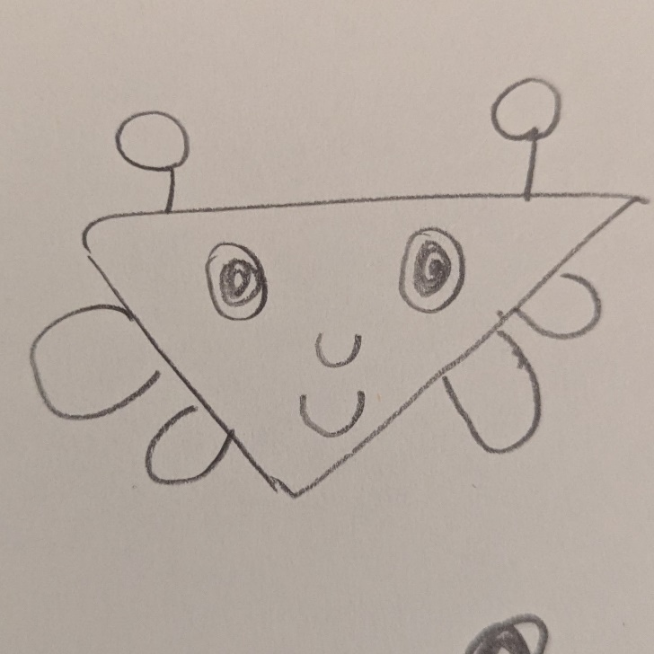
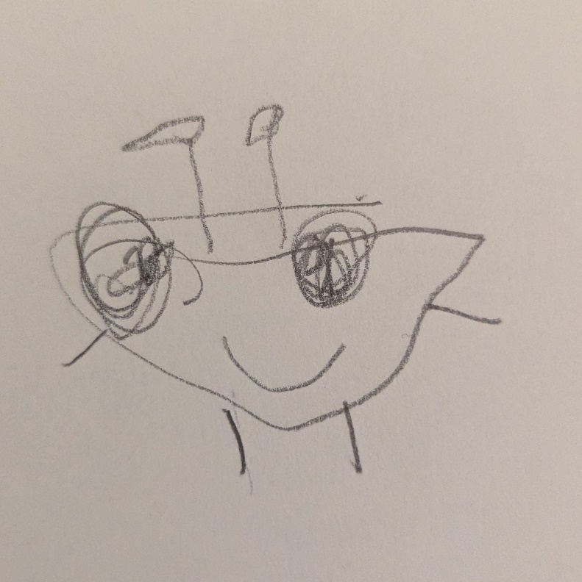
Glixer
Here are some images of “Glixers”.

Slide 15
Now let’s see how well you can classify these new images!
TRAILS.scot

Slide 16
Blorp or Glixer?
Notes:
Blorp

Slide 17
Blorp or Glixer?
Notes:
Glixer

Slide 18
Blorp or Glixer?
Notes:
Glixer

Slide 19
Blorp or Glixer?
Notes:
Blorp

Slide 20
Discussion
What further information do we need to be able to classify the last image?
What if I told you that only 5% of Blorps in the real world have tails? What does this mean for the images you’ve been trained on?
What are the differences between how you learn and how an AI classifier learns?
Notes:
Note to teacher: you can change this activity to be about TV Shows, Books, Music, YouTube Channels, Video Games…whatever type of media suits your group best!

Slide 21
Train your own AI Classifier

Slide 22
Create your own Classifier
You have a few different options for this activity:
Use the slides for “Blorps and Glixers” included here
Raspberry Pi’s “Apple vs. Tomato” activity: https://projects.raspberrypi.org/en/projects/apple-vs-tomato
If you have a computing class, you might prefer to use the “AI midge project” lesson in the RAI computing lessons pack (link when this is online)

Slide 23
Teachable Machine
Now we are going to train an actual AI Classification system on these images of Blorps and Glixers!
Do you think the system will be able to classify the species as well as you can?
Do you think there are enough training images in the set?

Slide 24
Teachable Machine
Go to
https://tm.gen-ai.fi
or
https://teachablemachine.withgoogle.com
Input your images to train the model!

Slide 25
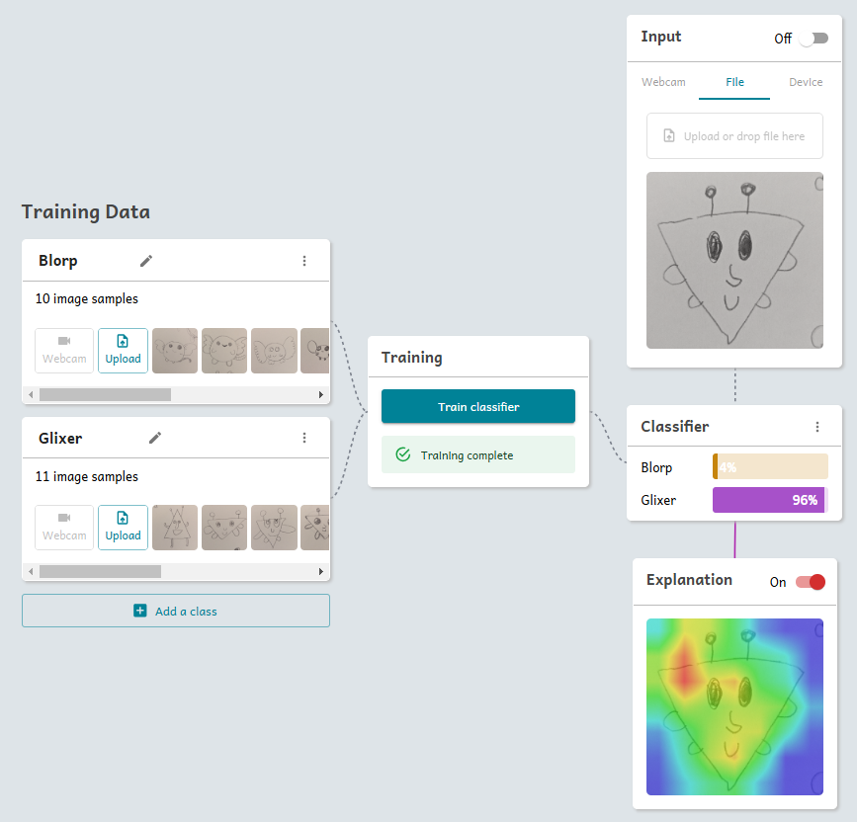
Teachable Machine

Slide 26
Teachable Machine
Once you’ve trained the model...
Draw your own pictures of blorps and glixers and show them to Teachable Machine. How well does the model classify these?
Explain: How does the model tell the difference between blorps and glixers? Is it “looking” in the right places?

Slide 27
Discussion

Slide 28
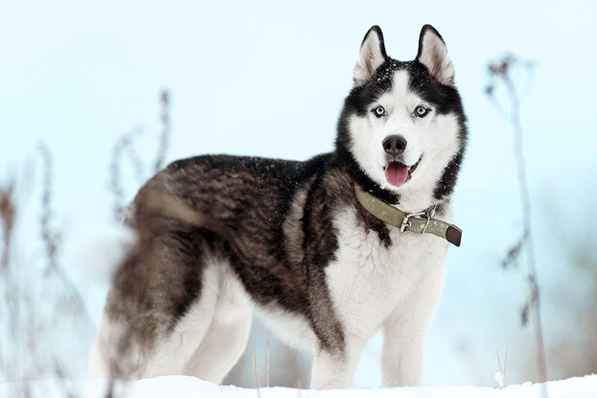
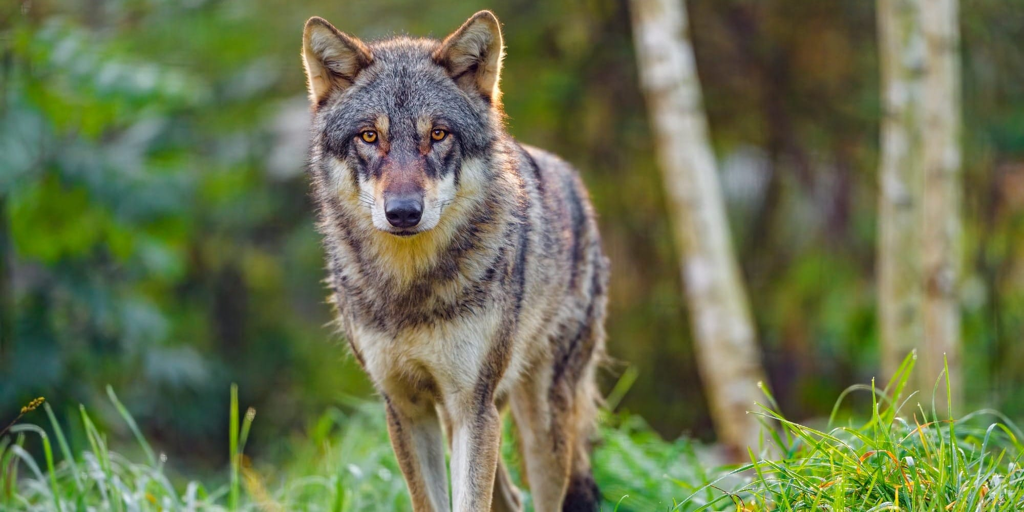
Husky or Wolf?
The data set used in training AI systems is important.
Back in 2016, researchers created a classification model that could distinguish between huskies and wolves, a difficult challenge due to their similar appearance.

Slide 29
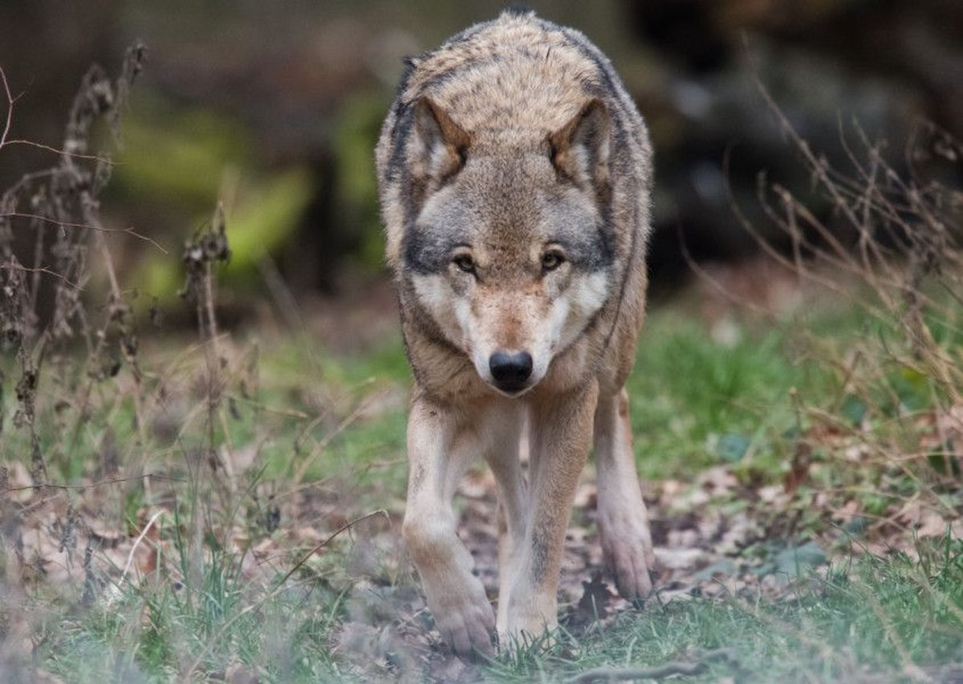
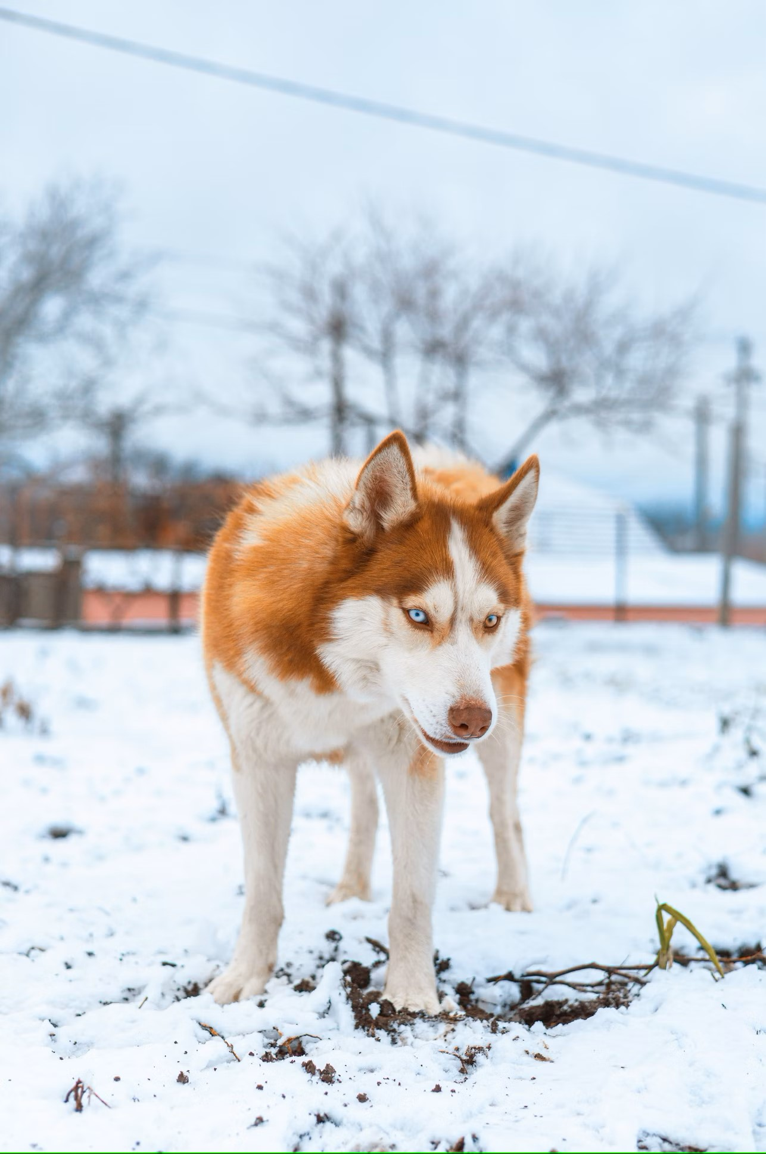
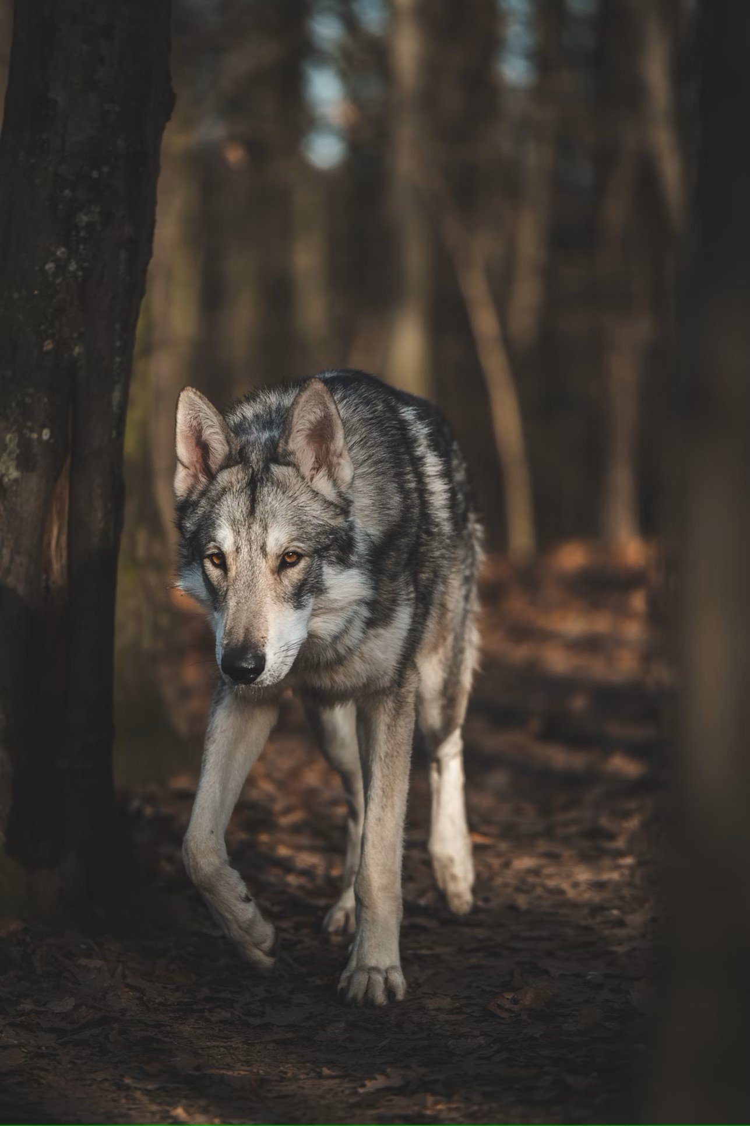
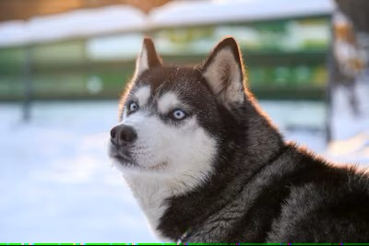
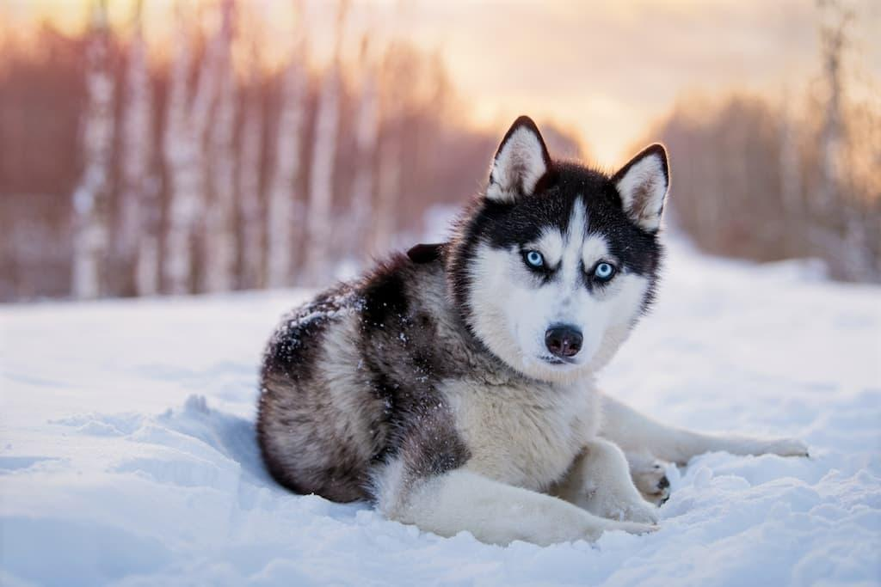
Wolf
Husky
Husky or Wolf?
However, it turns out that the model was not actually very good at distinguishing between the huskies and wolves themselves. Can you guess what it was paying attention to instead?
Husky
Wolf
Husky
Wolf

Slide 30
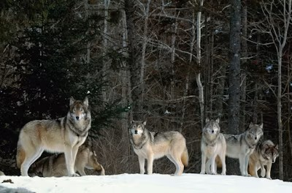
Husky or Wolf?
If you gave the model an image of a wolf in snow, how do you think it would classify this?
Can you imagine a scenario where an AI misclassifying something could lead to serious consequences?
Wolves

Slide 31
RESOURCE TITLE
The following slides contain some optional prompts to discuss this issue (sourced from www.aiedu.org/ai-snapshots), followed by a video about some of the harmful consequences of AI classification errors
TRAIL.scot

Slide 38
Video: AI, Ain’t I A Woman? – Joy Buolamwini (3 min)

