Slide 1
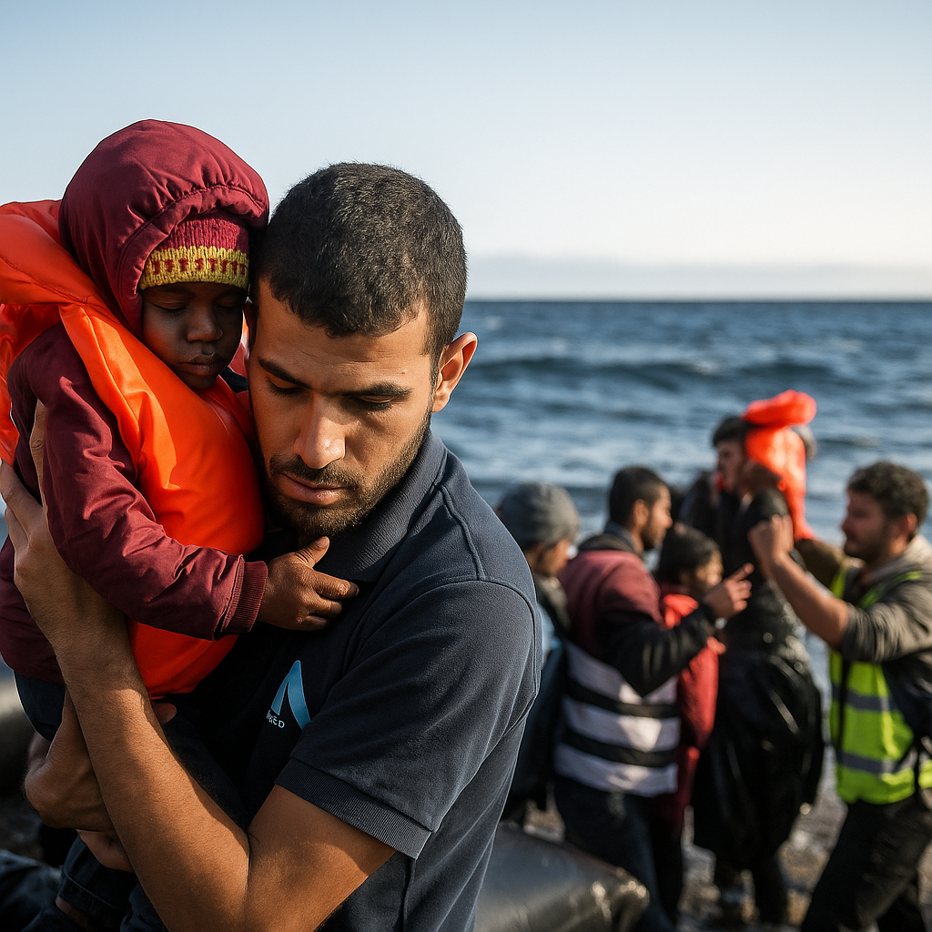
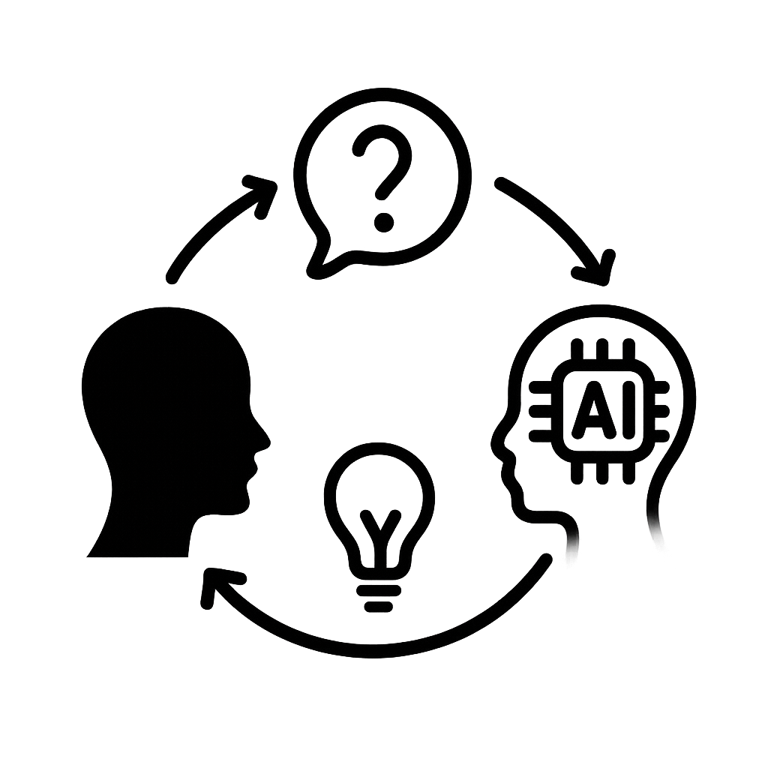
Reading Between and Behind the Lines: Using AI to understand the hidden messages in photos and pictures
Reading Between and Behind the Lines:
Using AI to understand the hidden messages in photos and pictures
In this lesson, we will use AI as a “thinking partner” to help us understand hidden messages and bias in news images.
Working with AI can help us build stronger thinking skills and look more closely at images in the media.
TRAIL.scot

Slide 2
Reading Between and Behind the Lines: Using AI to understand the hidden messages in photos and pictures
What we are learning:
We are learning how to use AI to analyse and evaluate hidden messages in news images.
How we know we have learned it:
I can describe what I notice in a news image.
I can use AI to explore points of view.
I can use a bias scale to think about how an image might affect opinions.
I can explain how bias might affect how someone understands an event.
Learning Intention and Success Criteria
TRAIL.scot

Slide 3
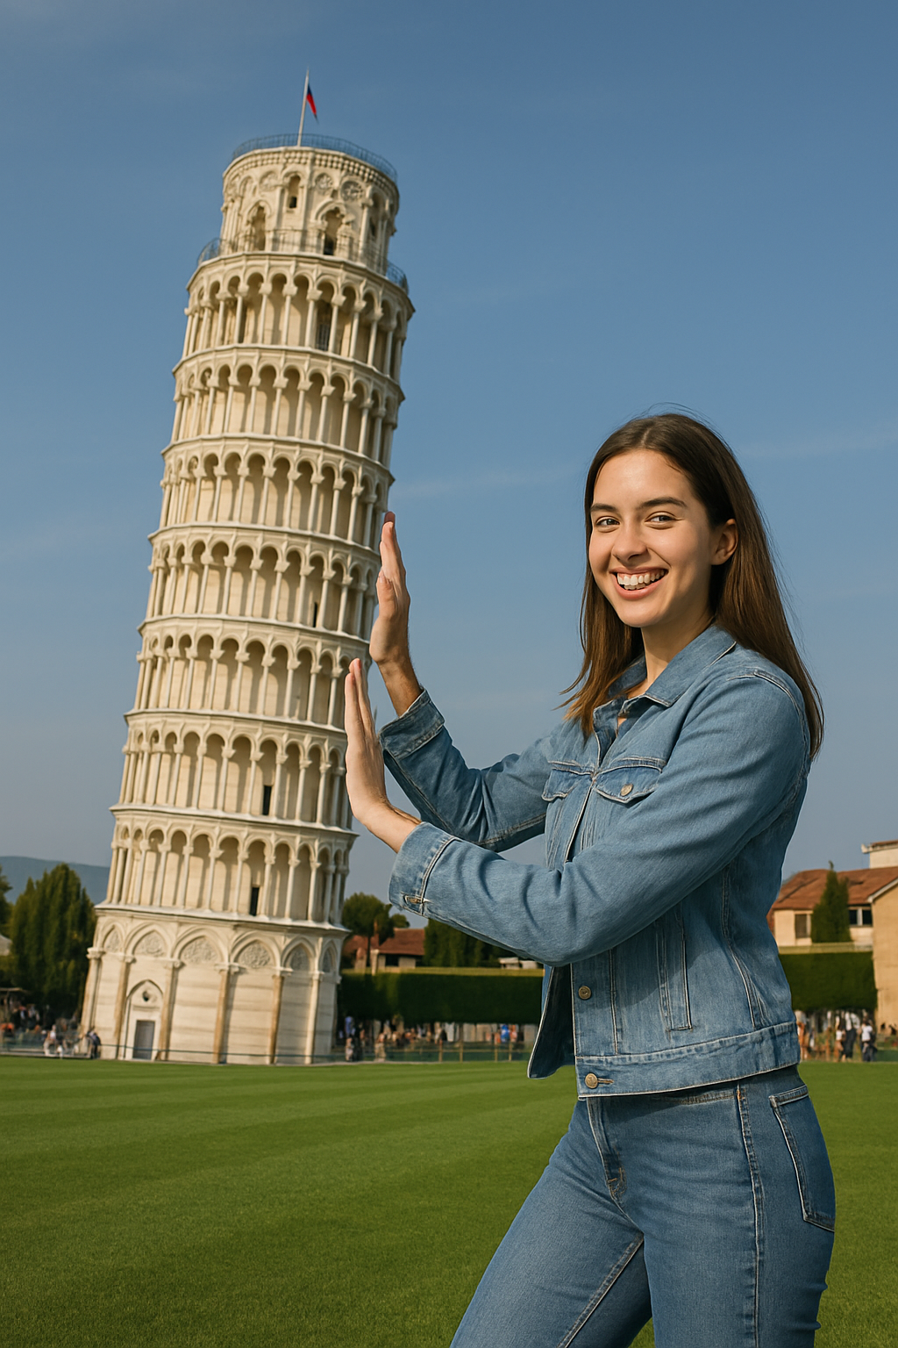
Reading Between and Behind the Lines: Using AI to understand the hidden messages in photos and pictures
What do you think?
What does this image show or make you think?
Starter
TRAILS.scot

Slide 4
Reading Between and Behind the Lines: Using AI to understand the hidden messages in photos and pictures
Compare
What does AI think?
Your thoughts
versus
AI’s thoughts
This photo shows a woman posing to look
like she’s holding up the Leaning Tower of Pisa. It’s a camera trick called forced perspective, where things far away look close. Many tourists do this for fun.
Starter
TRAILS.scot

Slide 5
Reading Between and Behind the Lines: Using AI to understand the hidden messages in photos and pictures
You are finished
Starter
TRAILS.scot

Slide 6
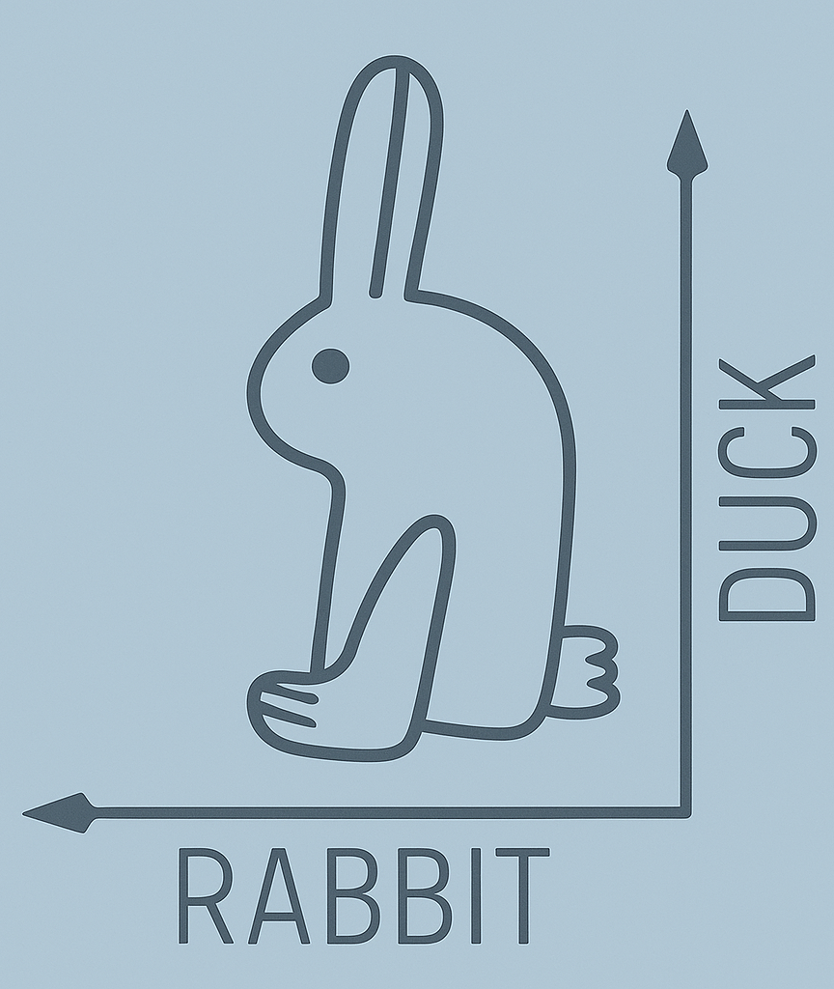
Reading Between and Behind the Lines: Using AI to understand the hidden messages in photos and pictures
What do you see?
Starter
TRAILS.scot

Slide 7
Reading Between and Behind the Lines: Using AI to understand the hidden messages in photos and pictures
What do you see?
02
03
04
Starter
TRAILS.scot

Slide 8
Reading Between and Behind the Lines: Using AI to understand the hidden messages in photos and pictures
First Thoughts
What do you see?
What do you think about when looking at this picture?
What do you think the people might be feeling?
How does the picture make you feel?
Picture 1
Learning Task
TRAILS.scot

Slide 9
Reading Between and Behind the Lines: Using AI to understand the hidden messages in photos and pictures
What is a Bias Scale?
Learning Tasks
TRAILS.scot

Slide 10
Reading Between and Behind the Lines: Using AI to understand the hidden messages in photos and pictures
Bias Scale Practice
Picture 1
Learning Task
TRAILS.scot

Slide 11
Reading Between and Behind the Lines: Using AI to understand the hidden messages in photos and pictures
Ask AI
Ask AI
Upload this image to AI
Ask AI: What do you think about when you look at this picture?
Compare AI’s answers to yours
Picture 1
Learning Task
TRAILS.scot

Slide 12
Reading Between and Behind the Lines: Using AI to understand the hidden messages in photos and pictures
First Thoughts
What do you see?
What do you think about when looking at this picture?
What do you think the people might be feeling?
How does the picture make you feel?
Picture 2
Learning Task
TRAILS.scot

Slide 13
Reading Between and Behind the Lines: Using AI to understand the hidden messages in photos and pictures
Ask AI
Ask AI
Upload this image to AI
Ask AI: What do you think about when you look at this picture?
Compare AI’s answers to yours
Picture 2
Learning Task
TRAILS.scot

Slide 14
Reading Between and Behind the Lines: Using AI to understand the hidden messages in photos and pictures
Checking for Bias in AI Answers
Learning Task
TRAILS.scot

Slide 15
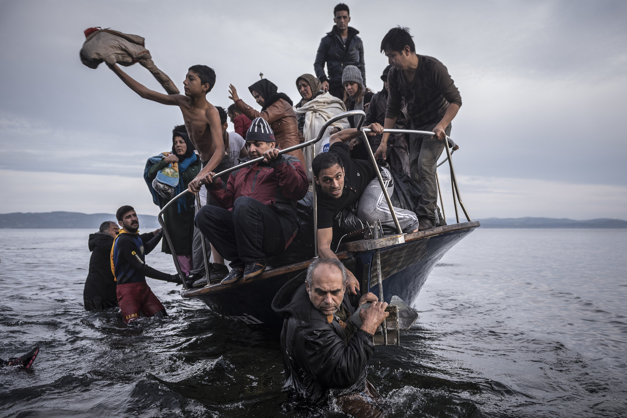
Reading Between and Behind the Lines: Using AI to understand the hidden messages in photos and pictures
Reflect
02
03
04
Plenary
TRAILS.scot

Slide 16
Reading Between and Behind the Lines: Using AI to understand the hidden messages in photos and pictures
Final Thoughts
Was using AI as a thinking partner helpful?
End of Lesson Reflection
TRAILS.scot

