Slide 1
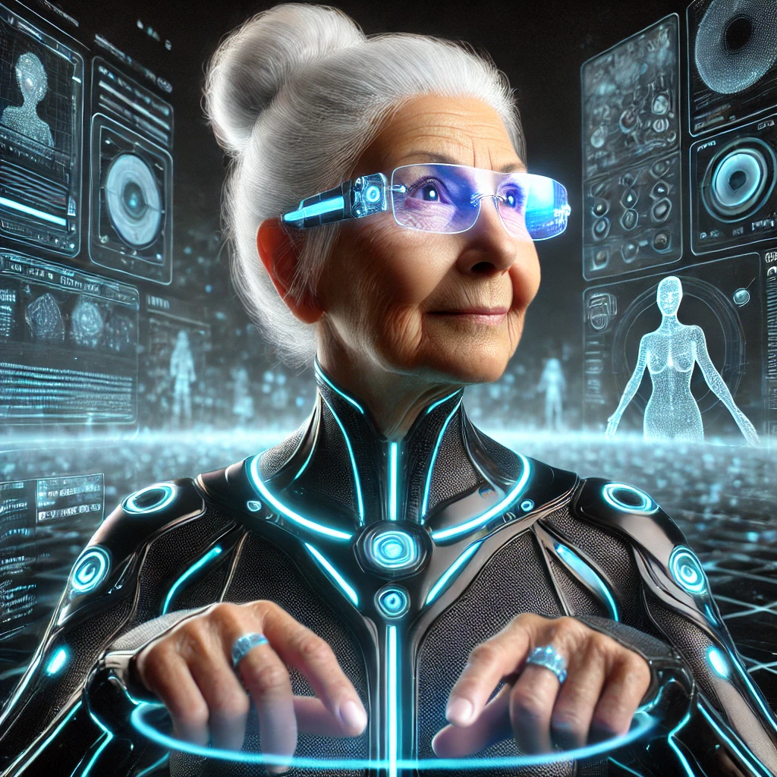
Seeing is Not Always Believing: Using AI to Explore Stereotypes
Seeing is Not Always Believing:
Using AI to Explore Stereotypes
In this lesson, AI is used as both a thinking partner and a creative tool to help us understand bias and stereotypes. By changing the instructions we give AI, we can create more inclusive images.
TRAIL.scot

Slide 2
Seeing is Not Always Believing: Using AI to Explore Stereotypes
Seeing is Not Always Believing:
Using AI to Explore Stereotypes
In this lesson, AI is used as both a thinking partner and a creative tool to help us understand bias and stereotypes. By changing the instructions we give AI, we can create more inclusive images.
TRAIL.scot

Slide 3
Seeing is Not Always Believing: Using AI to Explore Stereotypes
What we are learning:
We are learning how AI pictures can show stereotypes, and how we can use AI to create more inclusive images.
How we know we have learned it:
I can identify stereotypes in pictures and what makes them unfair.
I can describe how stereotypes can affect people negatively.
I can experiment with prompts to explore how wording influences images.
I can explain how my AI-generated pictures reflects a stereotype.
I can suggest ways to make images more fair and inclusive.
Learning Intention and Success Criteria
TRAIL.scot

Slide 4
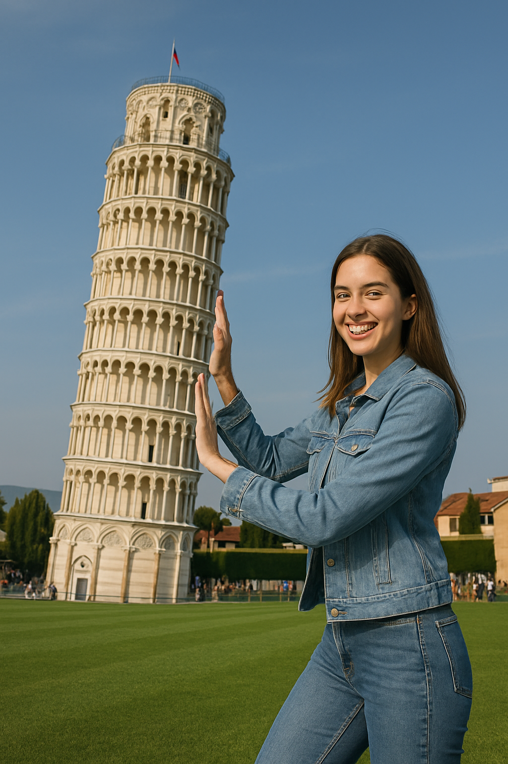
Seeing is Not Always Believing: Using AI to Explore Stereotypes
What do you notice about this superhero?
Starter
TRAILS.scot

Slide 5
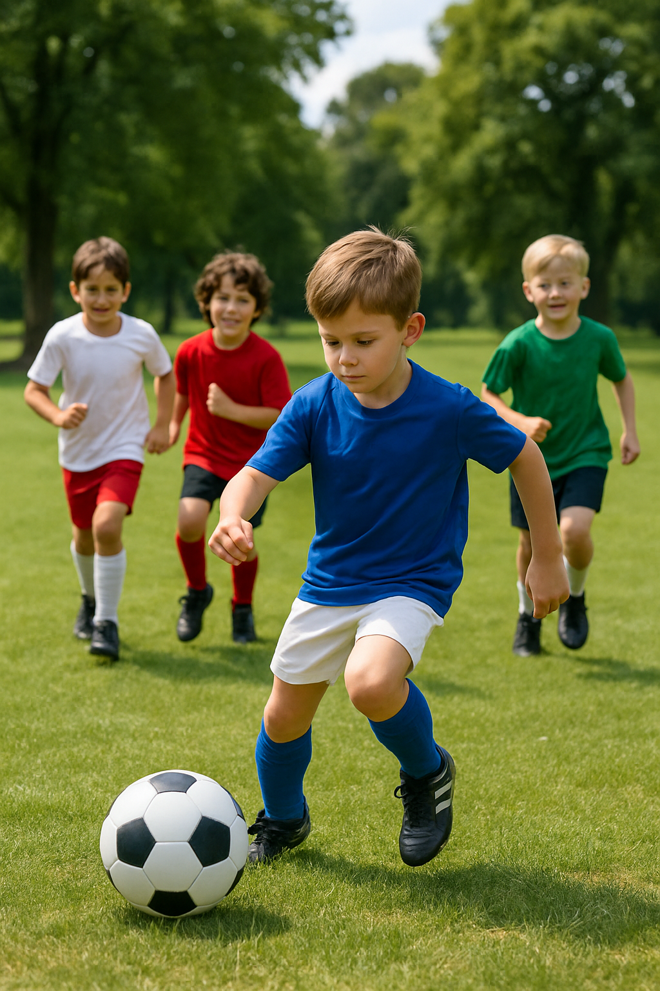
Seeing is Not Always Believing: Using AI to Explore Stereotypes
What are Stereotypes?
Core Concept
TRAILS.scot

Slide 6
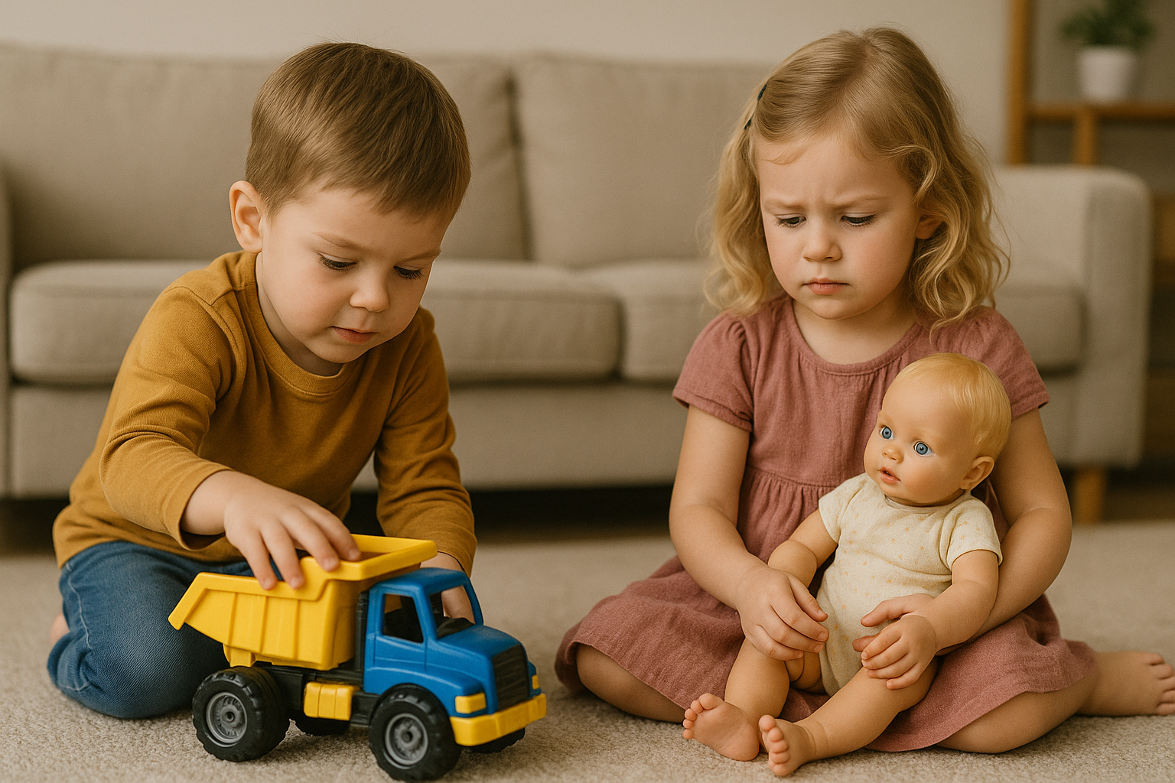
Seeing is Not Always Believing: Using AI to Explore Stereotypes
Common Stereotypes
02
03
04
Learning Task
TRAILS.scot

Slide 7
Seeing is Not Always Believing: Using AI to Explore Stereotypes
Identifying Stereotypes in Images
02
03
04
Learning Task
TRAILS.scot

Slide 8
Seeing is Not Always Believing: Using AI to Explore Stereotypes
Identifying Stereotypes in Images
02
03
04
Learning Task
TRAILS.scot

Slide 9
Seeing is Not Always Believing: Using AI to Explore Stereotypes
Identifying Stereotypes in Images
02
03
04
Learning Task
TRAILS.scot

Slide 10
Seeing is Not Always Believing: Using AI to Explore Stereotypes
Identifying Stereotypes in Images
02
03
04
Learning Task
TRAILS.scot

Slide 11
Seeing is Not Always Believing: Using AI to Explore Stereotypes
Generating Inclusive Images with AI
02
03
04
Guided Task
TRAILS.scot

Slide 12
Seeing is Not Always Believing: Using AI to Explore Stereotypes
How to Generate Inclusive Images with AI
02
03
04
Learning Task
TRAILS.scot

Slide 13
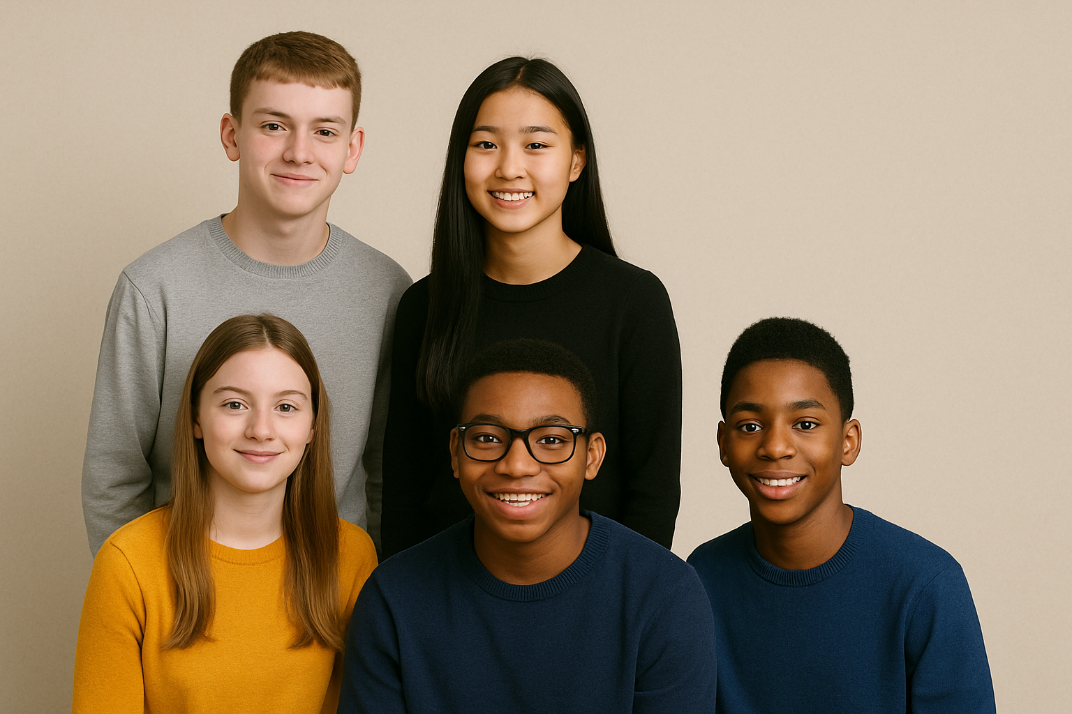
Seeing is Not Always Believing: Using AI to Explore Stereotypes
Reflect and Review
02
03
04
Plenary
TRAILS.scot

Slide 14
Seeing is Not Always Believing: Using AI to Explore Stereotypes
Final Thoughts
What did AI help you learn today?
End of Lesson Reflection
TRAILS.scot

