Slide 1
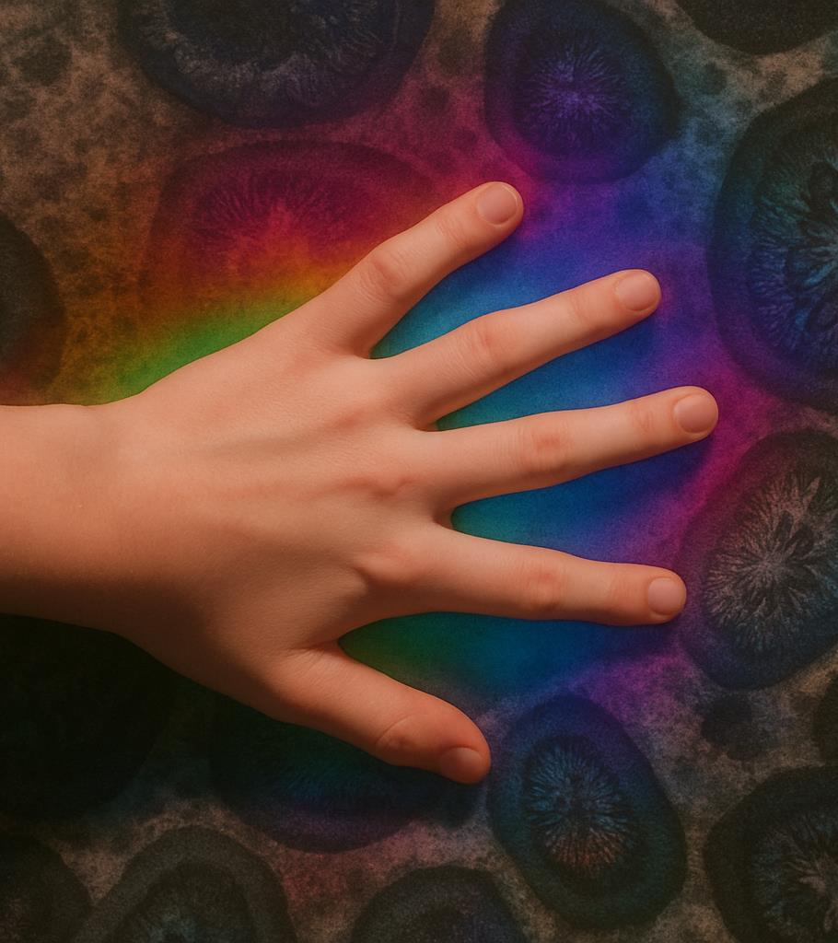




Seeing and Hearing: Using AI to Enhance Experiential and Sensory Learning
Seeing and Hearing:
Using AI to Enhance Experiential and Sensory Learning
In this lesson, learners will explore different spaces in different ways by using sound.
Learners will take photos of things that interest them, and through using an AI tool these pictures are turned into sounds.
This lesson supports sensory play, helps connect sounds to places, and gives learners the chance to show what they like through movement, gestures or sounds.
TRAIL.scot

Slide 2

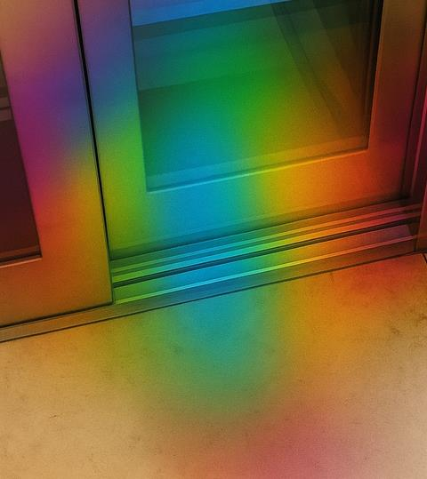

Seeing and Hearing: Using AI to Enhance Experiential and Sensory Learning
What we are learning:
We are learning how to support learners explore their environment using AI-generated sound
How we know we have learned it:
I can support learners to take a photo of something that interests them
I can use an AI tool to turn the photo into sound and share it with learners
I can observe and record how the learner responds to the sound
I can encourage learners to make choices and revisit places to make connections between sound and environment
Learning Intention and Success Criteria
TRAIL.scot

Slide 3
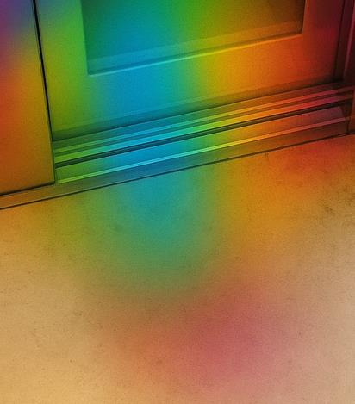




Seeing and Hearing: Using AI to Enhance Experiential and Sensory Learning
Learning Task
This learning activity uses AI-generated sound to support sensory learning, communication and choice in any environment.
The sounds created by AI are abstract and do not directly match the images. Instead, the AI turns visual patterns into music-like sounds.
The sounds may be surprising or unusual - and that’s the point.
AI is acting as a creative and sensory tool, designed to help learners explore and experience images in new and engaging ways.
Symbols
Look
Look carefully at something nearby or on the screen
Choose
Make a selection or show a preference
Take a photo
Use the camera to take a picture of something you like
Listen
Focus on the sounds you hear
Learning Tasks
TRAILS.scot

Slide 4
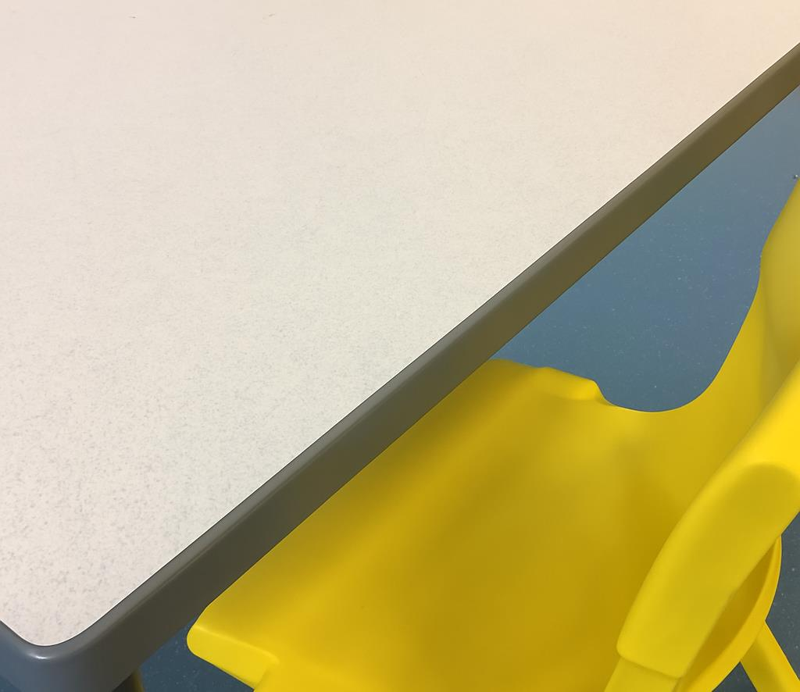

Seeing and Hearing: Using AI to Enhance Experiential and Sensory Learning
Task 1:
Take Photos
02
03
04
Learning Tasks
TRAILS.scot

Slide 5


Seeing and Hearing: Using AI to Enhance Experiential and Sensory Learning
Task 2:
Turn Image into Sound
Use an AI tool to create sound from the photo
Listen together
Ask: What do you notice? What do you like?
Learning Task
TRAILS.scot

Slide 6

Seeing and Hearing: Using AI to Enhance Experiential and Sensory Learning
Task 3:
Respond to Sound
Replay the sound with the image
Respond:
  Move to the sound
  Use gestures or expressions
  Choose your favourite
There is no right answer!
Learning Task
TRAILS.scot

Slide 7

Seeing and Hearing: Using AI to Enhance Experiential and Sensory Learning
Task 4:
Revisit the Space
Go back to the place where the photos were taken
Make new connections or take new photos
Learning Task
TRAILS.scot

Slide 8

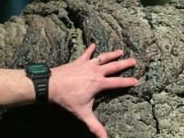


Seeing and Hearing: Using AI to Enhance Experiential and Sensory Learning
Examples
Here are 4 examples of how AI transformed pictures into sound.
Each 10 second sound clip was made during a museum visit.
Click through to play each video in order.
Take time to listen carefully to each sound as it plays.
Examples
TRAILS.scot

Slide 9




Seeing and Hearing: Using AI to Enhance Experiential and Sensory Learning
Reflecting on the Learning
What worked well?
What could you do differently next time?
Reflection
TRAILS.scot

