Slide 1
AI Midge Project
1) Train, Test and Compare AI Image Models

Slide 2
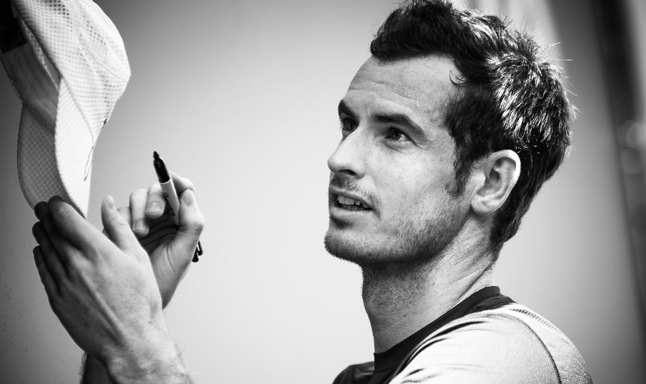
Notes:
Human Image Recognition
Humans can recognise faces in just a few hundred milliseconds.
Even when faces are partially obscured or shown at unusual angles, the brain is adept at identifying familiar faces.

Slide 4
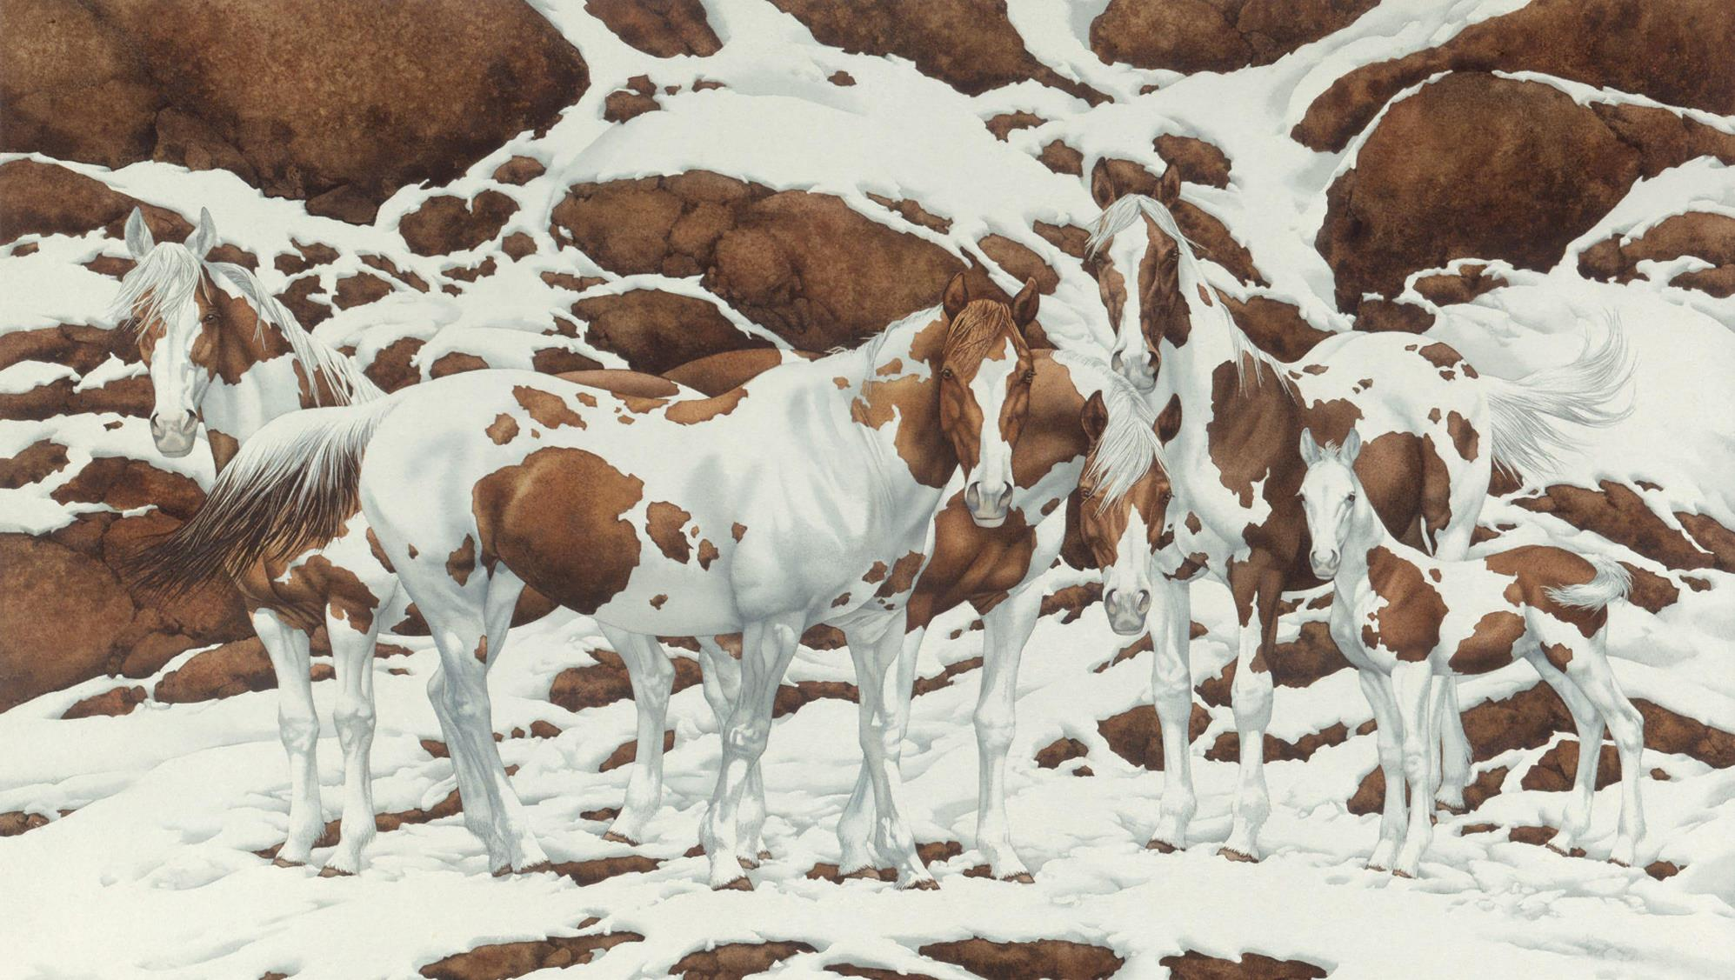
Notes:
How many horses?
Image: Bev Doolittle
Discuss edge detection, pattern recognition, image understanding

Slide 5
Notes:
Image: Bev Doolittle

Slide 6
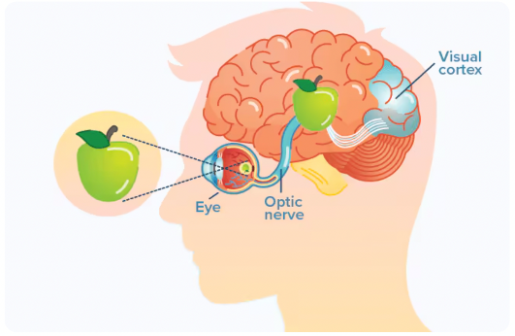
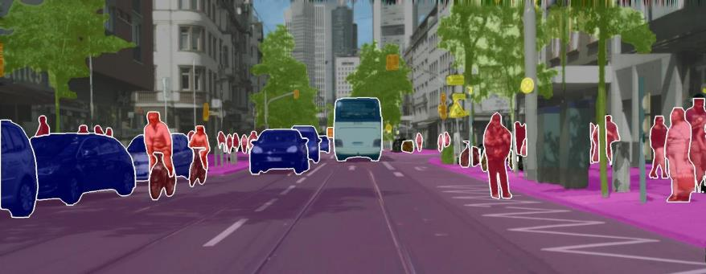
Image Recognition
The human brain has evolved to be incredibly good at image recognition.
Our brains process vast amounts of visual data almost instantaneously, helping us navigate the world efficiently.
Face Recognition
Humans can recognise faces in just a few hundred milliseconds. Even when faces are partially obscured or shown at unusual angles, the brain is adept at identifying familiar faces.
Visual Scene Understanding
The brain can quickly process a complex visual scene and identify key elements, like distinguishing between different objects (cars, trees, etc.) in a cluttered environment. It only takes about 200 milliseconds for the brain to identify objects in a scene, even in a high-stakes context like driving.

Slide 7
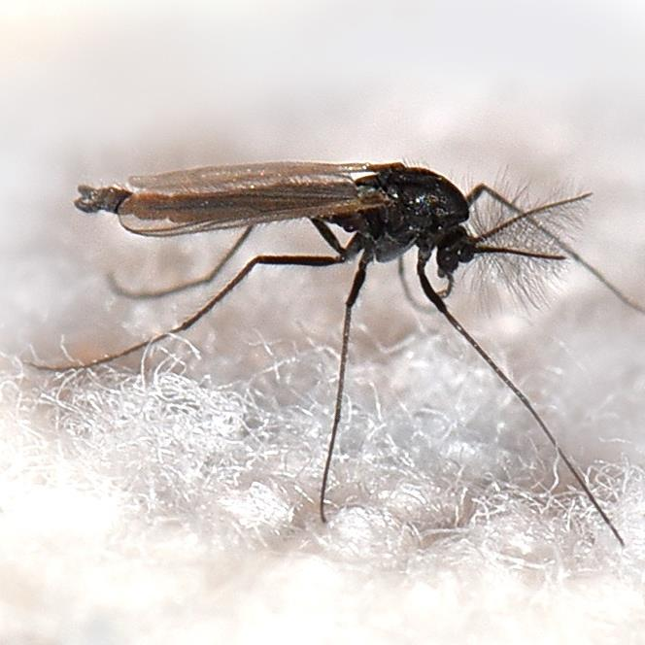
Impact of Midges in Scotland
Tourism Losses: Midges have been estimated to cost Scotland's economy up to £10 million annually, as their swarms deter tourists, especially outdoor enthusiasts like hikers and campers.
Seasonal Disruption: The midge season (May to September) overlaps with peak tourism months, causing many visitors to avoid or shorten their trips due to the discomfort of the insects.
Impact on Rural Communities: In midge-heavy areas, local economies that rely on outdoor tourism can suffer, with fewer visitors and a decline in business during the summer months.
Ecological Role: Despite their economic impact, midges play an important role in the ecosystem, providing food for birds, bats, and fish, which supports other industries like fishing and wildlife tourism.

Slide 8
"A cloud of pain" : Summertime 'explosion' of midges in Scotland. STV News 2021
https://youtu.be/ebE7wdsHXX8?si=8bFF1QuIczhOGy02
AI
Highland Midge Project

Slide 9
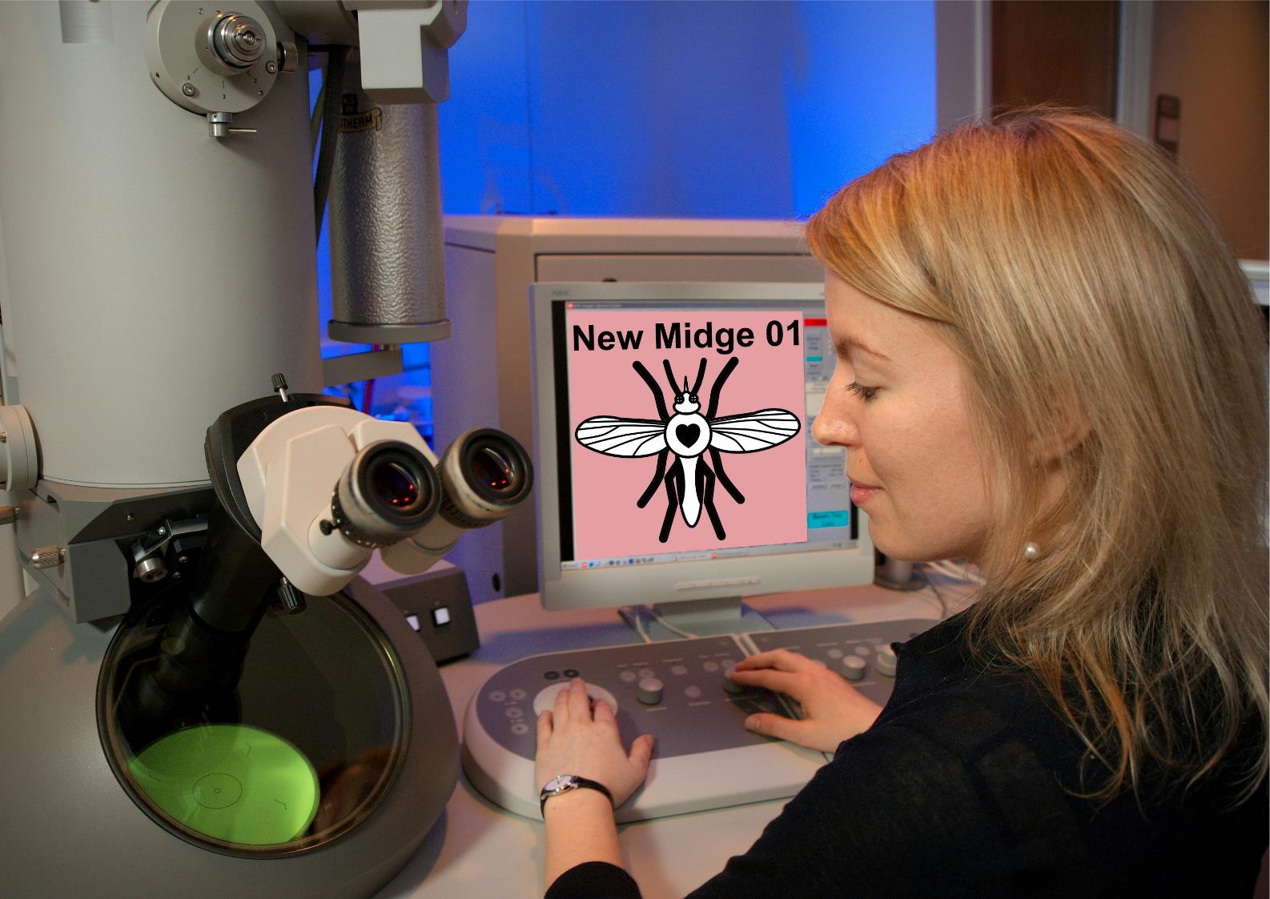
*** BREAKING NEWS! ***
Scientists at the University of Edinburgh believe they have discovered a new species of
non-biting midge.
They need your help to distinguish between midges that are:
Biting
Non-biting
Edinburgh scientists seek help to classify biting and non-biting midge in new

Slide 10
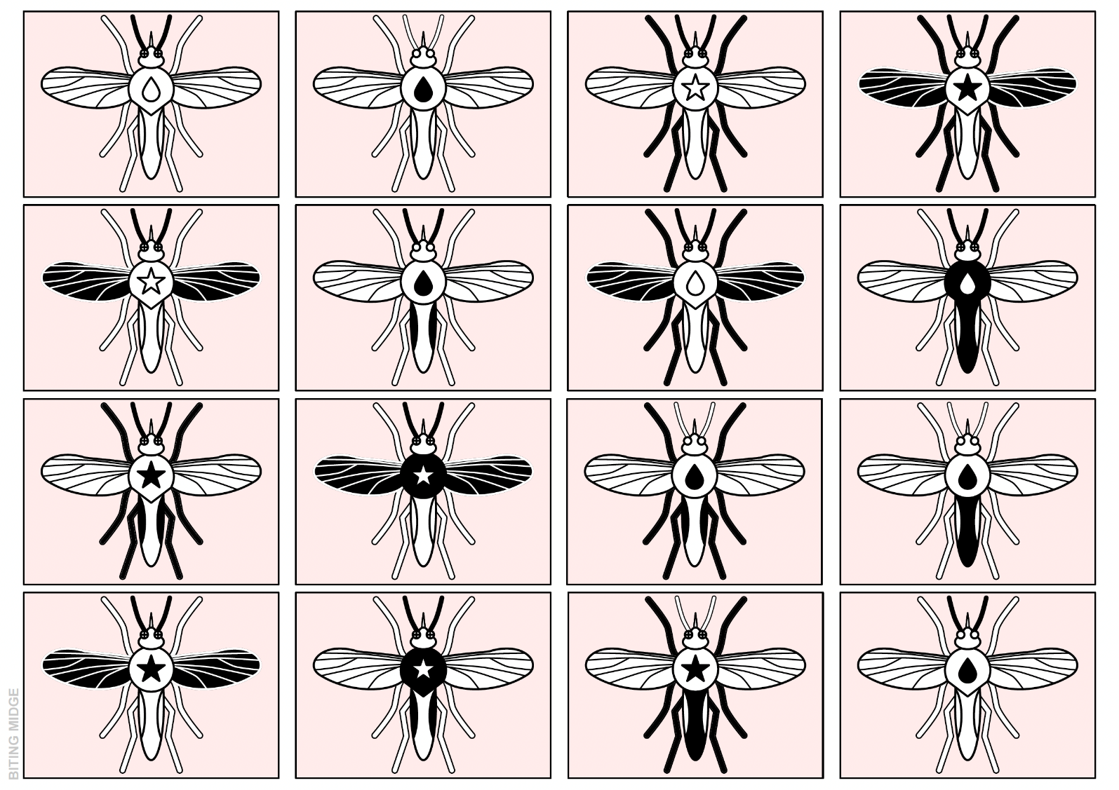
BITING MIDGE
Notes:
Biting Midge

Slide 11
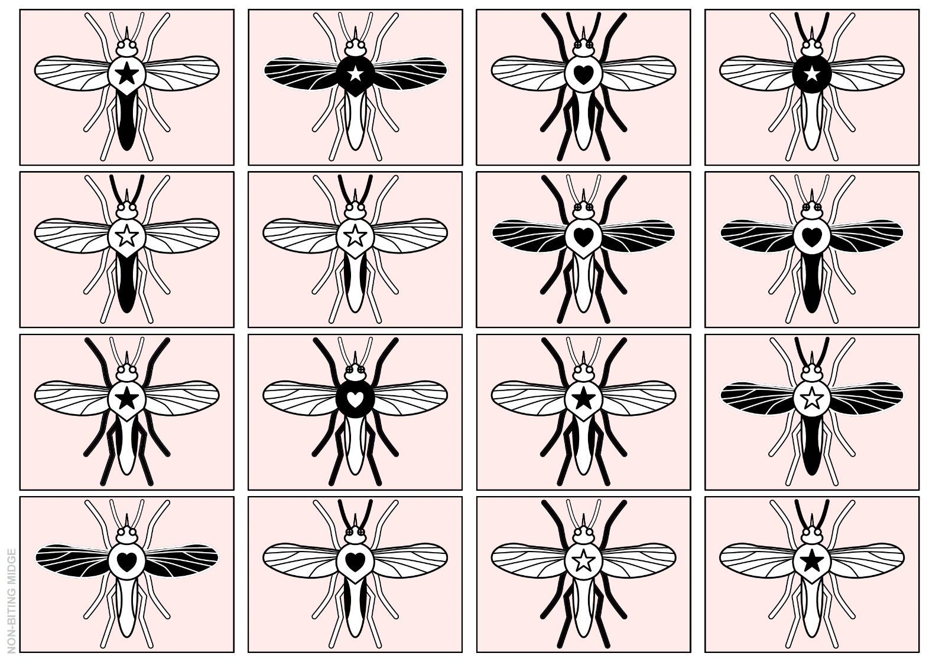
NON-BITING MIDGE
Notes:
Non-biting midge

Slide 12
What pattern(s) do you notice?
Legs? (White/Black)
Wings? (White/Black)
Antenna? (White/Black)
Eyes? (White/Black Cross)
Torso Shape? (Circle/Pointed)
Torso Colour? (White/Black)
Tail Main Colour? (White/Black)
Tail Side Colour? (White/Black)
Torso Symbol? (Heart/Star/Tear)
Torso Symbol Colour? (White/Black)

Slide 13
Most significant features?
Torso Symbol? (Heart/Star/Tear)
Eyes? (White/Black Cross)

Slide 14
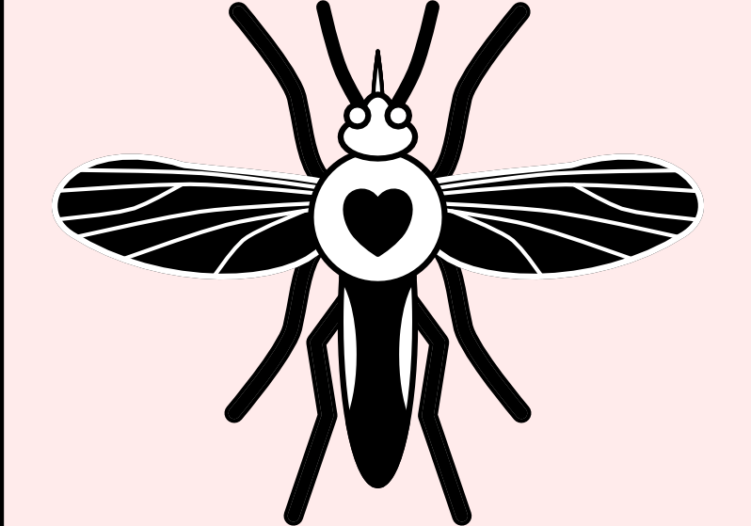
What is your hypothesis?
Which are the most important features that can help us to classify biting vs. non-biting midge?

Slide 15
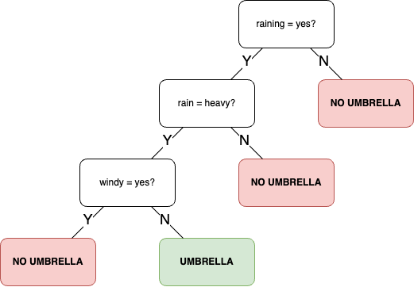
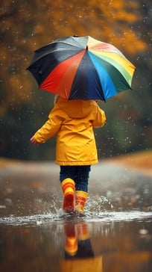
Decision Trees and Classification

Slide 16
Can we make a decision tree to identify which midges are biting and which are non-biting?
Torso Symbol? (Heart/Star/Tear)
Eyes? (White/Black Cross)

Slide 17
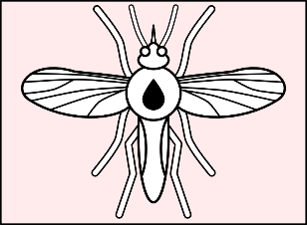
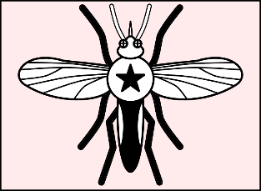
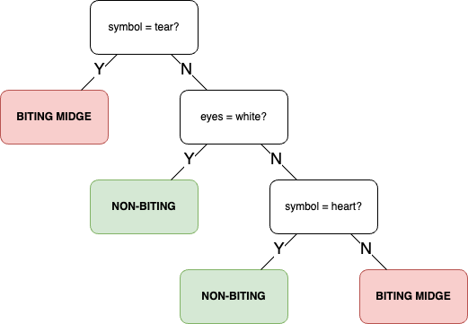
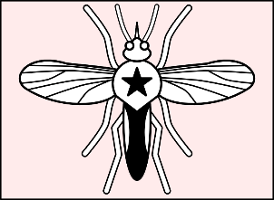
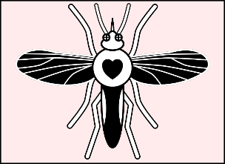
Decision Tree
BITING
EXAMPLES
TRAINING MIDGE
NON-BITING EXAMPLES

Slide 18
Decision Tree
BITING
EXAMPLES
TRAINING MIDGE
NON-BITING EXAMPLES

Slide 19
Decision Tree
BITING
EXAMPLES
TRAINING MIDGE
NON-BITING EXAMPLES

Slide 20
Decision Tree
BITING
EXAMPLES
TRAINING MIDGE
NON-BITING EXAMPLES

Slide 21
Decision Tree
BITING
EXAMPLES
TRAINING MIDGE
NON-BITING EXAMPLES

Slide 22
Decision Tree
BITING
EXAMPLES
TRAINING MIDGE
NON-BITING EXAMPLES

Slide 23
Decision Tree
BITING
EXAMPLES
TRAINING MIDGE
NON-BITING EXAMPLES

Slide 24
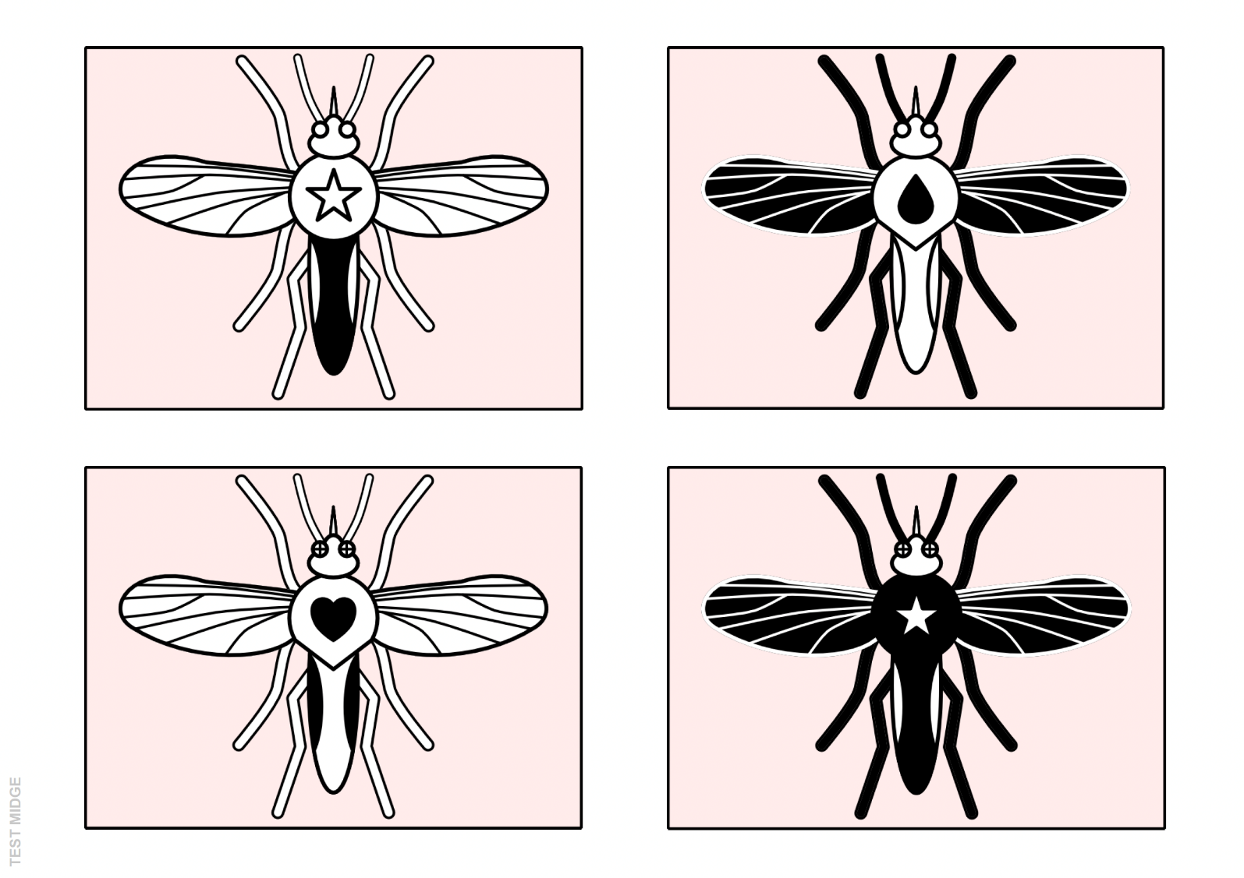
TEST MIDGE
Notes:
Test midge
Test your Hypothesis

Slide 25
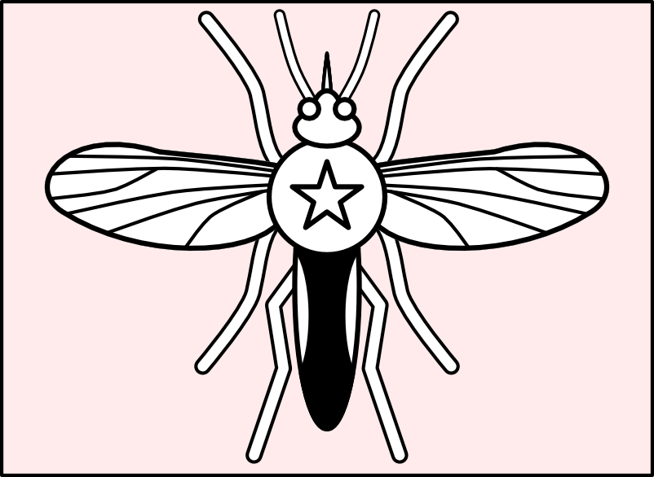
Test 1
NON-BITING
Notes:
Test midge
Test your Hypothesis

Slide 26
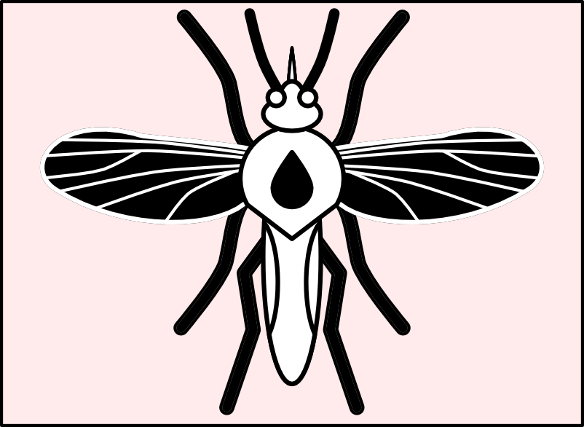
Test 2
BITING
Notes:
Test midge
Test your Hypothesis

Slide 27
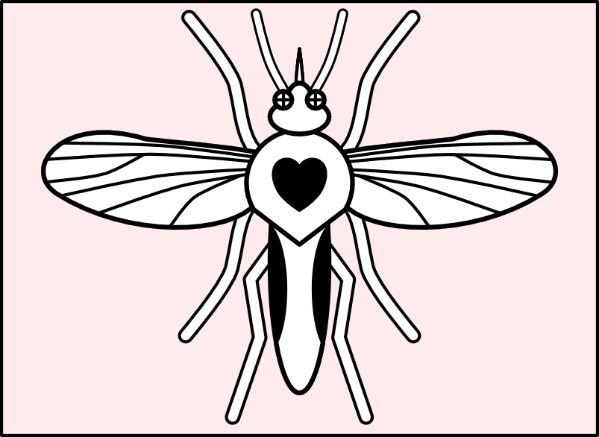
Test 3
NON-BITING
Notes:
Test midge
Test your Hypothesis

Slide 28
Test 4
BITING
Notes:
Test midge
Test your Hypothesis

Slide 29
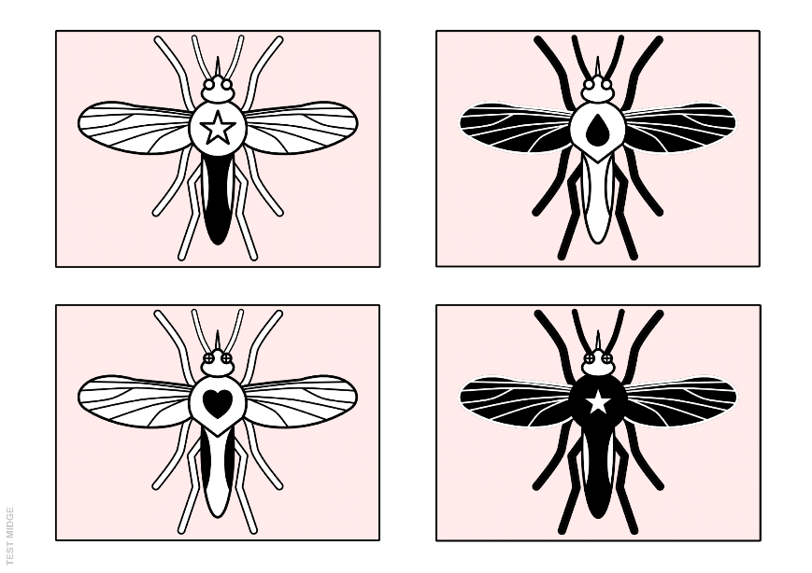
NON-BITING
BITING
NON-BITING
BITING
Notes:
Test midge
Test your Hypothesis

Slide 30
NON-BITING
BITING
TEST MIDGE
NON-BITING
BITING
Notes:
Test midge
Test your Hypothesis

Slide 31
Train and Test an AI Image Model

Slide 32
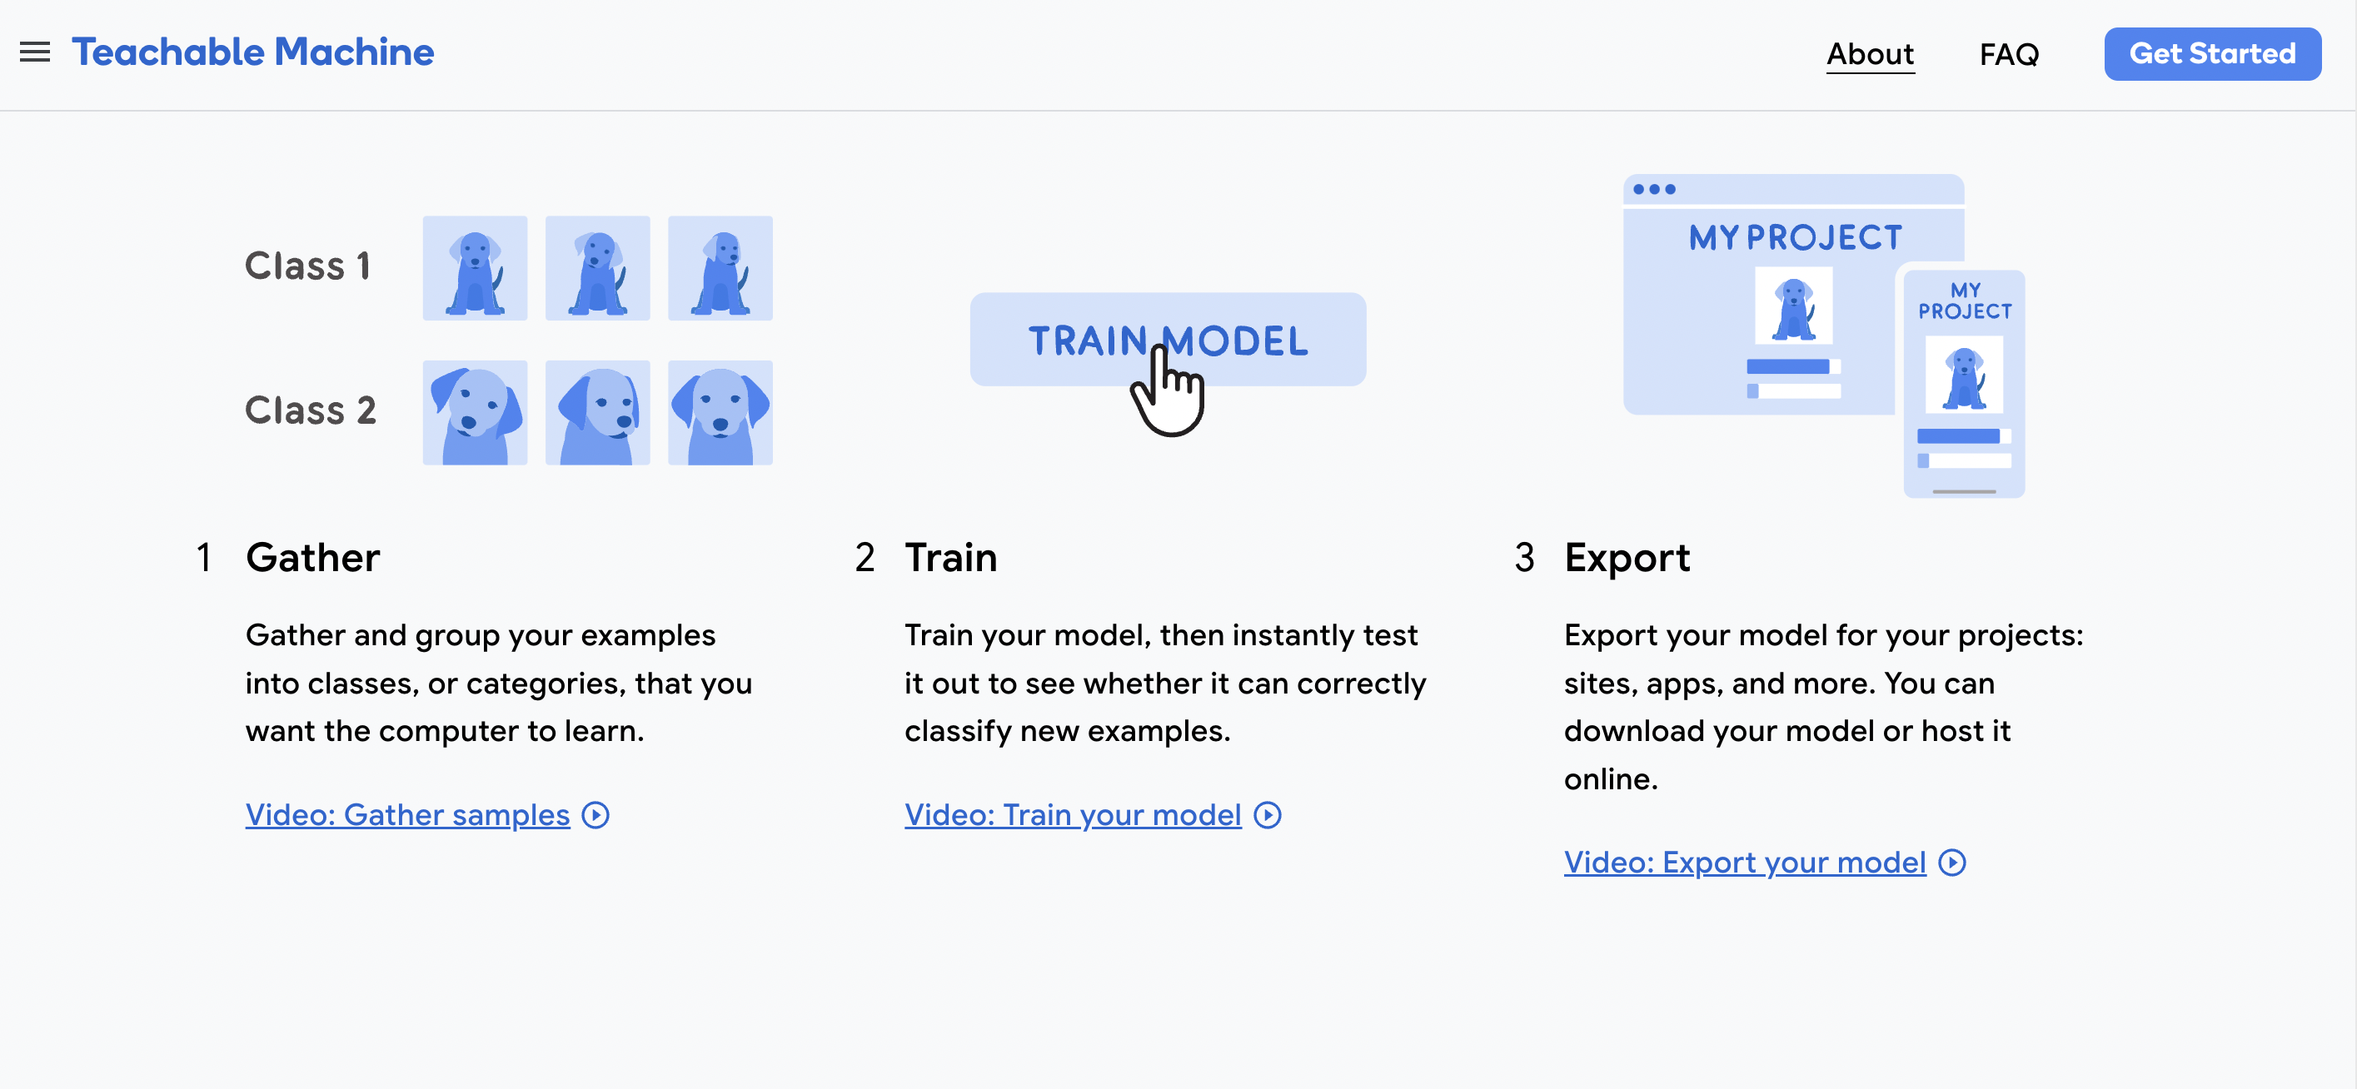
Train and Test an AI Image Model 1) Teachable Machine
Notes:
Teacher Demo.
Create 2 classes and use webcam to train a model and demo software. (e.g 2+ objects. 2+ pupils.)
Pupils will then create 2 classes for biting and non-biting midge. Upload training images, then Test using 4 test images.

Slide 33
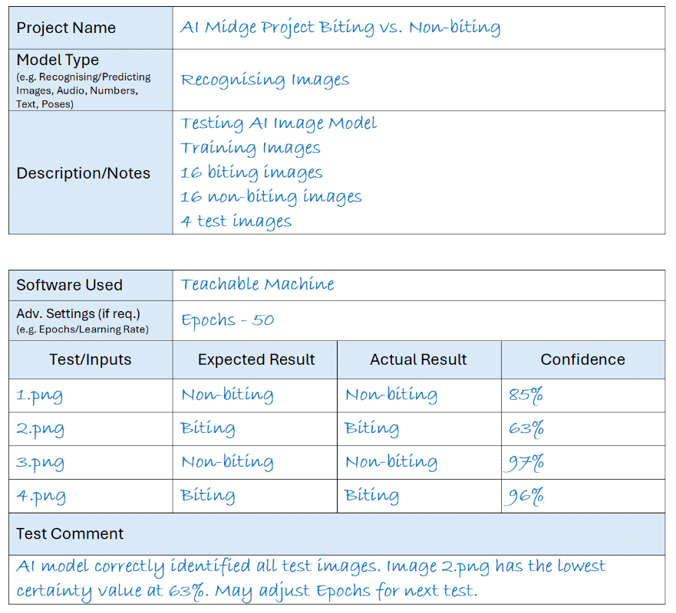
AI Image Model Teachable Machine – Testing and Evaluation

Slide 34
Train and Test an AI Image Model 2) Machine Learning for Kids

Slide 35
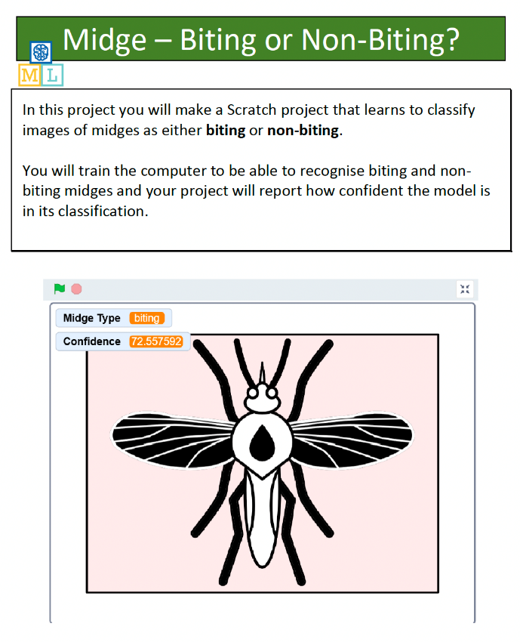
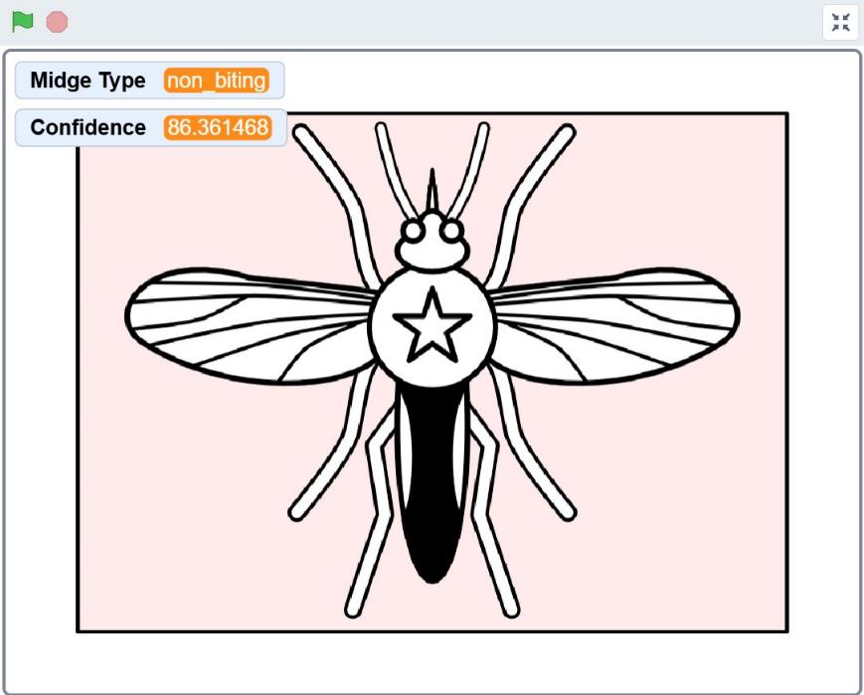
Create a ML Scratch Project
Notes:
Pupils should use the tutorial to create a simple Scratch project using their ML image recognition model

Slide 36
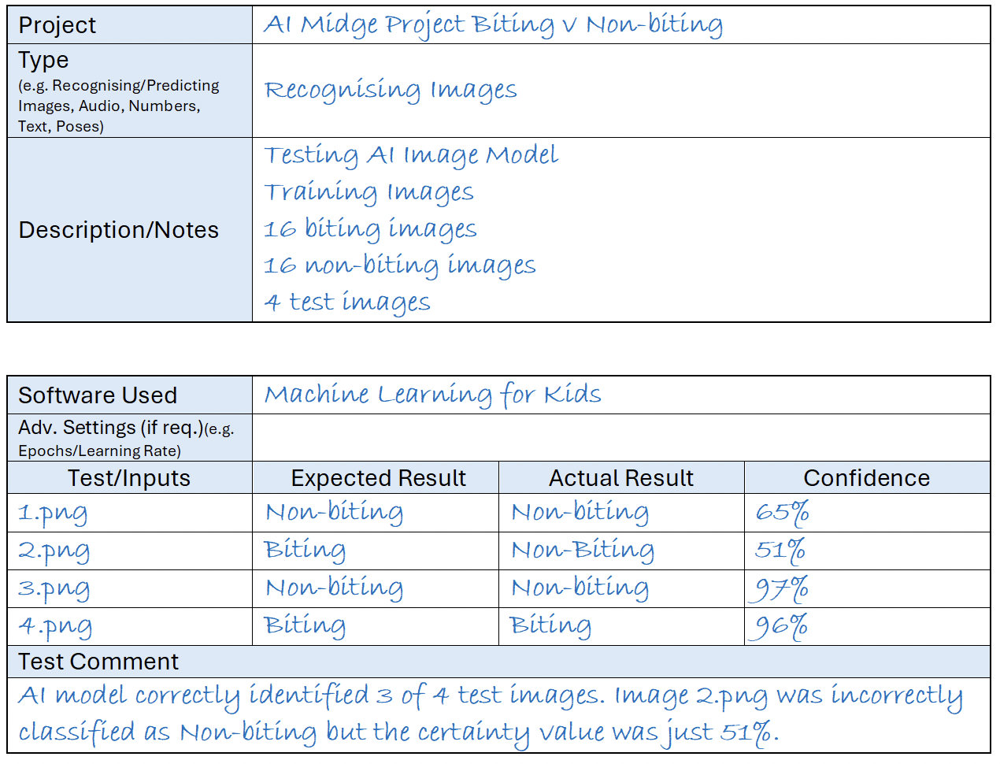
AI Image Model Machine Learning for Kids – Testing and Evaluation

Slide 37
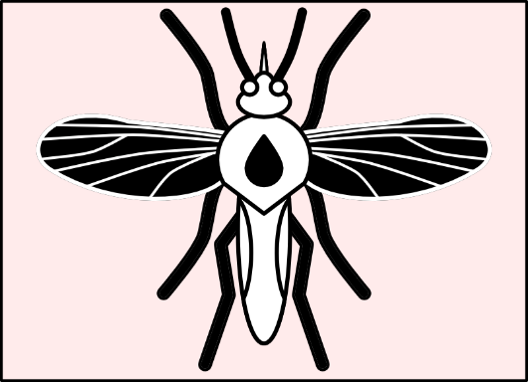
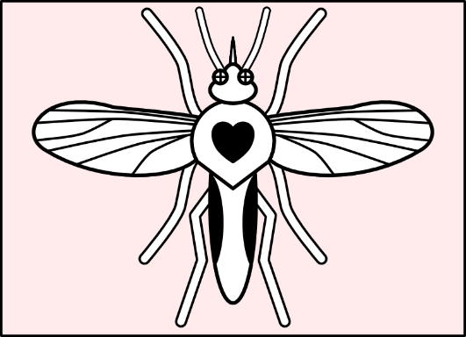
Summary
Midges can have an impact on the Scottish tourism industry, particularly in rural areas, by deterring outdoor activities during the summer months.
Our brains rapidly process large amounts of visual information, helping us identify and classify objects almost instantly.
Decision trees can be used to classify data, predict outcomes, and assist in decision-making processes.
AI models can be trained using supervised learning to recognise and classify images by learning from labeled examples.

