Slide 1
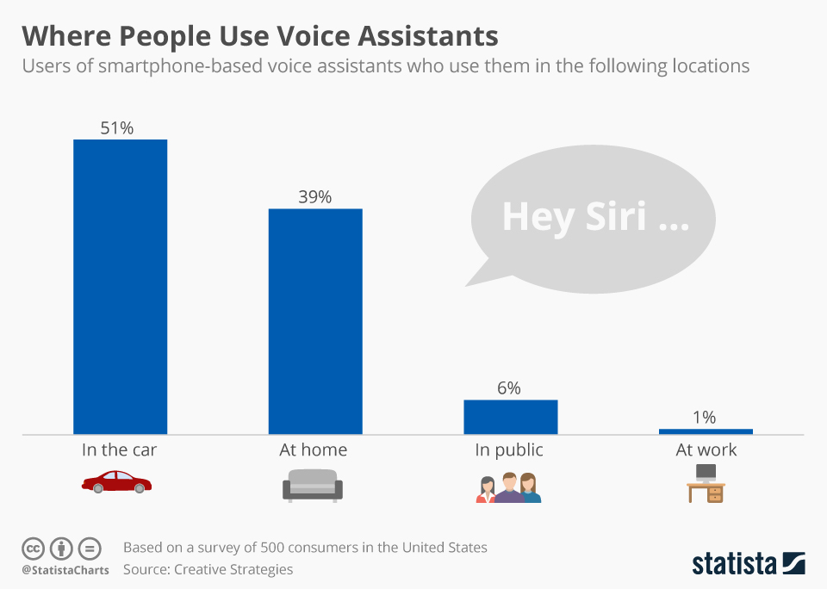
Notes:
Slow reveal chart
What might this chart represent?

Slide 2
Notes:
Hint 1

Slide 3
Notes:
Hint 2

Slide 4
Notes:
Hint 3

Slide 5
Notes:
Hint 4 – Missing categories?

Slide 6
Notes:
Hint 6 – Final missing category

Slide 8
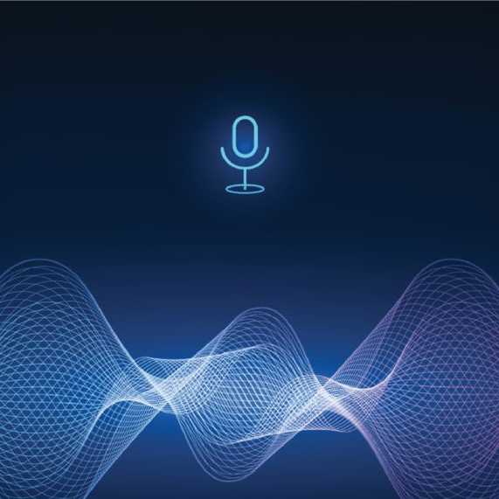
Voice Recognition in Games
Voice-controlled games are revolutionising the gaming industry by allowing players to interact with their games using speech.
This technology aims to make gaming more accessible for visually impaired and disabled individuals, while also enhancing the immersive experience for all players.
Developing these games involves significant challenges, including the need for extensive speech data to ensure smooth voice recognition.
Game developers must account for various accents, dialects, and languages, as well as natural language utterances to create a responsive and engaging gaming experience.
This Photo by Unknown Author is licensed under CC BY-SA

Slide 9
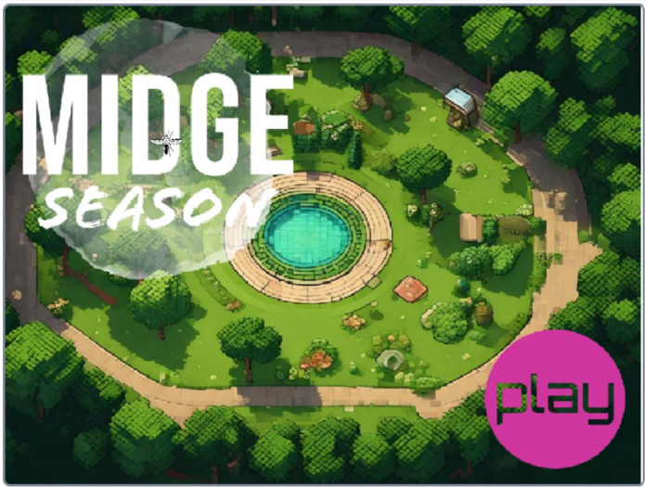
Midge Season:
The Game
TRAIL.scot

Slide 10
Notes:
Use the tutorial supplied to create Midge Season, a voice activated game.

Slide 11
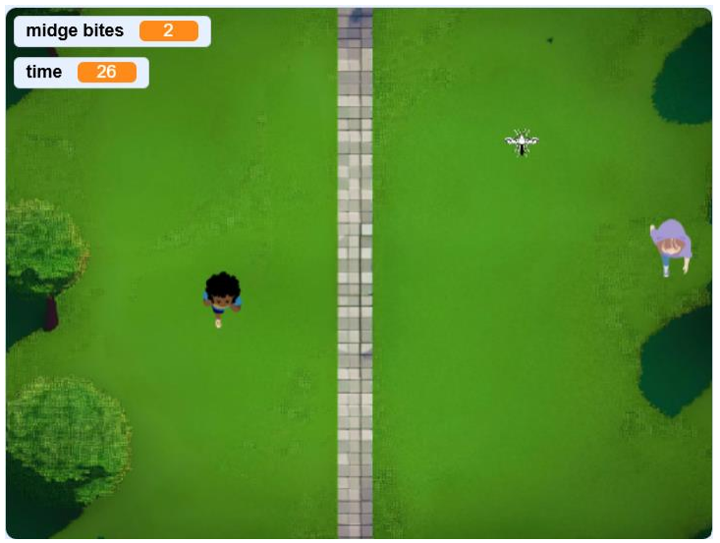
GenAI in Games
Did you notice that 2 of the images in Midge Season were created using GenAI tools?
Try using GenAI tools to create your own game images (e.g. title sceen) using text prompts.
How do GenAI games assets compare to user created assets?
Can you/players tell the difference?
Discussion
What impact do you foresee for the Games Industry of GenAI tools? Will we still need Graphic Artists? Story Writers? Coders? Sound Engineers?

Slide 12
1. What is the primary goal of voice-controlled games?
a) To reduce the cost of game development
b) To make gaming more accessible for visually impaired and disabled individuals
c) To increase the complexity of game controls
d) To eliminate the need for game localisation
Notes:
Plenary/Summary Quiz and Discussion

Slide 13
1. What is the primary goal of voice-controlled games?
a) To reduce the cost of game development
b) To make gaming more accessible for visually impaired and disabled individuals
c) To increase the complexity of game controls
d) To eliminate the need for game localisation

Slide 14
2. True or False
Voice-controlled games can help lower the learning curve for beginners.

Slide 15
2. True or False
Voice-controlled games can help lower the learning curve for beginners.

Slide 16
3. What are some of the challenges game developers face when creating voice-controlled games?

Slide 17
3. What are some of the challenges game developers face when creating voice-controlled games?
Game developers face challenges such as accounting for various accents, dialects, languages, and natural language utterances to ensure smooth voice recognition.

Slide 18
Open Questions
How do you think voice-controlled games could change the future of gaming?
Notes:
What impact do you foresee for the Games Industry of GenAI tools? Will we still need Graphic Artists? Story Writers? Coders? Sound Engineers?

Slide 19
Open Questions
What impact do you foresee for the Games Industry of GenAI tools?
Will we still need Graphic Artists? Story Writers? Coders? Sound Engineers?

