Slide 1
Midge by Numbers
2) Train and Test an AI Model to Recognise Patterns in Numerical Data

Slide 2
Missing words
I love to eat __________ .
Pizza
Pancakes
Toast

Slide 3
Missing words
With butter and jam, I love to eat __________ .
Pizza
Pancakes
Toast

Slide 4
Missing words
For breakfast, I love to eat __________ .
Pizza
Pancakes
Toast

Slide 5
Missing words
I’ve been to Italy. I love to eat __________ .
Pizza
Pancakes
Toast

Slide 6
AI Predictions: Filling in the Blanks
Did you know that AI can predict missing information just like you can guess a missing word in a sentence?
When we have a table of data (e.g. CSV file) with some missing values, an AI model can look at patterns and predict what should be there.
Imagine your school library has a list of books that students have borrowed, but some of the book genres are missing. Can you predict the missing genres?

Slide 7
Instead of guessing randomly, an AI model can look at the data and predict the missing genres based on patterns!
How AI Predicts Missing Genres
Pattern Matching in Titles – AI looks for keywords (e.g. "space" more likely Sci-Fi, "ocean/sea" more likely Non-Fiction).
Author Similarity – If an author has written mostly Sci-Fi books, a missing genre for another book by them is more likely Sci-Fi.
Year – Newer books may follow different trends than older ones.
Avg. Reader Age – Books for younger readers may be adventure/fantasy, while older ones lean toward non-fiction or sci-fi.
Additional Data (More Columns Help!) – If we add more details, AI can make even better predictions.

Slide 8
Midge By Numbers Recognising Patterns in Numerical Data
How can an image be turned into numerical data?

Slide 9
Recall the Key Features of our Midge Images
Legs? (White[0]/Black[1])
Wings? (White[0]/Black[1])
Antenna? (White[0]/Black[1])
Eyes? (White[0]/ Black Cross[1])
Torso Shape? (Circle[0]/Pointed[1])
Torso Colour? (White[0]/Black[1])
Tail Main Colour? (White[0]/Black[1])
Tail Side Colour? (White[0]/Black[1])
Torso Symbol? (Heart[0]/Star[1]/Tear[1])
Torso Symbol Colour? (White[0]/Black[1])

Slide 10
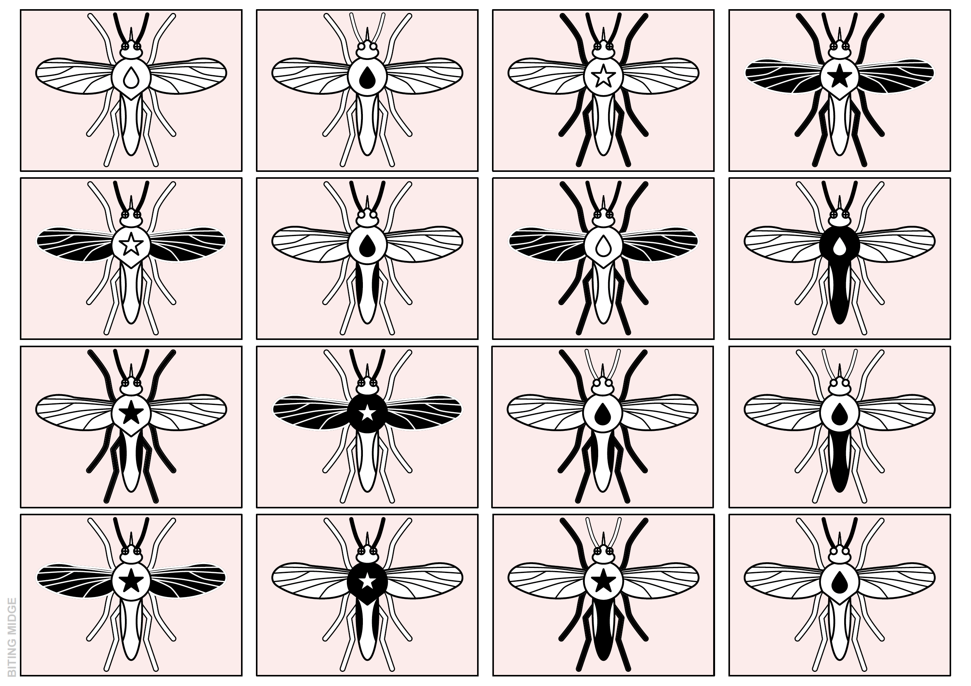
BITING MIDGE
Notes:
Biting Midge

Slide 11
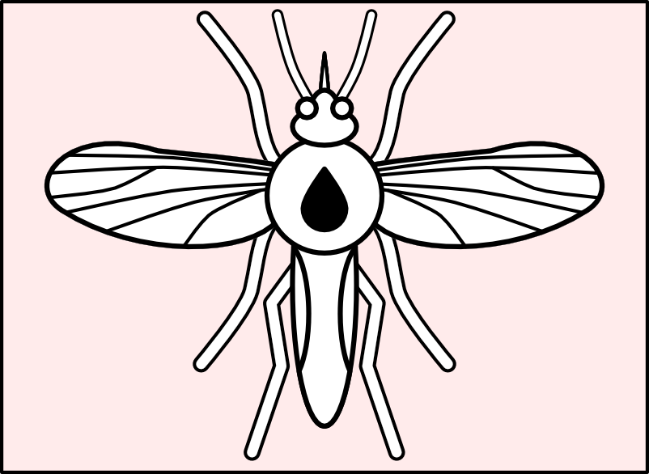
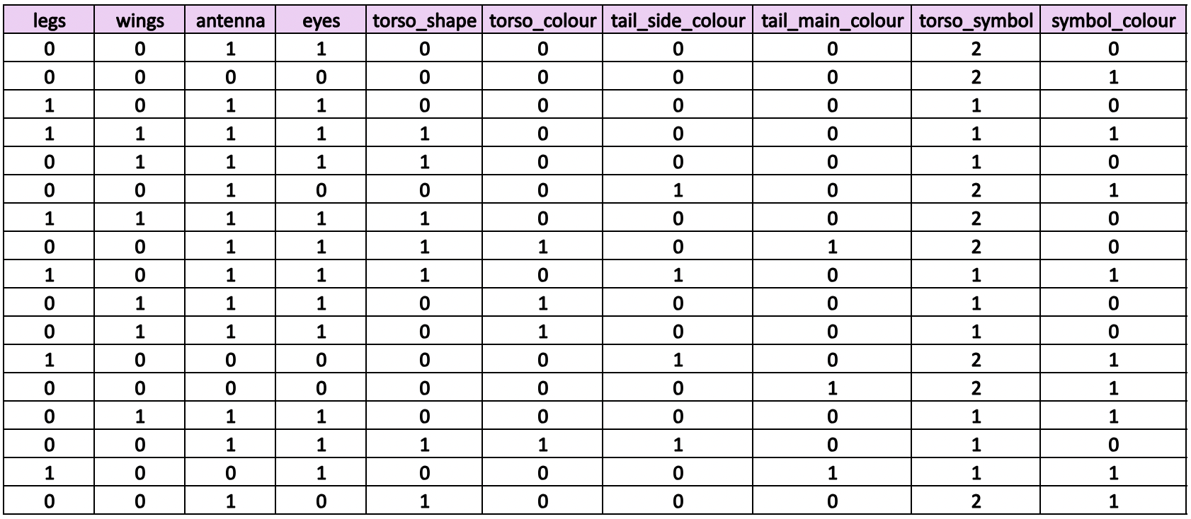
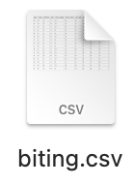
Image to Data Conversion
How can an image be turned into numerical data?

Slide 12
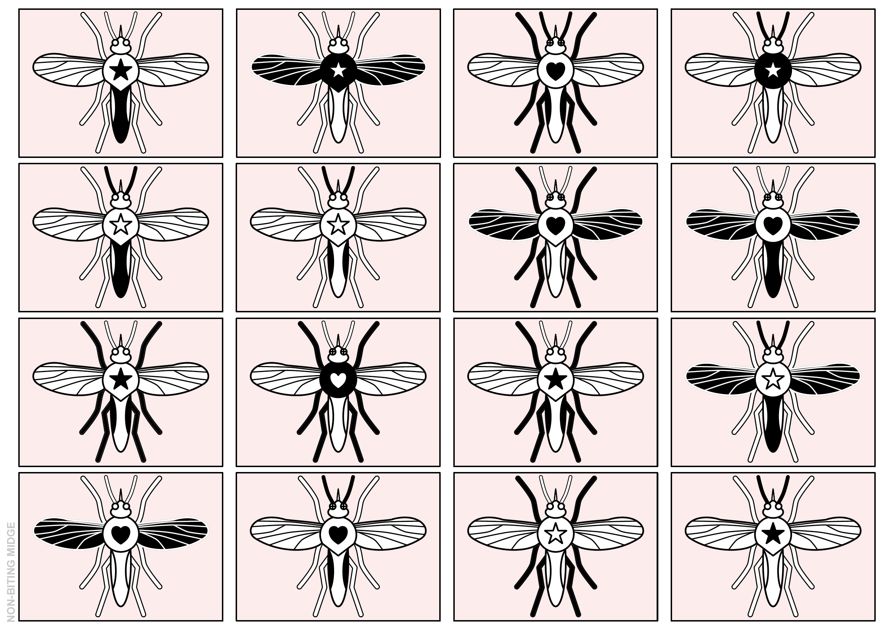
NON-BITING MIDGE
Notes:
Non-biting midge

Slide 13
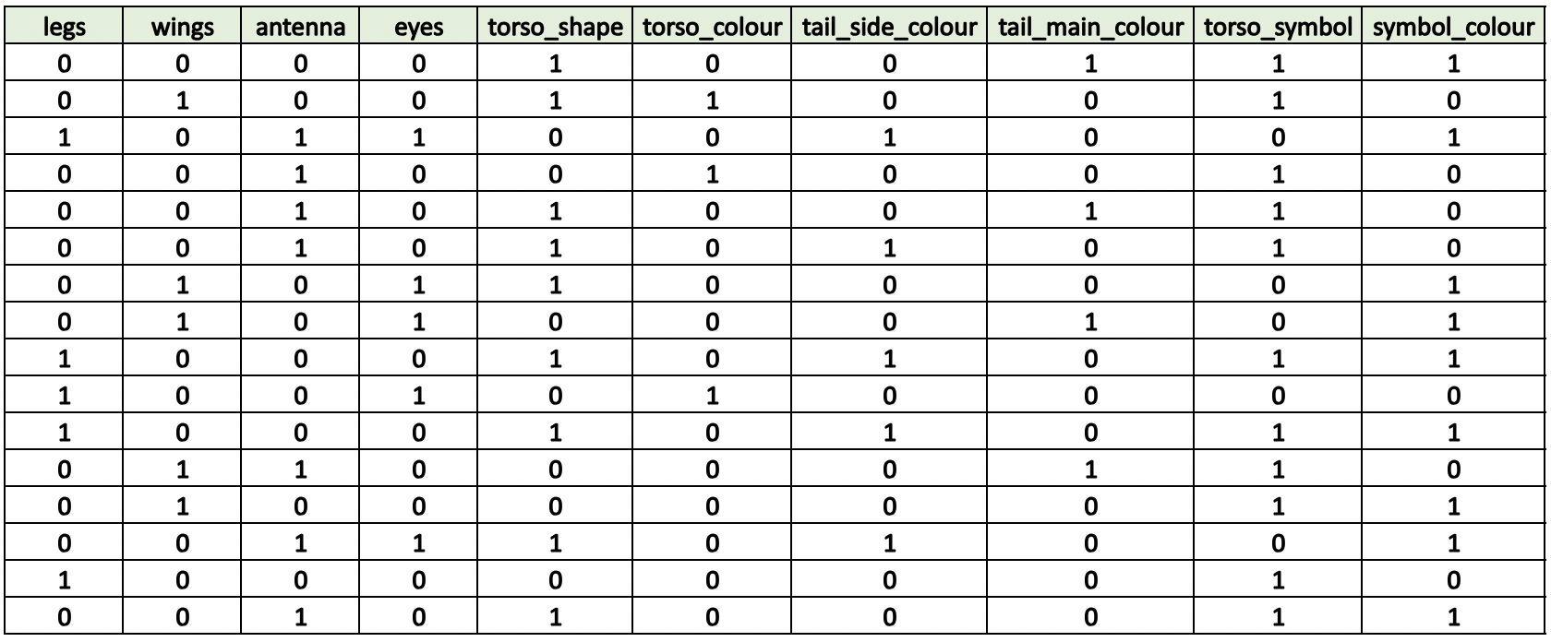
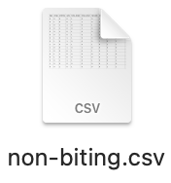
Image to Data Conversion
How can an image be turned into numerical data?

Slide 14
Train and Test an AI Model – Recognising Numbers Machine Learning for Kids

Slide 15
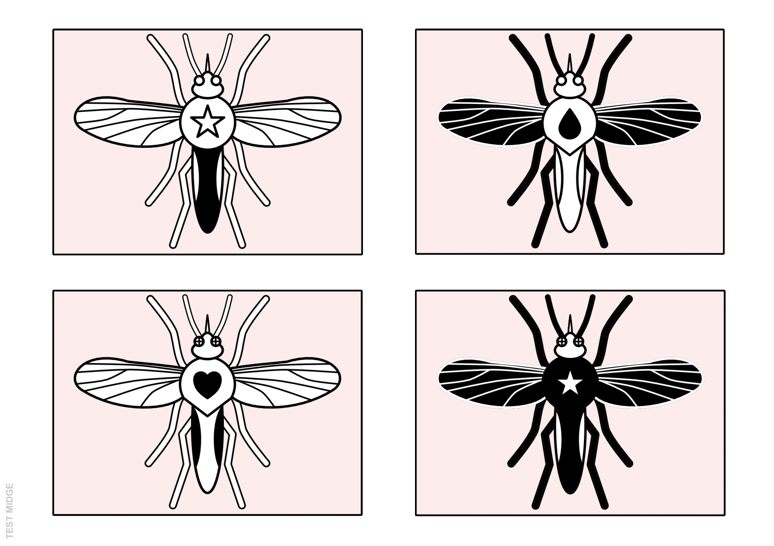
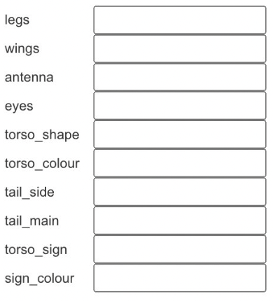
0
0
0
0
0
0
0
1
1
0
1
1
1
0
1
0
0
0
2
1
TEST MIDGE
0
0
0
1
1
0
1
0
0
1
1
1
1
1
0
1
0
1
1
0
Notes:
Test midge
Test your Hypothesis

Slide 16
NON-BITING
BITING
0
0
0
0
0
0
0
1
1
0
1
1
1
0
1
0
0
0
2
1
TEST MIDGE
0
0
0
1
1
0
1
0
0
1
1
1
1
1
0
1
0
1
1
0
NON-BITING
BITING
Notes:
Test midge
Test your Hypothesis

Slide 17
Train and Test an AI Model – Predicting Missing Data Machine Learning for Kids

Slide 18
