Slide 1
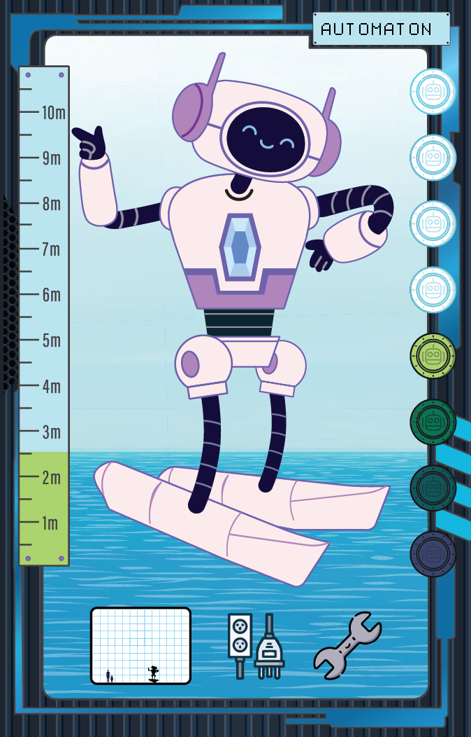
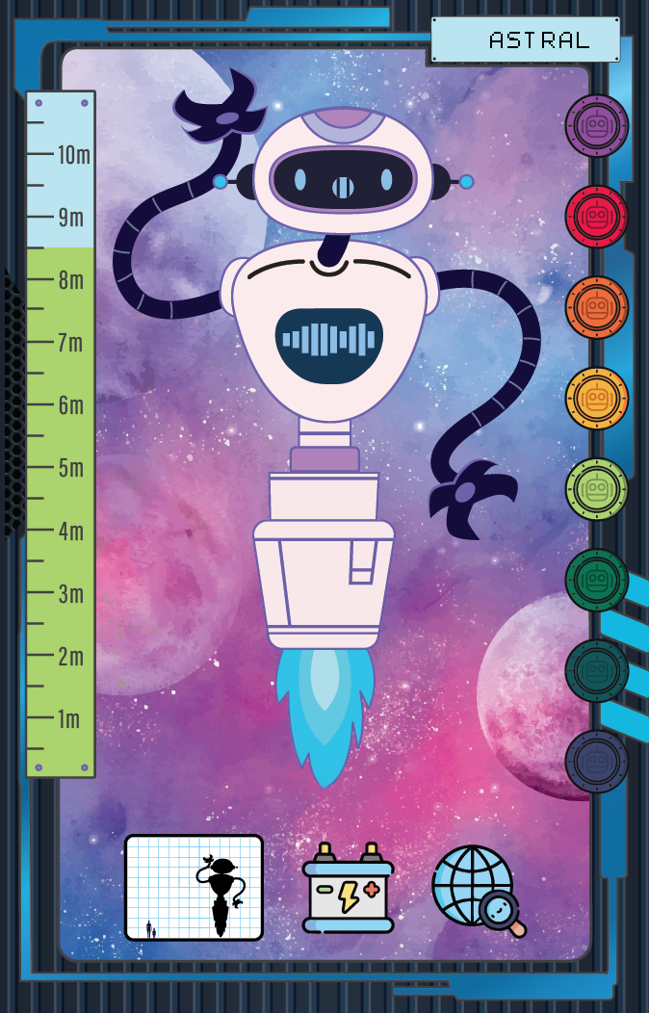

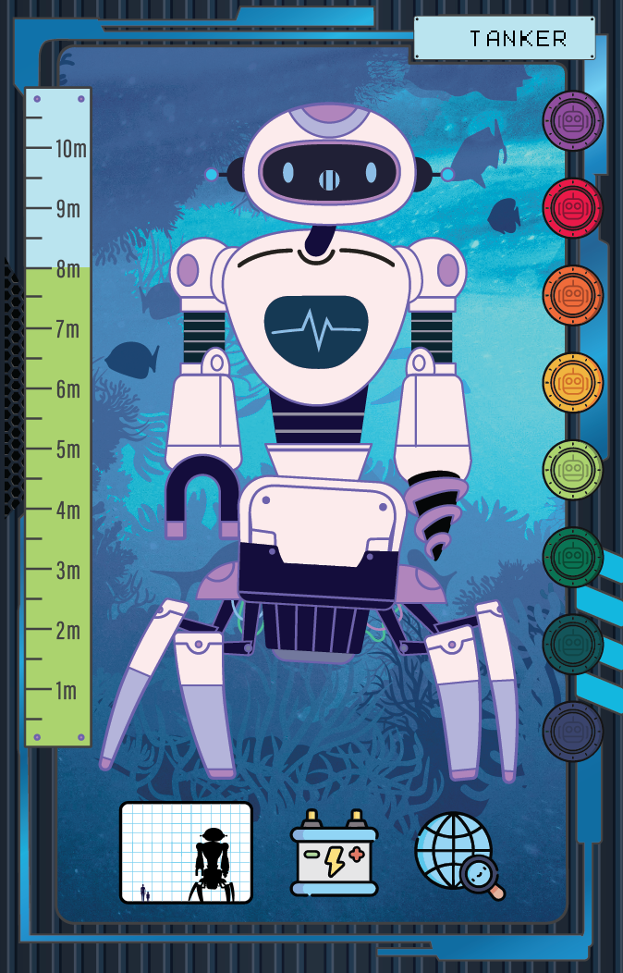
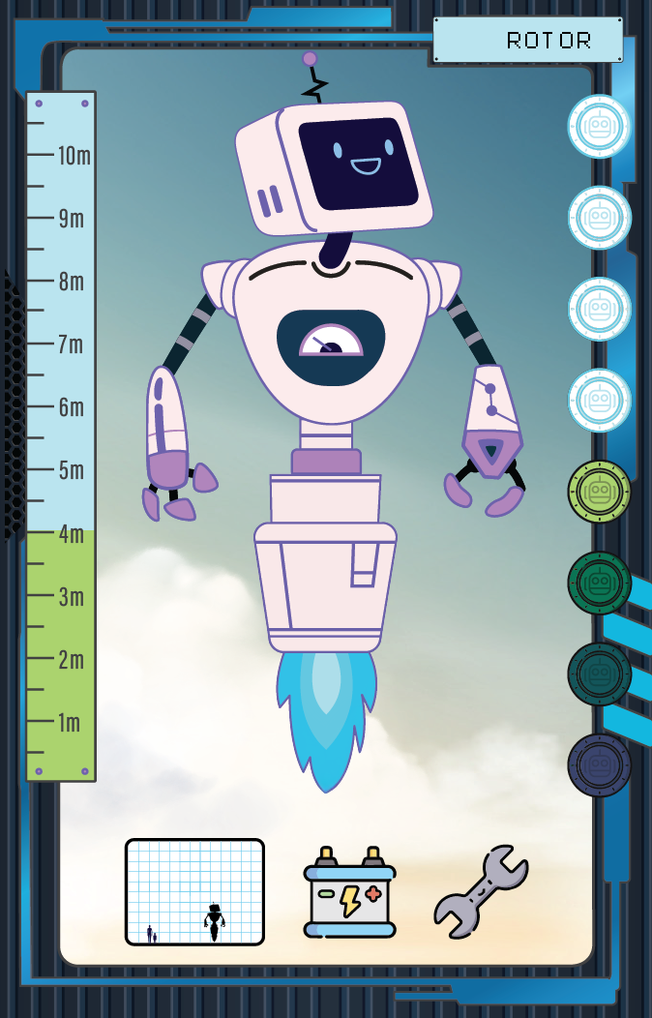

Robot Cards
An introduction to

Slide 2
What are Robot Cards?
You will be introduced to the robot cards!
Each card holds data about a fictional robot.
In your class, you will be able to play games with these cards, and discover more about them. Do you wonder anything?
Let’s learn about what’s on the card!
Notes:
The Robot Cards have been created for use in a Primary School classroom to give students an introduction to simple concepts in statistics and data analysis.
Students can go from using the cards to learn about early mathematical concepts such as ordering, to creating simple graphs such as bar charts and scatterplots with the cards.

Slide 3
The World of Robots
The robots on the robot cards exist in THE WORLD OF ROBOTS, a fictional world that is similar to our own.
In this world, robots help humans with many tasks from production to healthcare.

Slide 4
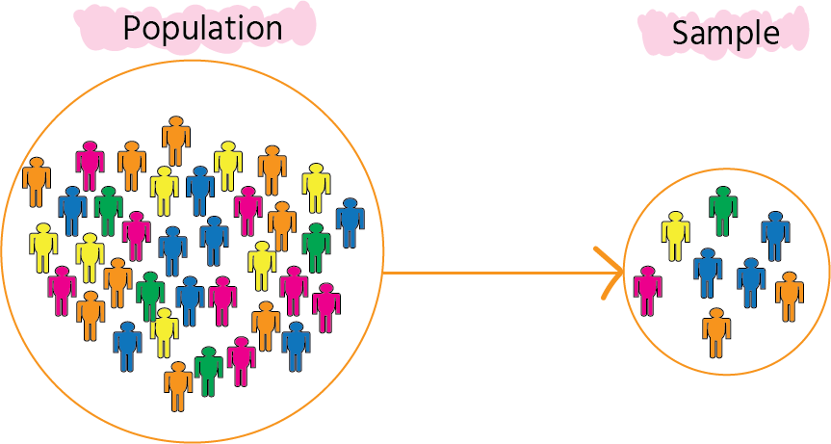
Sample
What is a sample?
A sample is a small part of a bigger group that we study to learn about the whole group.
The cards we have today are a sample of the total robot world population.
Notes:
First of all, ask the students if they know what a sample is.
How does this relate to the robot cards?

Slide 5
Sample
A sample is a small part of a bigger group that we study to learn about the whole group.
The robot cards we have are a set of all the robots that live in the robot world.
Can we use the cards we have to find out the wider robot population?
🤔
Notes:
First of all, ask the students if they know what a sample is.
Ask the students if we can use the cards to find out about the wider robot cards population.

Slide 6
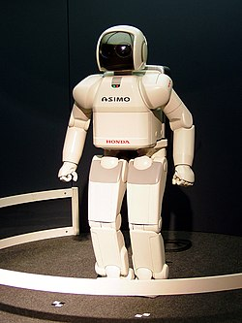
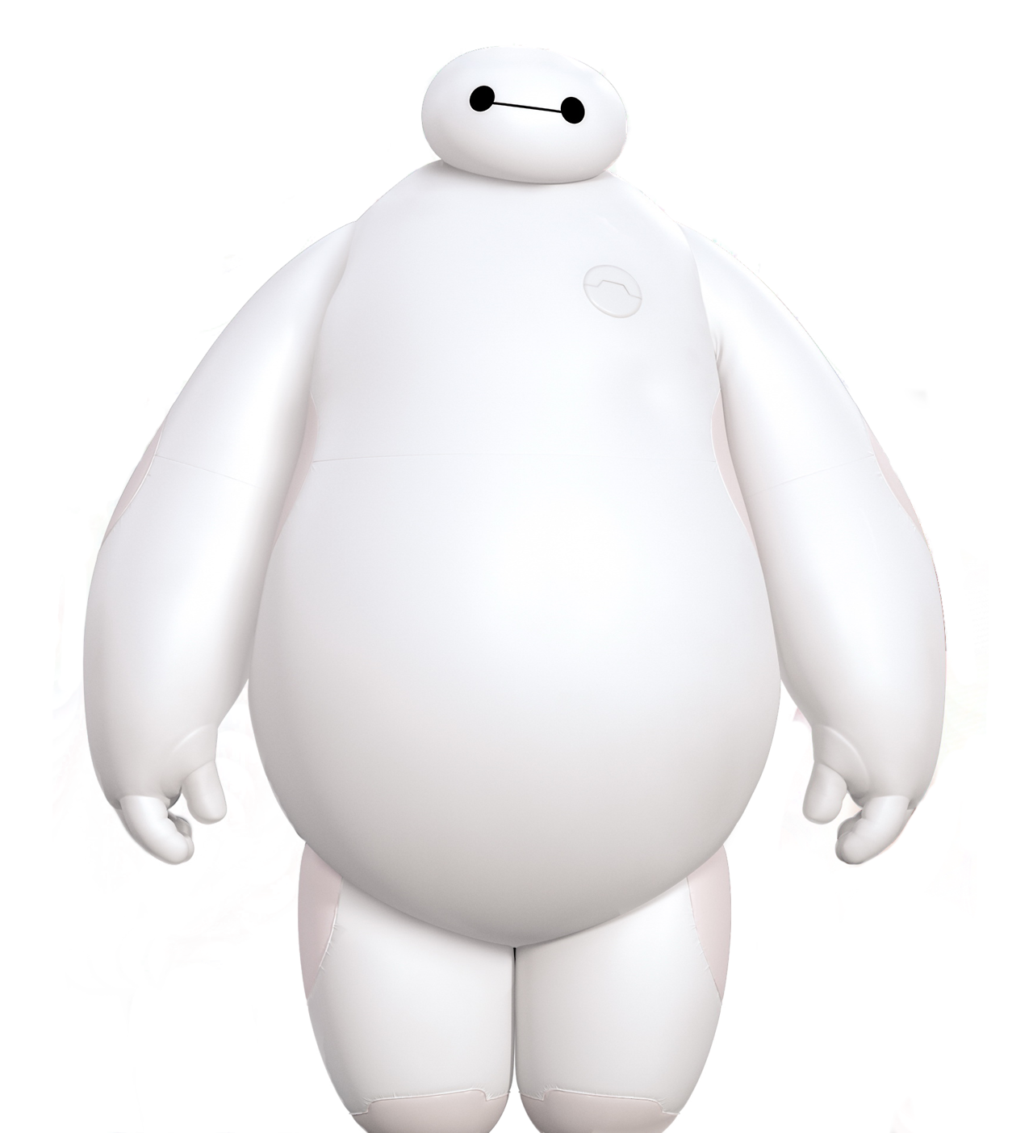
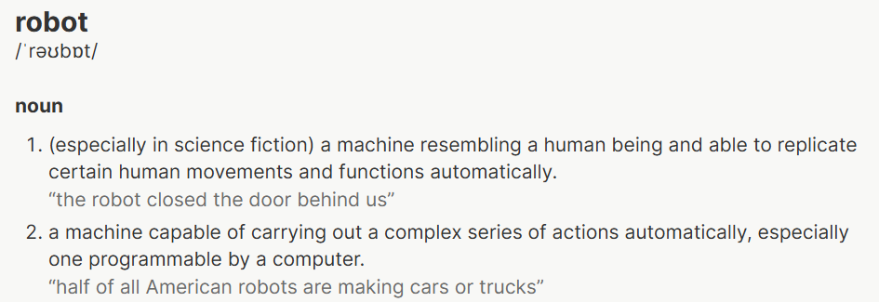
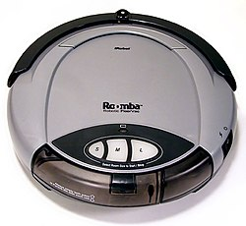

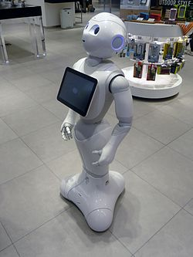
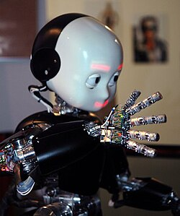
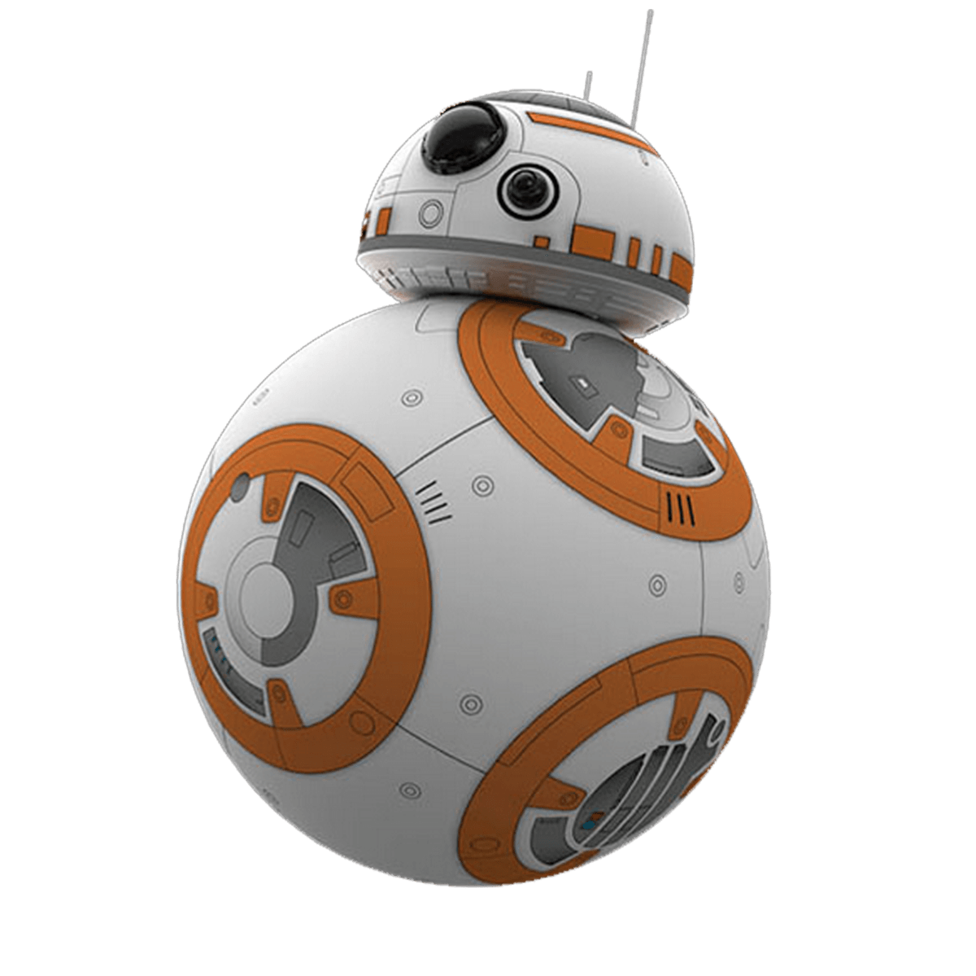

What is a robot?
Notes:
“Robot” refers to real-life AND fictional robots. What kind of robot are the ones on the cards?
Fictional.
Yes, because they aren’t actually present in the real world. These cards also don’t represent any real-life robots.
Although there is a difference between real-life and fictional robots, we can use similar attributes to describe them. The attributes that we’ve used for these robot cards can be used to describe real-life robots too.

Slide 7
What’s on the card? 🤔
Name
Location
COST
Height
Function
Power Type

Slide 8
Name
Each robot has a name, shown on the top right of the card!
This attribute can be used to refer to a specific robot, as every name is unique.

Slide 9
Location
The location of a robot is where a robot primarily operates and spends its time.
You can tell which location a robot has by the background showing the setting it’s in.
This card is an underwater robot.

Slide 10
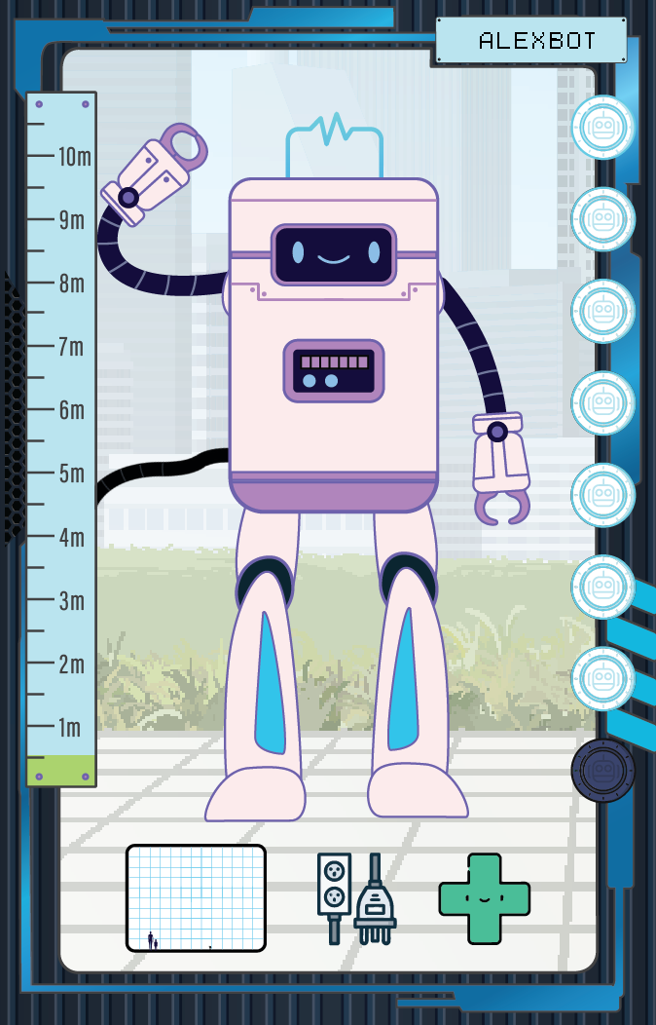
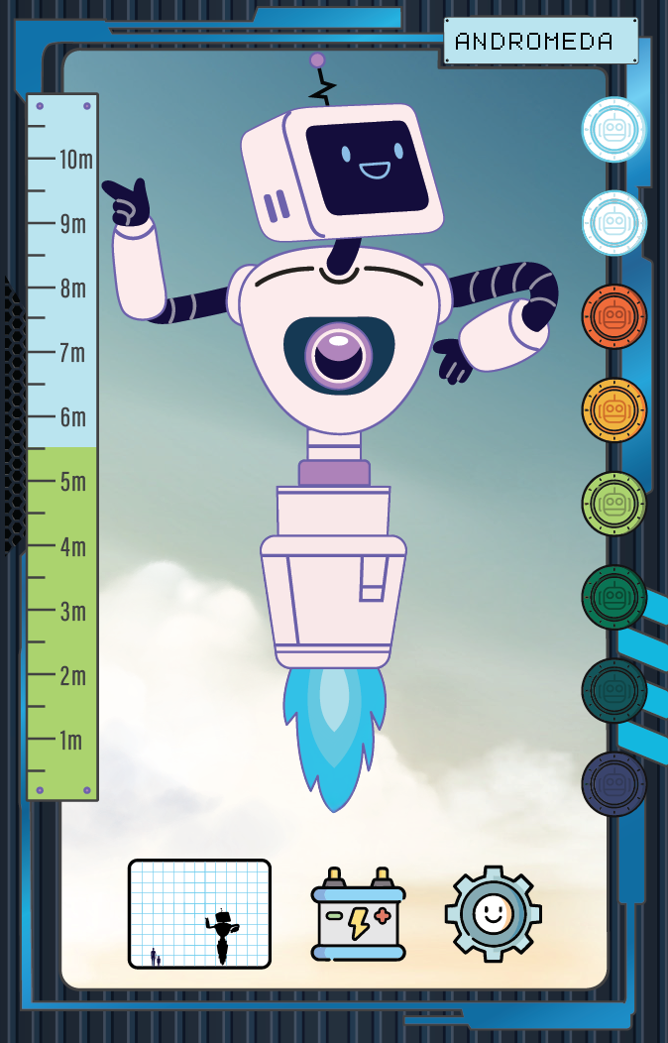
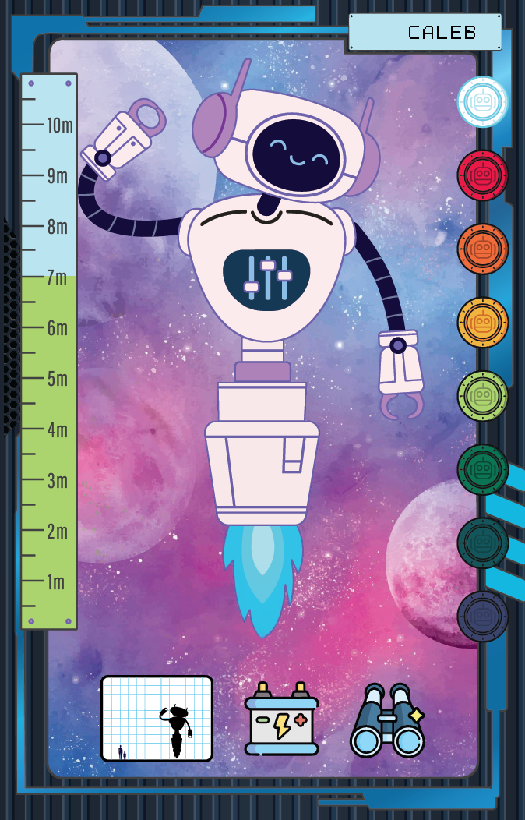
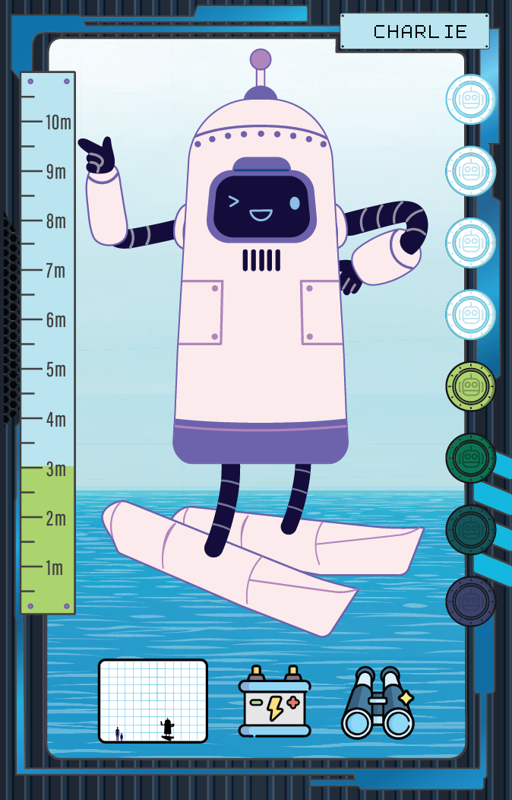
location
There are 5 locations:
On Land
In Air
In Space
In Water
On Water

Slide 11
Height
The height of a robot is shown by the green ruler on the left side of the card.
There is also a height comparison scale showing how big the robot is compared to a human (you can see the tiny human and child here!)

Slide 12
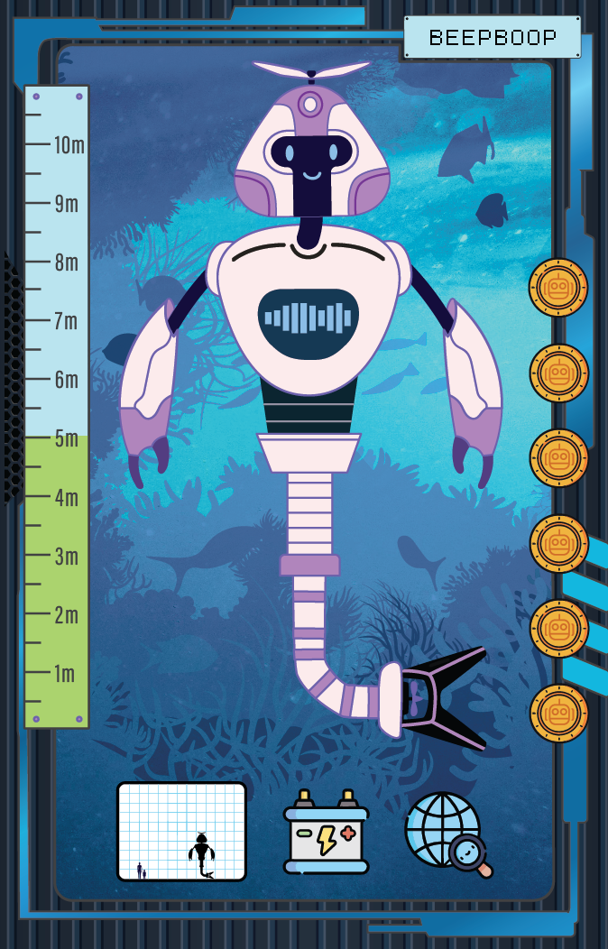
Cost
Cost is shown on the right-hand side in BOTCOINS.
The more BOTCOINS that there are, the higher the cost.
This is based on how expensive it was to manufacture this robot. What factors do you think contribute to this amount?

Slide 13
Function
The function of a robot is the main use it has to humans.
This is represented by the symbol on the bottom right.
This robot’s function is exploration.

Slide 14





Function
Each robot card has one of these 5 functions.
The function specifies what task the robot focuses on.
How might function relate to other attributes?
Search and Rescue
Exploration
Medical
Service
Production

Slide 15


Power Type
We can also see the power type of a robot, this is whether they operate through being connected to another power supply, or they have their own internal battery, which might be charged through solar power, for example.
The two power symbols are:
Battery
Plugged in

Slide 16
Robot Parts
We can see the different components of the robot by the picture of the robot in the middle.
How do you think these components might relate to other attributes the robot has?

Slide 17
What’s on the card? 🤔
Name
Location
COST
Height
Function
Power Type

Slide 18
Activities
Notes:
Now we will try some activities with the cards

Slide 19
Let’s have a look at the cards!
Have a look at the cards!
What do you notice about them?
Do you have any questions or wonder about anything about the cards or patterns in the cards?

Slide 20
ORDERING
Let’s start by ordering some cards by height!
In your groups, order the cards by size, which is shown on the left hand side shown by the green scale.
Notes:
There are two options for activity here:
Give each student 1 robot card and have them order themselves in a line.
Give each pair or group of students some robot cards (at least 10 cards per group) and have them order the cards by size
Students might notice that robots that are bigger seem to have certain classes (space, underwater), or that robots that are larger seem to have a higher cost. If students notice this, see if they might suggest why that’s the case.

Slide 21
ORDERING
Do you notice any patterns in the cards you’ve ordered?
Does this make you wonder anything?
Notes:
There are two options for activity here:
Give each student 1 robot card and have them order themselves in a line.
Give each pair or group of students some robot cards (at least 10 cards per group) and have them order the cards by size
Students might notice that robots that are bigger seem to have certain classes (space, underwater), or that robots that are larger seem to have a higher cost. If students notice this, see if they might suggest why that’s the case.

Slide 22
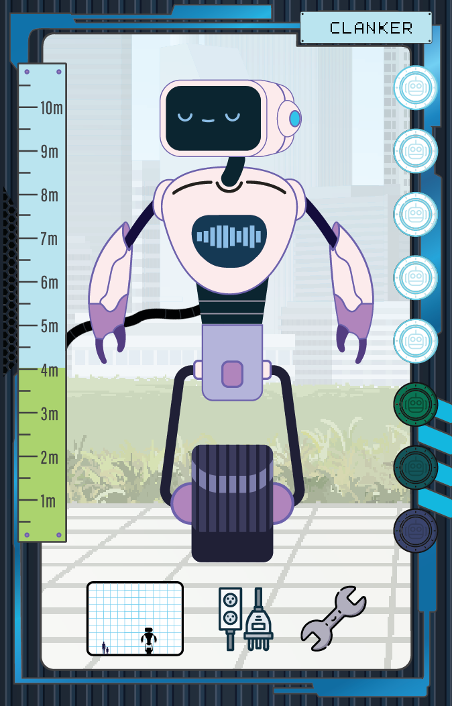
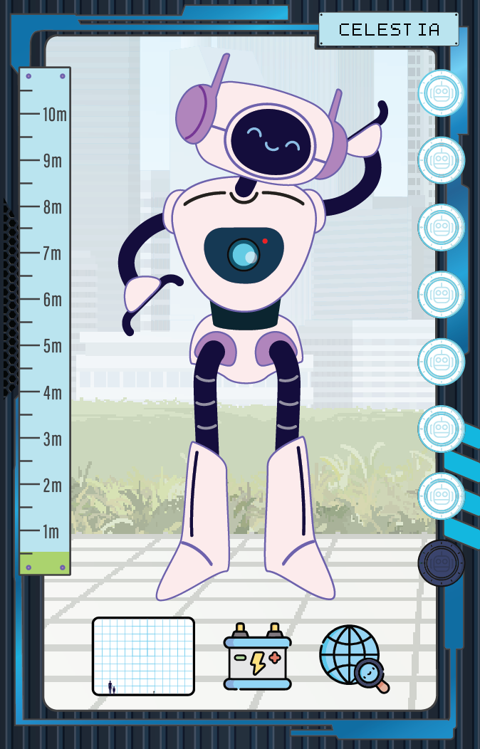
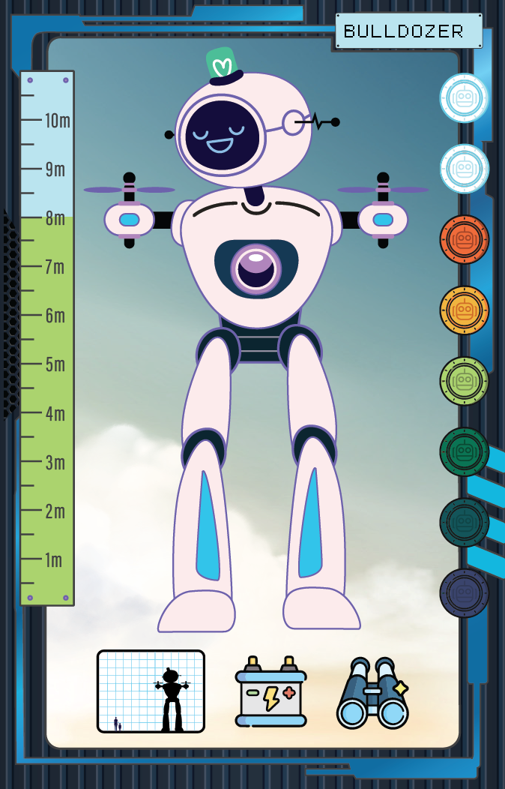
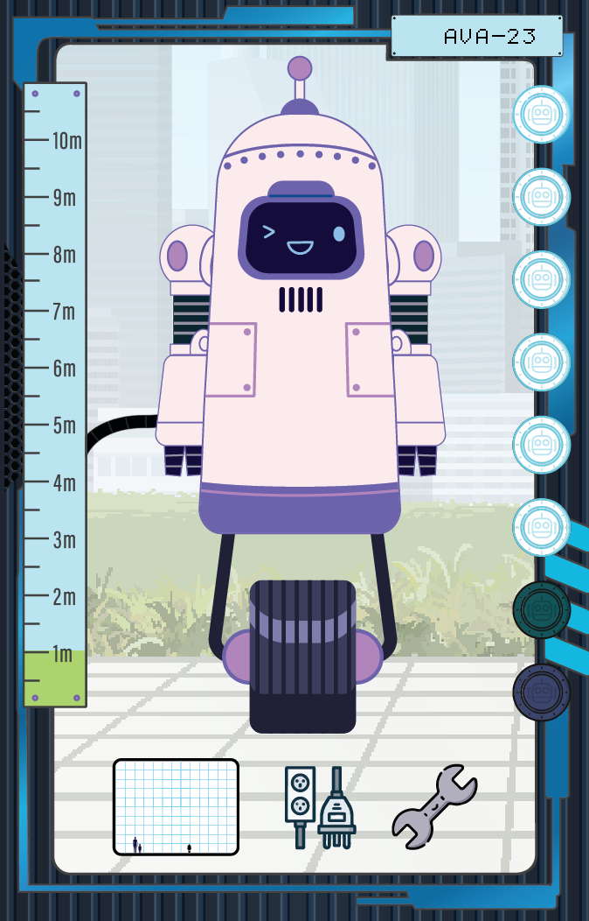
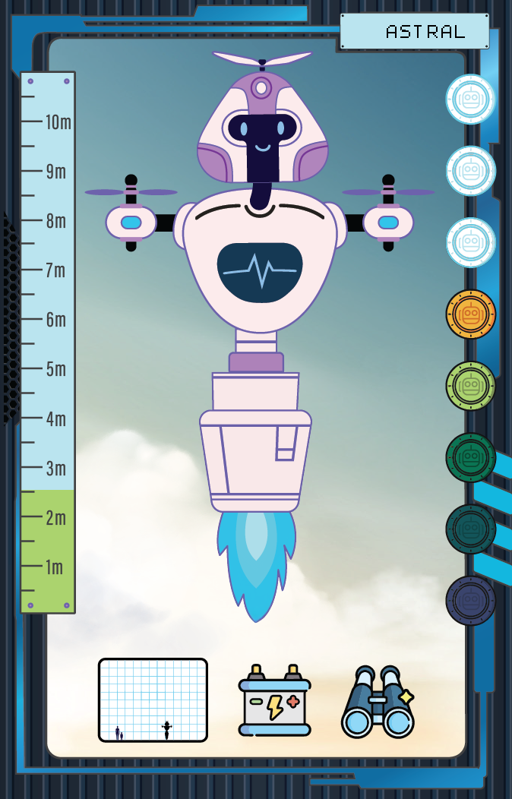
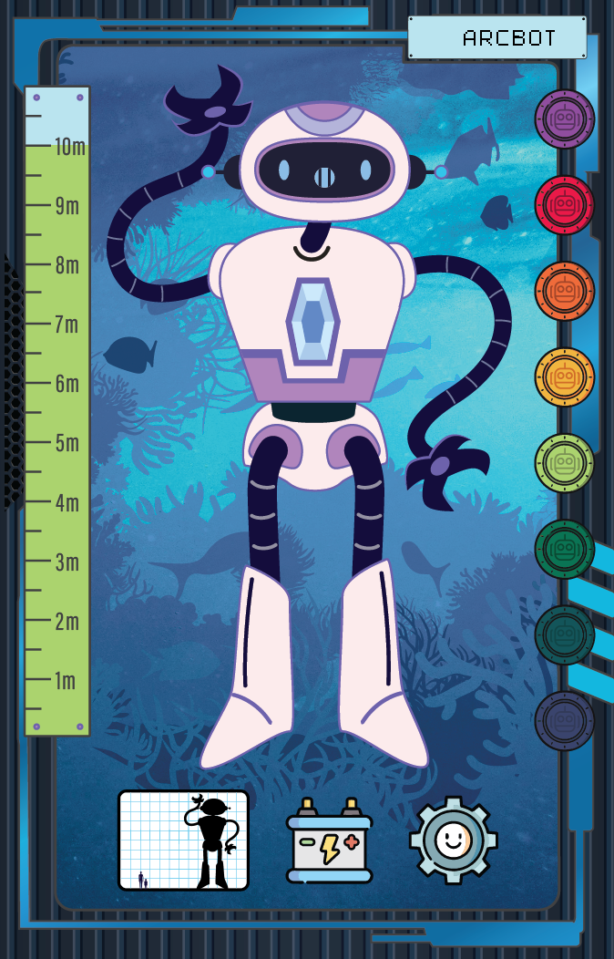
Grouping
Now let’s group robots together based on some of their attributes.
First, let’s group by location (the background on the cards).
Organise your cards in these groups by stacking them on top of each other.
Notes:
There are two options for activity here:
Give each student 1 robot card and have them order themselves in a line.
Give each pair or group of students some robot cards (at least 10 cards per group) and have them group

Slide 23
Grouping
Which group has the most cards in it?
Which group has the least?
Do you notice any patterns in the groups?
Notes:
For example, are certain attributes more common among some groups than others?

Slide 24
Grouping
Let’s do the same thing, but this time for cost!
What do you spot?

Slide 25
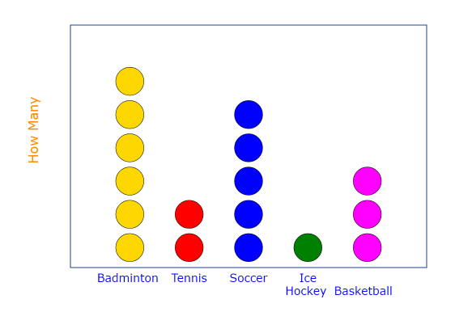
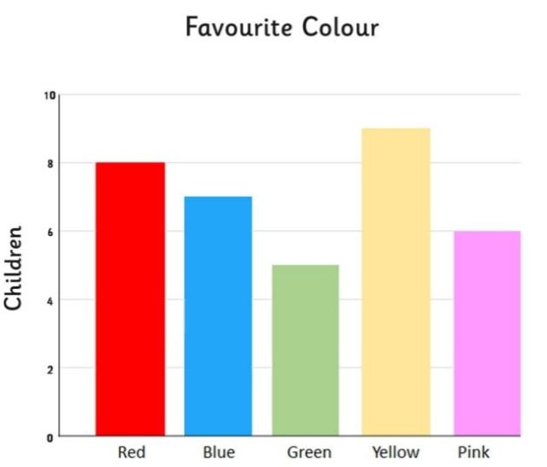
BAR CHARTS and dot plots
What’s the point of creating these charts?
🤔
A dot plot
A bar chart

Slide 26
BAR CHARTS and dot plots
What you’ve created is approximately a bar chart (or a dot plot)!
How has laying out the cards like this helped you understand the robots more?

Slide 27
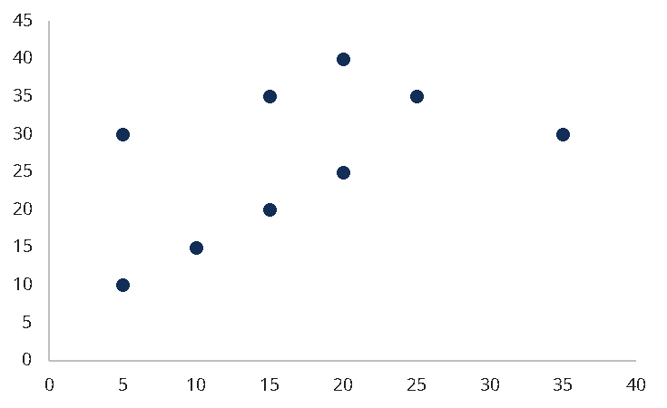
Scatter Plots
How can we visualise whether 2 variables are related?
Can we make a scatter plot of the cost and the size using the robot cards?

Slide 28
Averages
In this activity, you will work out the average height of robots of different classes.
Plan your investigation and carry this task out.
What results did you get?
How do your results compare with other groups?
What is the tallest and shortest location group on average?
How could your investigation be improved next time?

Slide 29
Investigation
Do you wonder anything about the robots?
How might different attributes relate to each other?
Decide on a theory you have about the robot cards, and investigate it. Some examples of hypothesis you might have are:
  Hypothesis: space robots tend to be more expensive.
  Hypothesis: land robots are more likely to have the function of production than air robots.
  Hypothesis: robots with more moving parts are move expensive.
What did you discover?

