Slide 1
Slow Reveal Graph
Example

Slide 2
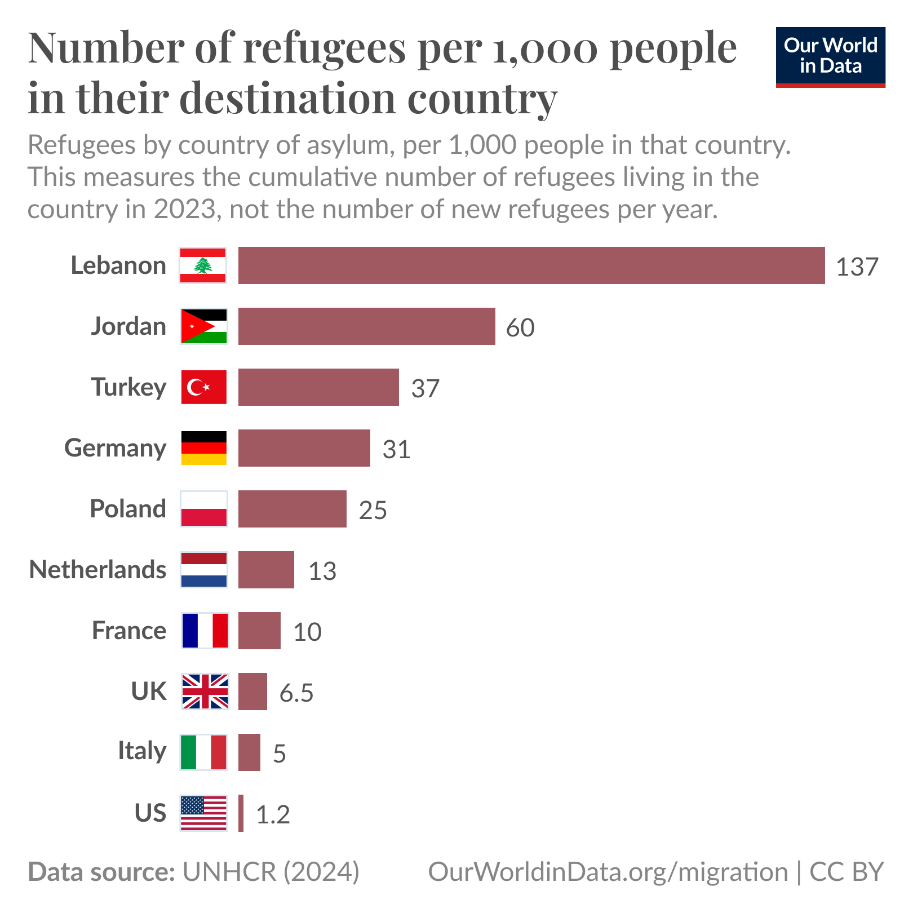

Slide 11
https://ourworldindata.org/data-insights/countries-differ-sharply-in-how-many-refugees-they-host

Slide 12
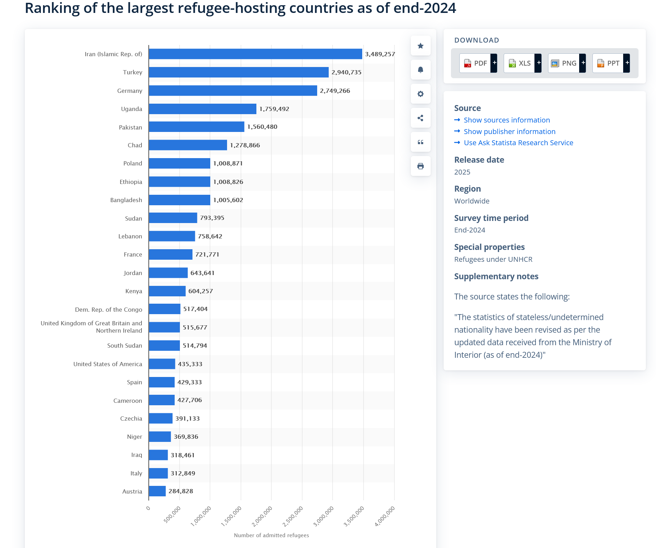

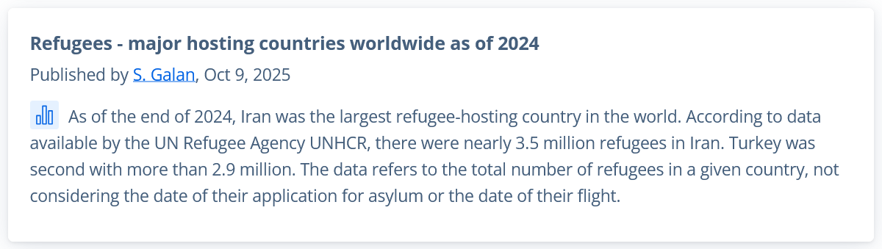
https://www.statista.com/statistics/263423/major-refugee-hosting-countries-worldwide/

Slide 13
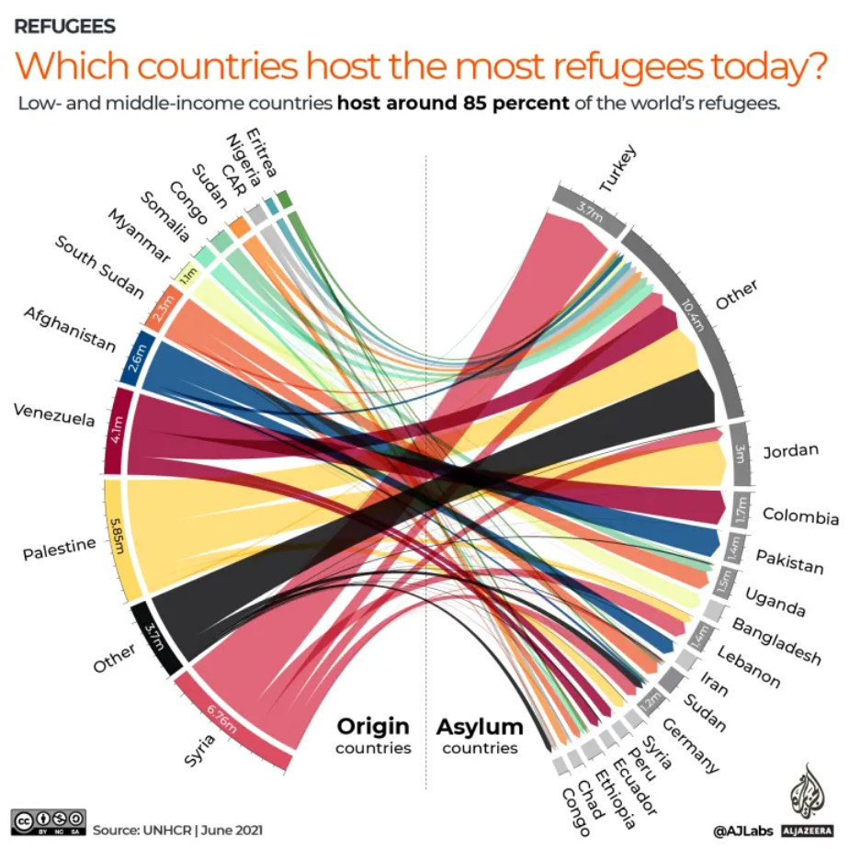

Slide 14
The Method
Prompt:
Annotate:
Inquire:
Who created this? How?
What is the message?
What (who) is not in this data?
What else would you want to know?
“What information did we just get?”
“How does this change your thinking?”
Features of the data
Units, scale, legend
Interpretations
slowrevealgraphs.com
Notes:
Features:
Points, shapes, inflection points, differences, trends, changes
Axes:
Items, categories, time
Explore: (what comes next)
The source of this viz and the story behind its creation
Who created this? How?
What is their message?
What is NOT in this data?
What ELSE would you want to know?
A data activity of our own
Could we replicate this?
What would we research or collect? What story will we find that we’ll want to tell?

Slide 15
What a Slow Reveal can do
The whole-class discussion
The data skills
Low floor and a hook.
S-l-o-w d-o-w-n. 1 thing at a time.
Makes our thinking visible.
Multiple focus points.
Multiple interpretations.
Revise our thinking.
Discourse re: data and subject.
Attend to the data itself.
Parse new graph types.
Data that hits a curricular goal.
What-how-why behind the graph.
Data to inform, convince, or tell a story.
Sense-making, not answer-getting
Notes:
SLOW DOWN: Look at one element at a time. Integrate info gradually, deliberately.
Multiple foci: kids will notice and key in on different parts of the graph, and sometimes pick out unexpected things. They’ll build on and refute one another’s ideas. We get fascinating and provocative conjectures, that then can be resolved.
Finished vizzes are often complex.
Inquiry: both sitting with momentary inquiry (Hmm, I wonder what that is) and setting up authentic exploration.
Better at finished viz: Ss understand better where to look, and what it means
Actual, meaningful data: Not the same old “birthday months” or “favorite ice cream flavors” or “favorite Pokemon characters” again. These are interesting personal surveys, but that’s limiting.

Slide 16
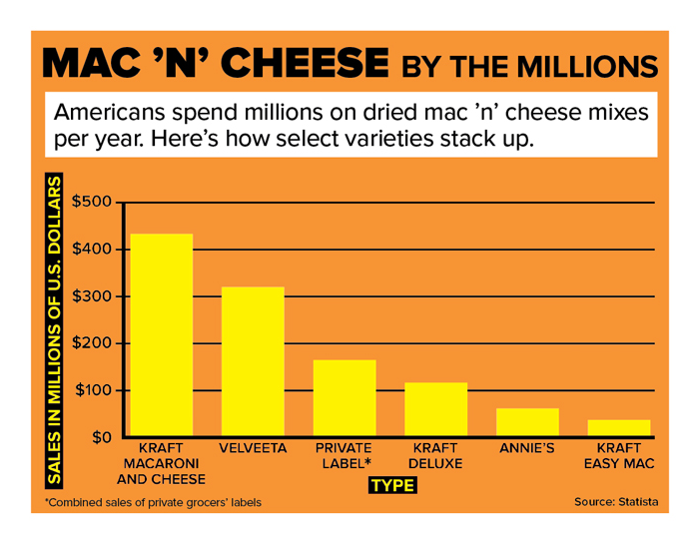
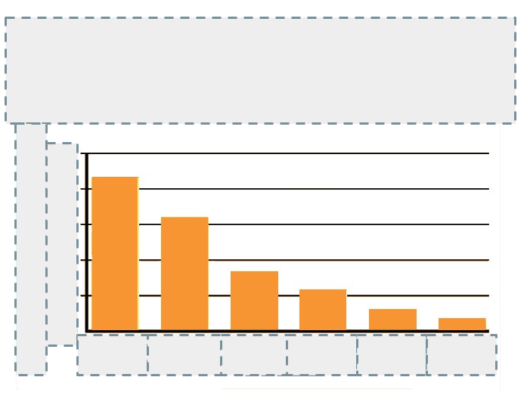
Make your own
From source data:
Grab or re-create a graph
Mask the details
Reveal them in a strategic order
slowrevealgraphs.com

