Slide 1


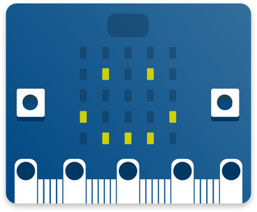




MICRO:BITS
PROGRESSION PLANNER
East Lothian Digital Learning Team

Slide 2




  WHY?
Micro:bits have become much more accessible now due to devices provided by Education Scotland. These little computers offer so many learning opportunities in the computing Science space, covering a range of experiences and outcomes that could have otherwise proved difficult. The Progression works through Bronze, Silver and Gold lessons with other additional projects that apply all skills learned within the programme. 5 topics will be covered across the 3 levels.
This framework has been structured in collaboration with the University of Edinburgh.

Slide 3





  TOPICS
1.
2.
Light & Animation
Gesture & Movement
3.
Sound & Music
4.
5.
Sensing & Data
Radio & Communication

Slide 4
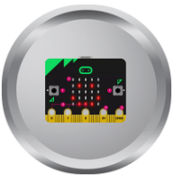
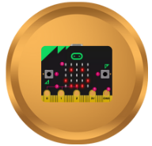
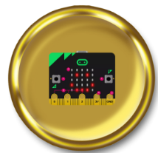
  Going for Gold with micro:bits
Silver
Bronze
Gold
Click on the badges above to explore all lessons
related to that level.

Slide 5





  BRONZE LEVEL
Gesture & Movement
Lights & Animation
Sound & Music
Sensing & Data
Radio & Comms
Beating heart.
Compass Bearing
Jukebox
Sunlight/Nightlight sensor
Flashing emotions
Dice
Create your own Music (coming soon)
Clapping Lights
Data Monsters
Name Badge
Step counter/Low energy step counter
Shining Sunbeams

Slide 6

  SILVER LEVEL
Gesture & Movement
Lights & Animation
Sound & Music
Sensing & Data
Radio & Comms
Calming animation
Magic 8 ball
Metronome
Environment explorer
Send a Smile
Rock, paper, scissors
Sound waves Music
Sound Meter
Teleporting Duck
Stop Watch
Frere Jacques

Slide 7
  GOLD LEVEL
Gesture & Movement
Lights & Animation
Sound & Music
Sensing & Data
Radio & Comms
Funny Voice Recorder
Movement Data Logger
Door Alarm
Treasure Hunt
Guitar Touch Tunes
Environment data logger
Tilt Alarm
Sensitive Step Counter
Banana Keyboard
Traffic Survey data logger
Indoor/Outdoor Thermometer
Kick Strength
Secure Messaging

Slide 8


Extension Projects
Playground Survey
Click here for more info
Exploring Machine Learning
Getting Started
Comparing Surface Temperatures
Tracking Physical Activity
Investigating Biodiversity
Measuring Area

Slide 9
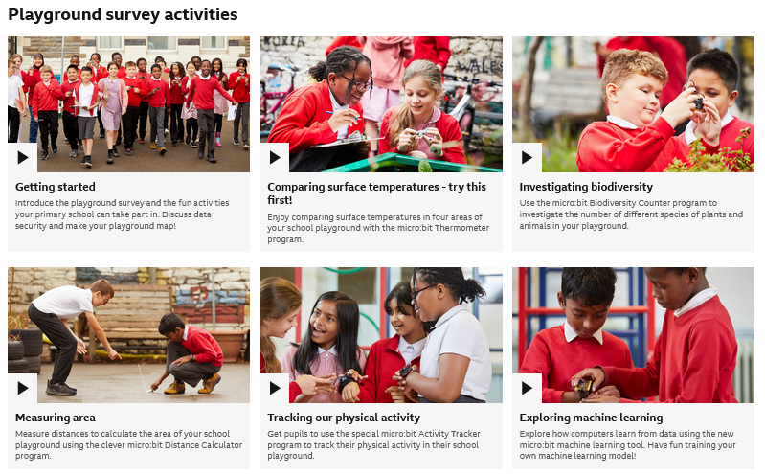
Playground Survey

Slide 10
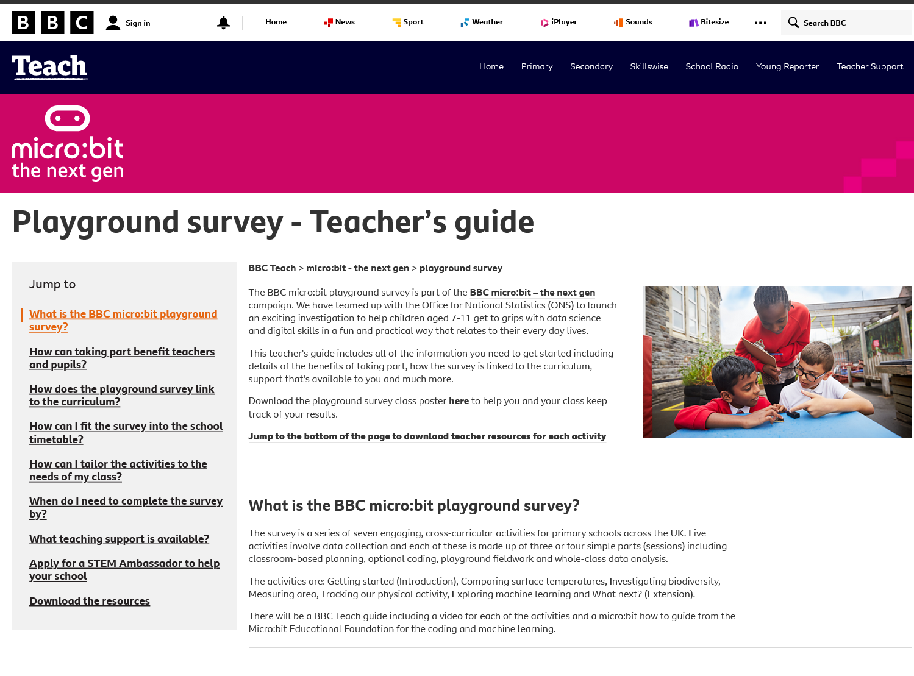

Slide 11

Extension Projects
Make your own Orchestra
COMING SOON!

Slide 12
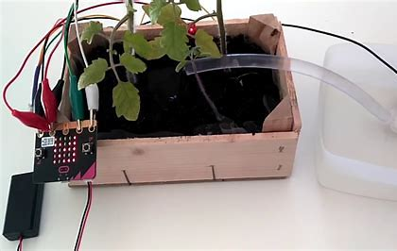
Extension Projects
Preserving our Environment
COMING SOON!

Slide 13
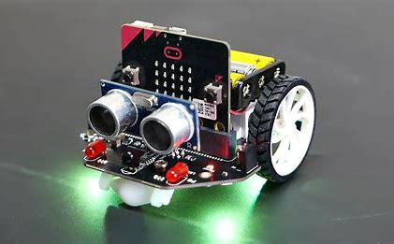
Extension Projects
All about Robotics
COMING SOON!

Slide 14
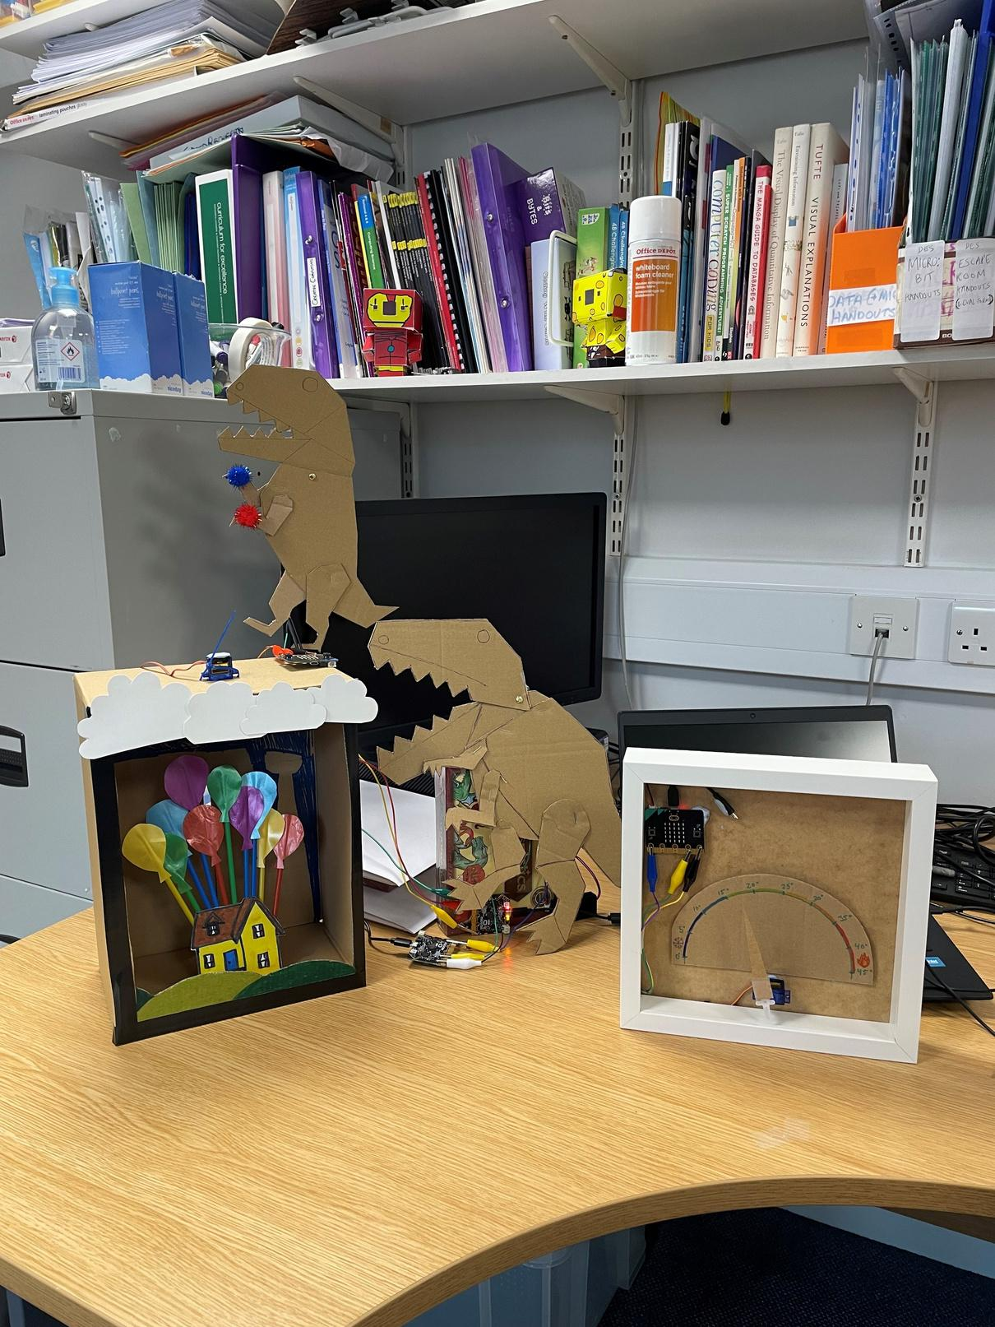
Extension Projects
Kinetic Sculptures
Let’s try it!

